Slide 1
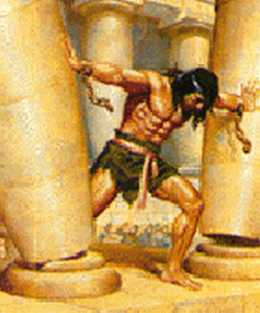
What Is A Person Like You Doing in A Place Like This? Text: Judges 16:21-30
Notes:
By Nathan L Morrison for Sunday May 7, 2023
All Scripture given is from NASB unless otherwise stated
For further study, or if questions, please Call: 804-277-1983 or Visit www.courthousechurchofchrist.com

Slide 2
Intro
The Rise and Fall of Carl Lentz, the Celebrity Pastor of Hillsong Church
(NYT, Ruth Graham, Dec. 5, 2020, Updated Aug. 5, 2021)
A charismatic pastor helped build a megachurch favored by star athletes and entertainers — until some temptations became too much to resist.
“What was a person like him doing in a place like that?”
Notes:
NYT: The Rise and Fall of Carl Lentz, the Celebrity Pastor of Hillsong Church by By Ruth Graham, Published Dec. 5, 2020, Updated Aug. 5, 2021
https://www.nytimes.com/2020/12/05/us/carl-lentz-hillsong-pastor.html
The fall of Carl Lentz, the celebrity “pastor” of Hillsong Church
Carl Lentz helped start the Australia-based Hillsong Church in New York.
He was known as a friend to Justin Bieber, and through his fashion designer style and his uplifting messages he became a celebrity in his own right.
“The global church now has congregations on six continents, and claims an average attendance of 150,000 people weekly.” (NYT: The Rise and Fall of Carl Lentz, the Celebrity Pastor of Hillsong Church by By Ruth Graham, Published Dec. 5, 2020, Updated Aug. 5, 2021; link below)
November 4, 2020 the religious world was rocked when Hillsong Church’s founder Brian Houston announced he had fired Mr. Lentz, citing, “Leadership issues and breaches of trust, plus a recent revelation of moral failures,” including “more than one affair. They were significant.” He also connected Mr. Lentz’s dismissal to “general narcissistic behavior, manipulating, mistreating people,” as well as “breaches of trust connected to lying, and constantly lying.”
The day after the announcement on November 5th, Carl Lentz confessed on Instagram, where he has almost 700,000 followers: “I was unfaithful in my marriage, the most important relationship in my life. This failure is on me, and me alone and I take full responsibility for my actions. I now begin a journey of rebuilding trust with my wife, Laura and my children, and taking real time to work on and heal my own life and seek out the help that I need.”
Prior to all of these revelations, Mr. Lentz ruffled feathers when a video surfaced of him and Justin Bieber “apparently doing shots at a bar in New Zealand.”
https://www.nytimes.com/2020/12/05/us/carl-lentz-hillsong-pastor.html
Both when that happened and in the aftermath of his disgraced departure from the Hillsong Church, people began asking, “What was a person like him doing in a place like that?”
First, regarding his being in a bar doing shots and not caring that it was filmed!
Second, in the ashes of what many called a “promising career.”

Slide 3
Intro
Have you ever had that moment?
“What am I doing here?”
“What Is A Person Like You Doing in A Place Like This?”

Slide 4
Intro
Judges 16:30
And Samson said, ‘Let me die with the Philistines!’ And he bent with all his might so that the house fell on the lords and all the people who were in it. So the dead whom he killed at his death were more than those whom he killed in his life.

Slide 5
Intro
Samson in prison
Samson humiliated before the Philistines
Samson the sport of their drunken entertainment (Judges 16:21-25)
Then he put his hands against the two central pillars of the pagan temple and brought down the building upon the Philistines — and upon himself.
“Thus he killed many more when he died than when he lived” (Judges 16:26-30)

Slide 6
Intro
What was a person like him doing in a place like that?

Slide 7
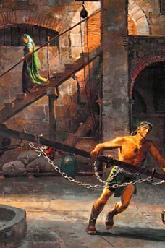
How Did Samson Get Here?
It wasn’t his birth (Judges 13:5)
It wasn’t his ability (Judges 14:6)
It wasn’t the absence of God (Judges 13:25; 14:6; 14:19; 15:18-19)
Samson had a lot going for him!
Family
Unparalleled ability
God with him
Judges 16:21-30: A slave, blind, mocked by his peers, eventually taking his own life along with a few thousand Philistines!
Notes:
How Did Samson Get Here?
It wasn’t his birth:
Some people excuse their actions by saying, “I didn’t have a chance from the beginning. Born into poverty and despair, I was just another nobody from a long line of nobodies.”
Born to lose — that’s what some say about their lives.
Samson couldn’t say that!
Judges 13:5: Samson was set apart by God from his birth, and his parents provided everything he could possibly need to live a life of effectiveness for God.
Samson was to be a Nazirite, dedicated to God.
It wasn’t his ability:
Some people explain their inactions with, “I was always just a one-talent sort of person. Everybody else had brains and talents but I was just incompetent from the beginning.”
Inferior to everyone else – that’s what some say about their lives and abilities and explain away their inaction. They are just inferior.
Samson couldn’t say that! He had incredible strength and unparalleled ability.
Judges 14:6: Samson had amazing strength. Just one example: Walking down the road, a roaring lion coming toward him. No problem for Samson. He tore the lion apart with his bare hands.
Samson had the ability to live a life of effectiveness for God.
It wasn’t the absence of God:
Some people explain their actions by complaining, “God just never cared about me. I would pray and seek God’s face, but I never saw any evidence of God in my life. I just couldn’t do it on my own. That was my problem.”
Without God in their lives – That’s what some people say about their lives.
Samson couldn’t say that!
From the moment of his conception, Samson was set apart by and marked by God.
Judges 13:25: “And the Spirit of the Lord began to stir him.”
Judges 14:6: “The Spirit of the Lord came upon him in power.”
Judges 14:19: “Then the Spirit of the Lord came upon him in power.”
God was with him and even answered his need for water after a fierce battle with the Philistines in Judges 15:18-19.
Samson, seemingly, had a lot going for him:
Samson had a remarkable beginning in a family which loved him and dedicated him to God.
Samson had unparalleled competency and strength with which to serve God.
All through his life, at every critical stage, God came to him with power.
And yet, here he is in Judges 16:21-30 in this sad predicament — a slave, blind, mocked by his peers, eventually taking his own life along with a few thousand Philistines.
What was a person like Samson doing in a place like that?

Slide 8
How Did Samson Get Here?
What was a person like Samson doing in a place like that?

Slide 9
Samson Made Poor Life Choices
What was a person like Samson doing in a place like that?
It was because of his choices; his very bad life choices!
Samson married a Philistine woman (Judges 14:1-3) – Bad choice
Samson went to Gaza to spend the night with a prostitute (Judges 16:1-3) – Bad choice
Samson fell in love with the beautiful but deceitful Delilah (Judges 16:4-6) – Bad choice
Notes:
How Did Samson Get Here?
Samson Made Poor Life Choices
What was a person like Samson doing in a place like that?
How did Samson get into such a predicament?
It was not because of his birth or his lack of abilities or the absence of God in his life!
It was because of his choices; his very bad life choices!
Samson chose to marry a Philistine woman instead of choosing a wife among his own people (Judges 14:1-3). Bad choice.
She betrayed him and he left her.
Samson chose to get revenge on the Philistines: burning up their fields, killing many of their warriors, stirring up an unquenchable hatred for him among the Philistines (Judges 15:1-10), which led to his wife’s death and the deaths of her family.
Samson went into the Philistine city of Gaza to spend the night with a prostitute (Judges 16:1-3). Bad choice.
The city was surrounded and he left at midnight, displaying great strength and power by carrying the city gates on his shoulders almost 40 miles.
Samson fell in love with the beautiful but deceitful Delilah who immediately cut a deal with the Philistines to help them capture Samson (Judges 16:4-6). Bad choice.
She persuaded him to tell her the secret of his strength (Judges 16:6-22).
When he finally told her it was his hair, she cut his hair and God left him.
The Philistines blinded him and took him into captivity.
At every one of these decision points in his life: the wedding feast to a Philistine girl, the prostitute’s house, Delilah’s house, someone could ask, “What was a person like Samson doing in a place like that?”
Good circumstances, outstanding abilities, and the presence of God in our lives can be neutralized in an instant by improper choices.
It happened to Samson. And it can and does happen to us over and over again.
The single factor which determines the quality of our lives — is our choices.
For the simple fact of life, written clearly in the story of Samson, written in between the lines in the stories of our lives, is that choices have consequences!
Robert Louis Stevenson once wrote, “Everybody, soon or later, sits down to a banquet of consequences.” Choices have consequences.
Demas was Paul’s traveling companion and “fellow worker” (Colossians 4:14; Philemon 24) but when things turned a little rough for the apostle, Demas chose the world instead (II Timothy 4:10).
What was a person like Samson doing in a place like that? Because…
…Choices have consequences!

Slide 10
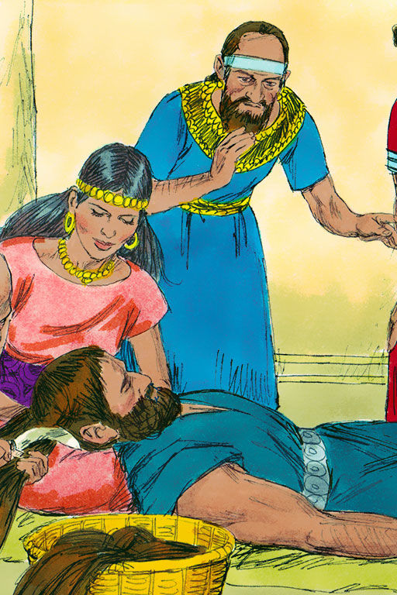
Samson Made Poor Life Choices
At every one of these decision points in his life:
The wedding feast to a Philistine girl
The prostitute’s house
Delilah’s house
Someone could ask, “What was a person like Samson doing in a place like that?
Choices have consequences! (Demas, II Tim. 4:10)
Notes:
How Did Samson Get Here?
Samson Made Poor Life Choices
What was a person like Samson doing in a place like that?
How did Samson get into such a predicament?
It was not because of his birth or his lack of abilities or the absence of God in his life!
It was because of his choices; his very bad life choices!
Samson chose to marry a Philistine woman instead of choosing a wife among his own people (Judges 14:1-3). Bad choice.
She betrayed him and he left her.
Samson chose to get revenge on the Philistines: burning up their fields, killing many of their warriors, stirring up an unquenchable hatred for him among the Philistines (Judges 15:1-10), which led to his wife’s death and the deaths of her family.
Samson went into the Philistine city of Gaza to spend the night with a prostitute (Judges 16:1-3). Bad choice.
The city was surrounded and he left at midnight, displaying great strength and power by carrying the city gates on his shoulders almost 40 miles.
Samson fell in love with the beautiful but deceitful Delilah who immediately cut a deal with the Philistines to help them capture Samson (Judges 16:4-6). Bad choice.
She persuaded him to tell her the secret of his strength (Judges 16:6-22).
When he finally told her it was his hair, she cut his hair and God left him.
The Philistines blinded him and took him into captivity.
At every one of these decision points in his life: the wedding feast to a Philistine girl, the prostitute’s house, Delilah’s house, someone could ask, “What was a person like Samson doing in a place like that?”
Good circumstances, outstanding abilities, and the presence of God in our lives can be neutralized in an instant by improper choices.
It happened to Samson. And it can and does happen to us over and over again.
The single factor which determines the quality of our lives — is our choices.
For the simple fact of life, written clearly in the story of Samson, written in between the lines in the stories of our lives, is that choices have consequences!
Robert Louis Stevenson once wrote, “Everybody, soon or later, sits down to a banquet of consequences.” Choices have consequences.
Demas was Paul’s traveling companion and “fellow worker” (Colossians 4:14; Philemon 24) but when things turned a little rough for the apostle, Demas chose the world instead (II Timothy 4:10).
What was a person like Samson doing in a place like that? Because…
…Choices have consequences!

Slide 11
Samson Made Poor Life Choices
What was a person like Samson doing in a place like that? Because…
Choices have consequences!

Slide 12
Your Choices
We have freedom of choice but we are not free from consequences!
Choose carefully: Heaven or Hell
Matthew 7:13-14: Jesus described them as choosing either a broad road that leads to destruction or the narrow road that leads to life
Matthew 25:31-46: Jesus described them as either obedience to His word and being on His right, or disobedience to His word and being on His left.
Both life and the punishment of fire are descried as “eternal”
Notes:
How Did Samson Get Here?
Samson Made Poor Life Choices
Your Choices
We have freedom in making our choices. However, we are not free to choose the consequences of our choices. They are built into the consequences themselves. Therefore:
We need to choose carefully.
We need to seek wise counsel as we make the key decisions of our lives.
Most of all, we need to choose from the perspective of the long view: Heaven or Hell.
Jesus laid out both destinations…
Matthew 7:13-14: Jesus described them as choosing either a broad road that leads to destruction (“Everybody is doing it!” “The party road!”) or the narrow road that leads to life (“Take the Exit from sin!” “Obey the gospel!”).
Matthew 25:31-46: Jesus described them as either obedience to His word and being on His right, or disobedience to His word and being on His left. Both life and the punishment of fire are descried as “eternal.”
Imagine: Living your life in the world (dead in sin and given over to every lust – Ephesians 2:1-3) and then obeying the gospel and becoming a child of God, a slave to righteousness (Romans 6:17-18; 8:14-17)…
…and upon your death being born by angels to Paradise (Luke 16:22) and later at the Judgment hearing Jesus say, “Come, you who are blessed of My Father, inherit the kingdom prepared for you from the foundation of the world.”
You might find yourself asking, “What is someone like me doing in a place like THIS?”
Imagine: Living your life as a child of God, a slave to righteousness (Romans 6:17-18; 8:14-17) and then through bad choices you choose the world over God (II Peter 2:20-22; Romans 6:1-2) and become a slave to sin again…
…and upon your death open your eyes in Torments (Luke 16:22-23) and later at the Judgment hearing Jesus say, “Depart from Me, accursed ones, into the eternal fire which has been prepared for the devil and his angels.”
You might find yourself asking, “What is someone like me doing in a place like THIS?”
Heaven is too beautiful to miss and Hell too terrible to go there, yet those are the choices before us every day!
Make good choices!

Slide 13
Your Choices
Imagine:
Living your life in the world (dead in sin and given over to every lust – Ephesians 2:1-3) and then obeying the gospel and becoming a child of God, a slave to righteousness (Romans 6:17-18; 8:14-17)…
…and upon your death being carried by angels to Paradise (Luke 16:22) and later at the Judgment hearing Jesus say, “Come, you who are blessed of My Father, inherit the kingdom prepared for you from the foundation of the world” (Matthew 25:34)
You might find yourself asking, “What is someone like ME doing in a place like THIS?”
Notes:
How Did Samson Get Here?
Samson Made Poor Life Choices
Your Choices
We have freedom in making our choices. However, we are not free to choose the consequences of our choices. They are built into the consequences themselves. Therefore:
We need to choose carefully.
We need to seek wise counsel as we make the key decisions of our lives.
Most of all, we need to choose from the perspective of the long view: Heaven or Hell.
Jesus laid out both destinations…
Matthew 7:13-14: Jesus described them as choosing either a broad road that leads to destruction (“Everybody is doing it!” “The party road!”) or the narrow road that leads to life (“Take the Exit from sin!” “Obey the gospel!”).
Matthew 25:31-46: Jesus described them as either obedience to His word and being on His right, or disobedience to His word and being on His left. Both life and the punishment of fire are descried as “eternal.”
Imagine: Living your life in the world (dead in sin and given over to every lust – Ephesians 2:1-3) and then obeying the gospel and becoming a child of God, a slave to righteousness (Romans 6:17-18; 8:14-17)…
…and upon your death being carried by angels to Paradise (Luke 16:22) and later at the Judgment hearing Jesus say, “Come, you who are blessed of My Father, inherit the kingdom prepared for you from the foundation of the world” (Matthew 25:34).
You might find yourself asking, “What is someone like ME doing in a place like THIS?”
Imagine: Living how you want and never obeying the gospel. Or, living your life as a child of God, a slave to righteousness (Romans 6:17-18; 8:14-17) and then through bad choices you choose the world over God (II Peter 2:20-22; Romans 6:1-2) and become a slave to sin again…
…and upon your death open your eyes in Torments (Luke 16:22-23) and later at the Judgment hearing Jesus say, “Depart from Me, accursed ones, into the eternal fire which has been prepared for the devil and his angels” (Matthew 25:41).
You might find yourself asking, “What is someone like ME doing in a place like THIS?”
Heaven is too beautiful to miss and Hell too terrible to go there, yet those are the choices before us every day!
Make good choices!

Slide 14
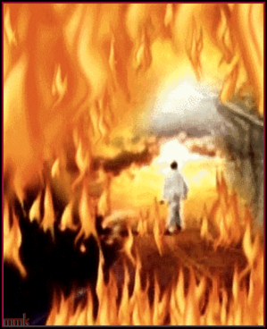
Your Choices
Imagine:
Living how you want and never obeying the gospel.
Or, living your life as a child of God, a slave to righteousness (Romans 6:17-18; 8:14-17) and then through bad choices you choose the world over God (II Peter 2:20-22; Romans 6:1-2) and become a slave to sin again…
…and upon your death open your eyes in Torments (Luke 16:22-23) and later at the Judgment hearing Jesus say, “Depart from Me, accursed ones, into the eternal fire which has been prepared for the devil and his angels” (Matthew 25:41)
You might find yourself asking, “What is someone like ME doing in a place like THIS?”
Notes:
How Did Samson Get Here?
Samson Made Poor Life Choices
Your Choices
We have freedom in making our choices. However, we are not free to choose the consequences of our choices. They are built into the consequences themselves. Therefore:
We need to choose carefully.
We need to seek wise counsel as we make the key decisions of our lives.
Most of all, we need to choose from the perspective of the long view: Heaven or Hell.
Jesus laid out both destinations…
Matthew 7:13-14: Jesus described them as choosing either a broad road that leads to destruction (“Everybody is doing it!” “The party road!”) or the narrow road that leads to life (“Take the Exit from sin!” “Obey the gospel!”).
Matthew 25:31-46: Jesus described them as either obedience to His word and being on His right, or disobedience to His word and being on His left. Both life and the punishment of fire are descried as “eternal.”
Imagine: Living your life in the world (dead in sin and given over to every lust – Ephesians 2:1-3) and then obeying the gospel and becoming a child of God, a slave to righteousness (Romans 6:17-18; 8:14-17)…
…and upon your death being carried by angels to Paradise (Luke 16:22) and later at the Judgment hearing Jesus say, “Come, you who are blessed of My Father, inherit the kingdom prepared for you from the foundation of the world” (Matthew 25:34).
You might find yourself asking, “What is someone like ME doing in a place like THIS?”
Imagine: Living how you want and never obeying the gospel. Or, living your life as a child of God, a slave to righteousness (Romans 6:17-18; 8:14-17) and then through bad choices you choose the world over God (II Peter 2:20-22; Romans 6:1-2) and become a slave to sin again…
…and upon your death open your eyes in Torments (Luke 16:22-23) and later at the Judgment hearing Jesus say, “Depart from Me, accursed ones, into the eternal fire which has been prepared for the devil and his angels” (Matthew 25:41)
You might find yourself asking, “What is someone like ME doing in a place like THIS?”
Heaven is too beautiful to miss and Hell too terrible to go there, yet those are the choices before us every day!
Make good choices!

Slide 15
Your Choices
Heaven is too beautiful to miss and Hell too terrible to go there, yet those are the choices before us every day…
Make Good Choices!

Slide 16
Conclusion
How sad it would be to find ourselves in a disappointing predicament like Samson that would cause others to say of us, “What is a person like you doing in a place like this?”!
The decisions we make in life now make the difference in our eternal destinies.
There are only two ways to travel – God’s Way, or Satan’s way (Way of the world).
Matthew 7:13-14: A broad road that leads to eternal destruction; a narrow road that leads to life.
Many find the broad way.
Few find the narrow way.
Choose the Narrow Way!
No matter what way you have chosen before, God wants you on the Narrow Road that leads to life! (Matthew 7:13-14)
Notes:
Conclusion
How sad it would be to find ourselves in a disappointing predicament like Samson that would cause others to say of us, “What is a person like you doing in a place like this?”!
The decisions we make in life now make the difference in our eternal destinies.
There are only two ways to travel – God’s Way, or Satan’s way (Way of the world).
Matthew 7:13-14: A broad road that leads to eternal destruction; a narrow road that leads to life.
Many find the broad way.
Few find the narrow way.
Choose the Narrow Way!
No matter what way you have chosen before, God wants you on the Narrow Road that leads to life! (Matthew 7:13-14)

Slide 17
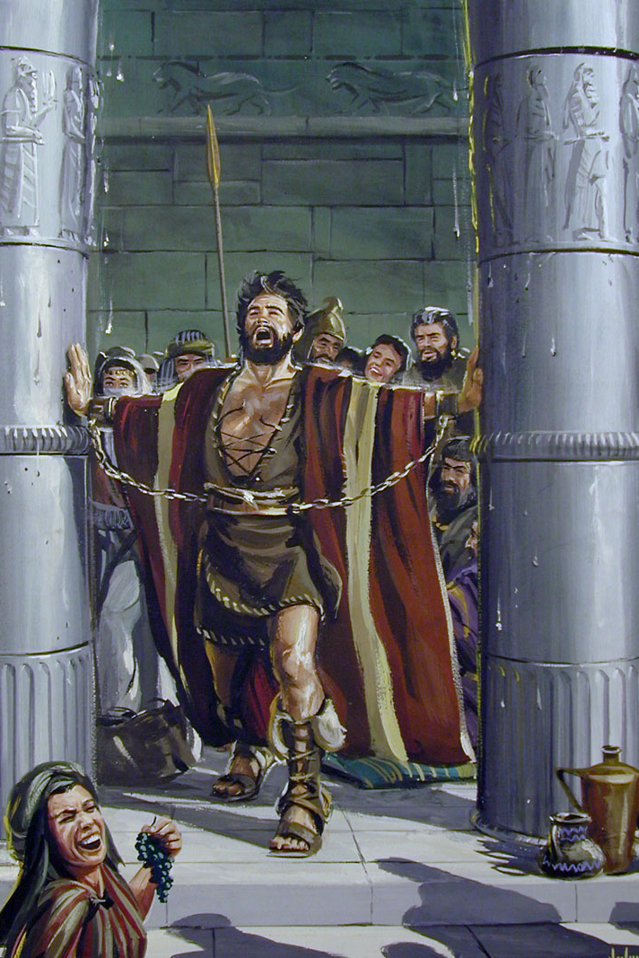
Conclusion
When you find yourself asking, or hearing someone else asking about you, “What is someone like that doing in a place like this?” You can change and make it right!
Samson’s sad predicament wasn’t the end of his story: He called out to God and God answered him in that he killed more Philistines in his death than in life (Judges 16:30)
This part of the story teaches us that as long as we draw breath we can come back to God!
Your “place like this” doesn’t have to be the end!

Slide 18
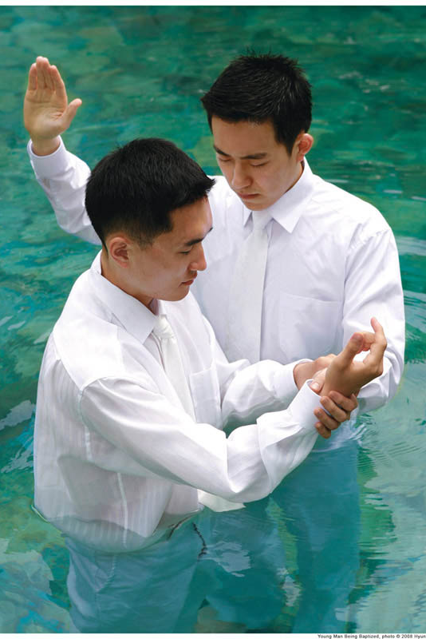
Conclusion
Make the best choice in life: Choose God and obey the gospel!
Or if needed, choose God and repent of your sins!

Slide 19
“What Must I Do To Be Saved?”
Hear The Gospel (Jn. 5:24; Rom. 10:17)
Believe In Christ (Jn. 3:16-18; Jn. 8:24)
Repent Of Sins (Lk. 13:3-5; Acts 2:38)
Confess Christ (Mt. 10:32; Rom. 10:10)
Be Baptized (Mk. 16:16; Acts 22:16)
Remain Faithful (Jn. 8:31; Rev. 2:10)
For The Erring Saint:
Repent (Acts 8:22), Confess (I Jn. 1:9),
Pray (Acts 8:22)

