Slide 1
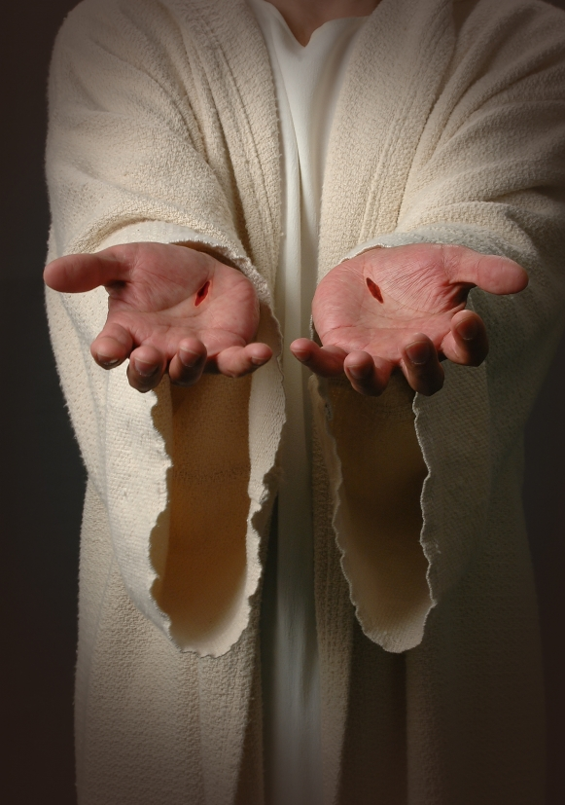
The Suffering Servant Text: Isaiah 42; 49; 50
Notes:
By Nathan L Morrison for Sunday April 2, 2023
All Scripture given is from NASB unless otherwise stated
For further study, or if questions, please Call: 804-277-1983 or Visit www.courthousechurchofchrist.com

Slide 2
Intro
One of the ways God established His supreme Deity & that His word was truth was by prophecy
The Eunuch was reading Isaiah 53 in Acts 8
God, through Isaiah, tells us how He was going to bring the Messiah, His “Suffering Servant” into the world
Let us look at the “Servant Passages” pertaining to Jesus in Isaiah! (Hundreds of years before Jesus)

Slide 3
Intro
We will examine the first three “Servant of the Lord” passages in Isaiah!

Slide 4
The Servant Has A Mission
Isaiah 42:1-7
1. "Behold, My Servant, whom I uphold; My chosen one in whom My soul delights. I have put My Spirit upon Him; He will bring forth justice to the nations.
2. "He will not cry out or raise His voice, Nor make His voice heard in the street.
3. "A bruised reed He will not break And a dimly burning wick He will not extinguish; He will faithfully bring forth justice.
4. "He will not be disheartened or crushed Until He has established justice in the earth; And the coastlands will wait expectantly for His law.“
5. Thus says God the LORD, Who created the heavens and stretched them out, Who spread out the earth and its offspring, Who gives breath to the people on it And spirit to those who walk in it,
6. "I am the LORD, I have called You in righteousness, I will also hold You by the hand and watch over You, And I will appoint You as a covenant to the people, As a light to the nations,
7. To open blind eyes, To bring out prisoners from the dungeon And those who dwell in darkness from the prison.

Slide 5
The Suffering Servant
The Servant Has A Mission (Isaiah 42:1-7)
Who is it that God upholds, chooses, delights in and gives His spirit to? A Servant! (Mt. 12:15-21)
The Servant was to be chosen by God (Isaiah 42:1)
He stands in sharp contrast with worldly conquerors (Isaiah 42:2)
Jesus would have pity on their low estate (Isaiah 42:3; Matthew 9:36)
There is an implied difficulty—but the Servant will prevail (Isaiah 42:4)
The “Servant” would establish justice, be a “covenant” to the people, a light to the nations, open blind eyes, and set captives free (Isaiah 42:6-7; Matthew 11:2-6)

Slide 6
The Servant Has A Mission (Isaiah 42:1-7)
The “Servant of the Lord” had a mission and would accomplish it!

Slide 7
The Servant Has Great Difficulties In His Mission
Isaiah 49:1-5
1. Listen to Me, O islands, And pay attention, you peoples from afar. The LORD called Me from the womb; From the body of My mother He named Me.
2. He has made My mouth like a sharp sword, In the shadow of His hand He has concealed Me; And He has also made Me a select arrow, He has hidden Me in His quiver.
3. He said to Me, "You are My Servant, Israel, In Whom I will show My glory.“
4. But I said, "I have toiled in vain, I have spent My strength for nothing and vanity; Yet surely the justice due to Me is with the LORD, And My reward with My God.“
5. And now says the LORD, who formed Me from the womb to be His Servant, To bring Jacob back to Him, so that Israel might be gathered to Him (For I am honored in the sight of the LORD, And My God is My strength),

Slide 8
The Servant Has Great Difficulties In His Mission
Isaiah 49:6-9
6. He says, "It is too small a thing that You should be My Servant To raise up the tribes of Jacob and to restore the preserved ones of Israel; I will also make You a light of the nations So that My salvation may reach to the end of the earth.“
7. Thus says the LORD, the Redeemer of Israel and its Holy One, To the despised One, To the One abhorred by the nation, To the Servant of rulers, "Kings will see and arise, Princes will also bow down, Because of the LORD who is faithful, the Holy One of Israel who has chosen You.“
8. Thus says the LORD, "In a favorable time I have answered You, And in a day of salvation I have helped You; And I will keep You and give You for a covenant of the people, To restore the land, to make them inherit the desolate heritages;
9. Saying to those who are bound, 'Go forth,' To those who are in darkness, 'Show yourselves.' Along the roads they will feed, And their pasture will be on all bare heights.

Slide 9
The Suffering Servant
The Servant Has Great Difficulties In His Mission (Isaiah 49:1-9)
The “Servant” speaks of Himself
The Servant was to “restore the preserved ones of Israel” (Isaiah 49:6; Matthew 10:5-6)
The Servant would be “abhorred” by the Jews (Isaiah 49:7; Luke 23:18-23)
The servant would set the captives free (Isaiah 49:8-9; Ephesians 1:7; Romans 6:16-18, 22-23)

Slide 10
The Servant Has Great Difficulties In His Mission (Isaiah 49:1-9)
Despite the difficulties of the mission, the “Servant” would prevail!

Slide 11
The Servant Will Suffer
Isaiah 50:4-6
4. The Lord GOD has given Me the tongue of disciples, That I may know how to sustain the weary one with a word. He awakens Me morning by morning, He awakens My ear to listen as a disciple.
5. The Lord GOD has opened My ear; And I was not disobedient Nor did I turn back.
6. I gave My back to those who strike Me, And My cheeks to those who pluck out the beard; I did not cover My face from humiliation and spitting.

Slide 12
The Servant Will Suffer
Isaiah 50:7-10
7. For the Lord GOD helps Me, Therefore, I am not disgraced; Therefore, I have set My face like flint, And I know that I will not be ashamed.
8. He who vindicates Me is near; Who will contend with Me? Let us stand up to each other; Who has a case against Me? Let him draw near to Me.
9. Behold, the Lord GOD helps Me; Who is he who condemns Me? Behold, they will all wear out like a garment; The moth will eat them.
10. Who is among you that fears the LORD, That obeys the voice of His servant, That walks in darkness and has no light? Let him trust in the name of the LORD and rely on his God.

Slide 13
The Suffering Servant
The Servant Will Suffer (Isaiah 50:4-10)
Isaiah introduces the Suffering Servant, Who speaks for Himself
The Servant is Jesus (Matthew 27:26; Luke 2:32)
The striking language of Isaiah 50:6 calls to mind the suffering of Jesus before His journey to the cross (Matthew 26:67-68; 27:26-31)
No reason is given in this section of Scripture for His suffering—we are left to wonder why He had to suffer (Isaiah 50:8; John 8:29; 16:32; Romans 1:1-7)

Slide 14
The Servant Will Suffer (Isaiah 50:4-10)
The Suffering Servant of the Lord had a mission and He would suffer in fulfilling it!

Slide 15
Conclusion
While Isaiah 50 tells us the Servant will suffer, it does not tell us the purpose, but that is revealed later in Isaiah 53
We know that He suffered and died for our sins (I Peter 2:21-25), but it is made all the more amazing by the fact that we are told that He would hundreds of years before His time (Isaiah 53:5-8)!

Slide 16
Conclusion
By knowing these Scriptures we can, like Philip, preach Jesus and His mission! (Acts 8:30-35)

Slide 17
Conclusion
Jesus suffered for you and me, for His friends as well as His enemies!
Have you obeyed His word?

Slide 18
“What Must I Do To Be Saved?”
Hear The Gospel (Jn. 5:24; Rom. 10:17)
Believe In Christ (Jn. 3:16-18; Jn. 8:24)
Repent Of Sins (Lk. 13:3-5; Acts 2:38)
Confess Christ (Mt. 10:32; Rom. 10:10)
Be Baptized (Mk. 16:16; Acts 22:16)
Remain Faithful (Jn. 8:31; Rev. 2:10)
For The Erring Saint:
Repent (Acts 8:22), Confess (I Jn. 1:9),
Pray (Acts 8:22)

