Slide 2
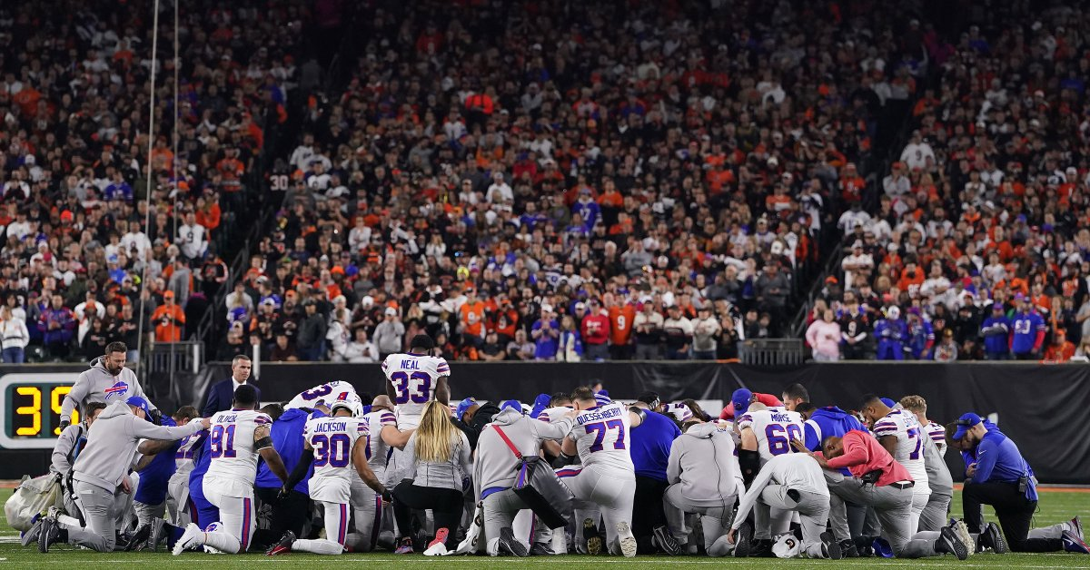

Slide 3
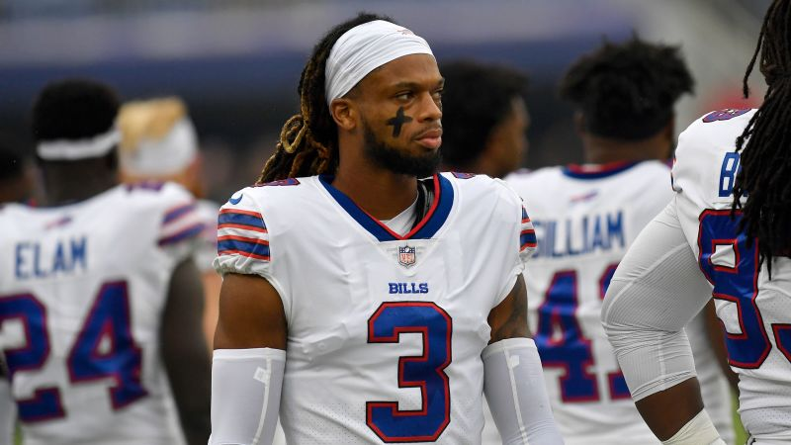

Slide 4
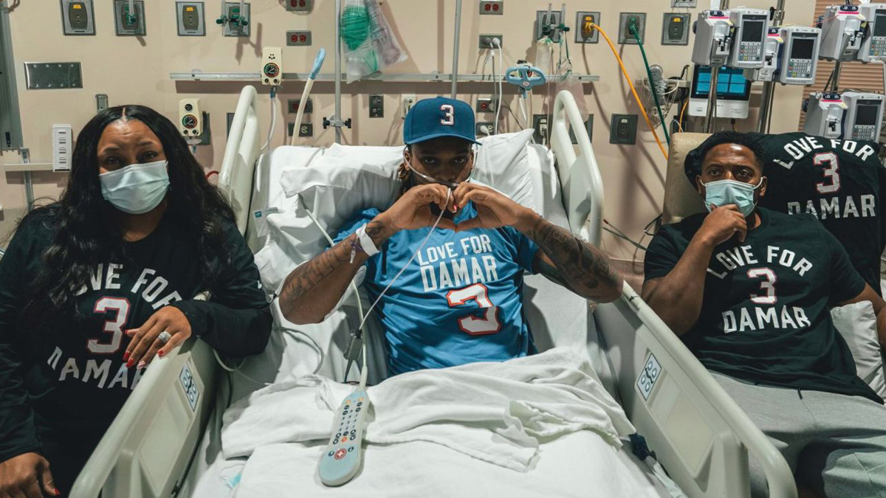

Slide 5
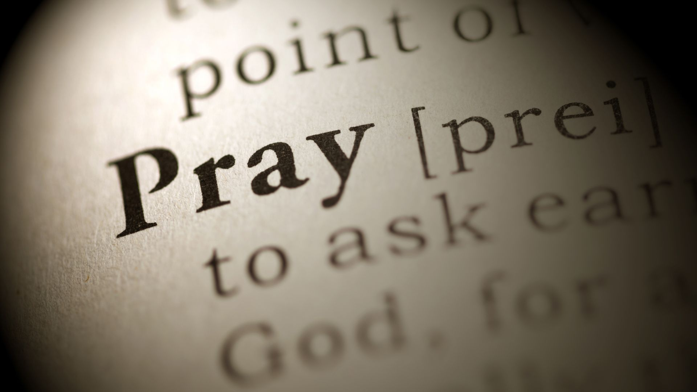

Slide 7
Jehoshaphat was king in Judah.
2 Chronicles 20:31-33
2 Chronicles 17:1-11
He sought after God.
He rejoiced in the way of the Lord.
He had God’s word taught.
He was blessed by God.

Slide 8
The problem that led to his prayer.
2 Chronicles 20:1-2
The Moabites, Ammonites, Meunites came to fight.
News of this made Jehoshaphat afraid.

Slide 9
The prayer of Jehoshaphat
2 Chronicles 20:3-13
He prayed with great confidence.
He focused on God’s power.
He rehearsed what God had done in the past.
He spoke to God about his problem.
He recognized his total dependence on God.

Slide 10
God’s Answer
2 Chronicles 20:14-30
The word of the LORD came to the people.
They were to listen carefully.
They were not to be afraid or discouraged.
The battle belonged to the LORD.
They were to go against their enemies.

Slide 11
Application For Us
“He resolved to seek the LORD.”
“Our eyes are on you.”
“All Judah was standing together.”
“Tomorrow, go out to face them.”
“Believe in His prophets, and you will succeed.”

Slide 12
“Jehoshaphat was afraid,
and he resolved to seek the LORD.”
“Then Jehoshaphat’s kingdom was quiet,
for his God gave him rest on every side.”

