Slide 1
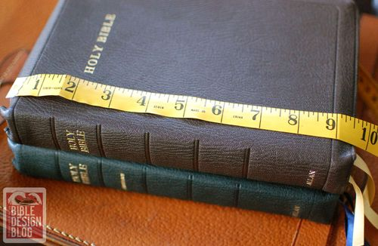
The Measuring Line Text: Romans 2:16; Ephesians 4:11-13
Notes:
By Nathan L Morrison for Sunday March 19, 2023
All Scripture given is from NASB unless otherwise stated
For further study, or if questions, please Call: 804-277-1983 or Visit www.courthousechurchofchrist.com

Slide 2
Intro
Zechariah 2:1-2
1. Then I lifted up my eyes and looked, and behold, there was a man with a measuring line in his hand.
2. So I said, "Where are you going?" And he said to me, "To measure Jerusalem, to see how wide it is and how long it is."

Slide 3
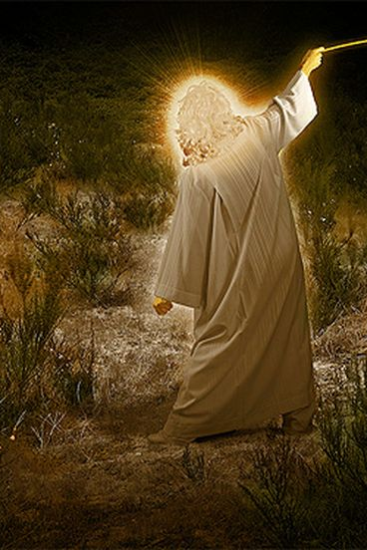
Intro
Zechariah 2:1-2: Zechariah saw “a man with a measuring line”
God was saying He would measure Jerusalem
God often ordered structures and items to be measured to see if they were to His pattern
Gen. 6:14-16: Noah’s Ark
Ex. 25:8-40: Tabernacle & Ark of the Covenant
I Chr. 28:11-12, 19: Temple
6

Slide 4
Intro
Do we recognize the standard (pattern) we are to measure up to?

Slide 5
Intro
Romans 2:14-16
14. For when Gentiles who do not have the Law do instinctively the things of the Law, these, not having the Law, are a law to themselves,
15. in that they show the work of the Law written in their hearts, their conscience bearing witness and their thoughts alternately accusing or else defending them,
16. on the day when, according to my gospel, God will judge the secrets of men through Christ Jesus.

Slide 6
Intro
Ephesians 4:11-13
11. And He gave some as apostles, and some as prophets, and some as evangelists, and some as pastors and teachers,
12. for the equipping of the saints for the work of service, to the building up of the body of Christ;
13. until we all attain to the unity of the faith, and of the knowledge of the Son of God, to a mature man, to the measure of the stature which belongs to the fullness of Christ.

Slide 7
Intro
The only true standard of what matters is in God’s word (Jn. 8:32; 17:17; II Tim. 3:16-17)
The church and the saints that make it up are God’s temple today (I Cor. 6:19-20) – How do we measure up?

Slide 8
The Measuring Line
Measuring the Church
Ephesians 2:19-22; 4:11-13
Matthew 18:20
Right place: Jerusalem – Isaiah 2:2-3; Acts 2
Right time: last days, when all nations flow into it – Is. 2:1-2; Dan. 2:44
Built by Jesus: Mt. 15:13; 16:18; Ps. 127:1

Slide 9
The Measuring Line
Measuring the Church
Measuring the Work of the Church
Evangelism: Romans 10:14; Ephesians 4:11-12, 16; I Thessalonians 1:8
Benevolence towards the saints: Romans 15:25-26
Edification of the saints: I Corinthians 14:12; Ephesians 4:11-12, 16

Slide 10
The Measuring Line
Measuring the Church
Measuring the Work of the Church
Measuring the Organization of the Church
Elders: Eph. 4:11; Phil. 1:1; Acts 14:23; 20:17, 28; I Timothy 3:1-7; Titus 1:5-9; I Peter 5:2
Deacons – Philippians 1:1; I Timothy 3:8-13

Slide 11
The Measuring Line
Measuring the Church
Measuring the Work of the Church
Measuring the Organization of the Church
Measuring the Assembly of the Church
Singing a cappella: Ephesians 5:19; Colossians 3:16
Lord’s Supper on Sunday: Acts 20:7; I Corinthians 11:26; 16:2
Giving as we have prospered & purposed in our hearts: I Cor. 16:2; II Cor. 9:7
Preaching: Colossians 4:16; II Timothy 4:2
Praying: Ephesians 6:18-20; I Timothy 2:8

Slide 12
The Measuring Line
Measuring the Church
Measuring the Work of the Church
Measuring the Organization of the Church
Measuring the Assembly of the Church
Measuring Our Steadfastness & Faithfulness
II Corinthians 13:5
I Corinthians 15:58
I Corinthians 4:2; Revelation 2:10
Colossians 1:23

Slide 13
Conclusion
As Zechariah saw “a man with a measuring line” to measure Jerusalem, one day we will stand before God and will be measured to the standard of Christ! (II Corinthians 5:10)

Slide 14
Conclusion
I Timothy 4:16
Pay close attention to yourself and to your teaching; persevere in these things, for as you do this you will ensure salvation both for yourself and for those who hear you.

Slide 15
Conclusion
Just as in building anything it is important to measure, so in living for Christ it is important we measure ourselves to His standard! (Romans 2:16; Ephesians 4:13)
How do you measure up?

Slide 16
“What Must I Do To Be Saved?”
Hear The Gospel (Jn. 5:24; Rom. 10:17)
Believe In Christ (Jn. 3:16-18; Jn. 8:24)
Repent Of Sins (Lk. 13:3-5; Acts 2:38)
Confess Christ (Mt. 10:32; Rom. 10:10)
Be Baptized (Mk. 16:16; Acts 22:16)
Remain Faithful (Jn. 8:31; Rev. 2:10)
For The Erring Saint:
Repent (Acts 8:22), Confess (I Jn. 1:9),
Pray (Acts 8:22)

