Slide 1
“Who Is On The Lord’s Side?”
Text:
Exodus 32:26
Notes:
By Nathan L Morrison for Sunday 02/12/2023
All Scripture given is from NASB unless otherwise stated
For further study, or if questions, please Call: 804-277-1983 or Visit: www.courthousechurchofchrist.com
Adapted from a lesson done by Richie Thetford
Image: Album Cover art by King E

Slide 2
Intro
Does it ever feel like you stand alone in your faith? (Hebrews 13:5)

Slide 3
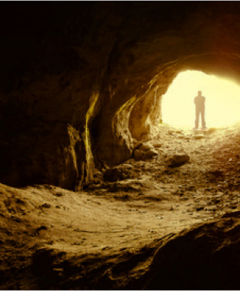
Intro
When we feel alone we need to remember there are others who are going through the same thing
Elijah ( I Kings 19:18 )
You (I Peter 5:8-9)
Elijah (7,000 is few in relation to the nation, but were more than Elijah!)
You (While our brethren are few in contrast to the world, they are more than you!)
Notes:
Intro
Does it ever feel like you stand alone in your faith sometimes?
Hebrews 13:5: We have the promise of Christ to not ever leave or forsake us!
Yet there are times in life that it feels we stand alone.
Sometimes the pressures of life make it seem as if we are all alone, and sometimes we will be, but we also need to remember there are others who are going through the same thing!
I Kings 19:18 (NKJV): Elijah felt alone against the idolatry and covenant-breaking Israelites of the Northern Ten Tribes, and God reminded him there were 7,000 people that had not bowed to Baal. 7,000 is few in relation to the nation, but were more than Elijah!
I Peter 5:8-9: We may sometimes feel we stand alone against the schemes of Satan, but we have brethren in the world who are and have suffered the same. While our brethren are few in contrast to the world (Matthew 7:14), they are more than me!
In those moments when we feel we stand alone against the sin and temptations of life, we may wonder, “Who will follow Jesus?,” “Who is on the Lord’s side?” (I Peter 5:9!)

Slide 4
Intro
In those moments when we feel we stand alone against the sin and temptations of life, we may wonder, “Who will follow Jesus?,” “Who is on the Lord’s side?” (I Peter 5:9!)

Slide 5
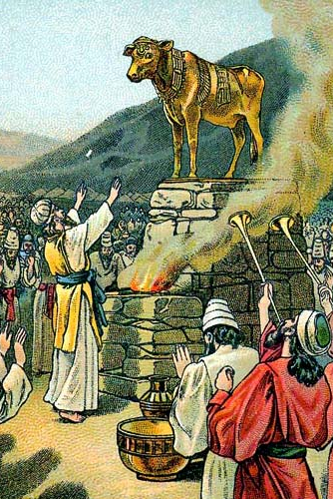
“Who is on the Lord’s Side?” in Situations Like:
Moses and the Levites vs. Israelites – the Golden Calf incident (Exodus 32:26)
“Who is on the Lord’s side?” (ESV)
Levites stepped forward and carried out the command of the Lord (Exodus 32:26f)
They stood alone against the 11 other tribes!
Though few in number they were more than Moses alone!
Notes:
“Who is on the Lord’s Side?” in Situations Like:
Moses and the Levites vs. Israelites – the Golden Calf incident
Exodus 32:17-26: (32:26) “Who is on the Lord’s side?” (ESV)
Moses forced them to choose, to make an unpopular decision – Levites stepped forward and carried out the command of the Lord (32:26f).
They stood alone against the 11 other tribes! (Though few in number they were more than Moses alone!)

Slide 6
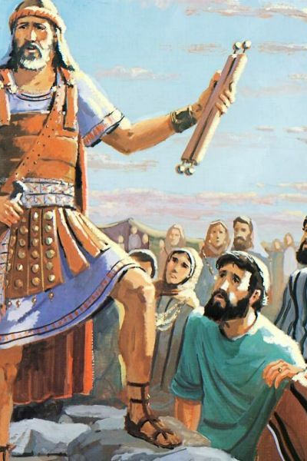
“Who is on the Lord’s Side?” in Situations Like:
Joshua vs. Israelites – his farewell address (Joshua 24:14-15)
“Choose whom you will serve?”
“As for me and my house we will serve the Lord”
This choice was ever before them, and Joshua’s choice proved to be the unpopular one time and again (The book of Judges)!
Notes:
“Who is on the Lord’s Side?” in Situations Like:
Moses and the Levites vs. Israelites – the Golden Calf incident
Joshua vs. Israelites – his farewell address
Joshua 24:14-15: He made a stand: “Choose whom you will serve;” “As for me and my house we will serve the Lord.”
Down through their history, this choice was ever before them, and Joshua’s choice proved to be the unpopular one time and again (The book of Judges)!

Slide 7
“Who is on the Lord’s Side?” in Situations Like:
Elijah vs. 450 prophets of Baal (I Kings 18:21-22)
Elijah stood alone against the 450 false prophets of Baal, against the nation and its king!
I Kings 19:1-3: Queen Jezebel sought his life
Elijah stood against a nation for its idolatry and God showed them that He was with him! (I Kings 18:36-40)
Notes:
“Who is on the Lord’s Side?” in Situations Like:
Moses and the Levites vs. Israelites – the Golden Calf incident
Joshua vs. Israelites – his farewell address
Elijah vs. 450 prophets of Baal
I Kings 18:21-22: Elijah made the choice of Joshua and stood alone against not only the 450 false prophets of Baal, but against the nation and its king!
I Kings 19:1-3: Jezebel sought his life for his act against her false prophets – she had killed the prophets of the Lord before (I Kings 18:3-4).
Elijah stood against a nation for its idolatry (I Kings 19:9-10: He felt alone!) and God showed them that He was with him (I Kings 18:36-40)

Slide 8
“Who is on the Lord’s Side?” in Situations Like:
Jeremiah vs. a king and the nation’s false prophets (Jeremiah 15:15-18)
His advice to the king from God was unpopular!
Jeremiah 15:19-21: God promised him if he trusted in Him, He would protect him
Jeremiah stood alone against the king, false prophets, and his nation!
Notes:
“Who is on the Lord’s Side?” in Situations Like:
Moses and the Levites vs. Israelites – the Golden Calf incident
Joshua vs. Israelites – his farewell address
Elijah vs. 450 prophets of Baal
Jeremiah vs. a king and the nation’s false prophets
Jeremiah 15:15-18: Because of the truth of God’s word, Jeremiah was alone against the king and the mockery of false prophets.
His advice to the king from God was unpopular: Do not rely on Egypt for help, surrender to Nebuchadnezzar and live, and do not flee the city, nor go to Egypt.
Jer. 15:19-21: God promised him if he trusted in Him, He would protect him.
He stood alone against the king, false prophets, and his nation!

Slide 9
“Who is on the Lord’s Side?” in Situations Like:
Paul: Arrested! (II Timothy 4:16-17)
Paul was deserted by his friends at his arrest and suffering, but acknowledged God was with him, and gave him strength
Paul stood alone before the authorities declaring the gospel! (Acts 9:15-16)
Notes:
“Who is on the Lord’s Side?” in Situations Like:
Moses and the Levites vs. Israelites – the Golden Calf incident
Joshua vs. Israelites – his farewell address
Elijah vs. 450 prophets of Baal
Jeremiah vs. a king and the nation’s false prophets
Paul – Arrested
II Timothy 4:16-17: Paul was deserted by his friends at his arrest and suffering, but acknowledged God was with him, and gave him strength!
Paul stood alone before the authorities declaring the gospel! (Acts 9:15-16)

Slide 10
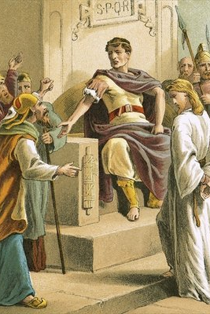
“Who is on the Lord’s Side?” in Situations Like:
Jesus: Arrested! (Mark 14:48-50)
At His arrest His followers scattered (Isaiah 53:3)
Jesus stood alone through His trial when He faced Pilate and the high priests
Notes:
“Who is on the Lord’s Side?” in Situations Like:
Moses and the Levites vs. Israelites – the Golden Calf incident
Joshua vs. Israelites – his farewell address
Elijah vs. 450 prophets of Baal
Jeremiah vs. a king and the nation’s false prophets
Paul – Arrested
Jesus – Arrested
Mark 14:48-50: At His arrest His followers scattered. (Isaiah 53:3)
Jesus stood alone through His trial when He faced Pilate and the high priests!

Slide 11
“Who is on the Lord’s Side?”
There are times when we must stand alone! (in God we are never truly alone)

Slide 12
“Who Is On The Lord’s Side” Against Worldliness?
Choose to follow Jesus (II Cor. 6:14-18)
Jesus warned against bowing to worldliness (Luke 21:34-36)
Paul warned Timothy about the distractions of the world (II Tim. 2:3-4)
Not to compromise with the world (Daniel 1:3-8; 6:10-11; II Peter 1:5)
Notes:
“Who is on the Lord’s Side?” in Situations Like
“Who Is On The Lord’s Side” Against Worldliness?
Saints must choose to follow Jesus and stand for what’s right (on the Lord’s side).
II Cor. 6:14-18: Like the Israelites of old, Christians are called to be separate from the world, to step over the dividing line (so to speak) to the Lord’s side!
Christ warned against bowing to worldliness.
Luke 21:34-36: The cares of this life can distract us from watching and being ready for His coming! (II Jn. 2:15-17: Not to love the world!)
Mt. 13:22: Christians can get so distracted by worldly cares they fall away!
Paul warned Timothy about the distractions of the world.
II Timothy 2:3-4: The analogy of a soldier: soldiers concern themselves with the affairs of the one who enlisted him, not the concerns of the world.
Not to surrender convictions for compromise with the world!
Daniel 1:3-8; 6:10-11: Daniel’s courage is required!
As a youth he stood for what was right, even though the majority of his countrymen did not!
As an old man, even knowing that the decree was signed, he continued praying to God, not in secret but just as before – windows open!
Courage is faith at work – II Peter 1:5: “In your faith supply moral excellence.”
To “follow Jesus” “on the Lord’s side” we must often stand against the world!

Slide 13
“Who Is On The Lord’s Side” Against Worldliness?
To “follow Jesus” “on the Lord’s side” we must often stand against the world!

Slide 14
“Who Will Follow Jesus” to God’s Promised Rewards?
Those who obey God will enter Heaven! (Matthew 7:21; Heb. 5:9; I Pet. 1:3-4)
Notes:
“Who is on the Lord’s Side?” in Situations Like
“Who Is On The Lord’s Side” Against Worldliness?
“Who Will Follow Jesus” to God’s Promised Rewards?
Those who obey God will enter Heaven! (Matthew 7:21; Hebrews 5:9; I Peter 1:3-4)
God has said, “I am with you” to those who choose the Lord’s side (ancient and today)!
Jeremiah 42:11: In obedience to God concerning the king of Babylon!
Haggai 1:13; 2:4: In rebuilding the Temple!
Matthew 28:18-20: In teaching the gospel!
Hebrews 2:18: In times of temptation!
God has said, “Be faithful” despite what the world around us does!
Revelation 2:10: “Be faithful until death, and I will give you the crown of life.”
Those who follow Jesus will enter Heaven, where man will never stand alone again!

Slide 15
“Who Will Follow Jesus” to God’s Promised Rewards?
God has said, “I am with you” to those who choose the Lord’s side (ancient and today)!
Jeremiah 42:11: In obedience to God concerning the king of Babylon!
Haggai 1:13; 2:4: In rebuilding the Temple!
Matthew 28:18-20: In teaching the gospel!
Hebrews 2:18: In times of temptation!
Notes:
“Who is on the Lord’s Side?” in Situations Like
“Who Is On The Lord’s Side” Against Worldliness?
“Who Will Follow Jesus” to God’s Promised Rewards?
Those who obey God will enter Heaven! (Matthew 7:21; Hebrews 5:9; I Peter 1:3-4)
God has said, “I am with you” to those who choose the Lord’s side (ancient and today)!
Jeremiah 42:11: In obedience to God concerning the king of Babylon!
Haggai 1:13; 2:4: In rebuilding the Temple!
Matthew 28:18-20: In teaching the gospel!
Hebrews 2:18: In times of temptation!
God has said, “Be faithful” despite what the world around us does!
Revelation 2:10: “Be faithful until death, and I will give you the crown of life.”
Those who follow Jesus will enter Heaven, where man will never stand alone again!

Slide 16
“Who Will Follow Jesus” to God’s Promised Rewards?
Those who obey God will enter Heaven! (Matthew 7:21; Heb. 5:9; I Pet. 1:3-4)
God has said, “I am with you” to those who choose the Lord’s side (ancient and today)!
God has said, “Be faithful” despite what the world around us does (Rev. 2:10)
Notes:
“Who is on the Lord’s Side?” in Situations Like
“Who Is On The Lord’s Side” Against Worldliness?
“Who Will Follow Jesus” to God’s Promised Rewards?
Those who obey God will enter Heaven! (Matthew 7:21; Hebrews 5:9; I Peter 1:3-4)
God has said, “I am with you” to those who choose the Lord’s side (ancient and today)!
Jeremiah 42:11: In obedience to God concerning the king of Babylon!
Haggai 1:13; 2:4: In rebuilding the Temple!
Matthew 28:18-20: In teaching the gospel!
Hebrews 2:18: In times of temptation!
God has said, “Be faithful” despite what the world around us does!
Revelation 2:10: “Be faithful until death, and I will give you the crown of life.”
Those who follow Jesus will enter Heaven, where man will never stand alone again!

Slide 17
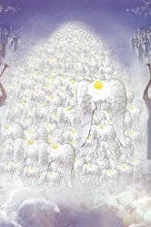
“Who Is On The Lord’s Side” Against Worldliness?
Those who follow Jesus will enter Heaven, where man will never stand alone again!

Slide 18
Conclusion
Hebrews 10:36-39
36. For you have need of endurance, so that when you have done the will of God, you may receive what was promised.
37. FOR YET IN A VERY LITTLE WHILE, HE WHO IS COMING WILL COME, AND WILL NOT DELAY.
38. BUT MY RIGHTEOUS ONE SHALL LIVE BY FAITH; AND IF HE SHRINKS BACK, MY SOUL HAS NO PLEASURE IN HIM.
39. But we are not of those who shrink back to destruction, but of those who have faith to the preserving of the soul.
Notes:
Heb 10:36 For you have need of endurance, so that when you have done the will of God, you may receive what was promised.
Heb 10:37 FOR YET IN A VERY LITTLE WHILE, HE WHO IS COMING WILL COME, AND WILL NOT DELAY.
Heb 10:38 BUT MY RIGHTEOUS ONE SHALL LIVE BY FAITH; AND IF HE SHRINKS BACK, MY SOUL HAS NO PLEASURE IN HIM.
Heb 10:39 But we are not of those who shrink back to destruction, but of those who have faith to the preserving of the soul.

Slide 19
Conclusion
It was never promised to be easy, but it is possible to live righteously! (Titus 2:11-14)
We are small in number in relation to the world around us, and the world is against us.
The reward is great in comparison to the scorn of the world! (Luke 6:22-23)

Slide 20
Conclusion
Hebrews 3:12-15
12. Take care, brethren, that there not be in any one of you an evil, unbelieving heart that falls away from the living God.
13. But encourage one another day after day, as long as it is still called "Today," so that none of you will be hardened by the deceitfulness of sin.
14. For we have become partakers of Christ, if we hold fast the beginning of our assurance firm until the end,
15. while it is said, "TODAY IF YOU HEAR HIS VOICE, DO NOT HARDEN YOUR HEARTS, AS WHEN THEY PROVOKED ME."
Notes:
Heb 3:12 Take care, brethren, that there not be in any one of you an evil, unbelieving heart that falls away from the living God.
Heb 3:13 But encourage one another day after day, as long as it is still called "Today," so that none of you will be hardened by the deceitfulness of sin.
Heb 3:14 For we have become partakers of Christ, if we hold fast the beginning of our assurance firm until the end,
Heb 3:15 while it is said, "TODAY IF YOU HEAR HIS VOICE, DO NOT HARDEN YOUR HEARTS, AS WHEN THEY PROVOKED ME."

Slide 21
Conclusion
“Who will follow Jesus?”
“Who is on the Lord’s side?”
Our eternal destiny depends on the answer – So it better be, “Master, here am I!”

Slide 22
“What Must I Do To Be Saved?”
Hear The Gospel (Jn. 5:24; Rom. 10:17)
Believe In Christ (Jn. 3:16-18; Jn. 8:24)
Repent Of Sins (Lk. 13:3-5; Acts 2:38)
Confess Christ (Mt. 10:32; Rom. 10:10)
Be Baptized (Mk. 16:16; Acts 22:16)
Remain Faithful (Jn. 8:31; Rev. 2:10)
For The Erring Saint:
Repent (Acts 8:22), Confess (I Jn. 1:9),
Pray (Acts 8:22)

