Slide 1
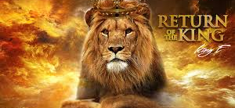
The Return Of The King
Text:
Revelation 1:7-8
Notes:
By Nathan L Morrison for Sunday 02/05/2023
All Scripture given is from NASB unless otherwise stated
For further study, or if questions, please Call: 804-277-1983 or Visit: www.courthousechurchofchrist.com
Adapted from a lesson done by Joe Price
Image: Album Cover art by King E

Slide 2
Intro
The Book of Revelation is the “Unveiling” of Jesus Christ (Revelation = “Unveiling” )

Slide 3
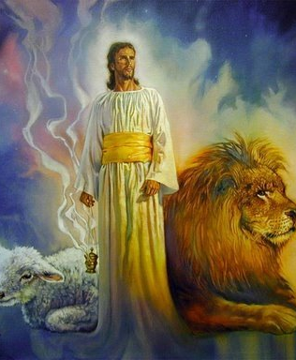
Intro
Jesus revealed to John (Rev. 1:1-2, 7-8) His true nature and what would happen when He returns!
Jesus, Lion of Judah, Lamb of God is the King of the nations (Rev. 5:5; 15:3)
Notes:
Rev 1:1 The Revelation of Jesus Christ, which God gave Him to show to His bond-servants, the things which must soon take place; and He sent and communicated it by His angel to His bond-servant John,
Rev 1:2 who testified to the word of God and to the testimony of Jesus Christ, even to all that he saw.
Rev 1:7 BEHOLD, HE IS COMING WITH THE CLOUDS, and every eye will see Him, even those who pierced Him; and all the tribes of the earth will mourn over Him. So it is to be. Amen.
Rev 1:8 "I am the Alpha and the Omega," says the Lord God, "who is and who was and who is to come, the Almighty."
Rev 5:5 and one of the elders *said to me, "Stop weeping; behold, the Lion that is from the tribe of Judah, the Root of David, has overcome so as to open the book and its seven seals."
Rev 15:3 And they sang the song of Moses, the bond-servant of God, and the song of the Lamb, saying, "Great and marvelous are Your works, O Lord God, the Almighty; Righteous and true are Your ways, King of the nations!

Slide 4
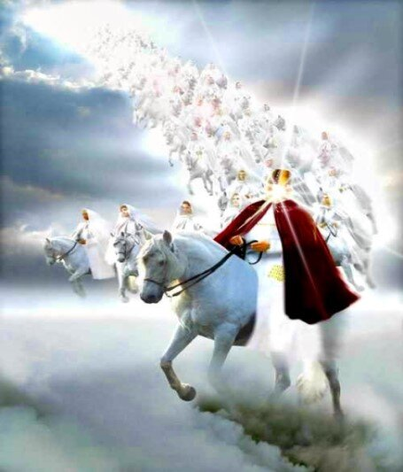
Intro
Revelation 19:11-16
11. And I saw heaven opened, and behold, a white horse, and He who sat on it is called Faithful and True, and in righteousness He judges and wages war.
12. His eyes are a flame of fire, and on His head are many diadems; and He has a name written on Him which no one knows except Himself.
13. He is clothed with a robe dipped in blood, and His name is called The Word of God.
14. And the armies which are in heaven, clothed in fine linen, white and clean, were following Him on white horses.
15. From His mouth comes a sharp sword, so that with it He may strike down the nations, and He will rule them with a rod of iron; and He treads the wine press of the fierce wrath of God, the Almighty.
16. And on His robe and on His thigh He has a name written, "KING OF KINGS, AND LORD OF LORDS."
Notes:
Rev 19:11 And I saw heaven opened, and behold, a white horse, and He who sat on it is called Faithful and True, and in righteousness He judges and wages war.
Rev 19:12 His eyes are a flame of fire, and on His head are many diadems; and He has a name written on Him which no one knows except Himself.
Rev 19:13 He is clothed with a robe dipped in blood, and His name is called The Word of God.
Rev 19:14 And the armies which are in heaven, clothed in fine linen, white and clean, were following Him on white horses.
Rev 19:15 From His mouth comes a sharp sword, so that with it He may strike down the nations, and He will rule them with a rod of iron; and He treads the wine press of the fierce wrath of God, the Almighty.
Rev 19:16 And on His robe and on His thigh He has a name written, "KING OF KINGS, AND LORD OF LORDS."

Slide 5
Intro
The return of the King was promised by:
Jesus (Jn. 14:1-6)
Angels (Acts 1:9-11)
Apostles (I Thess. 4:16; II Pet. 3:10; Rev. 1:7)
Notes:
II. The return of the King was promised by:
A. Jesus (Jn. 14:1-6), Angels (Acts 1:9-11), & Apostles (I Thess. 4:16; II Pet. 3:10; Rev. 1:7)

Slide 6
Intro
I Timothy 6:11-16
11. But flee from these things, you man of God, and pursue righteousness, godliness, faith, love, perseverance and gentleness.
12. Fight the good fight of faith; take hold of the eternal life to which you were called, and you made the good confession in the presence of many witnesses.
13. I charge you in the presence of God, who gives life to all things, and of Christ Jesus, who testified the good confession before Pontius Pilate,
14. that you keep the commandment without stain or reproach until the appearing of our Lord Jesus Christ,
15. which He will bring about at the proper time—He who is the blessed and only Sovereign, the King of kings and Lord of lords,
16. who alone possesses immortality and dwells in unapproachable light, whom no man has seen or can see. To Him be honor and eternal dominion! Amen.
Notes:
1Ti 6:11 But flee from these things, you man of God, and pursue righteousness, godliness, faith, love, perseverance and gentleness.
1Ti 6:12 Fight the good fight of faith; take hold of the eternal life to which you were called, and you made the good confession in the presence of many witnesses.
1Ti 6:13 I charge you in the presence of God, who gives life to all things, and of Christ Jesus, who testified the good confession before Pontius Pilate,
1Ti 6:14 that you keep the commandment without stain or reproach until the appearing of our Lord Jesus Christ,
1Ti 6:15 which He will bring about at the proper time—He who is the blessed and only Sovereign, the King of kings and Lord of lords,
1Ti 6:16 who alone possesses immortality and dwells in unapproachable light, whom no man has seen or can see. To Him be honor and eternal dominion! Amen.

Slide 7
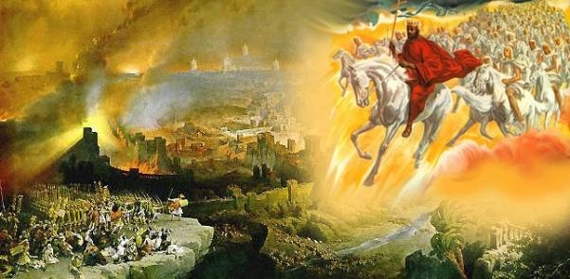
Intro
Peter said there would be mockers asking, “Where is the promise of His coming?”
(II Peter 3:3-4, 9)

Slide 8
Intro
People should ask, “What is the promise of His coming?” Wrath or Glory? (I Thess. 5:1-3, 9)

Slide 9
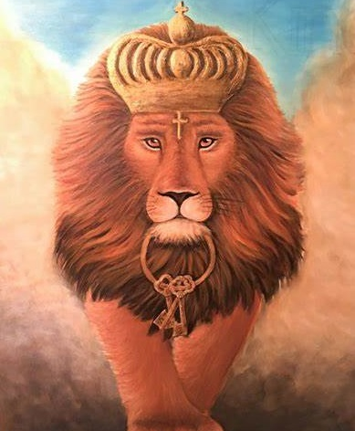
Intro
Jesus Christ’s 2nd Coming is for judgment & reward! (Heb. 9:27-28; Rev. 11:18; 22:12)

Slide 10
Events of Christ’s Return
The end of all things sounded (I Thess. 4:16)
Resurrection of all the Dead (I Thess. 4:16-17; Jn. 5:28-29)
All people bow, praise God, and confess Jesus Christ (Rom. 14:11-12; Phil. 2:9-11)
Judgment of All People (Books opened – Rev. 20:12)

Slide 11
Events of Christ’s Return
The Sentence will be Carried Out (Reward – Mt. 25:34, 46; Rom. 2:7; Punishment – Mt. 25:41, 46; II Thess. 1:8-9)
Material World Burned Up (II Pet. 3:10-12)

Slide 12
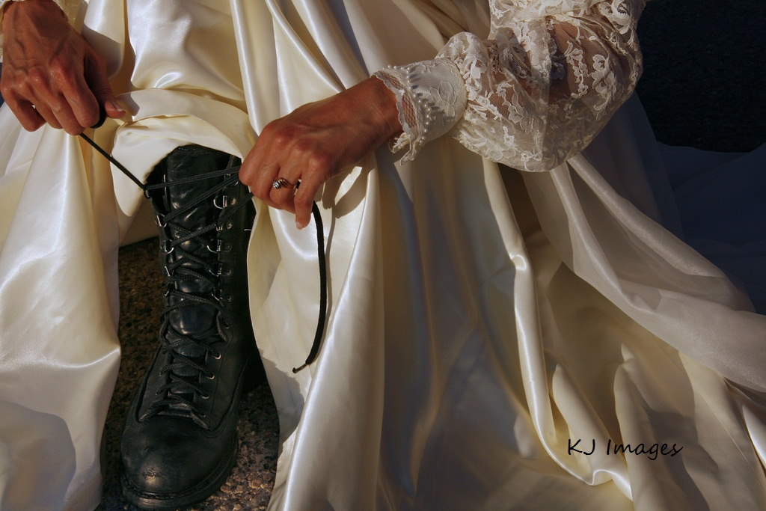
Events of Christ’s Return
Knowing how it all ends we are to be looking forward in readiness to that day!

Slide 13
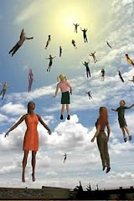
Will King Jesus Come to Earth or Take Us To Heaven (or Both)?
Jesus promised to take His disciples to Heaven! (John 14:1-6)
His 2nd Coming is for judgment & to destroy the world (Heb. 9:27-28; II Pet. 3:11-13)

Slide 14
Will King Jesus Come to Earth or Take Us To Heaven (or Both)?
Ready saints will be with Jesus in Heaven, not on Earth! (Jn. 14:2-3; I Thess. 4:17)!

Slide 15
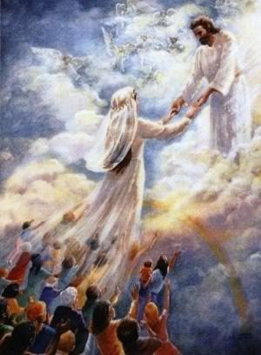
Comfort of His Promise
Our hope is secure (I Thess. 4:13-15; Heb. 6:19; I John 3:1-3)
Faith and hope will be realized when we “see Him face to face” “just as He is” (I Cor. 13:12-13; I John 3:2-3)

Slide 16
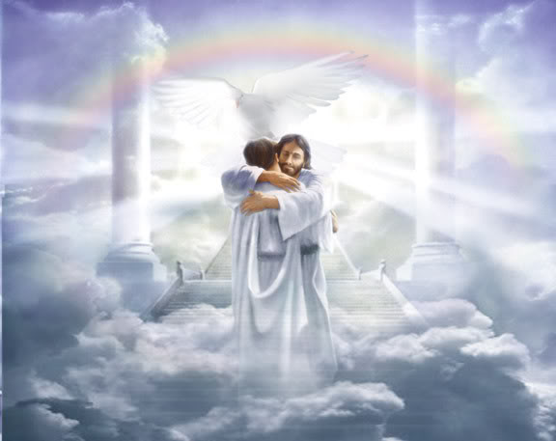
Comfort of His Promise
Love will continue forever as we dwell in the presence of God Almighty for eternity!

Slide 17
Conclusion
Though death comes to us here, an eternal life awaits those who “have loved His appearing” (II Tim. 4:8), and death will be the last enemy abolished (I Cor. 15:26)!
To be with Jesus in eternity: Love His (future, promised) Appearing like Paul did (II Tim. 4:7)

Slide 18
Conclusion
Live in “holy conduct & godliness” and look forward to the return of the King!

Slide 19
“What Must I Do To Be Saved?”
Hear The Gospel (Jn. 5:24; Rom. 10:17)
Believe In Christ (Jn. 3:16-18; Jn. 8:24)
Repent Of Sins (Lk. 13:3-5; Acts 2:38)
Confess Christ (Mt. 10:32; Rom. 10:10)
Be Baptized (Mk. 16:16; Acts 22:16)
Remain Faithful (Jn. 8:31; Rev. 2:10)
For The Erring Saint:
Repent (Acts 8:22), Confess (I Jn. 1:9),
Pray (Acts 8:22)

