Slide 1
Cows Of Bashan
Text:
Amos 4
Notes:
By Nathan L Morrison for Sunday 02/19/2023
All Scripture given is from NASB unless otherwise stated
For further study, or if questions, please Call: 804-277-1983 or Visit: www.courthousechurchofchrist.com

Slide 2
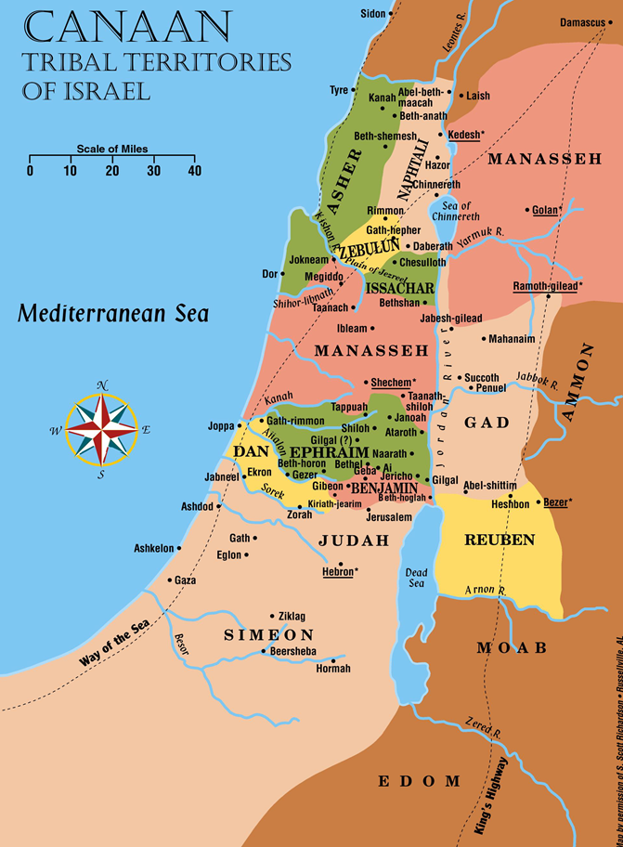
Intro
Israel, the Northern Kingdom, experienced great peace and prosperity under the reign of Jeroboam II, the son of King Joash of Israel
The prophets Jonah, Hosea & Amos were contemporary during this time (II Kings 14:25; Hosea 1:1; Amos 1:1)

Slide 3
Intro
God called Amos, a shepherd from Tekoa in Judah, and sent him to Israel to prophesy because Israel didn’t use the peace and prosperity from God as a time to repent: “You have not returned to Me”
In contrast, Assyria, Israel’s enemy and pagan country, repented from the peasant to the King when Jonah preached to them (Jonah 3:1-10). This brought peace to Israel!

Slide 4
Intro
For their sins, God pronounced judgement on Israel through Hosea and Amos (Hosea 4:6-7; Amos 7:7-17; 9:8-10) and other prophets (II Kings 17:6-23)

Slide 5
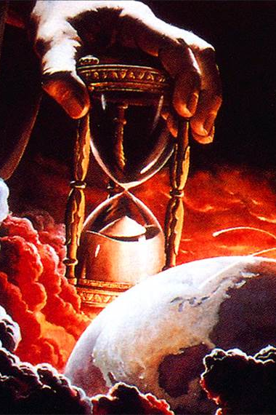
Intro
The book of Amos has many parallels to the world we live in today
God has promised destruction to the world and an eternal punishment to the wicked!

Slide 6
Cows of Bashan
Amos 4:1-3
1. Hear this word, you cows of Bashan who are on the mountain of Samaria, Who oppress the poor, who crush the needy, Who say to your husbands, "Bring now, that we may drink!"
2. The Lord GOD has sworn by His holiness, "Behold, the days are coming upon you When they will take you away with meat hooks, And the last of you with fish hooks.
3. "You will go out through breaches in the walls, Each one straight before her, And you will be cast to Harmon," declares the LORD.

Slide 7
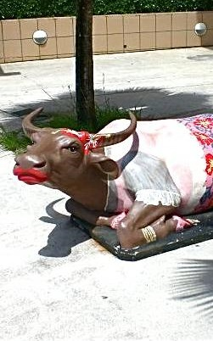
Cows of Bashan
Ungodly women, called “cows of Bashan” (Amos 4:1-3)
Lavish and decadent lives
Rejected repentance
Would be punished
Notes:
Cows of Bashan
Ungodly women, called “cows of Bashan.” (Amos 4:1-3)
Bashan was east of Jordan and good pastureland.
These were the wives of the rich and powerful.
Amos 4:1: They were selfish, insensitive, destructive & decadent.
Women will either be great blessing to society, or great curses upon society.
Amos 4:2-3: Amos’ illustration of their punishment: as fish are caught by hooks so these women would be taken captive.
Amos 4:3: “You will go out through breaches in the walls.”
Their hope in the fortified walls of the city would fail.
They would be led captive out of the city through the very holes which let the enemy in!
The city of Samaria would be in ruins.
During this time of peace the people lived decadent & lavish lives
Amos 3:15: When punishment from God strikes, it will demolish the great houses and their beds of ivory.
Amos 6:1-8: Despite all the warnings, from the prophets, of doom and destruction because of their idolatry, the Israelites were “at ease” and lounged on their “beds of ivory” and were not “grieved over the ruin of Joseph.”
God says their destruction is near.
Assyria has repented for now and God is giving them time to repent but within 50-70 years Assyria will rise up against them and carry them away into exile (II Kings 17).

Slide 8
Cows of Bashan
The world we live in today:
We live in relative peace to worship God as He wills
The world will be burned up and the wicked will be eternally punished (Matthew 25:41-46; II Peter 3:7, 10)
God has warned saints and the ungodly through His word
I Thessalonians 5:2-3: “Peace and safety!” then destruction!
The days of Noah before the flood and in the days of Lot before Sodom & Gomorrah were destroyed (Luke 17:26-32).
Many people around us reject God’s word and repentance!
Notes:
Cows of Bashan
Ungodly women, called “cows of Bashan.” (Amos 4:1-3)
During this time of peace the people lived decadent & lavish lives
The world we live in today:
We live in relative peace to worship God as He wills.
God has warned through His word that the world will be burned up (II Peter 3:7, 10) and the wicked will be eternally punished (Matthew 25:41-46).
God has warned saints, disciples of Jesus, to be alert and look forward to that day in holy and godly conduct (II Peter 3:10-12).
Yet, the majority of the world rejects God’s words and continues on day-to-day business as usual (I Thessalonians 5:2-3: “Peace and safety!” then destruction!).
Jesus said this was the case in the days of Noah before the flood and in the days of Lot before Sodom & Gomorrah were destroyed (Luke 17:26-32).
Many people around us live according to their desires with no fear or grief over the promised destruction and punishment to come!

Slide 9
Cows of Bashan
Ephesians 5:15-16
Therefore be careful how you walk, not as unwise men but as wise, making the most of your time (NKJV: “redeeming”), because the days are evil.

Slide 10
Cows of Bashan
God gives us time to repent (II Peter 3:9): What do you do with the time?

Slide 11
False Worship Won’t Save
Amos 4:4-5
4. "Enter Bethel and transgress; In Gilgal multiply transgression! Bring your sacrifices every morning, Your tithes every three days.
5. "Offer a thank offering also from that which is leavened, And proclaim freewill offerings, make them known. For so you love to do, you sons of Israel," Declares the Lord GOD.

Slide 12
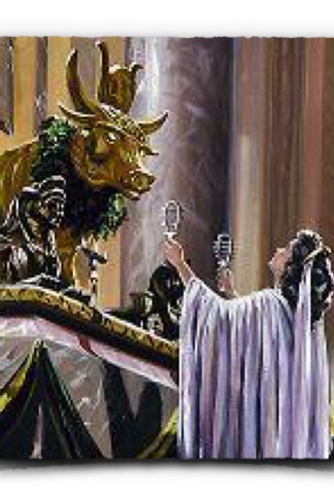
False Worship Won’t Save
False worship won’t save the Israelites (Amos 4:4-5; 7:10-13)
They loved idolatry
God rejected their sinful offerings
They didn’t want to hear the truth
Told the prophet to go home
Notes:
False Worship Won’t Save
Amos 4:4-5: False worship won’t save the Israelites.
Bethel and Gilgal were centers of idolatry.
Genesis 35:15; Joshua 4:20-24: They were once where God’s help was commemorated.
Amos 4:4-5: The people loved false worship.
They were very diligent; some may even say they were religious.
They sacrificed every morning.
They tithed every three days.
The problem of false worship:
Not authorized by God (offered up that which was leavened.)
Not offered to God (False gods: golden calves – Hos. 8:5; 10:5)
Sacrifices offered in sin are rejected (Amos 5:21-23)
Those engaged in false worship don’t want to hear the truth!
Amos 7:10-13: Amaziah, the priest at Bethel, sent word to the king accusing Amos of prophesying death to the king and exile to the nation.
Bethel was one of the centers of worship to the golden calves King Jeroboam the son of Nebat set up (I Kings 12:28-30).
King Abijah of Judah once accused King Jeroboam of running the Levites out of the land and selling the priesthood to whoever could pay for it from among all the other tribes (II Chronicles 13:9). So it is likely this Amaziah isn’t a Levite.
Notice what he said: “…the land is unable to endure all his words,” “Go, you seer, flee away to the land of Judah and there eat bread and there do your prophesying!” “…no longer prophesy at Bethel, for it is a sanctuary of the king and a royal residence.”
Where the word of God was needed the most: a false center of worship, the priest said go back home and prophesy.

Slide 13
False Worship Won’t Save
The world we live in today:
False worship/teachings causes people to think they are saved and don’t need to change
People can sin in worship!
Many in the world say, “Don’t preach here! Go home and preach! Preach quietly for we cannot endure your words.”
The world needs to hear the gospel taught!
Notes:
False Worship Won’t Save
Amos 4:4-5: False worship won’t save the Israelites.
Bethel and Gilgal were centers of idolatry.
Genesis 35:15; Joshua 4:20-24: They were once where God’s help was commemorated.
Amos 4:4-5: The people loved false worship.
They were very diligent; some may even say they were religious.
They sacrificed every morning.
They tithed every three days.
The problem of false worship:
Not authorized by God (offered up that which was leavened.)
Not offered to God (False gods: golden calves – Hos. 8:5; 10:5)
Sacrifices offered in sin are rejected (Amos 5:21-23)
Those engaged in false worship don’t want to hear the truth!
Amos 7:10-13: Amaziah, the priest at Bethel, sent word to the king accusing Amos of prophesying death to the king and exile to the nation.
Bethel was one of the centers of worship to the golden calves King Jeroboam the son of Nebat set up (I Kings 12:28-30).
King Abijah of Judah once accused King Jeroboam of running the Levites out of the land and selling the priesthood to whoever could pay for it from among all the other tribes (II Chronicles 13:9). So it is likely this Amaziah isn’t a Levite.
Notice what he said: “…the land is unable to endure all his words,” “Go, you seer, flee away to the land of Judah and there eat bread and there do your prophesying!” “…no longer prophesy at Bethel, for it is a sanctuary of the king and a royal residence.”
Where the word of God was needed the most: a false center of worship, the priest said go back home and prophesy.
The world we live in today:
Because of false teachings people think they are saved and don’t need to change (the Israelites who worshiped the golden calves felt the same).
Changing the command to be baptized (Mark 16:16; Acts 10:48) to saying a prayer (not found in the Scriptures) won’t save!
People can sin in worship!
Matthew 15:8-9: Worship may be in vain.
Colossians 2:23: Worship may be directed by man’s will.
Many in the world are like Amaziah: Don’t preach here! Go home and preach! Preach quietly for we cannot endure your words.
Like Amos we must not be silent but take the word of God to where it is needed the most: where wickedness and false teachings abound!

Slide 14
False Worship Won’t Save
Teach the word of God and take it to the people who need to hear it!

Slide 15
Return to God!
Amos 4:6-10 (vss. 6-7)
6. "But I gave you also cleanness of teeth in all your cities And lack of bread in all your places, Yet you have not returned to Me," declares the LORD.
7. "Furthermore, I withheld the rain from you While there were still three months until harvest. Then I would send rain on one city And on another city I would not send rain; One part would be rained on, While the part not rained on would dry up.

Slide 16
Return to God!
Amos 4:6-10 (vss. 8-10)
8. "So two or three cities would stagger to another city to drink water, But would not be satisfied; Yet you have not returned to Me," declares the LORD.
9. "I smote you with scorching wind and mildew; And the caterpillar was devouring Your many gardens and vineyards, fig trees and olive trees; Yet you have not returned to Me," declares the LORD.
10. "I sent a plague among you after the manner of Egypt; I slew your young men by the sword along with your captured horses, And I made the stench of your camp rise up in your nostrils; Yet you have not returned to Me," declares the LORD.

Slide 17
Return to God!
In peace God warned them (Amos 4:6-10)
Famine
Drought
Crops suffered
Plague
These weren’t just acts of nature but were direct judgments from God
Notes:
Return to God!
While God was blessing Israel with peace and prosperity, He also sent warnings to them to remind them to repent:
Amos 4:6: Famine:
Lack of rain three months before harvest would prevent full development of the grain.
Mt. 5:45; 6:11: We are dependent on God for our food.
He causes the sun to shine, and sends the rain.
Acts 14:17: The earth, rain, sunshine are the instruments by which God gives us food.
Amos 4:7-8: Drought:
Harvest came the last of April or first of June, so the February and March rains had been withheld.
God had caused it to rain in spots, so the drought was miraculous in nature and a sign from God.
Amos 4:9: The crops suffered:
“Scorching wind”: crops withered.
“Mildew”: a blight, which left the crops yellow and non-productive.
The people suffered from loss of water (Vss. 7-8) and food supply.
Amos 4:10: Plague:
Ex. 7-12: Plagues against Egypt: God sent similar ones against Israel.
Water & food affected, etc…
They would experience war and suffer loss of life.
So many died that they could not be buried fast enough to avoid the “stench of” the camps.
These weren’t just acts of nature but were direct judgments from God.

Slide 18
Return to God!
Amos 4:11
11. "I overthrew you, as God overthrew Sodom and Gomorrah, And you were like a firebrand snatched from a blaze; Yet you have not returned to Me," declares the LORD.

Slide 19
Return to God!
Reaction of the people (Amos 4:11)
Overthrown like Sodom & Gomorrah
But not total destruction (snatched from the fire)
God was merciful
“Yet you have not returned to Me”
Notes:
Return to God!
While God was blessing Israel with peace and prosperity, He also sent warnings to them to remind them to repent:
Amos 4:6: Famine:
Lack of rain three months before harvest would prevent full development of the grain.
Mt. 5:45; 6:11: We are dependent on God for our food.
He causes the sun to shine, and sends the rain.
Acts 14:17: The earth, rain, sunshine are the instruments by which God gives us food.
Amos 4:7-8: Drought:
Harvest came the last of April or first of June, so the February and March rains had been withheld.
God had caused it to rain in spots, so the drought was miraculous in nature and a sign from God.
Amos 4:9: The crops suffered:
“Scorching wind”: crops withered.
“Mildew”: a blight, which left the crops yellow and non-productive.
The people suffered from loss of water (Vss. 7-8) and food supply.
Amos 4:10: Plague:
Ex. 7-12: Plagues against Egypt: God sent similar ones against Israel.
Water & food affected, etc…
They would experience war and suffer loss of life.
So many died that they could not be buried fast enough to avoid the “stench of” the camps.
These weren’t just acts of nature but were direct judgments from God.
They were overthrown as Sodom and Gomorrah (Gen. 19) – Amos 4:11
Exemplified total destruction.
God’s judgment on those cities became a proverb for destruction.
(Deut. 29:23; Is. 1:9; 13:19; Jer. 49:18; Zeph. 2:9)
“Like a firebrand snatched from a blaze.”
Only by God’s grace & mercy were they not completely destroyed.
The Reaction of the People
Amos 4:11: “Yet you have not returned to Me.”
God gave them opportunity and they rejected Him time after time.
The people resisted repentance!

Slide 20
Return to God!
The world we live in today:
God’s people told to repent (Hebrews 3:13-15; 4:7)
God wants all men to know Him and be saved, and for all men to repent (I Timothy 2:4; Acts 17:30-31; II Peter 3:9)
Don’t fall for the lies of the world with all its temptations, justifications, and normalizations!
Notes:
Return to God!
While God was blessing Israel with peace and prosperity, He also sent warnings to them to remind them to repent:
Amos 4:6: Famine:
Lack of rain three months before harvest would prevent full development of the grain.
Mt. 5:45; 6:11: We are dependent on God for our food.
He causes the sun to shine, and sends the rain.
Acts 14:17: The earth, rain, sunshine are the instruments by which God gives us food.
Amos 4:7-8: Drought:
Harvest came the last of April or first of June, so the February and March rains had been withheld.
God had caused it to rain in spots, so the drought was miraculous in nature and a sign from God.
Amos 4:9: The crops suffered:
“Scorching wind”: crops withered.
“Mildew”: a blight, which left the crops yellow and non-productive.
The people suffered from loss of water (Vss. 7-8) and food supply.
Amos 4:10: Plague:
Ex. 7-12: Plagues against Egypt: God sent similar ones against Israel.
Water & food affected, etc…
They would experience war and suffer loss of life.
So many died that they could not be buried fast enough to avoid the “stench of” the camps.
These weren’t just acts of nature but were direct judgments from God.
They were overthrown as Sodom and Gomorrah (Gen. 19) – Amos 4:11
Exemplified total destruction.
God’s judgment on those cities became a proverb for destruction.
(Deut. 29:23; Is. 1:9; 13:19; Jer. 49:18; Zeph. 2:9)
“Like a firebrand snatched from a blaze.”
Only by God’s grace & mercy were they not completely destroyed.
The Reaction of the People
Amos 4:11: “Yet you have not returned to Me.”
God gave them opportunity and they rejected Him time after time.
The people resisted repentance!
The world we live in today:
God’s people are to repent when wrong and seek God’s forgiveness! (I John 1:9)
Hebrews 3:13-15; 4:7: Christians are reminded of the mistakes made by Israel and encouraged not to make the same errors (Heb. 3:7-11).
God wants all men to come to know Him and be saved and for all men to repent (I Timothy 2:4; Acts 17:30-31; II Peter 3:9)
Don’t fall for the lies of the world with all its temptations, justifications, and normalizations!
God is patient and eager for man’s repentance! (II Pet. 3:9)

Slide 21
Return to God!
God is patient and eager for man’s repentance! (II Peter 3:9)

Slide 22
Conclusion
God’s efforts were rejected in Israel, a nation no longer resembling God’s people but the world around them, which is what they wanted when they asked for a king (I Samuel 8:5, 19-20)
Five times God said, “Yet you have not returned to Me!”

Slide 23
Conclusion
Amos 4:12
12. "Therefore thus I will do to you, O Israel; Because I will do this to you, Prepare to meet your God, O Israel."

Slide 24
Conclusion
God promises the same thing to those who reject His word today:
John 12:48: Jesus’ word will judge those who rejected it.
Matthew 25:41-46: Eternal punishment awaits those who are disobedient to God.
God’s desire was for Israel’s repentance.
Acts 17:30; II Pet. 3:9: God’s desire today is for all people everywhere to repent.

Slide 25
Conclusion
Amos 4:13
13. For behold, He who forms mountains and creates the wind And declares to man what are His thoughts, He who makes dawn into darkness And treads on the high places of the earth, The LORD God of hosts is His name.

Slide 26
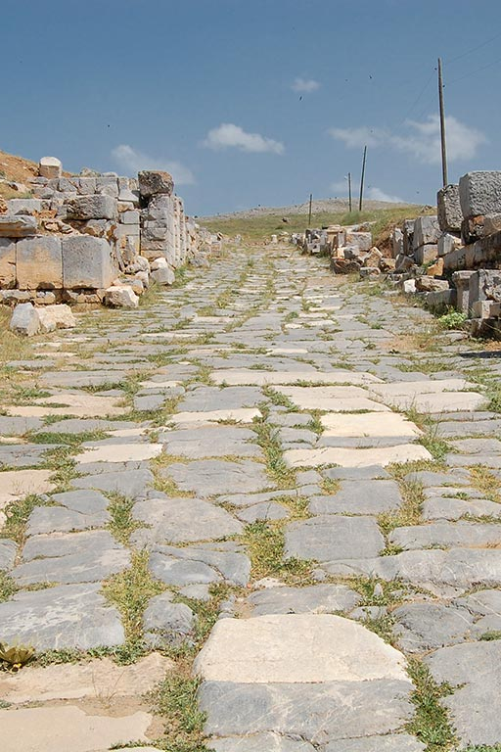
Conclusion
The account of Israel’s rejection and destruction gives us hope and warning:
It’s great news to know God is patient towards us.
The warning is that there is a limit as to how long He will wait!

Slide 27
Conclusion
Use the time you are given wisely: Repent and turn to God!

Slide 28
“What Must I Do To Be Saved?”
Hear The Gospel (Jn. 5:24; Rom. 10:17)
Believe In Christ (Jn. 3:16-18; Jn. 8:24)
Repent Of Sins (Lk. 13:3-5; Acts 2:38)
Confess Christ (Mt. 10:32; Rom. 10:10)
Be Baptized (Mk. 16:16; Acts 22:16)
Remain Faithful (Jn. 8:31; Rev. 2:10)
For The Erring Saint:
Repent (Acts 8:22), Confess (I Jn. 1:9),
Pray (Acts 8:22)

