Slide 1
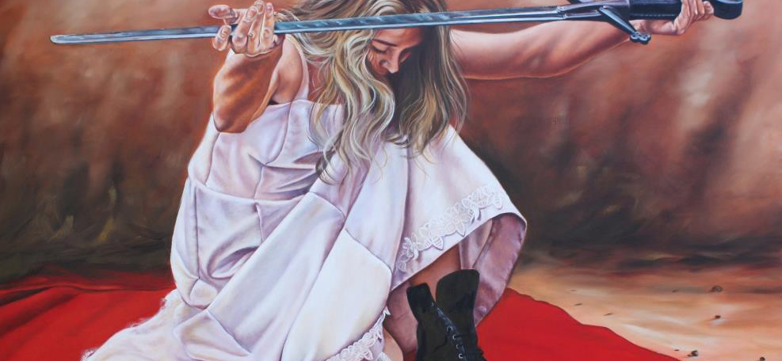
Ready For Jesus, Part 2
Text:
II Peter 3:12-18
Notes:
By Nathan L Morrison for Sunday 01/29/2023
All Scripture given is from NASB unless otherwise stated
For further study, or if questions, please Call: 804-277-1983 or Visit: www.courthousechurchofchrist.com

Slide 2
Intro
Jesus will come again! (John 14:1-6; II Peter 3:9-10)

Slide 3
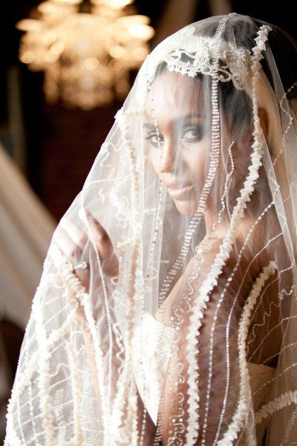
Intro
Matthew 25:1-13: Parable of the Ten virgins, 5 wise, 5 unwise
Revelation 19:7-8:
“Let us rejoice and be glad and give the glory to Him, for the marriage of the Lamb has come and His bride has made herself ready. It was given to her to clothe herself in fine linen, bright and clean; for the fine linen is the righteous acts of the saints.”
The church is depicted as a bride awaiting the arrival of the bridegroom
Notes:
Intro
Jesus came once to die for sin and promised to come again in judgment and reward
The church is depicted as a bride awaiting the arrival of the bridegroom (Mt. 25:1-13: Parable of the Ten Virgins; Rev. 19:7-8: “His bride has made herself ready; righteous acts of saints”)

Slide 4
Intro
In light of the return of Jesus and all that will take place, Peter makes a statement…
“What sort of people ought you to be…” (II Peter 3:11)
Notes:
Intro
Jesus came once to die for sin and promised to come again in judgment and reward
The church is depicted as a bride awaiting the arrival of the bridegroom (Mt. 25:1-13: Parable of the Ten Virgins; Rev. 19:7-8: “His bride has made herself ready; righteous acts of saints”)
In light of the Second Coming and all that will take place, Peter makes a statement…
A. II Peter 3:11: “What sort of people ought you to be…”
B. II Peter 3 sets forth at least ten characteristics of the “sort of people” we ought to be!

Slide 5
Conclusion
We studied the first five traits last time in Part 1
Sincere
Mindful
Informed
Holy
Godly

Slide 6
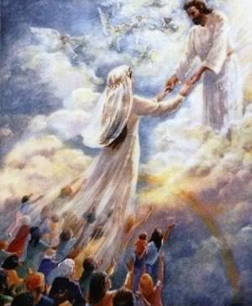
Intro
Our character should comprise these traits to be ready to meet the Lord when He comes again!

Slide 7
Looking (II Peter 3:12)
II Peter 3:12-13: looking for and hastening the coming of the day of God, because of which the heavens will be destroyed by burning, and the elements will melt with intense heat! But according to His promise we are looking for new heavens and a new earth, in which righteousness dwells.

Slide 8
Looking
Jesus urged His disciples to look for His return!
Matthew 24:35-38, 42; 25:1-13
Christ will bring eternal salvation to those who look for Him
Hebrews 9:28
Paul urged saints to watch for the Lord’s return
I Thess. 5:1-6; II Tim. 4:7-8
Notes:
Looking
II Peter 3:12-13: God’s people should be “looking for” the Lord’s return!
Titus 2:13: “…looking for the blessed hope and the appearing of the glory of our great God and Savior, Christ Jesus”
Jesus urged His disciples to look for His return! (Mt. 24:42; 25:13)
Mt. 24:35-36: Man will not know the day or hour.
Mt. 24:37-38: When He returns, many will be unprepared as in days of Noah!
Mt. 25:1-13: Some will be ready and others will not be ready! (Ten Virgins)
Christ will bring eternal salvation to those who look for Him:
Heb. 9:28: To those who “eagerly await Him” (“Look for” – KJV)
Those who look for Him also live for Him!
Paul urged saints to watch for the Lord’s return – I Thess. 5:1-6
Those looking for the Lord will love His appearing – II Tim. 4:7-8
Saints are to look for Christ’s return, being watchful and ready!

Slide 9
Looking (II Peter 3:12)
Diligent (II Peter 3:14)
II Peter 3:14: Therefore, beloved, since you look for these things, be diligent to be found by Him in peace, spotless and blameless

Slide 10
Diligent
Saints need diligence to apply virtuous character
II Peter 1:5-7
Those looking for the 2nd Coming of Christ will be diligent to be found by Him:
“In peace” (with God and other saints)
“Spotless”
“Blameless”
Notes:
Looking
Diligent
II Peter 3:14: God’s people should be “diligent” to be found spotless and blameless.
Gr. spoudazo (G4704): “to use speed, i.e. to make effort, be prompt or earnest: --do (give) diligence, be diligent, endeavor, labor, study.” (KJV: II Tim. 2:15)
Saints need diligence to apply virtuous character – II Peter 1:5-7: “Giving all diligence.”
Those looking for the 2nd Coming of Christ will be diligent to be found by Him:
“In peace” – II Peter 3:14
In peace with God – Rom. 5:1; Eph. 2:13-18
In peace with fellow Christians – I Thess. 5:13
“Spotless” – II Peter 3:14
Saints are to keep themselves “unstained” by the world – Js. 1:27
The church is to be found “spotless” and “blameless” – Eph. 5:26-27
“Blameless” – II Peter 3:14
Saints need to be diligent in “real knowledge” (Phil. 1:9-11) to be “sincere & blameless” (Phil. 2:15-16) when Christ returns!
Saints are to be diligent in obedience to Christ to be found ready when He comes again!

Slide 11
Looking (II Peter 3:12)
Diligent (II Peter 3:14)
Alert (II Peter 3:17)
II Peter 3:17: You therefore, beloved, knowing this beforehand, be on your guard so that you are not carried away by the error of unprincipled men and fall from your own steadfastness

Slide 12
Alert
Saints are to be Watchman, alert, sober, “on guard” for many things:
False prophets
Worldly philosophy (human wisdom)
The schemes of Satan
In prayer for God’s people
Christ’s Return (“Be on the alert!” – Mark 13:31-37)
Notes:
Looking
Diligent
Alert
II Peter 3:17: God’s people need to “be on your guard” (“Beware” – KJV).
Saints are to be Watchman, alert, sober, “on guard” for many things:
False prophets – Mt. 7:15; Eph. 4:14-16; II Tim. 4:3-5; II Peter 2:1
Worldly philosophy (human wisdom) – Col. 2:8
The schemes of Satan – II Cor. 2:11; Eph. 6:11; I Pet. 5:8
In prayer for God’s people – Eph. 6:18
Christ’s Return – Mark 13:31-37 (“Be on the alert!”)
Saints are God’s watchman so must be alert and “on guard” to save ourselves and others!

Slide 13
Looking (II Peter 3:12)
Diligent (II Peter 3:14)
Alert (II Peter 3:17)
Steadfast (II Peter 3:17)
II Peter 3:17: You therefore, beloved, knowing this beforehand, be on your guard so that you are not carried away by the error of unprincipled men and fall from your own steadfastness

Slide 14
Steadfast
I Cor. 15:58: Saints are to be “steadfast” in the work of the Lord!
I Cor. 16:13: Being alert plays a part in being “steadfast,” “firm in the faith”
I Pet. 5:8-9: Being alert to Satan and “firm in your faith” will enable one to resist him
Notes:
Looking
Diligent
Alert
Steadfast
II Peter 3:17: Saints are to be alert so as to not fall from one’s own “steadfastness.”
I Cor. 15:58: Saints are to be “steadfast” in the work of the Lord!
I Cor. 16:13: Being alert plays a part in being “steadfast,” “firm in the faith.”
I Pet. 5:8-9: Being alert to Satan and “firm in your faith” will enable one to resist him.
Saints must be “steadfast, immovable” when it comes to faith and work for the Lord!

Slide 15
Looking (II Peter 3:12)
Diligent (II Peter 3:14)
Alert (II Peter 3:17)
Steadfast (II Peter 3:17)
Growing (II Peter 3:18)
II Peter 3:18: but grow in the grace and knowledge of our Lord and Savior Jesus Christ. To Him be the glory, both now and to the day of eternity. Amen.

Slide 16
Growing
A child of God must also develop by growing in the knowledge of the Lord
Eph. 4:14-16
No substitute for knowing God’s word:
Rom. 10:1-3; Heb. 5:12-14; II Pet. 1:6
II Timothy 2:15
Notes:
Looking
Diligent
Alert
Steadfast
Growing
II Peter 3:18: Saints are to “grow” in knowledge of Christ, to be developing people! (A healthy child develops by growing, not only physically but also in knowledge.)
A child of God must also develop by growing in the knowledge of the Lord! (Eph. 4:14-16: No longer to be children but grow up into all aspects of Christ!)
Knowledge is the theme of II Peter:
In light of the coming judgment and return of the King (because He had judged the world before – II Peter 2), saints are to grow in God’s knowledge!
No substitute for knowing God’s word:
Rom. 10:1-3: Jews had zeal without knowledge and it did them no good.
Heb. 5:12-14: Must apply knowledge or will drift away (needed taught).
II Peter 1:6: Peter urged saints to diligently (1:5) add knowledge to their faith.
II Tim. 2:15: One must be diligent (G4704: KJV: “study”) in growing in God’s word to be able to accurately (rightly divide) the word of truth.
Saints are to grow in the knowledge of Christ and apply it to their lives!

Slide 17
Conclusion
Jesus will come again! (II Peter 3:8-10)

Slide 18
Conclusion
In light of the Lord’s 2nd Coming, what sort of people ought we to be?
Looking
Diligent
Alert
Steadfast
Growing

Slide 19
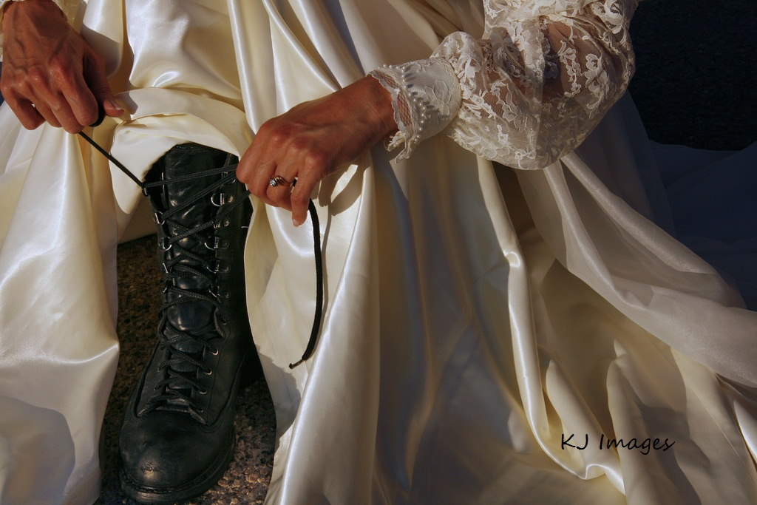
Conclusion
If Jesus were to come now, would He find us ready?

Slide 20
Conclusion
May we ever be diligent to be found by Him “spotless and blameless” and ready for His Return!

Slide 21
“What Must I Do To Be Saved?”
Hear The Gospel (Jn. 5:24; Rom. 10:17)
Believe In Christ (Jn. 3:16-18; Jn. 8:24)
Repent Of Sins (Lk. 13:3-5; Acts 2:38)
Confess Christ (Mt. 10:32; Rom. 10:10)
Be Baptized (Mk. 16:16; Acts 22:16)
Remain Faithful (Jn. 8:31; Rev. 2:10)
For The Erring Saint:
Repent (Acts 8:22), Confess (I Jn. 1:9),
Pray (Acts 8:22)

