Slide 1
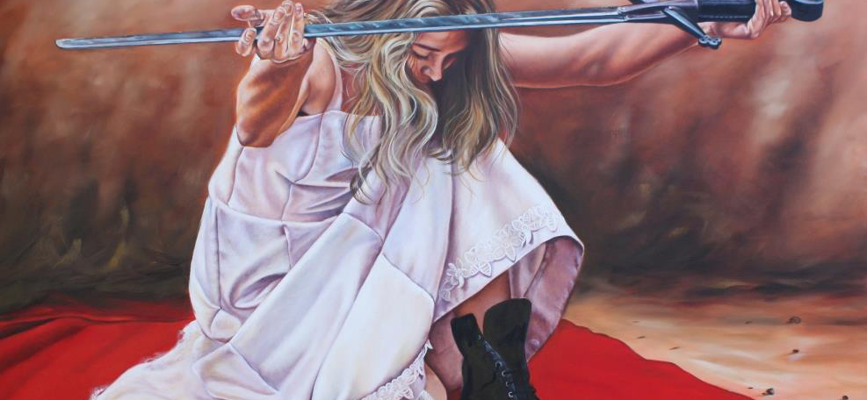
Ready For Jesus, Part 1
Text:
II Peter 3:1-11
Notes:
By Nathan L Morrison for Sunday 01/22/2023
All Scripture given is from NASB unless otherwise stated
For further study, or if questions, please Call: 804-277-1983 or Visit: www.courthousechurchofchrist.com

Slide 2
Intro
Jesus came once to die for sin and promised to come again in judgment and reward
John 14:1-6: Take His followers home
I Cor. 11:26: Lord’s Supper until He returns
I Thess. 4:13-18: Saints meet Him in the clouds
II Thess. 1:7-9: Return for judgment
Heb. 9:27-28: Return for salvation!
Rev. 1:7: Every eye will see Him
Notes:
Intro
Jesus came once to die for sin and promised to come again in judgment and reward:
Jn. 14:1-6: He will return to take His followers home (Heaven).
I Cor. 11:26: We partake of the Lord’s Supper until He comes again.
I Thess. 4:13-18: He will gather the saints to Him in the clouds.
II Thess. 1:7-9: He will return for judgment.
Heb. 9:27-28: Man dies once and then the judgment – Jesus will return for salvation!
Rev. 1:7: When He returns in the clouds, every eye will see Him.

Slide 3
Intro
Matthew 25:1-13: Parable of the Ten virgins, 5 wise, 5 unwise
Revelation 19:7-8:
“Let us rejoice and be glad and give the glory to Him, for the marriage of the Lamb has come and His bride has made herself ready. It was given to her to clothe herself in fine linen, bright and clean; for the fine linen is the righteous acts of the saints.”
The church is depicted as a bride awaiting the arrival of the bridegroom
Notes:
Intro
Jesus came once to die for sin and promised to come again in judgment and reward
The church is depicted as a bride awaiting the arrival of the bridegroom (Mt. 25:1-13: Parable of the Ten Virgins; Rev. 19:7-8: “His bride has made herself ready; righteous acts of saints”)

Slide 4
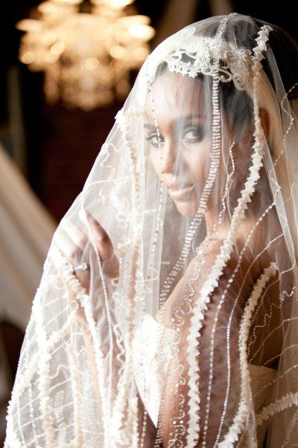
Intro
II Peter 3:9: The Lord is not slow about His promises (from 3:4).
II Peter 3:10: The day of the Lord will come as a “thief in the night.”
II Peter 3:10-11: The earth and its works will be “burned up.”
II Peter 3:11: “What sort of people ought you to be…”
Peter devoted time to discussing Christ’s Second Coming
Notes:
Intro
Jesus came once to die for sin and promised to come again in judgment and reward
The church is depicted as a bride awaiting the arrival of the bridegroom (Mt. 25:1-13: Parable of the Ten Virgins; Rev. 19:7-8: “His bride has made herself ready; righteous acts of saints”)
Peter devoted time to discussing Christ’s Second Coming:
A. II Peter 3:9: The Lord is not slow about His promises (from 3:4).
B. II Peter 3:10: The day of the Lord will come as a “thief in the night.”
C. II Peter 3:10-11: The earth and its works will be “burned up.”
In light of the Second Coming and all that will take place, Peter makes a statement…
A. II Peter 3:11: “What sort of people ought you to be…”
B. II Peter 3 sets forth at least ten characteristics of the “sort of people” we ought to be!

Slide 5
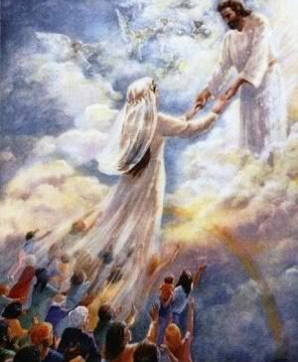
Intro
Our character should comprise these traits to be ready to meet the Lord when He comes again!

Slide 6
Sincere (II Peter 3:1)
II Peter 3:1: This is now, beloved, the second letter I am writing to you in which I am stirring up your sincere mind by way of reminder

Slide 7
Sincere
Men live in sin because of selfish or impure minds
I Tim. 6:3-5; Eph. 4:17-19
Saints must have “sincere” (pure) minds
Mt. 22:37-38; Phil. 4:8; Heb. 10:19-22; Col. 3:9 (Eph. 4:15, 25)
Saints are to have the “mind” of Christ
Phil. 2:5, 15-16
Notes:
Sincere
II Peter 3:1: God’s people should possess “sincere” (NKJ: “pure”) minds.
Men live in sin because of selfish or impure minds:
I Tim. 6:3-5: False teachers have a “depraved mind and deprived of the truth.”
Eph. 4:17-19: Men practice “every kind of impurity with greediness.”
Saints must have “sincere” (pure) minds:
Mt. 22:37-38: Christ said we are to love God with all our minds.
Phil. 4:8: Our minds are to be occupied with honorable, right, pure things!
Heb. 10:19-22: We draw near with a “sincere heart in full assurance of faith.”
Col. 3:9: “Do not lie to one another” – Speak the truth in love (Eph. 4:15, 25)
Saints are to have the “mind” of Christ (NKJ), or the “attitude” of Christ (NAS)
Phil. 2:5: “Have this attitude in yourselves which was also in Christ Jesus.”
Phil. 2:15-16: Obedience to God (like Christ) will prove us “to be blameless and innocent, children of God above reproach…”
Saints are to have “sincere minds!”

Slide 8
Sincere (II Peter 3:1)
Mindful (II Peter 3:2)
II Peter 3:2: that you should remember the words spoken beforehand by the holy prophets and the commandment of the Lord and Savior spoken by your apostles

Slide 9
Mindful
Saints should be reminded so that they don’t forget certain things
Psalm 1:2: word of God
II Peter 3:2: Prophets, Apostles
II Peter 1:9: Purification from sin
Notes:
Sincere
Mindful
II Peter 3:2: Saints should be “mindful” (NKJ) and remember (NAS) the word of God!
Saints should be reminded so that they don’t forget certain things:
Psalm 1:2: The faithful should “delight” and “meditate” on the word of God!
II Peter 3:2: Remember (NAS) the word of God by holy prophets.
The prophets spoke as inspired by the Holy Spirit – II Peter 1:20-21
Prophesies confirm the Deity of Christ – Acts 2:32-36; 17:2-3
The life of Christ confirmed O.T. prophecy – II Peter 1:16-19
II Peter 3:2: Remember the “commandment of the Lord” spoken by apostles!
The apostles are the “Ambassadors” of Christ – II Cor. 5:20
They were guided “into all the truth” – Jn. 16:13
They were given authority to “bind and loose” – Mt. 16:19; 18:18
II Peter 1:9: Saints must not forget their purification from sin (blood of Christ).
Saints are to be “mindful” of (to remember) the “commands” of God!

Slide 10
Sincere (II Peter 3:1)
Mindful (II Peter 3:2)
Informed (II Peter 3:5, 8)
II Peter 3:5-8: There are some people that “willfully forget” (NKJ) the things of God (Romans 10:1-3)

Slide 11
Informed
Saints are to be informed - - not to forget:
Danger of false teachers – II Peter 2:1-19
Temporal nature of material things – II Peter 3:10-12
2nd Coming of Christ – II Peter 3:8-10
Judgment and eternal separation – II Peter 3:7; Matthew 25
Notes:
Sincere
Mindful
Informed
II Peter 3:5, 8: There are some that “willfully forget” (NKJ) the things of God.
Rom. 10:1-3: Zeal without knowledge is not acceptable.
Saints are to be informed, and not to forget (not to “escape your notice” – NAS).
Must be informed of the danger of false teachers – II Peter 2:1-19
Must be informed of the temporal nature of material things – II Peter 3:10-12
Must be informed of the Second Coming of Christ – II Peter 3:8-10
Must be informed about judgment and eternal separation – II Peter 3:7; Mt. 25
Saints study God’s word so that they might be informed and teach others!

Slide 12
Sincere (II Peter 3:1)
Mindful (II Peter 3:2)
Informed (II Peter 3:5, 8)
Holy (II Peter 3:11)
II Peter 3:11: Since all these things are to be destroyed in this way, what sort of people ought you to be in holy conduct and godliness

Slide 13
Holy
Saints are to be holy in the way we live
I Peter 2:9
Holiness: Sacred, set apart
Saints are:
“Set apart” to God, separated from the world – Rom. 12:1-2; II Cor. 6:14-18
A “people for His own possession” – Titus 2:14
Notes:
Sincere
Mindful
Informed
Holy
II Peter 3:11: Being informed of the destruction of the world, “what sort of people” we ought to be is holy!
Saints are to be holy in the way we live – I Pet. 1:14-16 (Give up former way of life)
I Pet. 2:9: Saints are a “royal priesthood, a holy nation.”
What is “holiness?”
Gr. hagios [hag'-ee-os ] (G40): sacred (physically, pure, morally blameless or religious, ceremonially, consecrated): -- (most) holy (one, thing), saint.
Sacred or sanctified is “to set apart” (for a specific use).
Saints are:
“Set apart” to God, separated from the world – Rom. 12:1-2; II Cor. 6:14-18
A “people for His own possession, zealous for good deeds” – Titus 2:14
In light of the 2nd Coming, saints will “keep oneself unstained by the world!” (Js. 1:27)

Slide 14
Sincere (II Peter 3:1)
Mindful (II Peter 3:2)
Informed (II Peter 3:5, 8)
Holy (II Peter 3:11)
Godly (II Peter 3:11)
II Peter 3:11: Since all these things are to be destroyed in this way, what sort of people ought you to be in holy conduct and godliness

Slide 15
Godly
“Godliness” is the opposite of doing what is right in our own eyes
II Peter 1:4; 2:5-6
“Godliness” is based on God’s word:
II Peter 1:3; Titus 1:1; I Timothy 6:6, 11
“Godliness” leads to the life to come
I Timothy 4:7-8
Titus 2:12-13
Notes:
Sincere
Mindful
Informed
Holy
Godly
II Peter 3:11: The 2nd Coming should cause one to live godly in all things!
“Godliness” is the opposite of doing what is right in our own eyes.
II Peter 1:4: The “corruption” in the world through lust.
II Peter 2:5-6: People in Noah’s day and in Sodom & Gomorrah were ungodly!
“Godliness” must be based on knowledge of God’s word – II Peter 1:3; Titus 1:1
The pursuit of material wealth can bring ruin – I Tim. 6:6-10
Child of God should pursue godliness and contentment – I Tim. 6:6, 11
“Godliness” is profitable in this present life and leads to the life to come – I Tim. 4:7-8
Titus 2:12-13: We are to deny “ungodliness” and live righteously and godly, so that we may look for the blessed hope of the appearing of Christ! (Preview of what comes next in the list in II Peter 3!)
By living godly lives now, the saint remains above reproach and has the hope of Heaven!

Slide 16
Conclusion
Jesus will come again! (II Peter 3:8-10)

Slide 17
Conclusion
In light of the Lord’s 2nd Coming, what sort of people ought we to be?
Sincere
Mindful
Informed
Holy
Godly

Slide 18
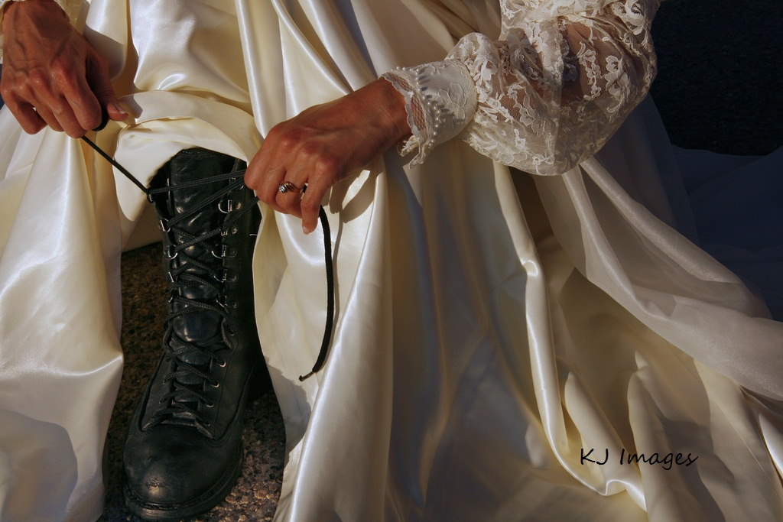
Conclusion
If Jesus were to come now, would He find us ready?
Let us pursue these things that will lead to an eternal life with Jesus Christ our Lord!

Slide 19
Conclusion
May we be found ready for Jesus Christ’s Return!

Slide 20
“What Must I Do To Be Saved?”
Hear The Gospel (Jn. 5:24; Rom. 10:17)
Believe In Christ (Jn. 3:16-18; Jn. 8:24)
Repent Of Sins (Lk. 13:3-5; Acts 2:38)
Confess Christ (Mt. 10:32; Rom. 10:10)
Be Baptized (Mk. 16:16; Acts 22:16)
Remain Faithful (Jn. 8:31; Rev. 2:10)
For The Erring Saint:
Repent (Acts 8:22), Confess (I Jn. 1:9),
Pray (Acts 8:22)

