Slide 1
Phoebe: Heart Of A Servant
Text:
Romans 16:1-2
Notes:
By Nathan L Morrison for Sunday 01/15/2023
All Scripture given is from NASB unless otherwise stated
For further study, or if questions, please Call: 804-277-1983 or Visit: www.courthousechurchofchrist.com

Slide 2
Romans 16:1-2
Intro
1. I commend to you our sister Phoebe, who is a servant of the church which is at Cenchrea;
2. that you receive her in the Lord in a manner worthy of the saints, and that you help her in whatever matter she may have need of you; for she herself has also been a helper of many, and of myself as well.
Notes:
Emphasis in Scripture Mine

Slide 3
Sister: Romans 16:1: “I commend to you our sister Phoebe…”
“When you read this letter, treat this woman just as you would treat me”
Sister (Mark 3:35; 10:28-30)
Family: brothers and sisters (I Cor. 7:15; Philemon 1:2; James 2:15)
Notes:
Sister
Romans 16:1: “I commend to you our sister Phoebe….”
The word “commend” (G4921 sunistaō sunistanō sunistēmi) means that Paul is standing beside her. It is a compound Greek word for introduction, commendation.
Paul is letting her borrow his reputation, saying, “When you read this letter, treat this woman just as you would treat me.”
It is believed by many that she was entrusted to bring the letter of Romans to Rome from Corinth, or at the very least accompanied those who did.
But the most significant part of this is that Paul refers to this woman as a “sister.” What a wonderful description!
Mk. 3:35; 10:28-30:
Jesus promised that His followers would have brothers and sisters (family) the world over.
When we obey the gospel, we are born into a spiritual family—a family so large that it literally covers the earth. Wherever we go, if we look, we can find brothers and sisters in the Lord! What a blessing!
Romans 16:1: Here Paul introduces Phoebe to the saints in Rome as their “sister.”
II Cor. 5:16: “Therefore from now on we recognize no one according to the flesh….”
The greatest way that we can describe our relationship as Christians is through the use of the words “brother” and “sister.” That’s it!
I Cor. 7:15 (Saints referred to as brother and sister); Philemon 1:2 (Apphia our sister); James 2:15 (Saints referred to as brother and sister).
When it comes to our Christian family, we are brothers and sisters in the Lord!
There is no greater honor in this life than being described as a brother or sister in the family of God!

Slide 4
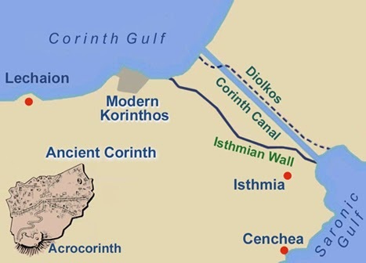
Sister
There is no greater honor in this life than being described as a brother or sister in the family of God!

Slide 5
Servant: Romans 16:1: “…who is a servant of the church which is at Cenchrea”
Cenchrea, the E. Harbor of Corinth on the Isthmus
Servant (G1249)
Attendant, waiter of tables, minister, deacon
Was Phoebe a deacon?
Notes:
Sister
Servant
Romans 16:1: “…who is a servant of the church which is at Cenchrea.”
Cenchrea was a port city approx. 6 miles east of Corinth.
Cenchrea comes from the Greek word for “the millet,” a grain that abounded there.
The city of Corinth was built on an isthmus.
An isthmus is a narrow strip of land with sea on either side, forming a link between two larger areas of land.
The isthmus at Corinth was several miles across, and Cenchrea was the port city on the east side of the isthmus. This is where the Isthmian Games were held, and probably to what Paul referred to in I Cor. 9:24-27.
Acts 18:18: On his 2nd Missionary Journey, Paul set sail to Syria from Cenchrea, after having his head shaved to fulfill a vow. So Cenchrea was the only city where we know for sure that Paul got a haircut!
Romans 16:1: Paul referred to Phoebe as a “servant of the church.” What a great honor!
She was not just a member of the church. She was not someone who just came on Sunday morning and sat there for an hour or two, but she was a “servant of the church.” Phoebe was a woman who did stuff! She was active in her Christian faith!
The word used here of Phoebe as a “servant” has caused many over the centuries to describe her as a “deaconess” and use her as an example to place women in such offices and for women to hold such titles.
“Servant” = diakonos (G1249): “an attendant, a waiter (at table or in other menial duties); specifically, a Christian teacher and deacon: - deacon, minister, servant.
Did Phoebe hold the office of deaconess, or was she simply a “servant” as all saints and Christians are called to be?
To come to an answer to this question, we need to understand that the word for servant is used all throughout the N.T. without referring to the “office” of “deacon.”
There are 3 major translations that refer to Phoebe as being a “deaconess”: the ISV, RSV and the NIV (2010).
Some refer to her as a “deacon” since diakonos is a male noun (GW, NLT, NRSV, TNIV).
A few refer to her as a “minister” (Bishop’s, Darby, DRB, YLT)
It is commonly used throughout the N.T. for “servants” (Mt. 20:26; Jn. 2:5; 12:26; II Cor. 6:4; 11:15) and for “minister” (Gal. 2:17; Eph. 3:7; 6:21; Col. 1:23).
Only three places the word diakonos is used to refer to the office of Deacons: Phil. 1:1; I Tim. 3:8, 12, where the qualifications is for men (Incl. having only one wife).
The better translation is “servant,” which is in keeping with the rest of Scripture:
I Cor. 14:34-35 & I Tim. 2:8-15: Women are not to hold public roles of leadership.
We need not think of her as belonging to the office of “deacon.” Any sister who serves in connection with a local assembly can be a “servant.”
There are lots of other ways a woman can be a servant of the Lord in the congregation. (Helpers: The Role Of Godly Women In The Church… http://www.courthousechurchofchrist.com/sermons/sermons/2022/09/18/helpers-the-role-of-godly-women-in-the-church )
NO, Phoebe was not a “deaconess” – for if she was, where are the qualifications?
Romans 16:1-2:
Paul is simply recommending this woman and he describes her as being a “servant” of the Lord’s church.
In verse 2, she was also a servant to Paul personally—she is described as being, “…a helper of many, and of myself as well.” Like Prisca and Aquila – Romans 16:4
The Gr. Word for “helper” means “benefactor” so it is thought she was wealthy.
Phoebe, therefore, is referred to by Paul as being a sister and a servant!

Slide 6
A Servant
Diakonos (G1249):
All Christians (John 12:26)
Deacons (Phil. 1:1; I Tim. 3:8, 12)
Married men with one wife & children
Notes:
A Servant
Did Phoebe hold the office of deaconess, or was she simply a “servant” as all saints and Christians are called to be?
To come to an answer to this question, we need to understand that the word for servant is used all throughout the N.T. without referring to the “office” of “deacon.”
There are 3 major translations that refer to Phoebe as being a “deaconess”: the ISV, RSV and the NIV (2010).
Some refer to her as a “deacon” since diakonos is a male noun (GW, NLT, NRSV, TNIV).
A few refer to her as a “minister” (Bishop’s, Darby, DRB, YLT)
It is commonly used throughout the N.T. for “servants” (Mt. 20:26; Jn. 2:5; 12:26; II Cor. 6:4; 11:15) and for “minister” (Gal. 2:17; Eph. 3:7; 6:21; Col. 1:23).
Only three places the word diakonos is used to refer to the office of Deacons: Phil. 1:1; I Tim. 3:8, 12, where the qualifications is for men (Incl. having only one wife).
The better translation is “servant,” which is in keeping with the rest of Scripture:
I Cor. 14:34-35 & I Tim. 2:8-15: Women are not to hold public roles of leadership.
We need not think of her as belonging to the office of “deacon.” Any sister who serves in connection with a local assembly can be a “servant.”
There are lots of other ways a woman can be a servant of the Lord in the congregation. (Helpers: The Role Of Godly Women In The Church… http://www.courthousechurchofchrist.com/sermons/sermons/2022/09/18/helpers-the-role-of-godly-women-in-the-church )
NO, Phoebe was not a “deaconess” – for if she was, where are the qualifications?

Slide 7
A Servant
Servant, the better translation
I Cor. 14:34-35 & I Tim. 2:8-15
Women are not to hold public roles of leadership
NO, Phoebe was not a “deaconess” (if she was, where are the qualifications?)
Notes:
A Servant
Did Phoebe hold the office of deaconess, or was she simply a “servant” as all saints and Christians are called to be?
To come to an answer to this question, we need to understand that the word for servant is used all throughout the N.T. without referring to the “office” of “deacon.”
There are 3 major translations that refer to Phoebe as being a “deaconess”: the ISV, RSV and the NIV (2010).
Some refer to her as a “deacon” since diakonos is a male noun (GW, NLT, NRSV, TNIV).
A few refer to her as a “minister” (Bishop’s, Darby, DRB, YLT)
It is commonly used throughout the N.T. for “servants” (Mt. 20:26; Jn. 2:5; 12:26; II Cor. 6:4; 11:15) and for “minister” (Gal. 2:17; Eph. 3:7; 6:21; Col. 1:23).
Only three places the word diakonos is used to refer to the office of Deacons: Phil. 1:1; I Tim. 3:8, 12, where the qualifications is for men (Incl. having only one wife).
The better translation is “servant,” which is in keeping with the rest of Scripture:
I Cor. 14:34-35 & I Tim. 2:8-15: Women are not to hold public roles of leadership.
We need not think of her as belonging to the office of “deacon.” Any sister who serves in connection with a local assembly can be a “servant.”
There are lots of other ways a woman can be a servant of the Lord in the congregation. (Helpers: The Role Of Godly Women In The Church… http://www.courthousechurchofchrist.com/sermons/sermons/2022/09/18/helpers-the-role-of-godly-women-in-the-church )
NO, Phoebe was not a “deaconess” – for if she was, where are the qualifications?

Slide 8
Servant: Romans 16:1: “…who is a servant of the church which is at Cenchrea”
Romans 16:1-2
Paul describes her as being a “servant” of the Lord’s church.
She was also a servant to Paul personally, “a helper of many, and of myself as well”
Notes:
Sister
Servant
Romans 16:1: “…who is a servant of the church which is at Cenchrea.”
Cenchrea was a port city approx. 6 miles east of Corinth.
Cenchrea comes from the Greek word for “the millet,” a grain that abounded there.
The city of Corinth was built on an isthmus.
An isthmus is a narrow strip of land with sea on either side, forming a link between two larger areas of land.
The isthmus at Corinth was several miles across, and Cenchrea was the port city on the east side of the isthmus. This is where the Isthmian Games were held, and probably to what Paul referred to in I Cor. 9:24-27.
Acts 18:18: On his 2nd Missionary Journey, Paul set sail to Syria from Cenchrea, after having his head shaved to fulfill a vow. So Cenchrea was the only city where we know for sure that Paul got a haircut!
Romans 16:1: Paul referred to Phoebe as a “servant of the church.” What a great honor!
She was not just a member of the church. She was not someone who just came on Sunday morning and sat there for an hour or two, but she was a “servant of the church.” Phoebe was a woman who did stuff! She was active in her Christian faith!
The word used here of Phoebe as a “servant” has caused many over the centuries to describe her as a “deaconess” and use her as an example to place women in such offices and for women to hold such titles.
“Servant” = diakonos (G1249): “an attendant, a waiter (at table or in other menial duties); specifically, a Christian teacher and deacon: - deacon, minister, servant.
Did Phoebe hold the office of deaconess, or was she simply a “servant” as all saints and Christians are called to be?
To come to an answer to this question, we need to understand that the word for servant is used all throughout the N.T. without referring to the “office” of “deacon.”
There are 3 major translations that refer to Phoebe as being a “deaconess”: the ISV, RSV and the NIV (2010).
Some refer to her as a “deacon” since diakonos is a male noun (GW, NLT, NRSV, TNIV).
A few refer to her as a “minister” (Bishop’s, Darby, DRB, YLT)
It is commonly used throughout the N.T. for “servants” (Mt. 20:26; Jn. 2:5; 12:26; II Cor. 6:4; 11:15) and for “minister” (Gal. 2:17; Eph. 3:7; 6:21; Col. 1:23).
Only three places the word diakonos is used to refer to the office of Deacons: Phil. 1:1; I Tim. 3:8, 12, where the qualifications is for men (Incl. having only one wife).
The better translation is “servant,” which is in keeping with the rest of Scripture:
I Cor. 14:34-35 & I Tim. 2:8-15: Women are not to hold public roles of leadership.
We need not think of her as belonging to the office of “deacon.” Any sister who serves in connection with a local assembly can be a “servant.”
There are lots of other ways a woman can be a servant of the Lord in the congregation. (Helpers: The Role Of Godly Women In The Church… http://www.courthousechurchofchrist.com/sermons/sermons/2022/09/18/helpers-the-role-of-godly-women-in-the-church )
NO, Phoebe was not a “deaconess” – for if she was, where are the qualifications?
Romans 16:1-2:
Paul is simply recommending this woman and he describes her as being a “servant” of the Lord’s church.
In verse 2, she was also a servant to Paul personally—she is described as being, “…a helper of many, and of myself as well.” Like Prisca and Aquila – Romans 16:4
The Gr. Word for “helper” means “benefactor” so it is thought she was wealthy.
Phoebe, therefore, is referred to by Paul as being a sister and a servant!

Slide 9
Servant
Phoebe is referred to by Paul as being a sister and a servant!

Slide 10
Saint: Romans 16:2: “…receive her in the Lord in a manner worthy of the saints”
Dangerous to travel 850 miles from Corinth to Rome
Paul recommended her to the Roman saints
She may have been going on business (KJV/NKJV)
John wrote on aiding visitors
Notes:
Sister
Servant
Saint
Romans 16:2: Paul urges the church in Rome, “…receive her in the Lord in a manner worthy of the saints, and that you help her in whatever matter she may have need of you.”
We can only imagine that it would have been rather dangerous for a single woman to travel those 850 miles from Corinth to Rome (if she did travel alone), and so Paul is sending her with a letter of recommendation, so to speak.
Before the days of Holiday Inn or Motel 6, people had to rely on the hospitality of friends and relatives along the way. Paul, therefore, was arranging for Phoebe to be cared for upon her arrival in the city of Rome.
She may have been traveling on business!
Her “matter” may have been business related – Gr. Word for business (KJV/NKJV.
John wrote a short letter that addresses this custom and gives us some information on how the process worked:
III John 5-8: “Beloved, you are acting faithfully in whatever you accomplish for the brethren, and especially when they are strangers; and they have testified to your love before the church. You will do well to send them on their way in a manner worthy of God. For they went out for the sake of the Name, accepting nothing from the Gentiles. Therefore we ought to support such men, so that we may be fellow workers with the truth.”
He encouraged the early Christians to care for those who are traveling.
Paul commended Phoebe to the church in Rome and told them to treat her, “…in a manner worthy of the saints.”
The word saint refers to someone or something that has been set aside for some special purpose.
As Christians, we have been set aside; we have been called out of the world as people who are special to God. We are unique. We are different from the world!
When someone has been buried with Christ in baptism, that person has been “set apart” in the eyes of God (Gal. 3:27-28). That person is a saint and heir of promise to Abraham! (Gal. 3:29)
Paul said she was worthy and that as a servant she had helped many, including him, and so asked the church at Rome to help her in any way she needed!
Paul told the church in Rome to receive Phoebe, “our sister… servant of the church which is at Cenchrea…in a manner worthy of the saints!”

Slide 11
III John 5-8
Saint
5. Beloved, you are acting faithfully in whatever you accomplish for the brethren, and especially when they are strangers;
6. and they have testified to your love before the church. You will do well to send them on their way in a manner worthy of God.
7. For they went out for the sake of the Name, accepting nothing from the Gentiles.
8. Therefore we ought to support such men, so that we may be fellow workers with the truth.
Notes:
Emphasis in Scripture Mine

Slide 12
Saint: Romans 16:2: “…receive her in the Lord in a manner worthy of the saints”
Saint refers to someone or something that has been set aside for some special purpose, holy
Christians are set aside for God, special purpose
Gal. 3:27-29
Notes:
Sister
Servant
Saint
Romans 16:2: Paul urges the church in Rome, “…receive her in the Lord in a manner worthy of the saints, and that you help her in whatever matter she may have need of you.”
We can only imagine that it would have been rather dangerous for a single woman to travel those 850 miles from Corinth to Rome (if she did travel alone), and so Paul is sending her with a letter of recommendation, so to speak.
Before the days of Holiday Inn or Motel 6, people had to rely on the hospitality of friends and relatives along the way. Paul, therefore, was arranging for Phoebe to be cared for upon her arrival in the city of Rome.
She may have been traveling on business!
Her “matter” may have been business related – Gr. Word for business (KJV/NKJV.
John wrote a short letter that addresses this custom and gives us some information on how the process worked:
III John 5-8: “Beloved, you are acting faithfully in whatever you accomplish for the brethren, and especially when they are strangers; and they have testified to your love before the church. You will do well to send them on their way in a manner worthy of God. For they went out for the sake of the Name, accepting nothing from the Gentiles. Therefore we ought to support such men, so that we may be fellow workers with the truth.”
He encouraged the early Christians to care for those who are traveling.
Paul commended Phoebe to the church in Rome and told them to treat her, “…in a manner worthy of the saints.”
The word saint refers to someone or something that has been set aside for some special purpose.
As Christians, we have been set aside; we have been called out of the world as people who are special to God. We are unique. We are different from the world!
When someone has been buried with Christ in baptism, that person has been “set apart” in the eyes of God (Gal. 3:27-28). That person is a saint and heir of promise to Abraham! (Gal. 3:29)
Paul said she was worthy and that as a servant she had helped many, including him, and so asked the church at Rome to help her in any way she needed!
Paul told the church in Rome to receive Phoebe, “our sister… servant of the church which is at Cenchrea…in a manner worthy of the saints!”

Slide 13
Saint
Paul told the church in Rome to receive Phoebe, “our sister… servant of the church which is at Cenchrea…in a manner worthy of the saints!”

Slide 14
Conclusion
We have learned of Phoebe:
Phoebe was a sister—she was an important part of God’s family
Phoebe was a servant—she used her God-given abilities to serve the church and to personally help the apostle Paul & others
Phoebe was a saint—she was set apart for a special purpose, and she was fulfilling that purpose in her life

Slide 15
Conclusion
We have learned of Paul:
Paul valued people
Paul expressed gratitude for those who had helped! (Rom. 16)

Slide 16
Conclusion
We have learned that a congregation of God’s people:
We need to receive godly women, as Paul instructed the church in Rome to receive Phoebe
Women have their glorious and exalted place by God's appointment, fellow heirs of the grace of life (Rom. 8:16-17; I Pet. 3:7)
Receive godly women with thanksgiving and encourage them in their faithful labors

Slide 17
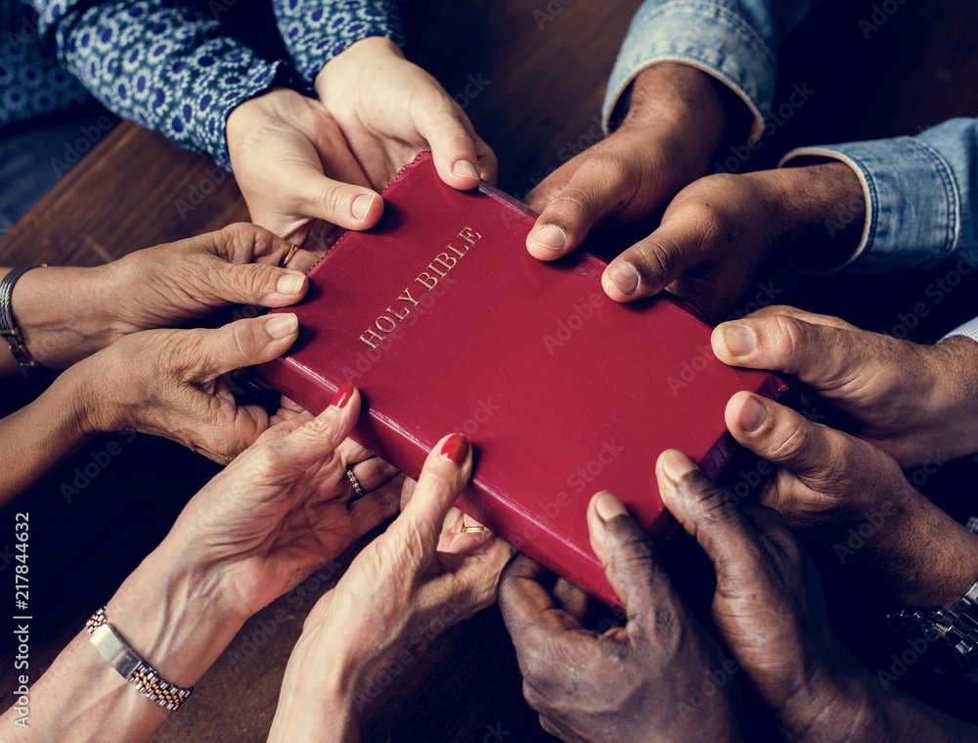
Conclusion
Being a servant to one another is important to God (Matthew 25:34-40) – Let us have a heart to serve as Phoebe did!

Slide 18
“What Must I Do To Be Saved?”
Hear The Gospel (Jn. 5:24; Rom. 10:17)
Believe In Christ (Jn. 3:16-18; Jn. 8:24)
Repent Of Sins (Lk. 13:3-5; Acts 2:38)
Confess Christ (Mt. 10:32; Rom. 10:10)
Be Baptized (Mk. 16:16; Acts 22:16)
Remain Faithful (Jn. 8:31; Rev. 2:10)
For The Erring Saint:
Repent (Acts 8:22), Confess (I Jn. 1:9),
Pray (Acts 8:22)

