Slide 1
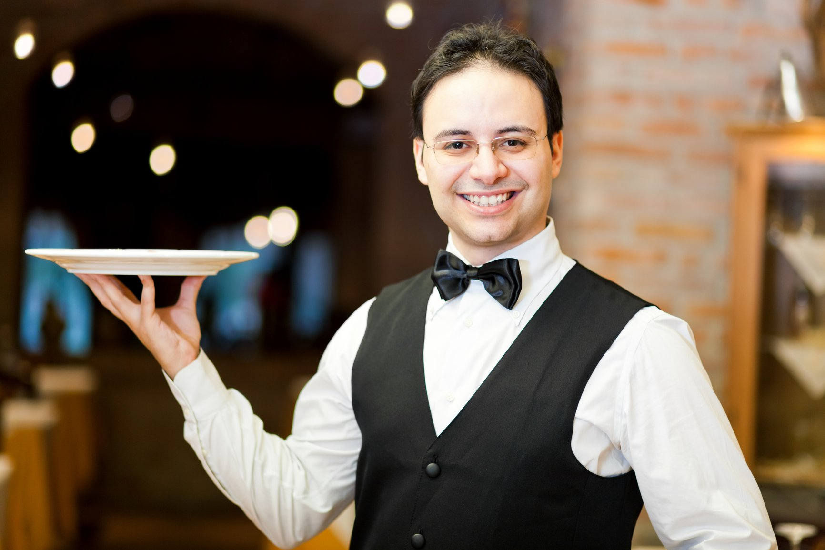
The Greatest In The Kingdom
Text:
I Timothy 3:8-13
Notes:
By Nathan L Morrison for Sunday 01/08/2023
All Scripture given is from NASB unless otherwise stated
For further study, or if questions, please Call: 804-277-1983 or Visit: www.courthousechurchofchrist.com

Slide 2
INTRO
What do these have in common?
Job
Abraham
Isaac
Jacob
Moses
David
Nebuchadnezzar
Angels
Paul
Phoebe
Government
All referred to as servants of God!

Slide 3
Intro
All referred to as servants of God!
Job (Job 1:8; 2:3)
Abraham (Genesis 26:24; Psalm 105:6)
Isaac (Genesis 24:12-13)
Jacob (Isaiah 45:4)
Moses (Numbers 12:7-8; “the servant of the Lord” 16 times in the book of Joshua)
David (I Chronicles 17:4-7)
Nebuchadnezzar (Jeremiah 25:9; 27:6; 43:10)
Angels (Daniel 7:10; Hebrews 1:7; Revelation 22:9)
Paul (Romans 1:1; Titus 1:1; Colossians 1:25)
Phoebe (Romans 16:1)
Government (Romans 13:1-4)
Notes:
All referred to as servants of God!
Job (Job 1:8; 2:3)
Abraham (Genesis 26:24; Psalm 105:6)
Isaac (Genesis 24:12-13)
Jacob (Isaiah 45:4)
Moses (Numbers 12:7-8; Moses is called “the servant of the Lord” 16 times in the book of Joshua)
David (I Chronicles 17:4-7)
Nebuchadnezzar (Jeremiah 25:9; 27:6; 43:10)
Angels (Daniel 7:10; Hebrews 1:7; Revelation 22:9)
Paul (Romans 1:1; Titus 1:1; Colossians 1:25; and the apostles in II Corinthians 6:4)
Phoebe (Romans 16:1)
Government (Romans 13:1-4: NASB uses “minister” = servant, as in diakanos G1249)

Slide 4
INTRO
When we think of servants we don’t often think of greatness!

Slide 5
Intro
Matthew 20:25-28
25. But Jesus called them to Himself and said, "You know that the rulers of the Gentiles lord it over them, and their great men exercise authority over them.
26. "It is not this way among you, but whoever wishes to become great among you shall be your servant,
27. and whoever wishes to be first among you shall be your slave;
28. just as the Son of Man did not come to be served, but to serve, and to give His life a ransom for many."
Notes:
When we think of servants we don’t often think of service being related to greatness.
COVID-19 taught us that those in service are very important! Long wait times at restaurants, shorter hours because staff is lacking all caused greater appreciation!
Jesus made this a noble skill
Matthew 20:20-28: Jesus said, “Whoever wishes to become great among you shall be your servant.”
Matthew 20:26-28: He summed it up: “…the Son of Man did not come to be served, but to serve, and to give His life a ransom for many.”
John 13:12-17: Jesus washed the apostles’ feet (13:1-11) and then told them that He as “Lord and the Teacher” washed their feet as an example for them to do for each other.

Slide 6
Intro
Jesus made the point that even though human wisdom says a servant is not great, one who is a servant to God and to each other IS great in His kingdom!

Slide 7
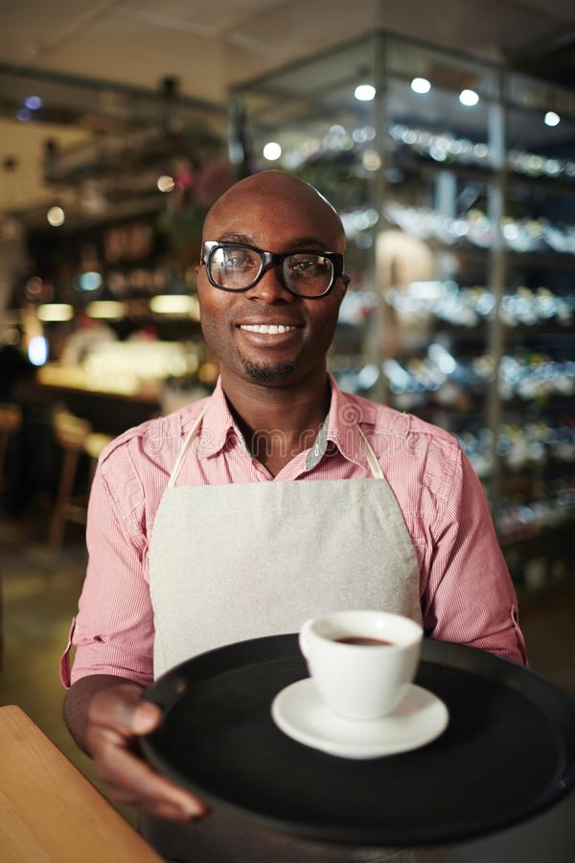
A Servant
Diakonos (G1249: an attendant, a waiter; one who waits on tables; a minister)
All Christians (John 12:26)
Acts 6:1-6
Notes:
A Servant
One of the words for servant that is oftentimes translated as minister is diakonos (G1249: an attendant, a waiter; one who waits on tables; a minister)
This Greek word is found in the NT 29 times, once in feminine form in Rom. 16:1 of Phoebe.
Jesus used this word and said, “If anyone serves Me, he must follow Me; and where I am, there My servant will be also; if anyone serves Me, the Father will honor him.”
All Christians are servants! For we follow Jesus!
As servants of the Lord, there is work to be done – it is a dedication to a life of service (to God and to others)!
We can see the verb of this Greek word used in Acts 6:1-2:
Acts 6:1: “Serving” (G1248 diakonia [dee-ak-on-ee'-ah]: attendance, serving, ministering).
Acts 6:2: “Serve” (G1247 diakoneō [dee-ak-on-eh'-o]: to be an attendant, that is, wait upon, to serve, to be a minister)
There was a problem: The Greek believing widows were being neglected.
The apostles, in a prototype of the office of deacons later, told the congregation to select men that could take care of this problem.
Acts 6:3-6: The congregation selected “seven men of good reputation, full of the Spirit and of wisdom.”
Christians are to be servants to each other and to God!

Slide 8
A Servant
Christians are to be servants to each other and to God!
Notes:
A Servant
One of the words for servant that is oftentimes translated as minister is diakonos (G1249: an attendant, a waiter; one who waits on tables; a minister)
This Greek word is found in the NT 29 times, once in feminine form in Rom. 16:1 of Phoebe.
Jesus used this word and said, “If anyone serves Me, he must follow Me; and where I am, there My servant will be also; if anyone serves Me, the Father will honor him.”
All Christians are servants! For we follow Jesus!
As servants of the Lord, there is work to be done – it is a dedication to a life of service (to God and to others)!
We can see the verb of this Greek word used in Acts 6:1-2:
Acts 6:1: “Serving” (G1248 diakonia [dee-ak-on-ee'-ah]: attendance, serving, ministering).
Acts 6:2: “Serve” (G1247 diakoneō [dee-ak-on-eh'-o]: to be an attendant, that is, wait upon, to serve, to be a minister)
There was a problem: The Greek believing widows were being neglected.
The apostles, in a prototype of the office of deacons later, told the congregation to select men that could take care of this problem.
Acts 6:3-6: The congregation selected “seven men of good reputation, full of the Spirit and of wisdom.”
Christians are to be servants to each other and to God!

Slide 9
Deacons
Diakonos (G1249) has a special meaning in Phil. 1:1 & I Tim. 3:8-13
“Deacons” = an attendant, a servant, a minister, one who waits tables
The deacons serve the congregation!
Notes:
A Servant
Deacons
The Greek word diakonos (G1249) has a special meaning in Philippians 1:1 & I Timothy 3:8-13
“Deacons” = an attendant, a servant, a minister, one who waits tables.
While it is also used of all Christians, here it has a special meaning: the office of “deacon,” an office that has qualifications similar to that of the elders.
While there isn’t a specific example of appointment of elders or deacons in the Scriptures, the most Biblical example we have is from Acts 6 where the congregation selected and put forth the men.
Above all other men, the apostles would be most qualified to choose men to serve. They could read hearts and minds. But they told the congregation to look among their own and put forth the men to serve.
We did that with the elders selection, and we want to hear from you as we select men to serve as deacons.
The deacons don’t serve the elders, that is they don’t do the job of elders, but they serve you!
Deacons are special servants of God who serve under the elders and serve the congregation’s needs!

Slide 10
Deacons
Deacons are special servants of God who serve under the elders and serve the congregation’s needs!
Notes:
A Servant
Deacons
The Greek word diakonos (G1249) has a special meaning in Philippians 1:1 & I Timothy 3:8-13
“Deacons” = an attendant, a servant, a minister, one who waits tables.
While it is also used of all Christians, here it has a special meaning: the office of “deacon,” an office that has qualifications similar to that of the elders.
While there isn’t a specific example of appointment of elders or deacons in the Scriptures, the most Biblical example we have is from Acts 6 where the congregation selected and put forth the men.
Above all other men, the apostles would be most qualified to choose men to serve. They could read hearts and minds. But they told the congregation to look among their own and put forth the men to serve.
We did that with the elders selection, and we want to hear from you as we select men to serve as deacons.
The deacons don’t serve the elders, that is they don’t do the job of elders, but they serve you!
Deacons are special servants of God who serve under the elders and serve the congregation’s needs!

Slide 11
Qualities of Deacons
Qualifications of Deacons from I Timothy 3:8-13
 | Qualities | Verses
1 | Be a man | I Tim. 3:8, 12
2 | Men of dignity (KJV: "Grave;" "NKJ: "Reverent") – Titus 2:2: Inspires respect in others | I Tim. 3:8
3 | Not double-tongued (NIV: "Sincere") – Not two-faced; Eph. 4:25: Speak the truth. | I Tim. 3:8
4 | Not addicted to wine (KJV: "Not given to wine") – I Peter 4:1-3; 5:8-9: Be sober. | I Tim. 3:8
5 | Free from the love of money (NKJ: "Not greedy for money") – Col. 3:5 Not covetous | I Tim. 3:8
6 | Holding to the mystery of the faith with a clear conscience – Not a hypocrite! | I Tim. 3:9
7 | Tested (must also first be tested) - "Proved" (KJV) – Proved, examined, not a novice | I Tim. 3:10
8 | Beyond reproach (KJV: "Being found blameless") – I John 1:7: Walking in the light | I Tim. 3:10
9 | Husband of one wife – Lawfully and Scripturally wedded. | I Tim. 3:12
10 | Manages his own household well – His house is under control | I Tim. 3:12
Notes:
A Servant
Deacons
Qualities of Deacons
I Timothy 3:8-13: Deacons must…
Character is important: Modeling the Word is important – Some Notes:
Not be greedy for money: One of the functions of a deacon might be to handle the funds of the local church. This exposes him to special temptation if he has a lust for money. He might be tempted to help himself. Judas was not the last treasurer (John 12:6) to betray his Lord for mere money!
Holding to the mystery of the faith with a clear conscience: He cannot be a man with a seared conscience (I Timothy 4:1-2). The word “holding” indicates a pattern of life. Does he exemplify a student of God’s word?
Tested: Luke 14:19: In this parable of people making excuses for not attending a big dinner they were invited to, one said he bought oxen and said he wanted to “try” them out. The NET says, “examine” and the Greek word means “to approve, to discern.” Peter uses the word to liken our character being tested as though “tested” by fire (I Peter 1:7).
Husband of one wife: To be Scripturally lawfully married to one woman:
Lawfully married if married to a woman – Mt. 19:4-6
Lawfully married if any previous marriage ended in the death of his wife, thus he was a widower – Rom. 7:1-3; I Cor. 7:39
Lawfully married if any previous marriage ended with putting his wife away for adultery – Mt. 19:8-9
Lawfully married if married to a woman who was previously married and the marriage ended with her putting away an adulterous husband or she is a widow – Mt. 19:8-9; Rom. 7:1-3
Manages his house well: That he has children and his house is in order. Children can be of any age as it doesn’t specify a qualifier. The qualifier is that his house is under control.
The men with these qualities are selected to do the tasks that need to be done.
Not necessarily within their skill set, but within their character strengths!
Deacons obtain a high standing by their service – I Timothy 3:13
The greatest in the kingdom is a servant!

Slide 12
Qualities of Deacons
The greatest in the kingdom is a servant!

Slide 13
Conclusion
Jesus taught His apostles that to be great, one must serve (Matthew 20:25-28)
There is greatness in being a servant of the Lord – Great reward!
Notes:
Conclusion
Jesus taught His apostles that to be great, one must serve (Matthew 20:25-28).
There is greatness in being a servant of the Lord for if we remain faithful until death & overcome the trials of life, we will spend eternity with our Lord and Savior!
There is greatness in serving as a Deacon, for you will obtain for yourself “high standing and great confidence in the faith that is in Christ Jesus” (I Timothy 3:13).
If you have not obeyed the gospel, NOW’s the chance. You are a servant, but not the Lord’s. Serving Self is serving Satan. Repent of your sins and be baptized and serve the Lord!
If a Christian who has wandered your own path, NOW’s the time to come home. If not serving Christ, you are serving another. Repent of your sins and ask God for forgiveness!
Whatever your requests, come forward NOW while we stand and sing!

Slide 14
Conclusion
There is greatness in serving as a Deacon, for you will obtain for yourself “high standing and great confidence in the faith that is in Christ Jesus” (I Timothy 3:13)
Notes:
Conclusion
Jesus taught His apostles that to be great, one must serve (Matthew 20:25-28).
There is greatness in being a servant of the Lord for if we remain faithful until death & overcome the trials of life, we will spend eternity with our Lord and Savior!
There is greatness in serving as a Deacon, for you will obtain for yourself “high standing and great confidence in the faith that is in Christ Jesus” (I Timothy 3:13).
If you have not obeyed the gospel, NOW’s the chance. You are a servant, but not the Lord’s. Serving Self is serving Satan. Repent of your sins and be baptized and serve the Lord!
If a Christian who has wandered your own path, NOW’s the time to come home. If not serving Christ, you are serving another. Repent of your sins and ask God for forgiveness!
Whatever your requests, come forward NOW while we stand and sing!

Slide 15
“What Must I Do To Be Saved?”
Hear The Gospel (Jn. 5:24; Rom. 10:17)
Believe In Christ (Jn. 3:16-18; Jn. 8:24)
Repent Of Sins (Lk. 13:3-5; Acts 2:38)
Confess Christ (Mt. 10:32; Rom. 10:10)
Be Baptized (Mk. 16:16; Acts 22:16)
Remain Faithful (Jn. 8:31; Rev. 2:10)
For The Erring Saint:
Repent (Acts 8:22), Confess (I Jn. 1:9),
Pray (Acts 8:22)

