Slide 1
MZUNGU
Text:
John 17:13-18
Notes:
By Nathan L Morrison
All Scripture given is from NASU unless otherwise stated
For further study, or if questions, please Call: 804-277-1983 or Visit www.courthousechurchofchrist.com
Adapted from a lesson by Andrew Roberts (10/30/2022)

Slide 2
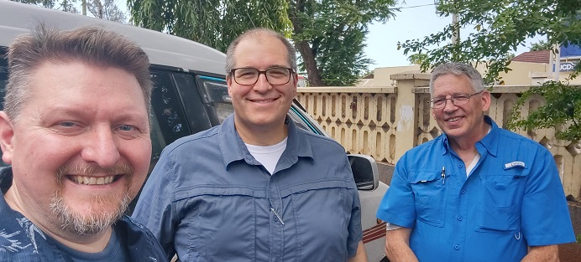
MZUNGU…?
Nathan Morrison
(Richmond, VA)
Andrew Roberts
(Tampa, FL)
Edward Smith
(Paris, TN)

Slide 3
Mzungu!
“Mzungu, literally translated, means a person who walks in circles. It is the name reserved for Westerners and it is advisable to abandon any irritation with the tag early in your stay: depending on the length of your visit you might hear it thousands of times.” – Tanzania: Customs & Culture, 50

Slide 4
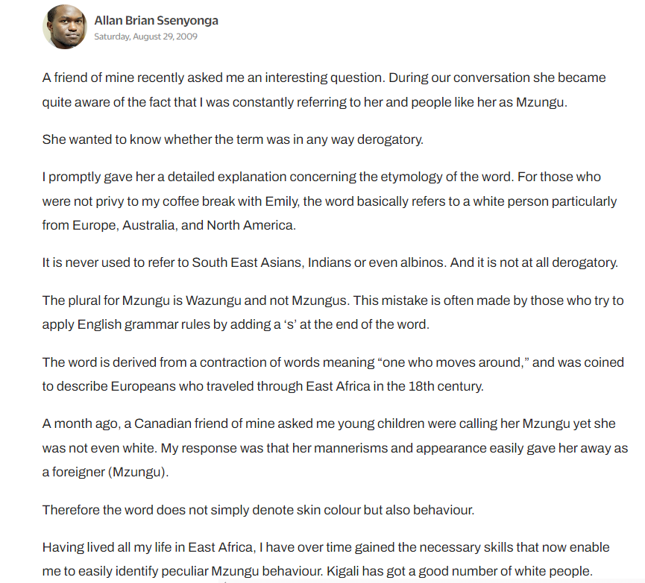
Mzungu!
Notes:
https://www.newtimes.co.rw/article/24870/yes-its-obvious-you-are-a-mzungu

Slide 5
MZUNGU

Slide 6
Intro
John 17:13-18
13. "But now I come to You; and these things I speak in the world so that they may have My joy made full in themselves.
14. "I have given them Your word; and the world has hated them, because they are not of the world, even as I am not of the world.
15. "I do not ask You to take them out of the world, but to keep them from the evil one.
16. "They are not of the world, even as I am not of the world.
17. "Sanctify them in the truth; Your word is truth.
18. "As You sent Me into the world, I also have sent them into the world.

Slide 7
Christian
Mzungu!
You are Distinct! That is what I want to encourage you to be today: To be in the world, but not of the world.
Be Distinct!

Slide 8
Christians,
Embrace Your Distinction
MZUNGU

Slide 9
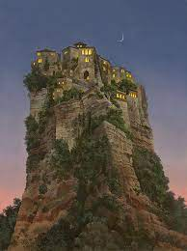
Embrace Your Distinction
Salt of the earth (Matthew 5:13)
Light of the world (Matthew 5:14-16)
A city on a hill (Matthew 5:14)
God’s special people (I Peter 2:9-10)
Sojourners and Pilgrims (I Peter 2:11-12)

Slide 10
Embrace Your Distinction
Why are we tempted to blend-in with the world at times?

Slide 11
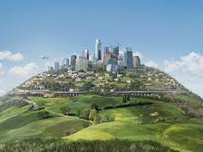
Embrace Your Distinction
City On A Hill
Their appearance is modest (I Timothy 2:9-10)
Their speech is appropriate (Philippians 2:14-15; Colossians 4:5-6; Ephesians 4:15, 29-31; I Peter 2:1)
Their manner of life is commendable, “Having your conduct honorable among the gentiles” (I Peter 2:11-12)

Slide 12
Embrace Your Distinction
City On A Hill
Their manner of life is commendable (I Peter 2:11-12)
Honest work and dealings (Col. 3:22-25; I Pet. 2:18-19)
Marriage, not fornication/cohabitation (Heb. 13:4)
Raising children (Eph. 6:1-4)

Slide 13
Embrace Your Distinction
City On A Hill
Their appearance is modest (I Timothy 2:9-10)
Their speech is appropriate (Philippians 2:14-15; Colossians 4:5-6; Ephesians 4:15, 29-31; I Peter 2:1)
Their manner of life is commendable (I Peter 2:11-12)
Their hearts are generous – loving neighbors and enemies (Mark 12:29-31; Matthew 5:43-44)

Slide 14
Christians,
Embrace Your Distinction
We cannot be ashamed of who we are in Christ. Embrace the distinction. It’s shining in ways you don’t think about!
MZUNGU

Slide 15
Christians,
Protect Your Distinction
MZUNGU

Slide 16
Protect Your Distinction
What if we lose our distinction?
Salt loses savor (Matthew 5:13)
Light under a basket (Matthew 5:14-15)
Lukewarm to the taste (Revelation 3:15-16)

Slide 17
Protect Your Distinction
Ears hurt by blasphemy and cursing (James 3:10)
Able to blush at lewd and lasciviousness, immorality (Jeremiah 6:15; 8:12)
Righteous Indignation is healthy (II Corinthians 11:29)
Expose works of darkness (Ephesians 5:8-12)
Don’t befriend the world; be distinct (James 4:4-5; I John 2:15-17)

Slide 18
Christians,
Protect Your Distinction
May the Lust of Eyes, Lust of Flesh, Pride of Life be strange places for Christians!
MZUNGU

Slide 19
Christians,
Confess Your Distinction
MZUNGU

Slide 20
Confess Your Distinction
When they see you have Goodness, Righteousness, and Truth (Ephesians 5:9)
When they see you have Love, Joy, Peace, Patience, Kindness, Goodness, Faithfulness, Gentleness, Self-control (Galatians 5:21-23)
When they see you have a Living Hope (I Peter 1:3)
People in the world want what a Christian has

Slide 21
Confess Your Distinction
I Peter 3:15
but sanctify Christ as Lord in your hearts, always being ready to make a defense to everyone who asks you to give an account for the hope that is in you, yet with gentleness and reverence
People in the world want what a Christian has

Slide 22
Confess Your Distinction
People in the world want what a Christian has
Matthew 10:32-33
32. "Therefore everyone who confesses Me before men, I will also confess him before My Father who is in heaven.
33. "But whoever denies Me before men, I will also deny him before My Father who is in heaven.
Colossians 4:5-6
5. Conduct yourselves with wisdom toward outsiders, making the most of the opportunity.
6. Let your speech always be with grace, as though seasoned with salt, so that you will know how you should respond to each person.

Slide 23
Christians,
Confess Your Distinction
Confess your distinction as you confess Jesus by the way you live your life!
MZUNGU

Slide 24
Conclusion
This World Is Not Our Home
John 17:15-16
15. "I do not ask You to take them out of the world, but to keep them from the evil one.
16. "They are not of the world, even as I am not of the world.
Philippians 3:20
20. For our citizenship is in heaven, from which also we eagerly wait for a Savior, the Lord Jesus Christ.

Slide 25
Conclusion
A Caucasian in Africa is a “Mzungu” and stands out
A Christian, no matter their ethnicity or background will stand out and be distinct
Embrace the distinction
Protect the distinction
Confess the distinction

Slide 26
CHRISTIAN
In this world, wherever we go, let us stand out for belonging to Jesus and being a Christian!

Slide 27
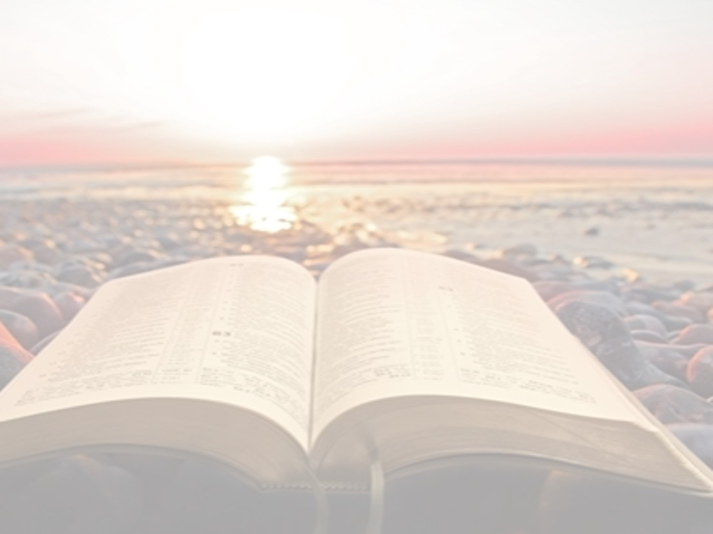
“What Must I Do To Be Saved?”
Hear The Gospel (Jn. 5:24; Rom. 10:17)
Believe In Christ (Jn. 3:16-18; Jn. 8:24)
Repent Of Sins (Lk. 13:3-5; Acts 2:38)
Confess Christ (Mt. 10:32; Acts 8:37)
Be Baptized (Mk. 16:16; Acts 22:16)
Remain Faithful (Jn. 8:31; Rev. 2:10)
For The Erring Saint:
Repent (Acts 8:22), Confess (I Jn. 1:9),
Pray (Acts 8:22)

