Slide 1
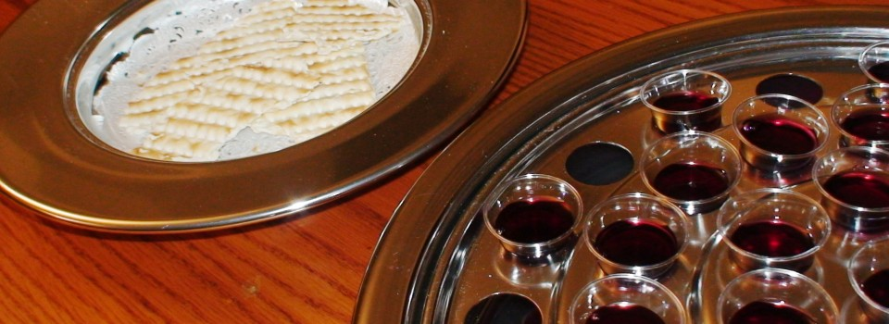
In Remembrance
Text:
Luke 22:19-20
Notes:
By Nathan L Morrison for Sunday 01/01/2023
All Scripture given is from NASB unless otherwise stated
For further study, or if questions, please Call: 804-277-1983 or Visit: www.courthousechurchofchrist.com

Slide 2
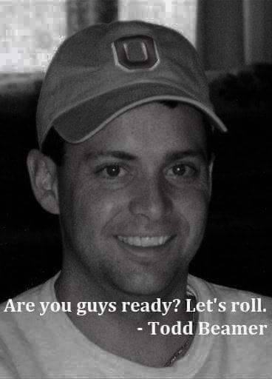
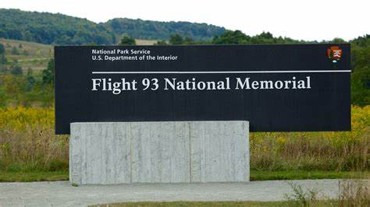
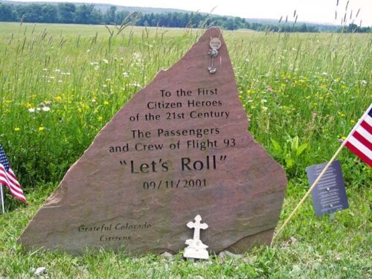
INTRO
Flight 93 Memorial, Shanksville, PA
Notes:
Images from the Flight 93 Memorial: A Common field one day. A Field of Honor forever.
On our way home from Ohio we stopped in Shanksville, PA to visit the Flight 93 Memorial.
This was different from many memorials around our nation: This didn’t honor soldiers, who volunteer for duty and sign up for danger, but for everyday citizens who didn’t sign up for a fight for their lives.
Their plane was delayed by about 25 minutes, which gave them time to get the info from their loved ones over the phone that 3 other planes had been hijacked and used as weapons.
Within 20 minutes from takeoff, they would band together in the back of the plane, many of them called their loved ones (some were recorded), and then attack the terrorists, which caused the plane to nose dive at 586 MPH into an empty field, creating a 45 foot crater. All aboard were lost. “Let’s Roll” rallied and unified our nation!
There is a quote from a first responder there: “A Common Field one day. A Field of Honor Forever.”
Families of three passengers and crew allowed the museum to have their recorded voicemails accessible. It was moving to hear their last words to loved ones. The common theme in the 3 recordings was hope and love.
In the days to years following, many people left tributes at the site. One of the moving ones to me was from a soldier who enlisted because of the events of September 11, 2001. He fought for four years in Afghanistan, and in 2005 he left his combat boots at the site.
While many people can visit the museum and the other two memorials that are set up, only family are allowed to actually visit the crash site.

Slide 3
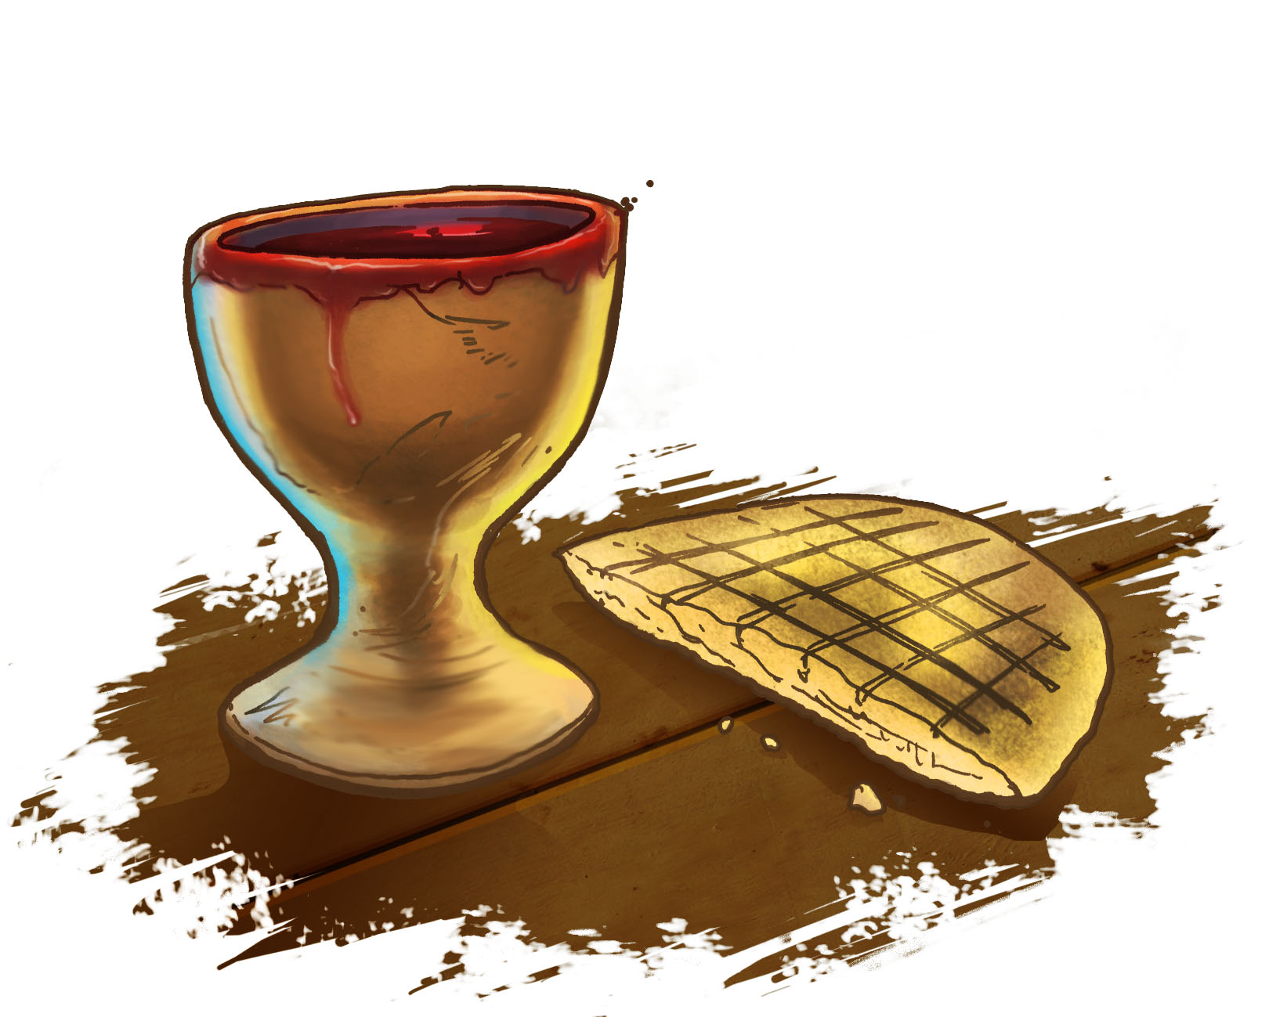
Intro
Luke 22:19-20
19. And when He had taken some bread and given thanks, He broke it and gave it to them, saying, “This is My body which is given for you; do this in remembrance of Me.”
20. And in the same way He took the cup after they had eaten, saying, “This cup which is poured out for you is the new covenant in My blood.”
Notes:
Luke 22:19-20:
Jesus knew His time on earth was short and He shared a last meal with His apostles.
He told them how He wanted to be remembered: In the eating of the unleavened bread and the drinking of the fruit of the vine.
I Corinthians 11:23-25: Paul relates how the Lord told him that as we eat the bread and drink the fruit of the vine that we do so “in remembrance of Me.”
The early church did this on the first day of the week (Sunday) when they came together “as the church” (Acts 20:7; I Corinthians 11:18, 33; 16:1-2).
The Jews celebrated the Passover, God’s deliverance of His people from the bondage of Egypt, in their first month of the new year.
Christians celebrate the Lord’s Supper, Jesus’ deliverance of His people from the bondage of sin, every first day of the week.

Slide 4
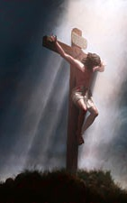
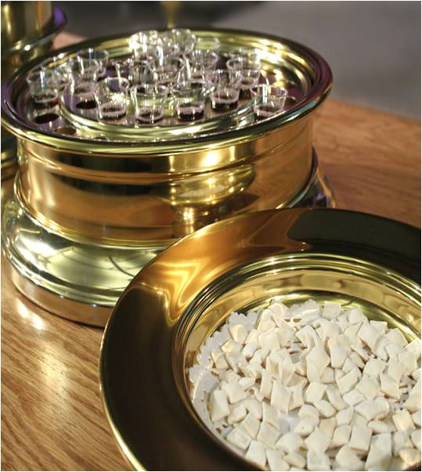
Intro
From violence and tragedy comes honor and remembrance!

Slide 5
A Common Meal Honored Forever
Luke 22:19-20
Unleavened bread (Exodus 12:17)
Fruit of the vine (Luke 22:18)
Do this “in remembrance of Me”
Notes:
A Common Meal Honored Forever
The memorial says, “A common field one day. A field of honor forever.”
Luke 22:19-20:
Jesus celebrated the Passover one last time before His death and He took the bread (unleavened – Exodus 12:17) and said it symbolized His body and they were to remember Him as they eat it.
Then He took the cup that contained the fruit of the vine (Luke 22:18) and told them it was the New Covenant in His blood and they were to remember Him as often as they drank it (I Corinthians 11:25).
He was still with them at this time. They didn’t fully grasp what was about to happen!
The Lord's Supper, common bread and juice, made forever an honorable memorial to Jesus!

Slide 6
A Common Meal Honored Forever
The Lord's Supper, common bread and juice, made forever an honorable memorial to Jesus!
Notes:
A Common Meal Honored Forever
The memorial says, “A common field one day. A field of honor forever.”
Luke 22:19-20:
Jesus celebrated the Passover one last time before His death and He took the bread (unleavened – Exodus 12:17) and said it symbolized His body and they were to remember Him as they eat it.
Then He took the cup that contained the fruit of the vine (Luke 22:18) and told them it was the New Covenant in His blood and they were to remember Him as often as they drank it (I Corinthians 11:25).
He was still with them at this time. They didn’t fully grasp what was about to happen!
The Lord's Supper, common bread and juice, made forever an honorable memorial to Jesus!

Slide 7
Last Words Recorded
Jesus’ last words were of comfort and hope
Love and unity (John 17:6-23)
Forgiveness (Luke 23:34)
Fulfillment (John 19:30)
Motivated by love (Romans 5:8)
Notes:
Last Words Recorded
It was a moving tribute to be able to hear the voices of the passengers and crew that were recorded, to hear their last words, to hear them say, “I love you.”
We have Jesus’ last words recorded for us and they were words of comfort and hope.
In His prayer in the garden of Gethsemane the night He would be betrayed by one of His own, He turned His thoughts off His coming suffering and prayed for His apostles and companions, and then prayed for all those who would believe on Him through their word (you and me!) – John 17:6-23: He spoke of love and unity.
On the cross the next day Jesus said of those who were putting Him to death “Father, forgive them; for they do not know what they are doing” (Luke 23:34).
As His earthly body gave out, He said, “It is finished” and then breathed His last (John 19:30; Luke 23:46) – He had fulfilled what He came to do!
We are told that Jesus’ motivation for His sacrifice was love – Romans 5:8 (5:6-10)
Here Paul says Jesus died for the helpless, ungodly, sinners, enemies, and saved them from the wrath of God, reconciling them to God in His death.
Jesus willingly died for you and me!
Every time we partake of the Lord’s Supper, it draws us closer to Jesus!

Slide 8
Last Words REcorded
Every time we partake of the Lord’s Supper, it draws us closer to Jesus!
Notes:
Last Words Recorded
It was a moving tribute to be able to hear the voices of the passengers and crew that were recorded, to hear their last words, to hear them say, “I love you.”
We have Jesus’ last words recorded for us and they were words of comfort and hope.
In His prayer in the garden of Gethsemane the night He would be betrayed by one of His own, He turned His thoughts off His coming suffering and prayed for His apostles and companions, and then prayed for all those who would believe on Him through their word (you and me!) – John 17:6-23: He spoke of love and unity.
On the cross the next day Jesus said of those who were putting Him to death “Father, forgive them; for they do not know what they are doing” (Luke 23:34).
As His earthly body gave out, He said, “It is finished” and then breathed His last (John 19:30; Luke 23:46) – He had fulfilled what He came to do!
We are told that Jesus’ motivation for His sacrifice was love – Romans 5:8 (5:6-10)
Here Paul says Jesus died for the helpless, ungodly, sinners, enemies, and saved them from the wrath of God, reconciling them to God in His death.
Jesus willingly died for you and me!
Every time we partake of the Lord’s Supper, it draws us closer to Jesus!

Slide 9
Family Has A Closer Connection
Saints are called to “fellowship” with Christ & with one another (I Cor. 1:9-10; Phil. 1:27; Rom. 15:5-6; Phil. 3:10)
Only the family of God can “proclaim the Lord's death until He comes” (I Cor. 11:26)
In the Lord’s Supper saints share in Christ’s blood and share in His body! (I Cor. 10:16-17)
Notes:
Family Has A Closer Connection
Anyone can go to the Flight 93 Memorial but only the families of the heroes on board that day can go to the crash site.
Anyone, children and visitors, can observe and partake of the Lord’s Supper, but only those who have been obedient to the gospel and entered the family of God can share in Jesus’ sacrifice.
I Cor. 1:9-10; Phil. 1:27; Rom. 15:5-6; Phil. 3:10: Saints are called to “fellowship” with Christ to “strive together” to be of the “same mind” (sharing in faith) and “same judgment” (partakers of the same goal), “standing firm in one spirit” (same goal of pleasing God), “with one mind striving together for the faith of the gospel (same doctrine), and to have fellowship in His sufferings.
I Cor. 11:26: Personal sharing with Christ is made possible in partaking of the Lord’s Supper!
Only the family of God can “proclaim the Lord's death until He comes.”
I Cor. 10:16-17: Paul makes a very explicit and impressive argument on this subject!
In the assembly of the saints when the bread and fruit of the vine are taken in commemoration of Jesus’ death there is “sharing” (fellowship) with Christ, with His body and His blood, and therefore sharing with Christ, personally (I Cor. 10:16).
There is fellowship with Christ and Christians and there is fellowship of Christians with each other in the body of Christ (I Cor. 10:17).
Through partaking of the Lord’s Supper we share in Christ’s blood and we share in Christ’s body!
In the family of God we have fellowship with Jesus and with one another!

Slide 10
Family Has A Closer Connection
In the family of God we have fellowship with Jesus and with one another!
Notes:
Family Has A Closer Connection
Anyone can go to the Flight 93 Memorial but only the families of the heroes on board that day can go to the crash site.
Anyone, children and visitors, can observe and partake of the Lord’s Supper, but only those who have been obedient to the gospel and entered the family of God can share in Jesus’ sacrifice.
I Cor. 1:9-10; Phil. 1:27; Rom. 15:5-6; Phil. 3:10: Saints are called to “fellowship” with Christ to “strive together” to be of the “same mind” (sharing in faith) and “same judgment” (partakers of the same goal), “standing firm in one spirit” (same goal of pleasing God), “with one mind striving together for the faith of the gospel (same doctrine), and to have fellowship in His sufferings.
I Cor. 11:26: Personal sharing with Christ is made possible in partaking of the Lord’s Supper!
Only the family of God can “proclaim the Lord's death until He comes.”
I Cor. 10:16-17: Paul makes a very explicit and impressive argument on this subject!
In the assembly of the saints when the bread and fruit of the vine are taken in commemoration of Jesus’ death there is “sharing” (fellowship) with Christ, with His body and His blood, and therefore sharing with Christ, personally (I Cor. 10:16).
There is fellowship with Christ and Christians and there is fellowship of Christians with each other in the body of Christ (I Cor. 10:17).
Through partaking of the Lord’s Supper we share in Christ’s blood and we share in Christ’s body!
In the family of God we have fellowship with Jesus and with one another!

Slide 11
Conclusion
Flight 93
Ordinary flight, ordinary people
In their last moments they did something extraordinary, something heroic
Something to remember and honor
You
None of us knows how much time we have
You don’t know what time you have left but you can do something extraordinary now, while you yet live
You can repent and be baptized and obey the gospel to become a child of God!
You can repent and be renewed in the eyes of God, if you have strayed!
Notes:
Conclusion
Flight 93: Ordinary flight, ordinary people.
In their last moments they did something extraordinary, something heroic.
Something to remember and honor.
You: None of us knows how much time we have.
The passengers on Flight 93 did something extraordinary with the time they had left.
You don’t know what time you have left but you can do something extraordinary now, while you yet live.
You can repent and be baptized and obey the gospel to become a child of God!
You can repent and be renewed in the eyes of God, if you have strayed.
We honor Jesus every first day of the week for His sacrifice to redeem us from sin.
You can become part of the family of God and dedicate your life to live for Him!
If not a Christian, you need to be! Repent and be baptized for the forgiveness of sins!
If a Christian in sin, don’t wait till it’s eternally too late! Repent and be renewed!
Whatever your requests, let them be made known NOW while we stand & sing!

Slide 12
Conclusion
Saints honor Jesus every first day of the week for His sacrifice to redeem us from sin!
Notes:
Conclusion
Flight 93: Ordinary flight, ordinary people.
In their last moments they did something extraordinary, something heroic.
Something to remember and honor.
You: None of us knows how much time we have.
The passengers on Flight 93 did something extraordinary with the time they had left.
You don’t know what time you have left but you can do something extraordinary now, while you yet live.
You can repent and be baptized and obey the gospel to become a child of God!
You can repent and be renewed in the eyes of God, if you have strayed.
We honor Jesus every first day of the week for His sacrifice to redeem us from sin.
You can become part of the family of God and dedicate your life to live for Him!
If not a Christian, you need to be! Repent and be baptized for the forgiveness of sins!
If a Christian in sin, don’t wait till it’s eternally too late! Repent and be renewed!
Whatever your requests, let them be made known NOW while we stand & sing!

Slide 13
Conclusion
You can become part of the family of God and dedicate your life to live for Him!
Notes:
Conclusion
Flight 93: Ordinary flight, ordinary people.
In their last moments they did something extraordinary, something heroic.
Something to remember and honor.
None of us knows how much time we have.
The passengers on Flight 93 did something extraordinary with the time they had left.
You don’t know what time you have left but you can do something extraordinary now, while you yet live.
You can repent and be baptized and obey the gospel to become a child of God!
You can repent and be renewed in the eyes of God, if you have strayed.
We honor Jesus every first day of the week for His sacrifice to redeem us from sin.
You can become part of the family of God and dedicate your life to live for Him!
If not a Christian, you need to be! Repent and be baptized for the forgiveness of sins!
If a Christian in sin, don’t wait till it’s eternally too late! Repent and be renewed!
Whatever your requests, let them be made known NOW while we stand & sing!

Slide 14
“What Must I Do To Be Saved?”
Hear The Gospel (Jn. 5:24; Rom. 10:17)
Believe In Christ (Jn. 3:16-18; Jn. 8:24)
Repent Of Sins (Lk. 13:3-5; Acts 2:38)
Confess Christ (Mt. 10:32; Rom. 10:10)
Be Baptized (Mk. 16:16; Acts 22:16)
Remain Faithful (Jn. 8:31; Rev. 2:10)
For The Erring Saint:
Repent (Acts 8:22), Confess (I Jn. 1:9),
Pray (Acts 8:22)

