Slide 1
Count Your Blessings
Text:
Psalm 96
Notes:
By Nathan L Morrison
All Scripture given is from NASB unless otherwise stated
For further study, or if questions, please Call: 804-277-1983 or Visit www.courthousechurchofchrist.com
Adapted from a lesson by Richie Thetford; based on the hymn, “Count Your Blessings” by by Johnson Oatman, Jr. (1897)

Slide 2
Intro
The life of saints is to be categorized as grateful!
Ingratitude can be seen in the attitudes and actions of many people, and sometimes even Christians!
Ingratitude is a character of the wicked! (Romans 1:21; II Timothy 3:2)

Slide 3
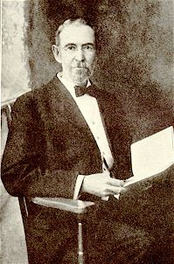
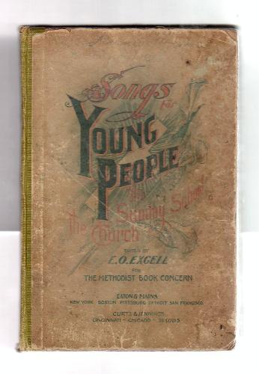
Intro
Johnson Oatman, Jr. (1856-1922)
“Count Your Blessings” (1897)
A Methodist preacher, and song writer of over 5,000 hymns.
Spent his life mostly as a businessman and songwriter.
Focused hymn writing on young people learning of Jesus!
First published in Songs For Young People in 1897.
Johnson Oatman, Jr.
May we ever give thanks to God for the blessings in our lives!
(Name them one by one!)
Notes:
Read the article on Johnson Oatman, Jr.
Sources:
http://biblestudycharts.com/HH_Count_Your_Blessings.html
Then Sings My Soul by Robert J. Morgan p. 243
Then Sings My Soul Book 2 by Robert J. Morgan p. 227, 235
Image:
Hymnal: Songs For Young People by E. O. Excell, 1897

Slide 4
Psalm 96
Give Thanks to God in Song (Psalm 96: 1,12)
Luke 19:37-40; Psalm 148; I Chronicles 15:26-28; 16:4-7; Ephesians 5:19-20; Colossians 3:16; Luke 19:40

Slide 5
Psalm 96
Give Thanks to God in Song (Psalm 96: 1,12)
For salvation – Psalm 96:2; 71:15
For His wonderful deeds – Psalm 96:3-4, 7-8
For creation – Psalm 96:5-6
For His majesty – Psalm 96:9-10
Give Thanks to God in Praise (Psalm 96:2-10)

Slide 6
Psalm 96
Give Thanks to God in Song (Psalm 96: 1,12)
God’s judgments are righteous – Romans 2:5
Because of God’s judgments, we can judge righteously – John 7:24
God’s judgments are according to truth – Romans 2:1-4
Give Thanks to God in Praise (Psalm 96:2-10)
Give Thanks to God for His Judgments (Psalm 96:10-13)

Slide 7
Conclusion
To be ungrateful is to be like the 9 lepers (Luke 17:11-19)
To be ungrateful is to be like the butler that forgot Joseph
(Genesis 40:14, 21, 23)
Ingratitude is a character of the wicked!
(Romans 1:21; II Timothy 3:2)

Slide 8
Thankfulness is a character of the faithful! (Ephesians 5:3-4, 19-20)
Give Thanks to God in Song (Psalm 96: 1,12)
Give Thanks to God in Praise (Psalm 96:2-10)
Give Thanks to God for His Judgments (Psalm 96:10-13)
Tell of His glory among the nations, His wonderful deeds among all the peoples! (Psalm 96:3)

Slide 9
Conclusion
Let us have a thankful heart as we sing, “Count Your Blessings!”

Slide 10
“What Must I Do To Be Saved?”
Hear The Gospel (Jn. 5:24; Rom. 10:17)
Believe In Christ (Jn. 3:16-18; Jn. 8:24)
Repent Of Sins (Lk. 13:3-5; Acts 2:38)
Confess Christ (Mt. 10:32; Acts 8:37)
Be Baptized (Mk. 16:16; Acts 22:16)
Remain Faithful (Jn. 8:31; Rev. 2:10)
For The Erring Saint:
Repent (Acts 8:22), Confess (I Jn. 1:9),
Pray (Acts 8:22)

