Slide 1
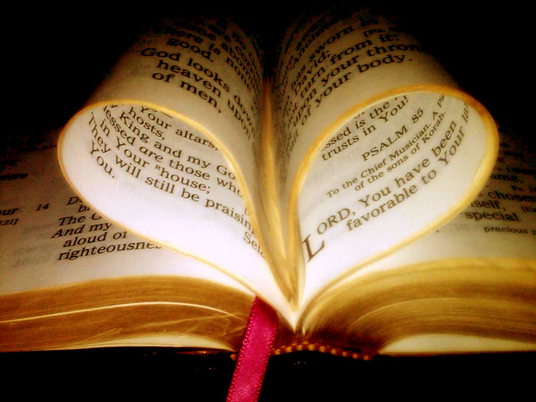
Heart Of Ezra
Text: Ezra 7:8-10
Notes:
By Nathan L Morrison for Sunday July 3rd, 2022
All Scripture given is from NASB unless otherwise stated
For further study, or if questions, please Call: 804-277-1983; or Visit: www.courthousechurchofchrist.com
Based on a lesson by Richard Thetford, and an article by David Dann in Truth Magazine, July 2009

Slide 2
Intro
II Timothy 2:20-21
20. Now in a large house there are not only gold and silver vessels, but also vessels of wood and of earthenware, and some to honor and some to dishonor.
21. Therefore, if anyone cleanses himself from these things, he will be a vessel for honor, sanctified, useful to the Master, prepared for every good work.

Slide 3
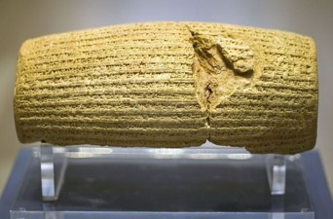
Intro
In the first year of Cyrus’ reign, he decreed the Jewish captives were free to return to their land and rebuild the temple!
(Ezra 1 – after their 70 years in exile from Jeremiah 29:10)
In 538-536 B.C. the first exiles returned to Jerusalem!
Ezra did not return with the first exiles but about 80 years later in 458 B.C.!
Notes:
Image: The Cyrus Cylinder
https://www.metmuseum.org/exhibitions/listings/2013/cyrus-cylinder
Excavated at Babylon in 1879, the Cylinder was inscribed in Babylonian cuneiform on the orders of the Persian king Cyrus the Great after he captured Babylon in 539 B.C. It marks the establishment of Persian rule and records how Cyrus restored shrines and allowed deported peoples to return home. Although not mentioned, it is thought to be at this time that the Jews returned to Jerusalem to build the Second Temple, as recorded in the Bible. The Cylinder and sixteen related works, all on loan from the British Museum, reflect the innovations initiated by Persian rule in the ancient Near East (550–331 B.C.) and chart a new path for this empire, the largest the world had known.

Slide 4
Intro
Ezra 7:8-10
8. He came to Jerusalem in the fifth month, which was in the seventh year of the king.
9. For on the first of the first month he began to go up from Babylon; and on the first of the fifth month he came to Jerusalem, because the good hand of his God was upon him.
10. For Ezra had set his heart to study the law of the LORD and to practice it, and to teach His statutes and ordinances in Israel.

Slide 5
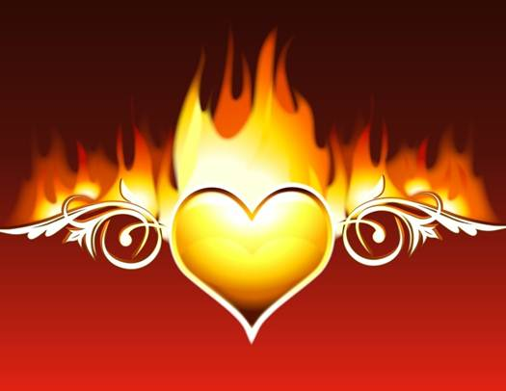
Intro
Ezra may not have been one of the first of his people to return to Jerusalem but when he did his heart was well
prepared!
May we have hearts like Ezra’s!

Slide 6
Ezra Had A Heart to Study the Law of God
Ezra 7:10: “For Ezra had set his heart to study the law of the LORD...”
The heart must be prepared to study
God’s people need to “study” God’s word
Christians today need to “prepare” our hearts to study the word of God!
Study
II Peter 3:18: Grow
Acts 17:11: Search the Scriptures daily
II Timothy 2:15: Study

Slide 7
Ezra Had A Heart to Obey the Law of God
Ezra 7:10: “For Ezra had set his heart to study the law of the LORD and to practice it...”
Be prepared to hear and obey the word of God
Must hear it and Obey it!
James 1:21-22: Hear & Do!
Romans 6:16-18: Obey from the heart!
Hebrews 5:9: Christ saves those who obey Him!
John 13:17: Blessed if you obey
Obey

Slide 8
Ezra Had A Heart to Teach the Law of God
Ezra 7:10: “…and to teach His statutes and ordinances in Israel.”
Ezra was prepared to: Study, Obey, and Teach!
Christians today need to be prepared to teach!
II Timothy 2:2: Teach others!
I Timothy 3:2: Elders “able to teach”
II Timothy 2:24: Christians “able to teach”
Hebrews 5:12-14: Should have been teachers but weren’t!
Teach

Slide 9
Conclusion
Before leaving for Jerusalem, Ezra had a prepared heart to:
Before going out into the world, saints need a prepared heart to:
Study
Obey
Teach
Study
Obey
Teach
If our hearts are truly prepared we will live it!

Slide 10
Conclusion
II Timothy 2:20-21
20. Now in a large house there are not only gold and silver vessels, but also vessels of wood and of earthenware, and some to honor and some to dishonor.
21. Therefore, if anyone cleanses himself from these things, he will be a vessel for honor, sanctified, useful to the Master, prepared for every good work.

Slide 11
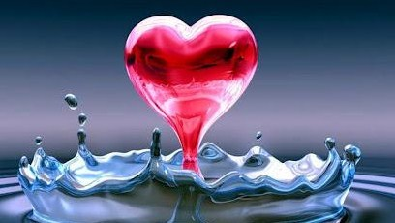
Conclusion
Ezra was prepared!
ARE YOU?
Let us prepare our hearts to study the word of the Lord, to do it, and to teach it to others!

Slide 12
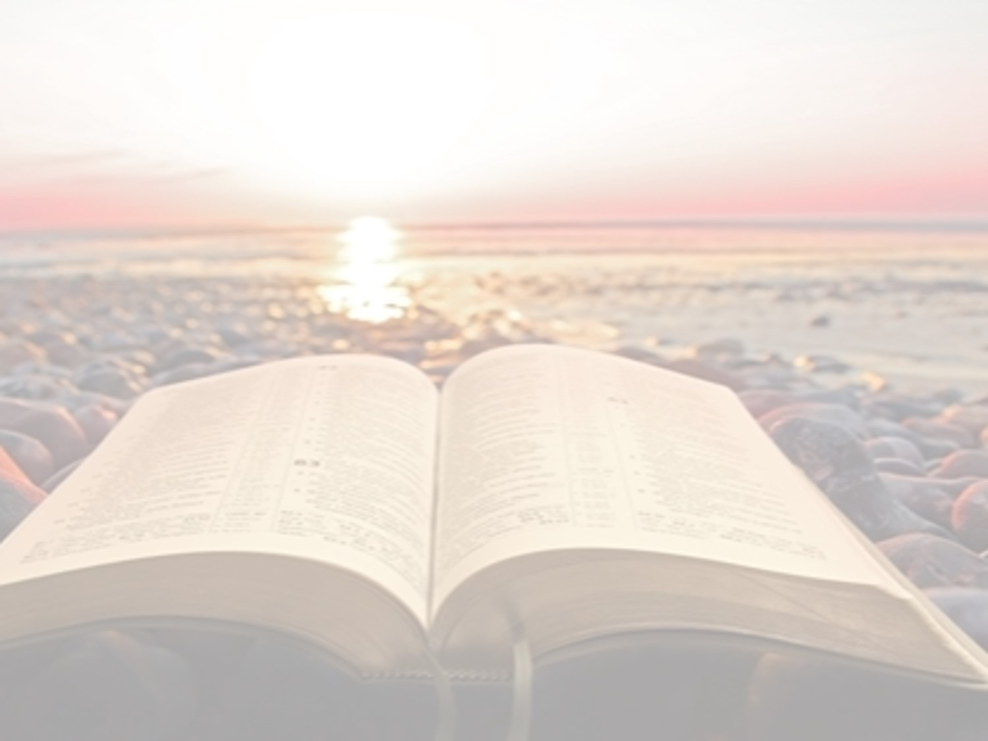
“What Must I Do To Be Saved?”
Hear The Gospel (Jn. 5:24; Rom. 10:17)
Believe In Christ (Jn. 3:16-18; Jn. 8:24)
Repent Of Sins (Lk. 13:3-5; Acts 2:38)
Confess Christ (Mt. 10:32; Rom. 10:10)
Be Baptized (Mk. 16:16; Acts 22:16)
Remain Faithful (Jn. 8:31; Rev. 2:10)
For The Erring Saint:
Repent (Acts 8:22), Confess (I Jn. 1:9),
Pray (Acts 8:22)

