Slide 1
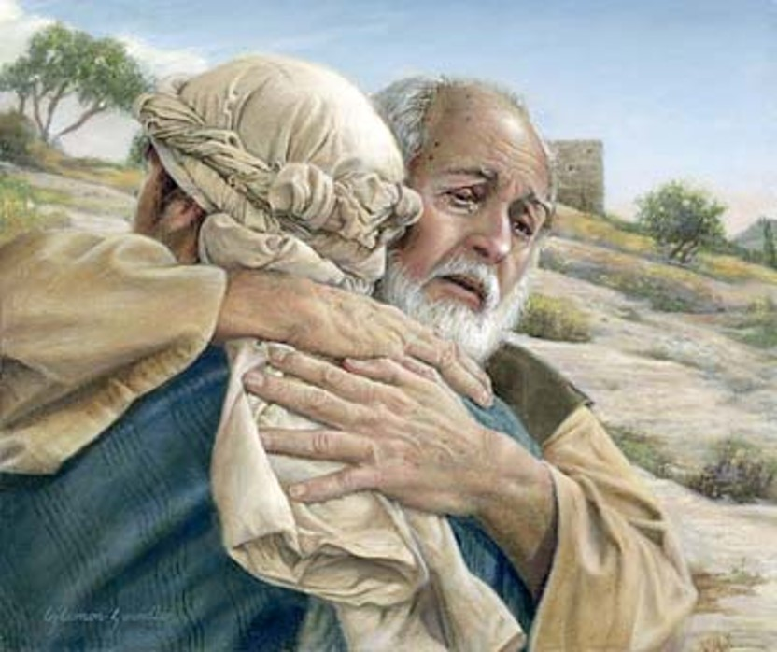
The Loving Father & His Lost Sons
Text:
Luke 15:11-32
Notes:
By Nathan L Morrison for Sunday 06/19/2022
All Scripture given is from NASB unless otherwise stated
For further study, or if questions, please Call: 804-277-1983 or Visit: www.courthousechurchofchrist.com
Adapted from a lesson by Richie Thetford

Slide 2
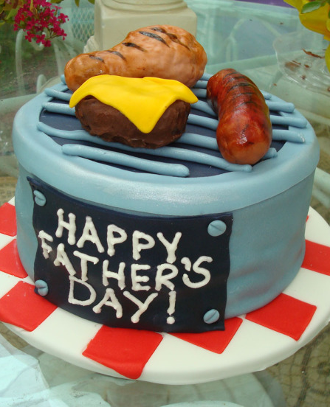
INTRO
The Month of June!
A time when we reflect on and honor our fathers
Father’s Day is a special one-time event each year, but we should all honor our fathers on a daily basis – especially those who are faithful to God!
Notes:
The beginning of Father’s Day:
June 19, 1910: The first Father's Day was observed in Washington State at the urging of Sonora Smart Dodd from Spokane, WA to honor fathers because her father raised her when her mother died.
1924: President Calvin Coolidge recognized Father's Day as the third Sunday in June and encouraged states to do the same.
1956: Congress officially recognized Father's Day with the passage of a joint resolution.
1966: President Lyndon Johnson issued a proclamation recognizing the third Sunday in June as Father's Day.
1972: President Richard Nixon permanently established it.
Sonora Smart Dodd lived to see her idea come to fruition. She died in 1978 at the ripe old age of 96. (A Brief History of Father's Day by Andrew Hollandbeck)
II. Though this is a holiday to honor and remember our earthly fathers, today, on the anniversary of the first Father’s Day in our country, 112 years ago, let’s focus on our Heavenly Father, God!

Slide 3
INTRO
Luke 15:3-7: The Lost Sheep
Luke 15:8-10: The Lost Coin
Luke 15:11-32: The Lost (Prodigal) Son
Luke 15: Three Parables that speak of the Loving Father we serve

Slide 4
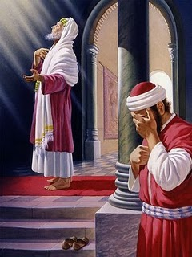
INTRO
Luke 15:1-2
Jesus interacts with two different groups of people who will be represented in the last parable, the tax collectors & sinners, and the Pharisees & Scribes
The Pharisees and scribes complained saying, “This man receives sinners and eats with them.”
Let’s study the Parable of the Prodigal Son and see what Jesus said of the Loving Father & His Lost Sons!

Slide 5
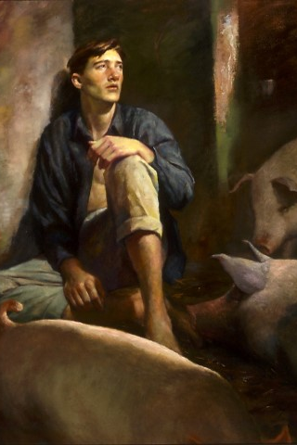
The Prodigal Son
His Error
Self-will (Luke 15:12)
Separation (Luke 15:13)
Prodigal Living (Luke 15:13)
Selfishness (Luke 15:13)
Destitution (Luke 15:14-15)
Starvation (Luke 15:16)
Luke 15:11-16
Notes:
The Young Son’s Error (Luke 15:11-16):
Self-will (Luke 15:12): He asked for his inheritance early (his father was still alive) and was only concerned with “self” with no real plan and wasn’t concerned with the consequences.
Separation (Luke 15:13): He traveled to a “distant country” away from his family and those who cared about him.
Prodigal Living (Luke 15:13): He “wasted his possessions with prodigal living” (NKJV)
Prodigal (as most headings have it) means “reckless and extravagant” (NNIBD)
ESV: “reckless living”
HCSB: “foolish living”
KJV: “riotous living”
NASU: “loose living”
NET: “wild lifestyle”
NIV: “wild living”
NKJV: “prodigal living”
Selfishness (Luke 15:13): He spent his inheritance on himself and only thought of himself.
Destitution (Luke 15:14-15): Physical: He had nothing for when the famine hit! Spiritual: He turned to the keeping of someone else’s pigs (an unclean animal to the Jews – Deuteronomy 14:8) – An illustration of how bad things were and how far he had fallen.
Starvation (Luke 15:16): Not only was he in violation of the Law of Moses but he envied the pigs and desired to eat the “pods” that the pigs were eating but no one gave him anything!
Side Note: In his book, What Do They Hear?: Bridging the Gap Between Pulpit & Pew (2007) author Mark Allan Powell relates an account of preaching the Parable of the Prodigal Son to Americans, Russians and Tanzanians.
He asked American seminarians (preacher students) to briefly outline the parable of the Prodigal Son (Luke 15:11-32) after reading it and was surprised when only 6% mentioned the famine in Luke 15:14 but 100% mentioned the squandering.
He asked Russian preacher students to do the same thing after reading it and was shocked that 84% mentioned the famine and only 34% mentioned the squandering. They understood famines to be deadly since St. Petersburg suffered from a 900-day famine due to the Nazi siege of the city (Leningrad) during WW2, when 1.1 to 1.3 million Russian civilians died, mostly from starvation.
The Americans considered the son wicked, while the Russians considered the son foolish.
He later posed the question to Tanzanian preacher students, “Why did the son end up starving?” and 80% came up with a third answer: “Because no one gave him anything to eat” from Luke 15:16. They believed letting the boy starve was callous. People in a foreign country often lose their money, because they don't know how things work, and they don't anticipate famines.
However the young son came to that state, envying the pigs their food and starving, Jesus let His hearers know that he had hit rock-bottom.
Sometimes, it is when those who have turned from God hit rock-bottom that they decide to return (no matter who or what is at fault).

Slide 6
The Prodigal Son
His Return
Realization (Luke 15:17)
Resolution (Luke 15:18)
Repentance (Luke 15:19)
Return (Luke 15:20)
Luke 15:17-20
Notes:
The Young Son’s Return (Luke 15:17-20):
Realization (Luke 15:17): He realized his father’s servants were better off than he was! He remembered how good it was back at home, they had “more than enough bread.”
Resolution (Luke 15:18): He resolved to go back and face his father and confess his sins before God and his father.
Repentance (Luke 15:19): He wants to return home and declare his unworthiness to be called a son and to beg his father to take him on as a hired servant! No longer the pride with which he left but a humble heart.
Return (Luke 15:20): “So he got up and came to his father.” Repentance isn’t just thinking of change but is action, a change of direction. He resolved in his heart to return home and he set off to do what he said.

Slide 7
The Prodigal Son
The sinners and tax collectors and anyone who wanders far from God can always repent, change direction in humility, and come home to Him!

Slide 8
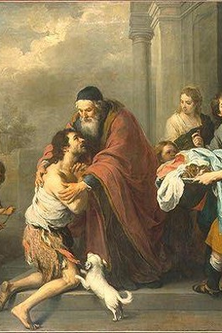
The Loving Father
Luke 15:20-24
Reconciled (Luke 15:20)
Put the best robe, a ring and sandals on him (Luke 15:21-22)
Great Rejoicing (Luke 15:23-24)
Notes:
The young son learned a valuable lesson in humility and returned home and his father took action:
A reconciliation takes place (Luke 15:20): The father, seeing his son from a distance, RUNS to him and smothers him in hugs and kisses.
Hearing the confession of his wayward son the father reclothes him in the best robe and put a ring and sandals on him (Luke 15:21-22): The clothes signify his station as one of his sons and not as a hired hand.
A great rejoicing takes place (Luke 15:23-24): The father calls for a fatted calf to be killed and prepared for a feast because “this son of mine was dead and has come to life again; he was lost and has been found.”

Slide 9
The Loving Father
Ephesians 2:1-3; 4:17-19: “Dead,” “Darkness”
Those who return to God are “made alive” (Ephesians 2:4-7) and “reconciled” to God (Ephesians 2:14-16), no longer being in “darkness” but “children of Light” (Ephesians 5:8)
“for this son of mine was dead and has come to life again; he was lost and has been found.' And they began to celebrate”
(Luke 15:24)
Notes:
The loving father was filled with great joy that his “dead” and “lost” son had returned!
Sound familiar?
Ephesians 2:1-3; 4:17-19: People who are lost are “dead” in their trespasses and sins and are in darkness, having a “darkened understanding.”
Through Jesus those who return to God are “made alive” (Ephesians 2:4-7) and “reconciled” to God (Ephesians 2:14-16), thus no longer being in “darkness” but “children of Light” (Ephesians 5:8)!

Slide 10
The Loving Father
No matter how we “squander” or waste our lives in sinful living or how far we run from God, our Loving Father will embrace us and accept us as His children when we repent and return to Him!

Slide 11
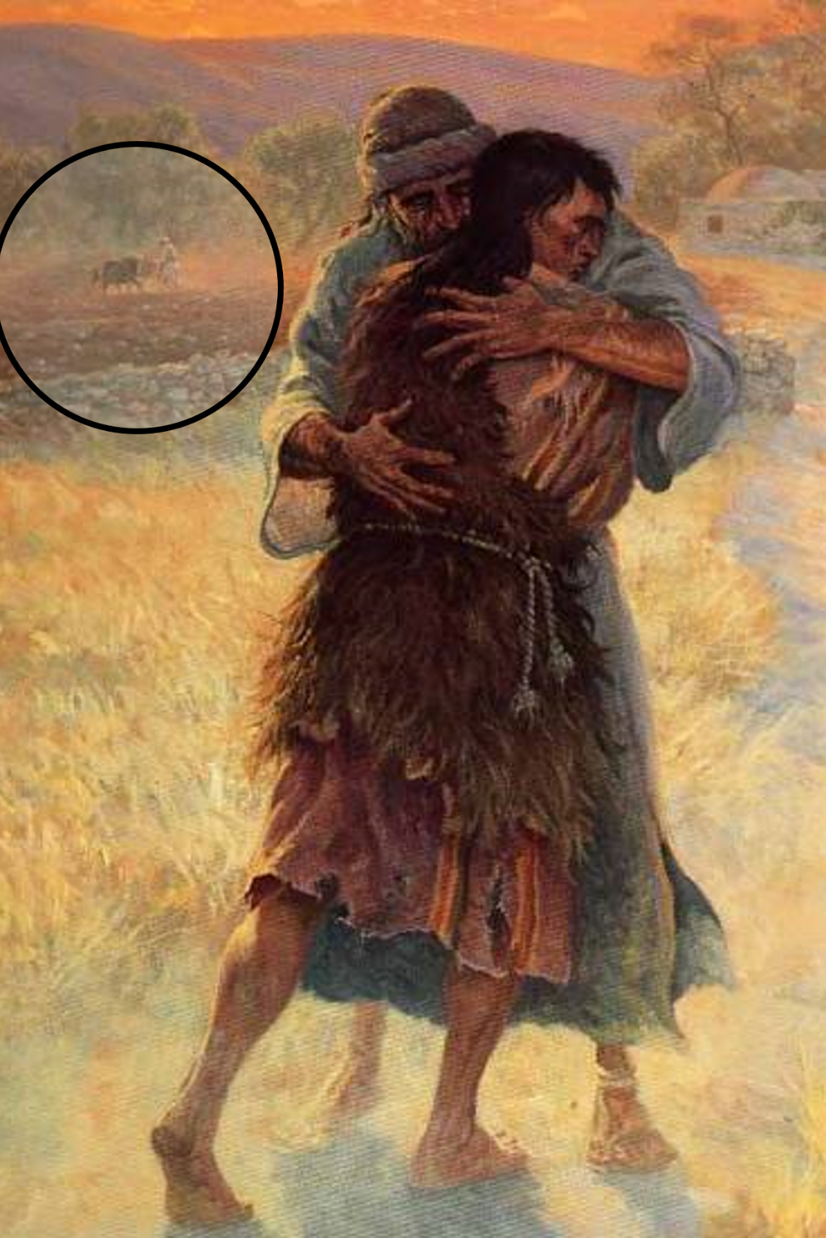
The Older Son
Luke 15:25-32
Refuses to join the celebration (Luke 15:25)
His father pleads for him to join in the celebration (Luke 15:28)
He complains! (Luke 15:29-30)
Served many years
Never disobeyed
No party for me
“Son, you have always been with me, and all that is mine is yours. But we had to celebrate and rejoice, for this brother of yours was dead and has begun to live, and was lost and has been found”
(Luke 15:31-32)
Notes:
The older brother jealously rejects his younger brother (Luke 15:25-32):
He refuses to join in the celebration
His father pleads for him to join in the celebration
The older brother complains:
“For so many years I have been serving you” (Luke 15:29)
“I have never neglected a command of yours” (Luke 15:29)
“You have never given me a young goat, so that I might celebrate with my friends” (Luke 15:29)
“When this son of yours came, who has devoured your wealth with prostitutes, you killed the fattened calf for him” (Luke 15:30) – Meaning, “your son left, lived a sinful life, and you still welcomed him back!”
The Loving Father’s response: “Son, you have always been with me, and all that is mine is yours. But we had to celebrate and rejoice, for this brother of yours was dead and has begun to live, and was lost and has been found” (Luke 15:31-32).

Slide 12
The Older Son
Luke 15:25-32
May we as Christians learn the proper way to receive the erring child who returns back to the loving Father – Not with jealousy but with joyous celebration!
“Sufficient for such a one is this punishment which was inflicted by the majority, so that on the contrary you should rather forgive and comfort him, otherwise such a one might be overwhelmed by excessive sorrow. Wherefore I urge you to reaffirm your love for him”
(II Corinthians 2:6-8)
Notes:
May we as Christians learn the proper way to receive the erring child who returns back to the loving Father – Not with jealousy but with joyous celebration! (II Corinthians 2:6-8)
“Sufficient for such a one is this punishment which was inflicted by the majority, so that on the contrary you should rather forgive and comfort him, otherwise such a one might be overwhelmed by excessive sorrow. Wherefore I urge you to reaffirm your love for him.”

Slide 13
The Older Son
Let us learn to receive the lost who have been found with great celebration, arms open wide with forgiveness and words of comfort and love!

Slide 14
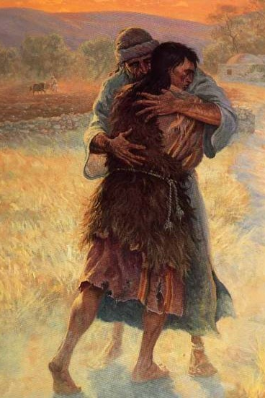
Conclusion
This is a parable of two lost sons:
The sinners and tax collectors
The Pharisees and the scribes
Notes:
This is a parable of two lost sons:
The sinners and tax collectors
People far away from God who need to be drawn in by the sacrifice of Jesus
Jesus said He would draw all men to Himself (John 12:32)
Jesus said He came to seek and save the lost (Luke 19:10)
Jesus said He came to bring two flocks of sheep into one fold (John 10:16)
The Pharisees and the scribes
The first two parables of the Lost Sheep and the Lost Coin were to teach them how they were to behave (celebrate when the lost are found).
This third parable, The Prodigal Son, showed them how they did behave (as the older brother)
Like the older brother who said he never disobeyed the father’s commands, the Jews had repeatedly sinned and were in need of saving as well for they were the “lost sheep of Israel (Matthew 15:24).

Slide 15
Conclusion
Lessons for earthly fathers
Treat your children with patience and benefit of the doubt
When they stray and sin and then return, show them forgiveness and love
Give them words of encouragement and comfort

Slide 16
Conclusion
Conclusion
The Loving Father in this parable teaches us the great patience and awesome love our Heavenly Father has for each of us, whatever state we are in, and power in forgiveness!
“But God demonstrates His own love toward us, in that while we were yet sinners, Christ died for us”
(Romans 5:8)

Slide 17
Conclusion
Our Heavenly Father LOVES His children:
Even when they turn away from Him, and He watches for them in love!
Especially when they repent and return!
“Joy in heaven over one sinner who repents” (Luke 15:7)
“Joy in the presence of the angels of God over one sinner who repents” (Luke 15:10)

Slide 18
Conclusion
Which brother are you?
Have you wandered away from God and never obeyed the gospel?
Have you obeyed the gospel but strayed away in your heart?

Slide 19
Conclusion
Whatever you have done, wherever you have wandered, you can have a joyous homecoming by repenting and returning to God and to His family!

Slide 20
“What Must I Do To Be Saved?”
Hear The Gospel (Jn. 5:24; Rom. 10:17)
Believe In Christ (Jn. 3:16-18; Jn. 8:24)
Repent Of Sins (Lk. 13:3-5; Acts 2:38)
Confess Christ (Mt. 10:32; Rom. 10:10)
Be Baptized (Mk. 16:16; Acts 22:16)
Remain Faithful (Jn. 8:31; Rev. 2:10)
For The Erring Saint:
Repent (Acts 8:22), Confess (I Jn. 1:9),
Pray (Acts 8:22)

