Slide 1
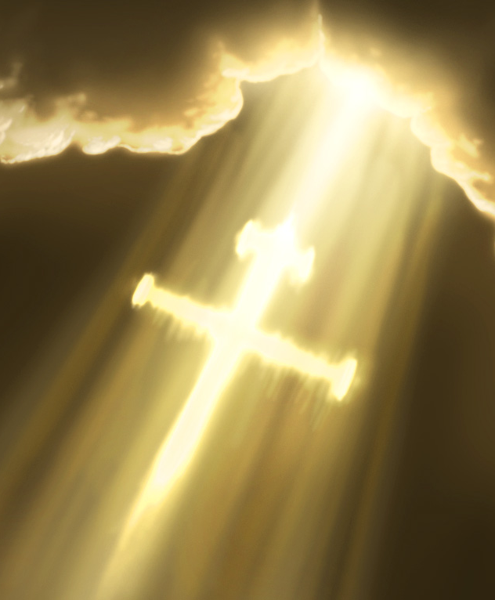
“Light Shall Shine Out Of Darkness”
Text:
II Corinthians 4:5-6
Notes:
By Nathan L Morrison for Sunday 05/29/2022
All Scripture given is from NASB unless otherwise stated
For further study, or if questions, please Call: 804-277-1983 or Visit: www.courthousechurchofchrist.com
‘Send The Light’ hymn by Charles H Gabriel

Slide 2
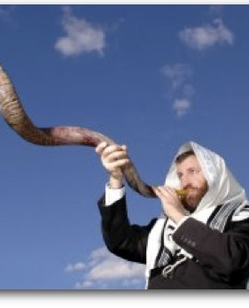
INTRO
The Thessalonian Saints
Were a great example of teaching the gospel to others everywhere they went!
I Thessalonians 1:6-8
Were called through the gospel to have the glory of Christ!
II Thessalonians 2:13-14

Slide 3
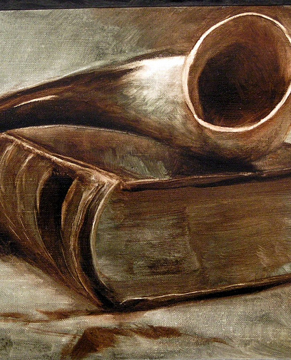
INTRO
The call of God has sounded forth (I Thessalonians 1:8)
He “called us by His own glory and excellence” (II Peter 1:1-4)
Saints are called by God! (I Corinthians 1:2)
Called out of darkness into the Light of the Son! (I Peter 2:9)

Slide 4
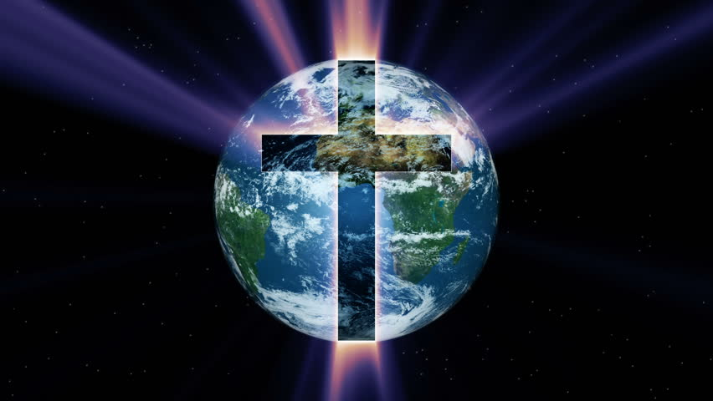
INTRO
What the dark and evil world around us needs is to hear the gospel!

Slide 5
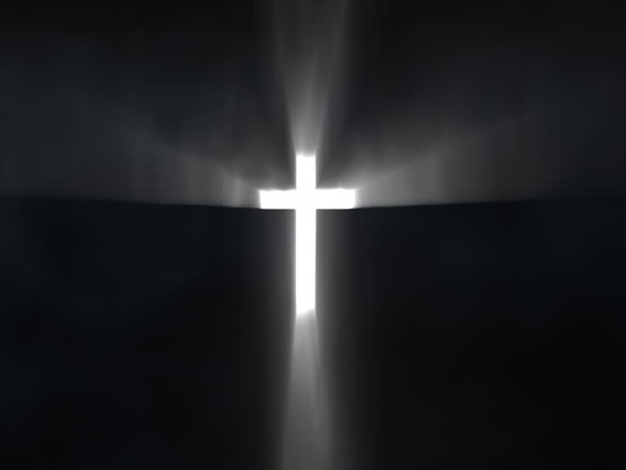
Intro
Colossians 3:16: Singing psalms, hymns, and spiritual songs can teach and admonish!
We will focus our thoughts today on the lyrics to the hymn, “Send The Light” (1890) by Charles H. Gabriel (1856-1932)

Slide 6
Intro
II Corinthians 4:5-6
5. For we do not preach ourselves but Christ Jesus as Lord, and ourselves as your bond-servants for Jesus' sake.
6. For God, who said, "Light shall shine out of darkness," is the One who has shone in our hearts to give the Light of the knowledge of the glory of God in the face of Christ.
The darkness of the world needs to hear the gospel – Who will “Send the Light?”

Slide 7
Souls to Save
“Send The Light” (1890) by Charles H. Gabriel
(1856-1932) Stanza 1:
“There's a call come's ringing o'er the restless wave, 'Send the light! Send the light!' There are souls to rescue, there are souls to save; Send the light! Send the light!”
“Light Shall Shine Out Of Darkness”

Slide 8
Souls to Save
The call is through the gospel (II Thessalonians 2:14)
Jesus said He came to seek and save the lost! (Luke 19:10)
Saints need to shine the light of the gospel into the dark world around us! (II Corinthians 4:5-6)
Souls need to be rescued because they are precious (Matthew 16:26)
Because these precious souls have sinned, they need to be saved (Romans 3:23; 6:23)
There are souls to save so saints need to “Send the Light!”

Slide 9
Help of the Gospel
“Send The Light” (1890) by Charles H. Gabriel
(1856-1932) Stanza 2:
“We have heard the Macedonian call today: 'Send the light! Send the light!' And a golden offering at the cross we lay; Send the light! Send the light!”
“Light Shall Shine Out Of Darkness”

Slide 10
Help of the Gospel
The gospel calls all Christians to shine the light out of darkness (II Corinthians 4:5-6)
Acts 16:9: A man from Macedonia appeared to Paul in a vision saying, “Come over to Macedonia and help us”
Acts 16:10: Paul and the others with him understood that they needed to go preach the gospel to the people of Macedonia!
Notes:
When Paul received the plea for help…
a. He did not go and build homes and orphanages in Macedonia.
b. He wasn’t sending in food and other rations.
c. He didn’t take up a collection of funds to send!
d. He did not set up a sponsoring church to send funds to for them to distribute to the Macedonians!
He knew that the best way to help the Macedonians was to make sure the gospel was heard by the people (Acts 16:11-15)

Slide 11
Help Of The Gospel
While we should go where we can, no one individual can go everywhere, but all of us can give a “golden offering” so that those who can go to other places can be supported (Philippians 4:15-16; II Corinthians 9:6-7)
Notes:
Php 4:15 You yourselves also know, Philippians, that at the first preaching of the gospel, after I left Macedonia, no church shared with me in the matter of giving and receiving but you alone;
Php 4:16 for even in Thessalonica you sent a gift more than once for my needs.
2Co 9:6 Now this I say, he who sows sparingly will also reap sparingly, and he who sows bountifully will also reap bountifully.
2Co 9:7 Each one must do just as he has purposed in his heart, not grudgingly or under compulsion, for God loves a cheerful giver.

Slide 12
Help of the Gospel
The gospel is the best “help” for a dark and evil world! (John 3:19-21)
The gospel is God’s power to save (Rom. 1:16) and in it we learn of man’s sin, and the cure (Rom. 3:23; Jn. 3:16)
We learn of Christ, and how He came to this earth, lived and taught the truth and then died upon the cross and shed His blood “for forgiveness of sins” (Mt. 20:28, 26:28; Eph. 1:7; I Cor. 15:3-4)
Notes:
The gospel is the best “help” for a dark and evil world! (John 3:19-21)
1. The gospel is God’s power to save (Rom. 1:16) and in it we learn of man’s sin, and the cure (Rom. 3:23; Jn. 3:16).
2. We learn of Christ, and how He came to this earth (Mt. 1; Lk. 2), lived and taught the truth (Mt. 5-7), and then died upon the cross and shed His blood “for forgiveness of sins” (Mt. 20:28, 26:28; Eph. 1:7; I Cor. 15:3-4).
3. We then learn of His victory over death at His resurrection and His ascension (Lk. 24:1-9; Acts 1:9-11; I Cor. 15:1-8)
4. Hearing, believing in Christ and being baptized “for the forgiveness of sins” (Mk. 16:16; Acts 2:38) is the beginning of a new life and walk with God (Rom. 6:3-8).
5. When people hear, believe, and obey the Lord’s plan of salvation, this is when they are truly helped! (James 1:21; John 12:48; II Thess. 1:7-9)

Slide 13
Help of the Gospel
The gospel is the best “help” for a dark and evil world! (John 3:19-21)
We learn of His victory over death at His resurrection and His ascension (Lk. 24:1-9; Acts 1:9-11; I Cor. 15:1-8)
Hearing, believing in Christ and being baptized “for the forgiveness of sins” (Mk. 16:16; Acts 2:38) is the beginning of a new life and walk with God (Rom. 6:3-8)
When people hear, believe, and obey the Lord’s plan of salvation, this is when they are truly helped! (James 1:21; John 12:48; II Thess. 1:7-9)
True “help” comes by introducing sinful man to Christ and showing them the Lord’s plan of salvation – “Send the Light” into the dark world!
Notes:
The gospel is the best “help” for a dark and evil world! (John 3:19-21)
1. The gospel is God’s power to save (Rom. 1:16) and in it we learn of man’s sin, and the cure (Rom. 3:23; Jn. 3:16).
2. We learn of Christ, and how He came to this earth (Mt. 1; Lk. 2), lived and taught the truth (Mt. 5-7), and then died upon the cross and shed His blood “for forgiveness of sins” (Mt. 20:28, 26:28; Eph. 1:7; I Cor. 15:3-4).
3. We then learn of His victory over death at His resurrection and His ascension (Lk. 24:1-9; Acts 1:9-11; I Cor. 15:1-8)
4. Hearing, believing in Christ and being baptized “for the forgiveness of sins” (Mk. 16:16; Acts 2:38) is the beginning of a new life and walk with God (Rom. 6:3-8).
5. When people hear, believe, and obey the Lord’s plan of salvation, this is when they are truly helped! (James 1:21; John 12:48; II Thess. 1:7-9)

Slide 14
Not Grow Weary
“Send The Light” (1890) by Charles H. Gabriel
(1856-1932) Stanza 3:
“Let us not grow weary in the work of love; Send the light! Send the light! Let us gather jewels for a crown above; Send the light! Send the light!”
“Light Shall Shine Out Of Darkness”

Slide 15
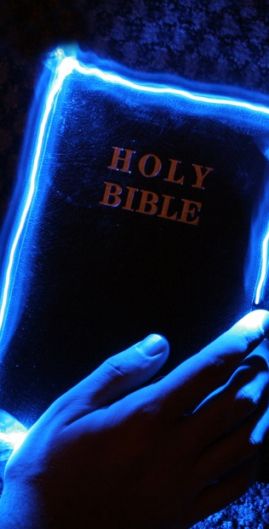
Not Grow Weary
In the work of sending the light, we must not grow weary (Gal. 6:9-10; II Tim. 2:24-26)
Jesus spoke in parables, so let us consider a modern-day parable on how the church can grow weary and complacent and fail her mission…

Slide 16
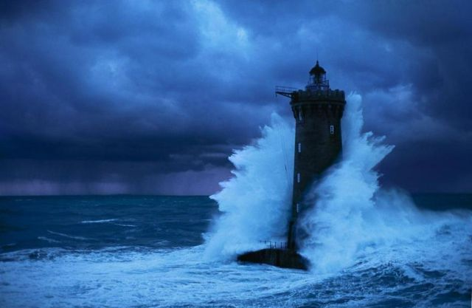
Not Grow Weary
Parable of the Life-Saving Station by an Unknown Author
Notes:
Parable of the Life-Saving Station
On a dangerous seacoast where shipwrecks often occur there was a once a crude little life-saving station. The building was just a hut, and there was only one boat, but the few devoted members kept a constant watch over the sea, and with no thought for themselves, they went out day or night tirelessly searching for the lost.
Many lives were saved by this wonderful little station, so that it became famous. Some of those who were saved, and various others in the surrounding areas, wanted to become associated with the station and give of their time and money and effort for the support of its work. New boats were bought and new crews were trained. The little life-saving station grew.
Some of the new members of the life-saving station were unhappy that the building was so crude and so poorly equipped. They felt that a more comfortable place should be provided as the first refuge of those saved from the sea.
So they replaced the emergency cots with beds and put better furniture in an enlarged building. Now the life-saving station became a popular gathering place for its members, and they re-decorated it beautifully and furnished it as a sort of club.
Fewer of the members were now interested in going to sea on life-saving missions, so they hired life boat crews to do this work. The mission of life-saving was still given lip-service but most were too busy or lacked the necessary commitment to take part in the life-saving activities personally.
About this time a large ship was wrecked off the coast, and the hired crews brought in boat loads of cold, wet, and half-drowned people. The victims were dirty and sick and thus made a mess in the beautiful new clubhouse. The property committee immediately had a shower house built outside the club where victims of shipwreck could be cleaned up before coming inside.
At the next meeting, there was a split in the club membership. Most of the members wanted to stop the club's life-saving activities on account of it being unpleasant and a hindrance to the normal life pattern of the club. But some members insisted that life-saving was their primary purpose and pointed out that they were still called a life-saving station. They were finally voted down and told that if they wanted to save the life of all the various kinds of people who were shipwrecked in those waters, they could begin their own life-saving station. They did.
As the years went by, the new station experienced the same changes that had occurred in the old. They evolved into a club and yet another life-saving station was founded. If you visit the seacoast today you will find a number of exclusive clubs along that shore. Shipwrecks are still frequent in those waters, only now most of the people drown.
Author Unknown
http://www.bible.ca/evangelism/e-parable-life-saving.htm
http://www.ecfvp.org/vestrypapers/death-and-resurrection/parable-of-the-lifesaving-station/
http://www.allsaintslindfield.org/blog/the-parable-of-the-lifeboat-station

Slide 17
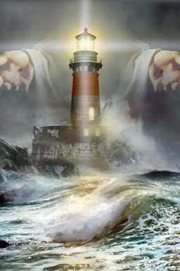
Not Grow Weary
Some people say they are not gifted at teaching or preaching so the work of saving the lost is left for someone else more capable…

Slide 18
Not Grow Weary
There are four simple things every saint can do:
Shine – Mt. 5:16
Speak – Eph. 4:15
Invite – Jn. 1:45-46 (Challenge!)
Welcome – James 2:1-4
Notes:
Some people say they are not gifted at teaching or preaching so the work of saving the lost is left for someone else more capable.
There are four simple things every saint can do!
a. Shine – Mt. 5:16: Live by example (Eph. 4:1-3)! Old saying…
1) “Your life may be all the sermon a person gets – make it a good one!”
b. Speak – Eph. 4:15: As saints Christ should be in our conversations.
1) We talk about things important to us – do others hear you speak of Jesus?
c. Invite – Jn. 1:45-46: Be like Philip to Nathaniel: “Come and see!”
1) CHALLENGE: Meet and greet two people in the next month and hand them a church “invitation card” (to be passed out earlier)
2) This is something everyone can do!
d. Welcome – James 2:1-4: James tells saints how to welcome and how to not welcome people into our assemblies.
1) The assembly of God’s people should be a warm & welcoming place!

Slide 19
Not Grow Weary
God wants all men to be saved! (I Tim. 2:3-4; II Pet. 3:9)
The “jewels” which we gather will also be our joy and crown (Phil. 4:1)
Matthew 6:19-21: This world is not our home! We must not grow weary or content with the treasures of the world but seek the treasures of Heaven! (Heb. 12:1-3; Col. 3:1-3)
Let us not grow weary and lose heart, but continue to “Send the Light!”
Notes:
God wants all men to be saved! (I Tim. 2:3-4; II Pet. 3:9): We shall not grow weary if we remember that we are gathering up God's “jewels” for Him.
It will also help us to persevere to recall that the “jewels” which we gather will also be our joy and crown (Phil. 4:1)
Matthew 6:19-21: This world is not our home! We must not grow weary or content with the treasures of the world but seek the treasures of Heaven! (Heb. 12:1-3; Col. 3:1-3)

Slide 20
Conclusion
“Send The Light” (1890) by Charles H. Gabriel
(1856-1932) Chorus:
“Send the light! the blessed gospel light! Let it shine from shore to shore. Send the light! the blessed gospel light! Let it shine forevermore.”
“Light Shall Shine Out Of Darkness”

Slide 21
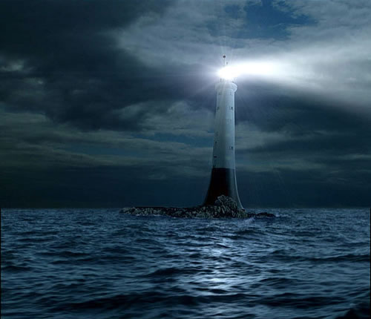
Conclusion
What kind of “lifesaving station” are we?
One that is faithfully fulfilling its mission?
One that is basking in its material blessings?

Slide 22
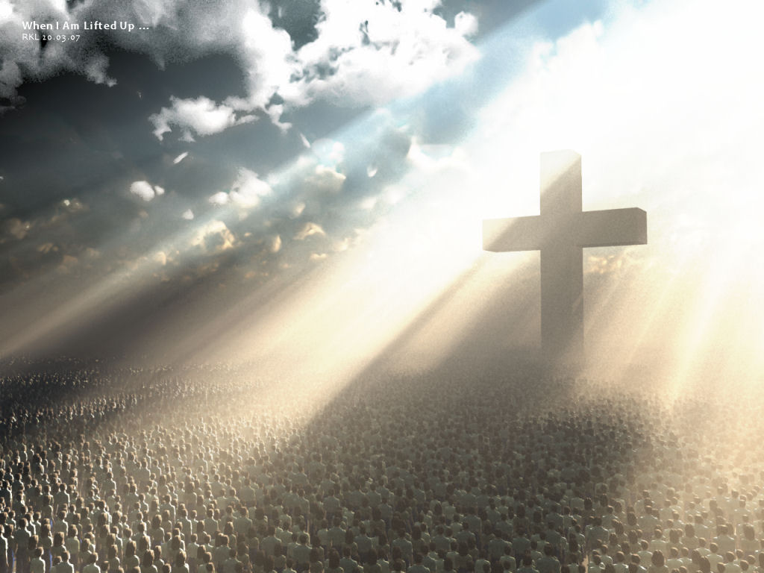
Conclusion
May God's grace and mercy shown toward us compel us to be active in sharing the same grace and mercy to others!
We can do this by
sounding forth the gospel
call to obey and
proclaiming the
praises of God!

Slide 23
Conclusion
The darkness and evil of this world cannot be legislated out, because it is a heart problem!
The gospel can change hearts and transform lives (I Corinthians 6:9-11)
“Send the Light!”

Slide 24
“What Must I Do To Be Saved?”
Hear The Gospel (Jn. 5:24; Rom. 10:17)
Believe In Christ (Jn. 3:16-18; Jn. 8:24)
Repent Of Sins (Lk. 13:3-5; Acts 2:38)
Confess Christ (Mt. 10:32; Rom. 10:10)
Be Baptized (Mk. 16:16; Acts 22:16)
Remain Faithful (Jn. 8:31; Rev. 2:10)
For The Erring Saint:
Repent (Acts 8:22), Confess (I Jn. 1:9),
Pray (Acts 8:22)

