Slide 1
Welcome
Let us join together in worship
…You who seek God, let your hearts revive.
Psalm 69:32
Please silence all devices
This Photo by Unknown Author is licensed under CC BY-SA
This Photo by Unknown Author is licensed under CC BY-SA

Slide 2
Welcome and Announcements
Song
Song
Opening Prayer
Song
Lord’s Supper
Offering
Song
Lesson
Song
Closing Prayer
“It is good to give thanks to the Lord,
And to sing praises to Your name, O Most High” - Psalm 92:1

Slide 3
Faith Is the Victory
515
Hymn: John H. Yates (1891)
Tune: SANKEY • Ira D. Sankey (1891)

Slide 4
FaithIsTheVictory_st1_a
Vs 1
© 2014 Sumphonia Productions, LLC

Slide 5
FaithIsTheVictory_st1_b
Vs 1
© 2014 Sumphonia Productions, LLC

Slide 6
FaithIsTheVictory_st1_c
Vs 1
© 2014 Sumphonia Productions, LLC

Slide 7
FaithIsTheVictory_st1_d
Vs 1
© 2014 Sumphonia Productions, LLC

Slide 8
FaithIsTheVictory_ref_a
Refrain
© 2014 Sumphonia Productions, LLC

Slide 9
FaithIsTheVictory_ref_b
Refrain
© 2014 Sumphonia Productions, LLC

Slide 10
FaithIsTheVictory_st2_a
Vs 2
© 2014 Sumphonia Productions, LLC

Slide 11
FaithIsTheVictory_st2_b
Vs 2
© 2014 Sumphonia Productions, LLC

Slide 12
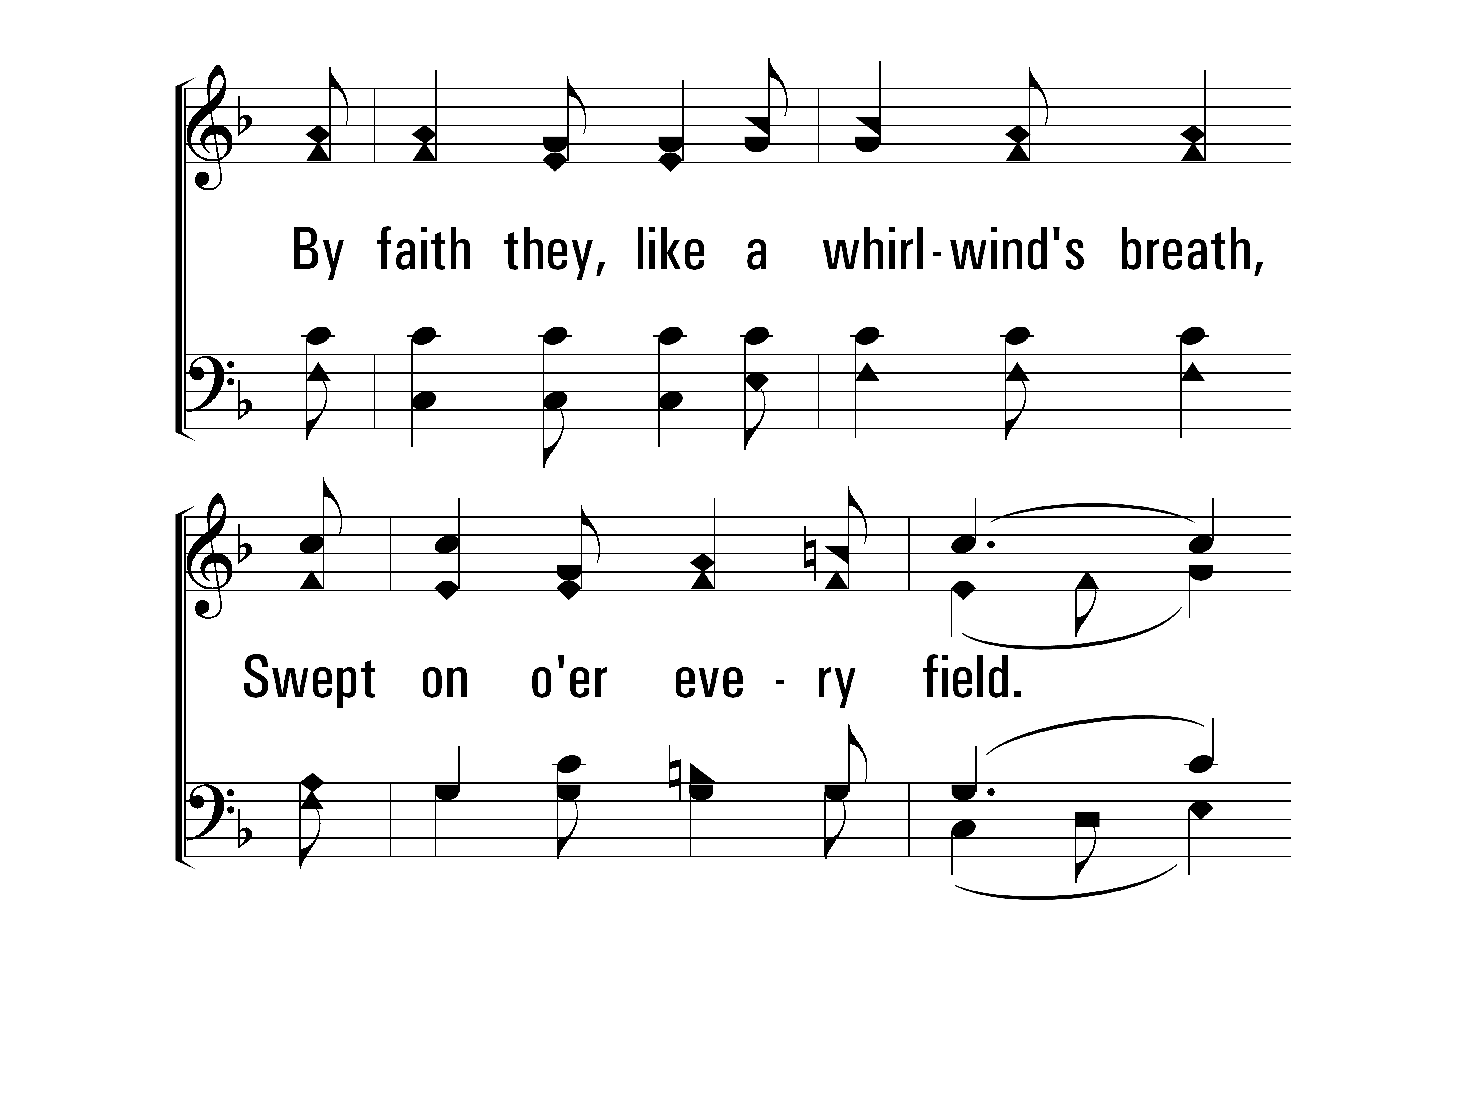
FaithIsTheVictory_st2_c
Vs 2
© 2014 Sumphonia Productions, LLC

Slide 13
FaithIsTheVictory_st2_d
Vs 2
© 2014 Sumphonia Productions, LLC

Slide 14
FaithIsTheVictory_ref_a
Refrain
© 2014 Sumphonia Productions, LLC

Slide 15
FaithIsTheVictory_ref_b
Refrain
© 2014 Sumphonia Productions, LLC

Slide 16
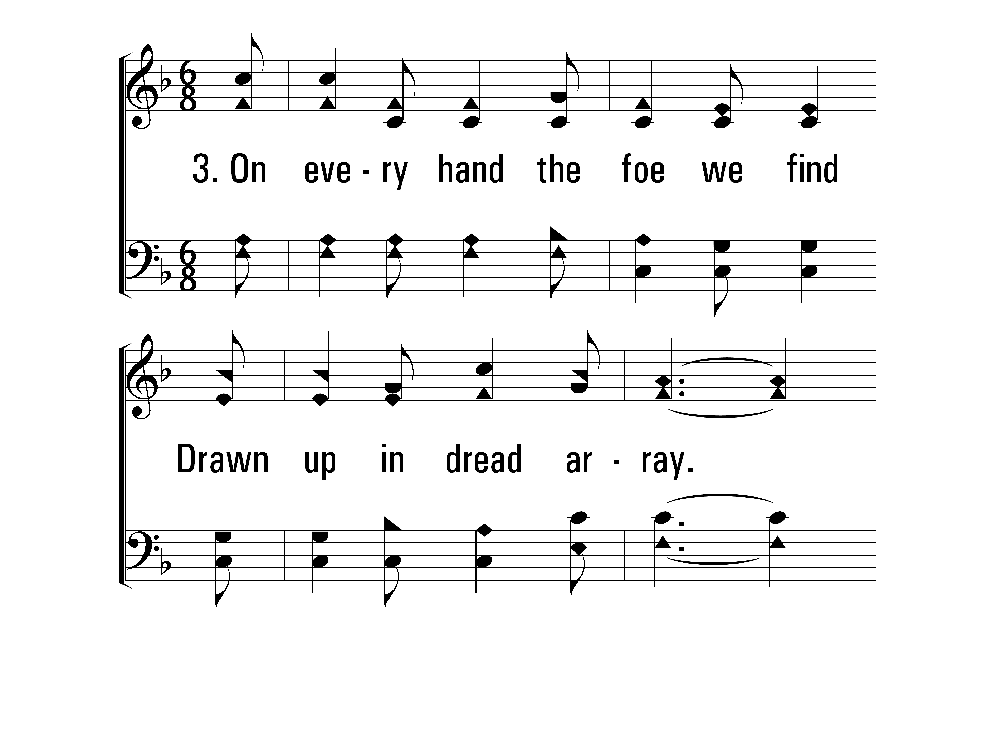
FaithIsTheVictory_st3_a
Vs 3
© 2014 Sumphonia Productions, LLC

Slide 17
FaithIsTheVictory_st3_b
Vs 3
© 2014 Sumphonia Productions, LLC

Slide 18
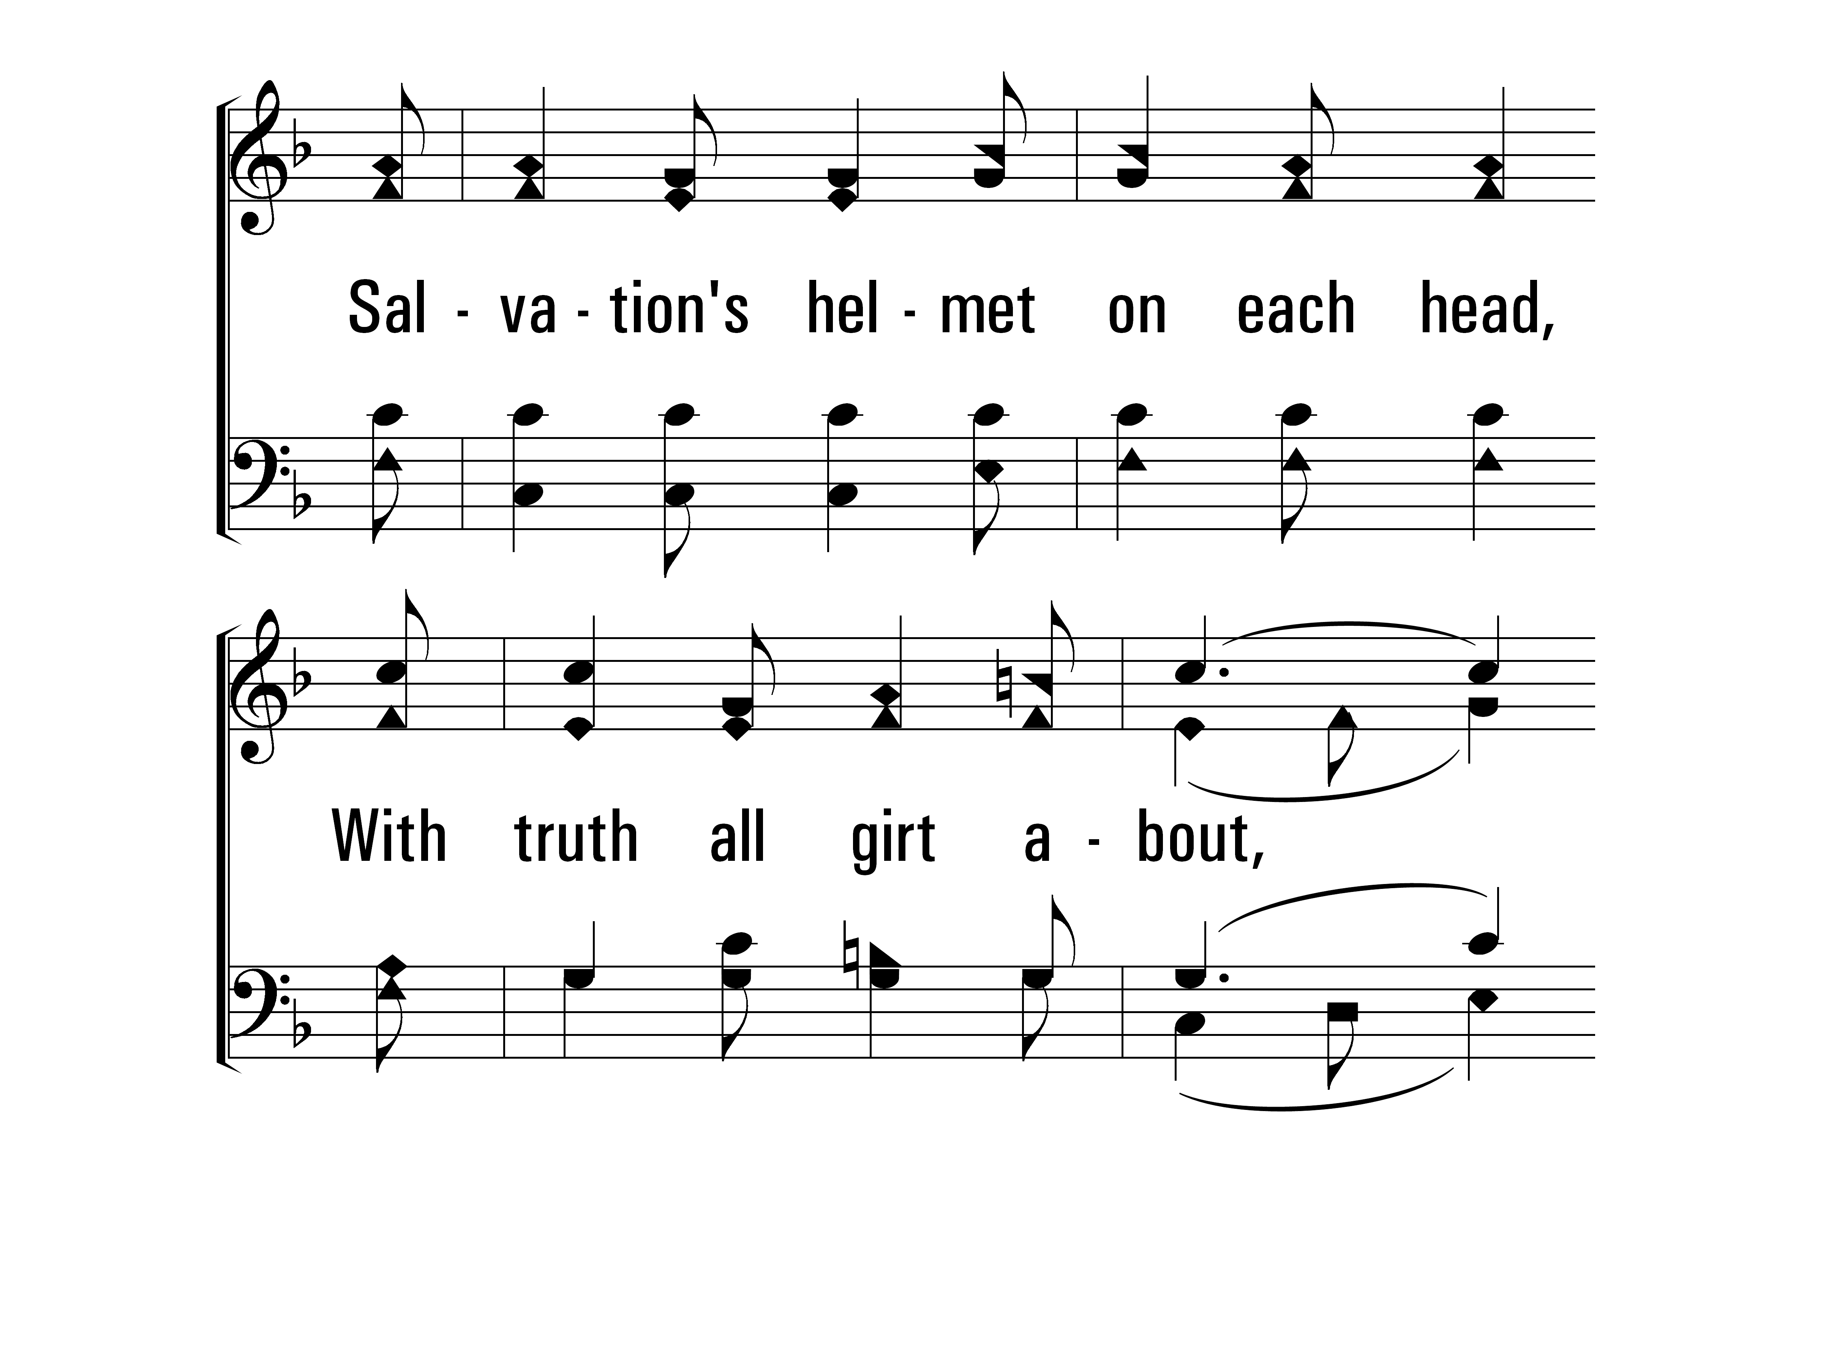
FaithIsTheVictory_st3_c
Vs 3
© 2014 Sumphonia Productions, LLC

Slide 19
FaithIsTheVictory_st3_d
Vs 3
© 2014 Sumphonia Productions, LLC

Slide 20
FaithIsTheVictory_ref_a
Refrain
© 2014 Sumphonia Productions, LLC

Slide 21
FaithIsTheVictory_ref_b
Refrain
© 2014 Sumphonia Productions, LLC

Slide 22
FaithIsTheVictory_st4_a
Vs 4
© 2014 Sumphonia Productions, LLC

Slide 23
FaithIsTheVictory_st4_b
Vs 4
© 2014 Sumphonia Productions, LLC

Slide 24
FaithIsTheVictory_st4_c
Vs 4
© 2014 Sumphonia Productions, LLC

Slide 25
FaithIsTheVictory_st4_d
Vs 4
© 2014 Sumphonia Productions, LLC

Slide 26
FaithIsTheVictory_ref_a
Refrain
© 2014 Sumphonia Productions, LLC

Slide 27
FaithIsTheVictory_ref_b
Refrain
© 2014 Sumphonia Productions, LLC
End

Slide 28
Revive Us Again
133
Hymn: William P. Mackay (1863)
Tune: John J. Husband (1820)

Slide 29
ReviveUsAgain_st1_a
Vs 1
© 2014 Sumphonia Productions, LLC

Slide 30
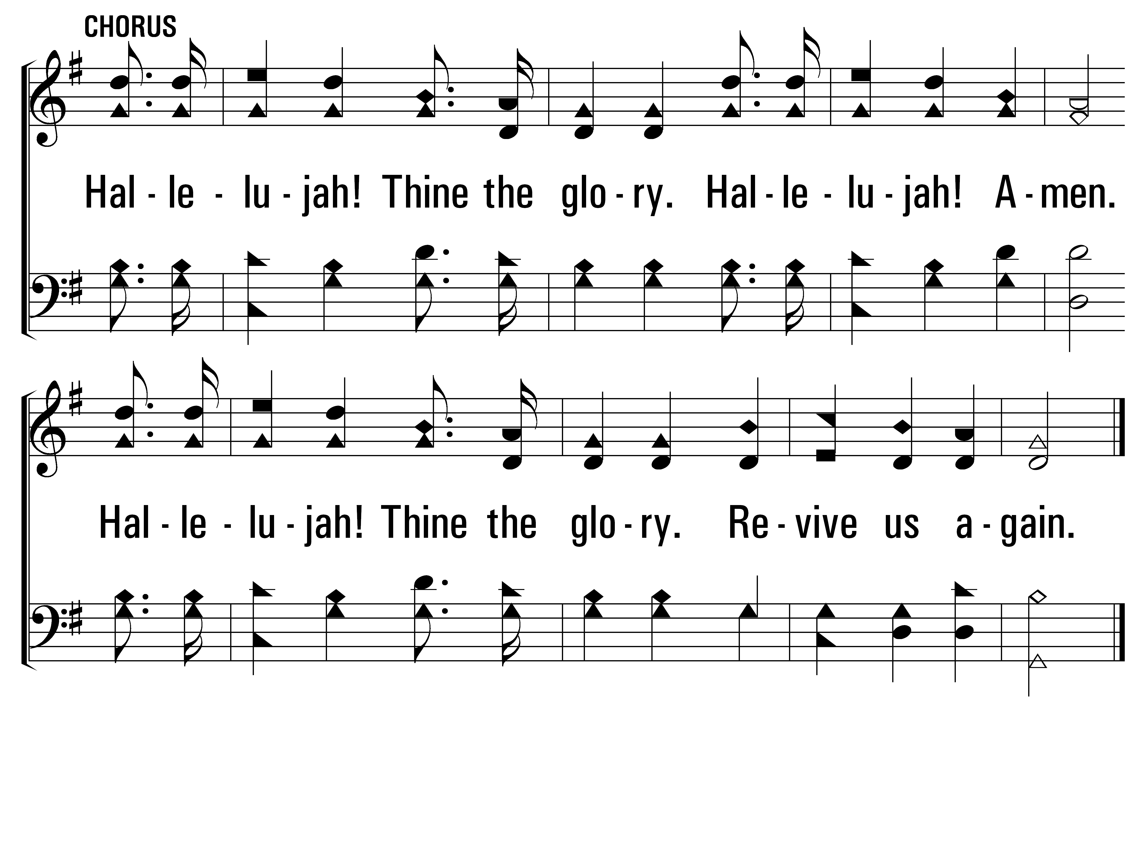
ReviveUsAgain_cho_a
Chorus
© 2014 Sumphonia Productions, LLC

Slide 31
ReviveUsAgain_st2_a
Vs 2
© 2014 Sumphonia Productions, LLC

Slide 32
ReviveUsAgain_cho_a
Chorus
© 2014 Sumphonia Productions, LLC

Slide 33
ReviveUsAgain_st3_a
Vs 3
© 2014 Sumphonia Productions, LLC

Slide 34
ReviveUsAgain_cho_a
Chorus
© 2014 Sumphonia Productions, LLC

Slide 35
ReviveUsAgain_st4_a
Vs 4
© 2014 Sumphonia Productions, LLC

Slide 36
ReviveUsAgain_cho_a
Chorus
© 2014 Sumphonia Productions, LLC
End

Slide 37
Opening Prayer
Song
Lord’s Supper
Offering
Song
Lesson
Song
Closing Prayer
“Be anxious for nothing, but in everything by prayer and supplication, with thanksgiving, let your requests be made known to God”
– Philippians 4:6

Slide 38
In Gethsemane Alone
221
Hymn: Samuel E. Reed (1912)
Tune: Samuel E. Reed (1912)

Slide 39
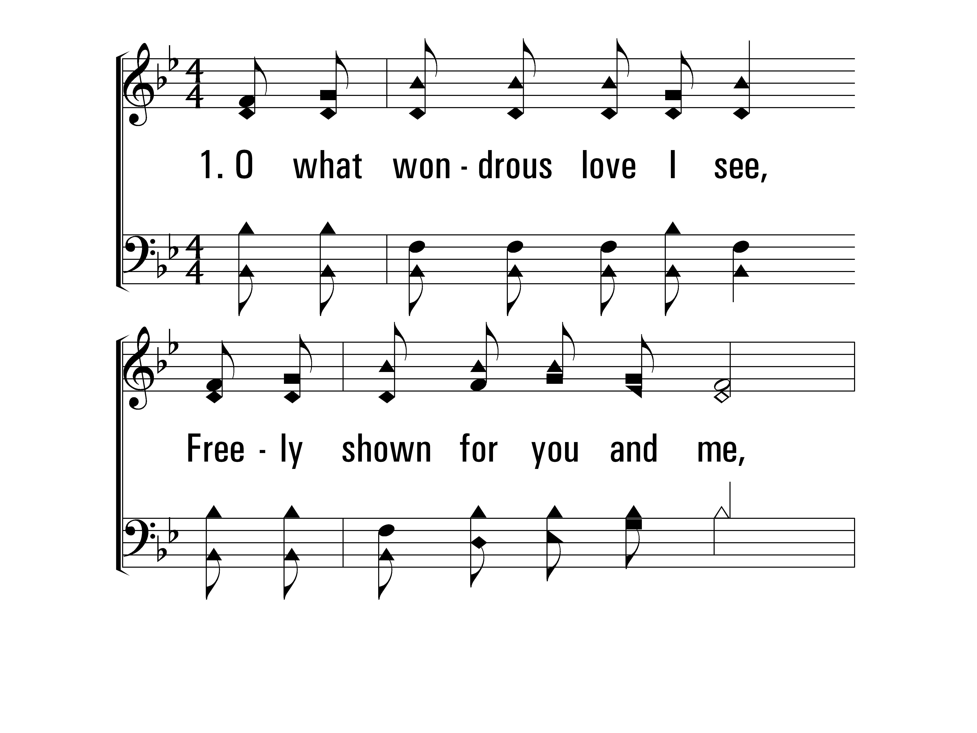
InGethsemaneAlone_st1_a
Vs 1
© 2014 Sumphonia Productions, LLC

Slide 40
InGethsemaneAlone_st1_b
Vs 1
© 2014 Sumphonia Productions, LLC

Slide 41
InGethsemaneAlone_st1_c
Vs 1
© 2014 Sumphonia Productions, LLC

Slide 42
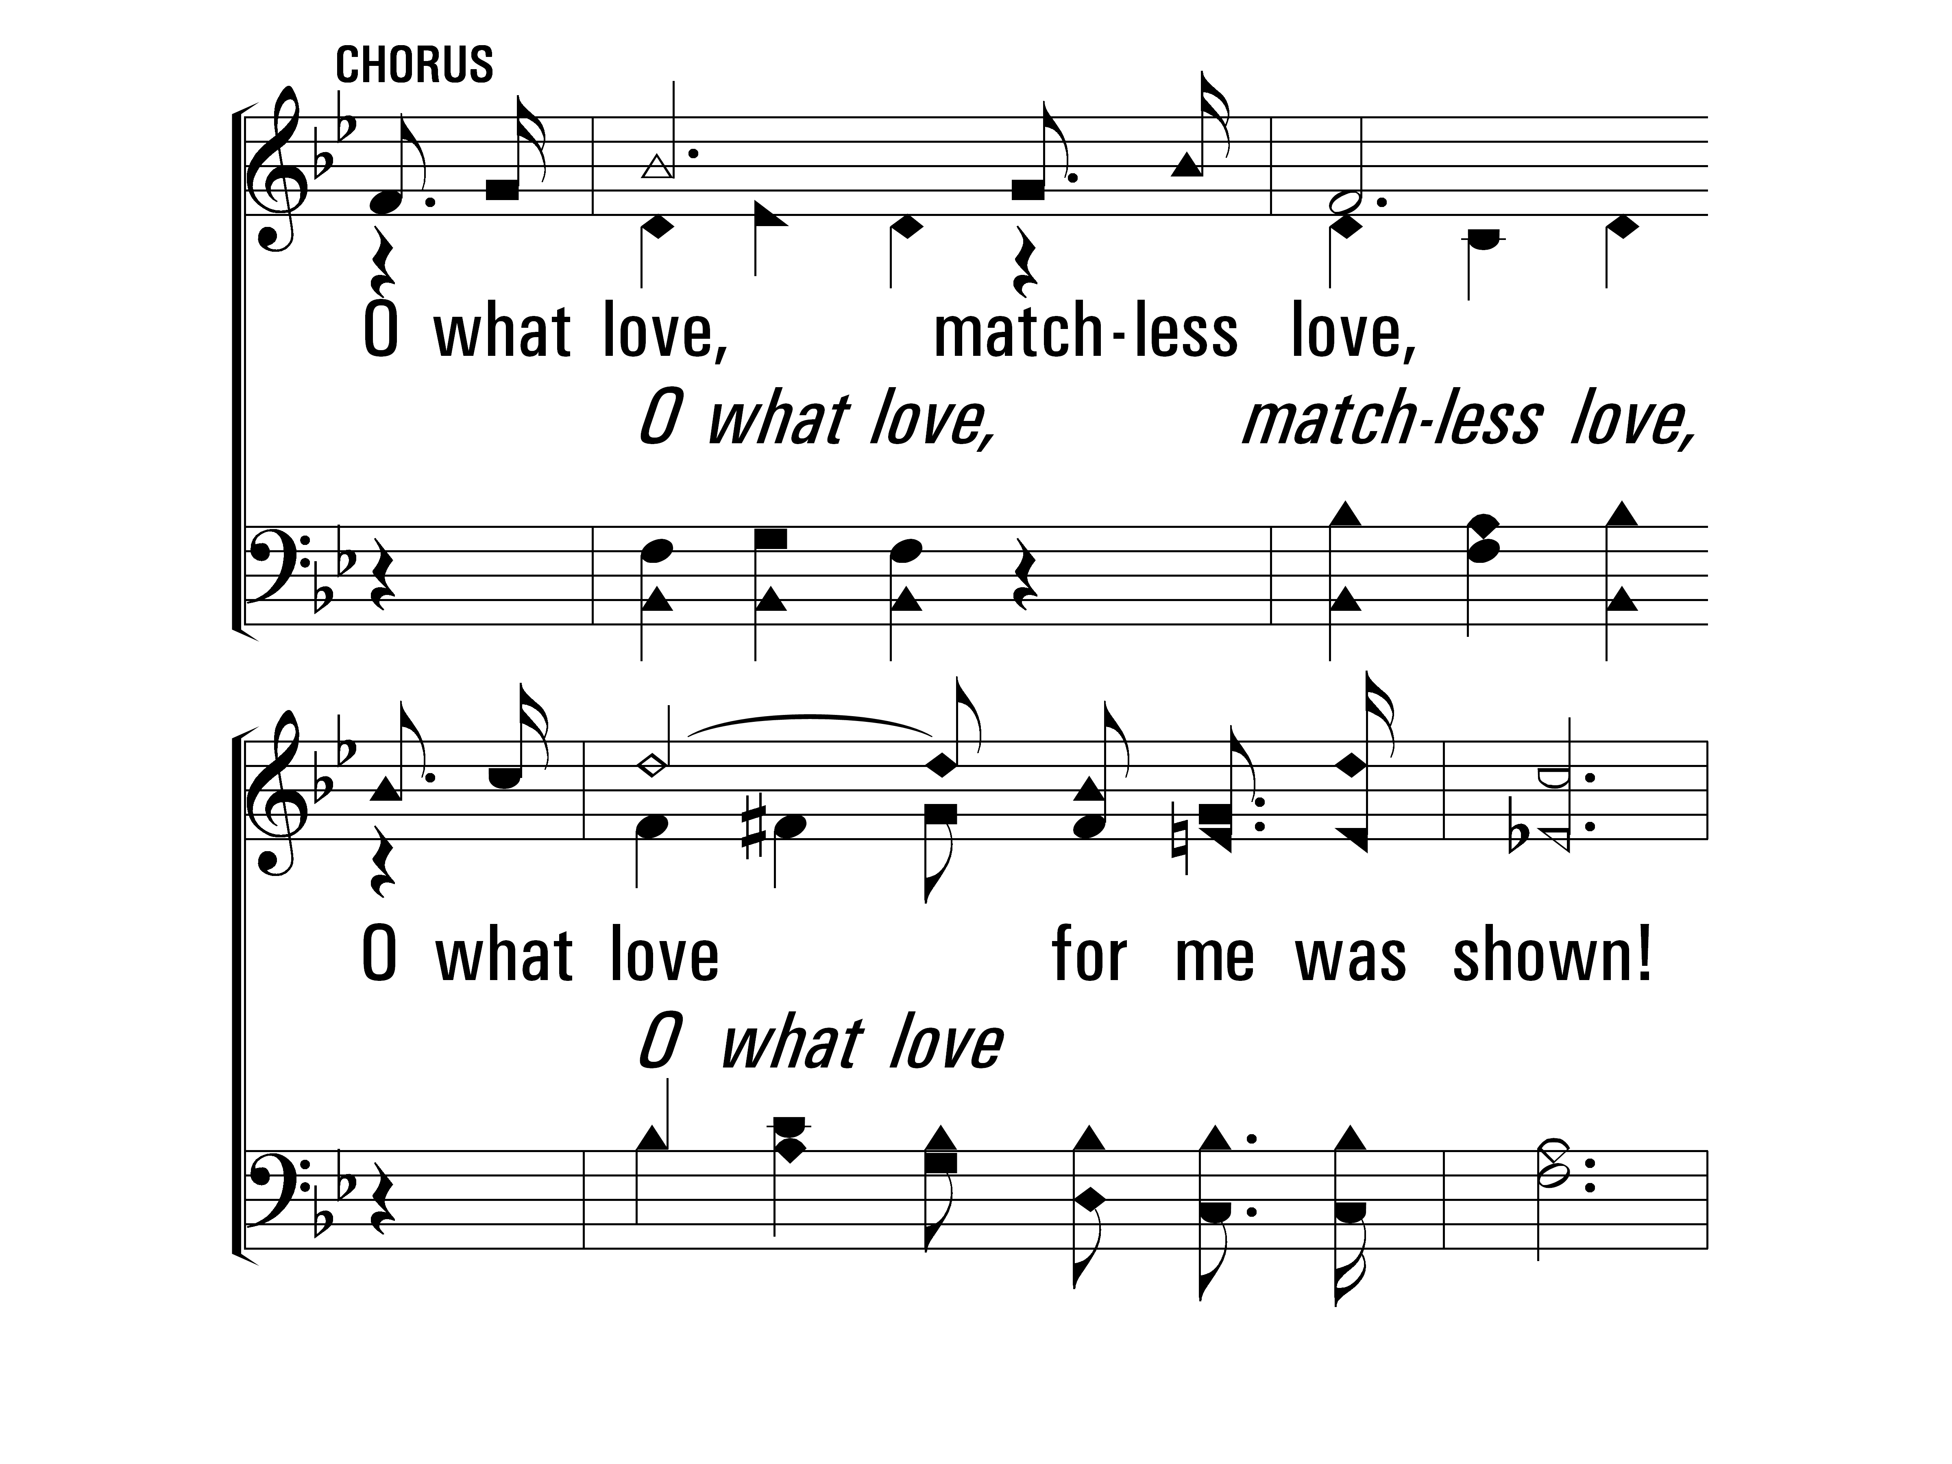
InGethsemaneAlone_cho_a
Chorus
© 2014 Sumphonia Productions, LLC

Slide 43
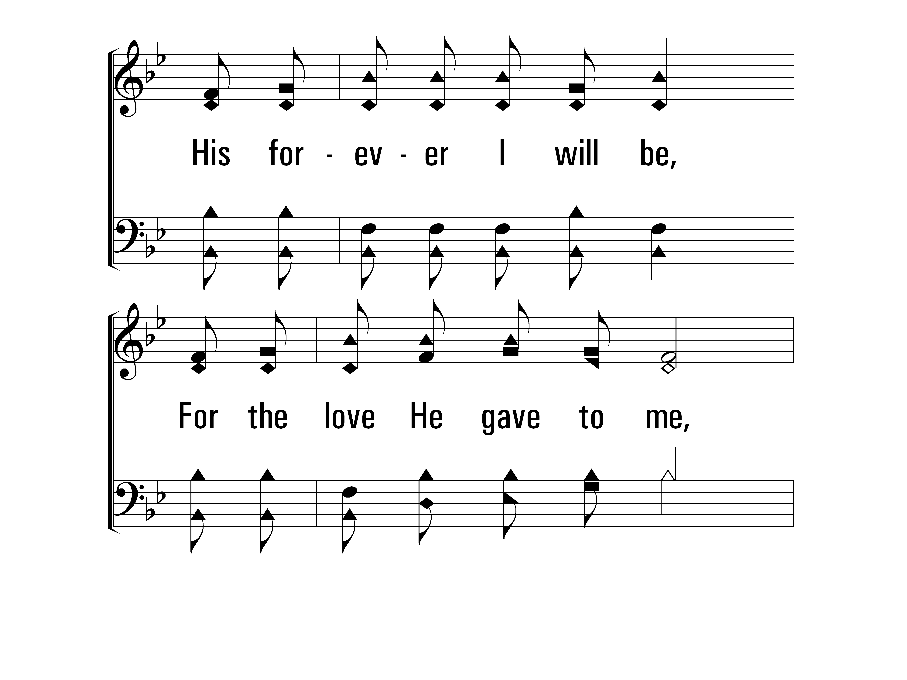
InGethsemaneAlone_cho_b
Chorus
© 2014 Sumphonia Productions, LLC

Slide 44
InGethsemaneAlone_cho_c
Chorus
© 2014 Sumphonia Productions, LLC

Slide 45
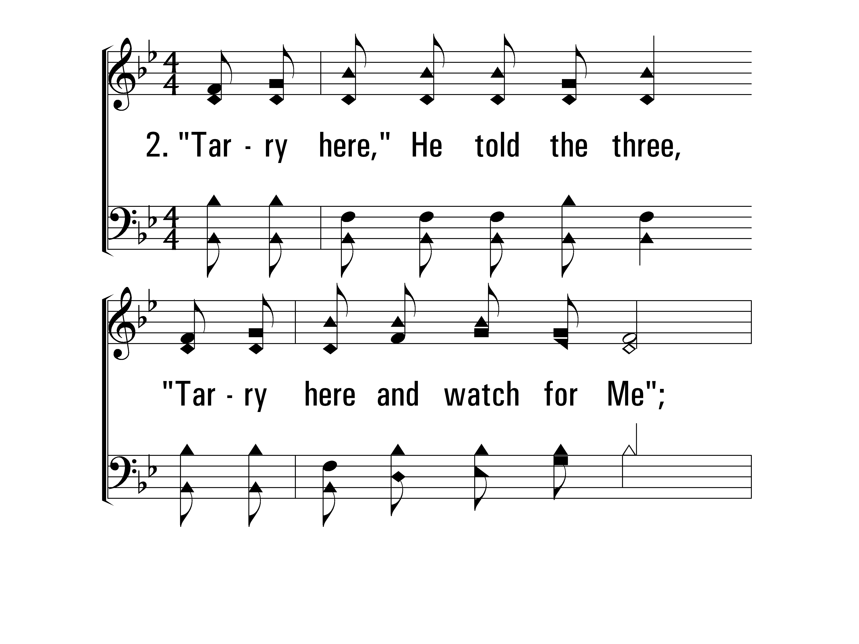
InGethsemaneAlone_st2_a
Vs 2
© 2014 Sumphonia Productions, LLC

Slide 46
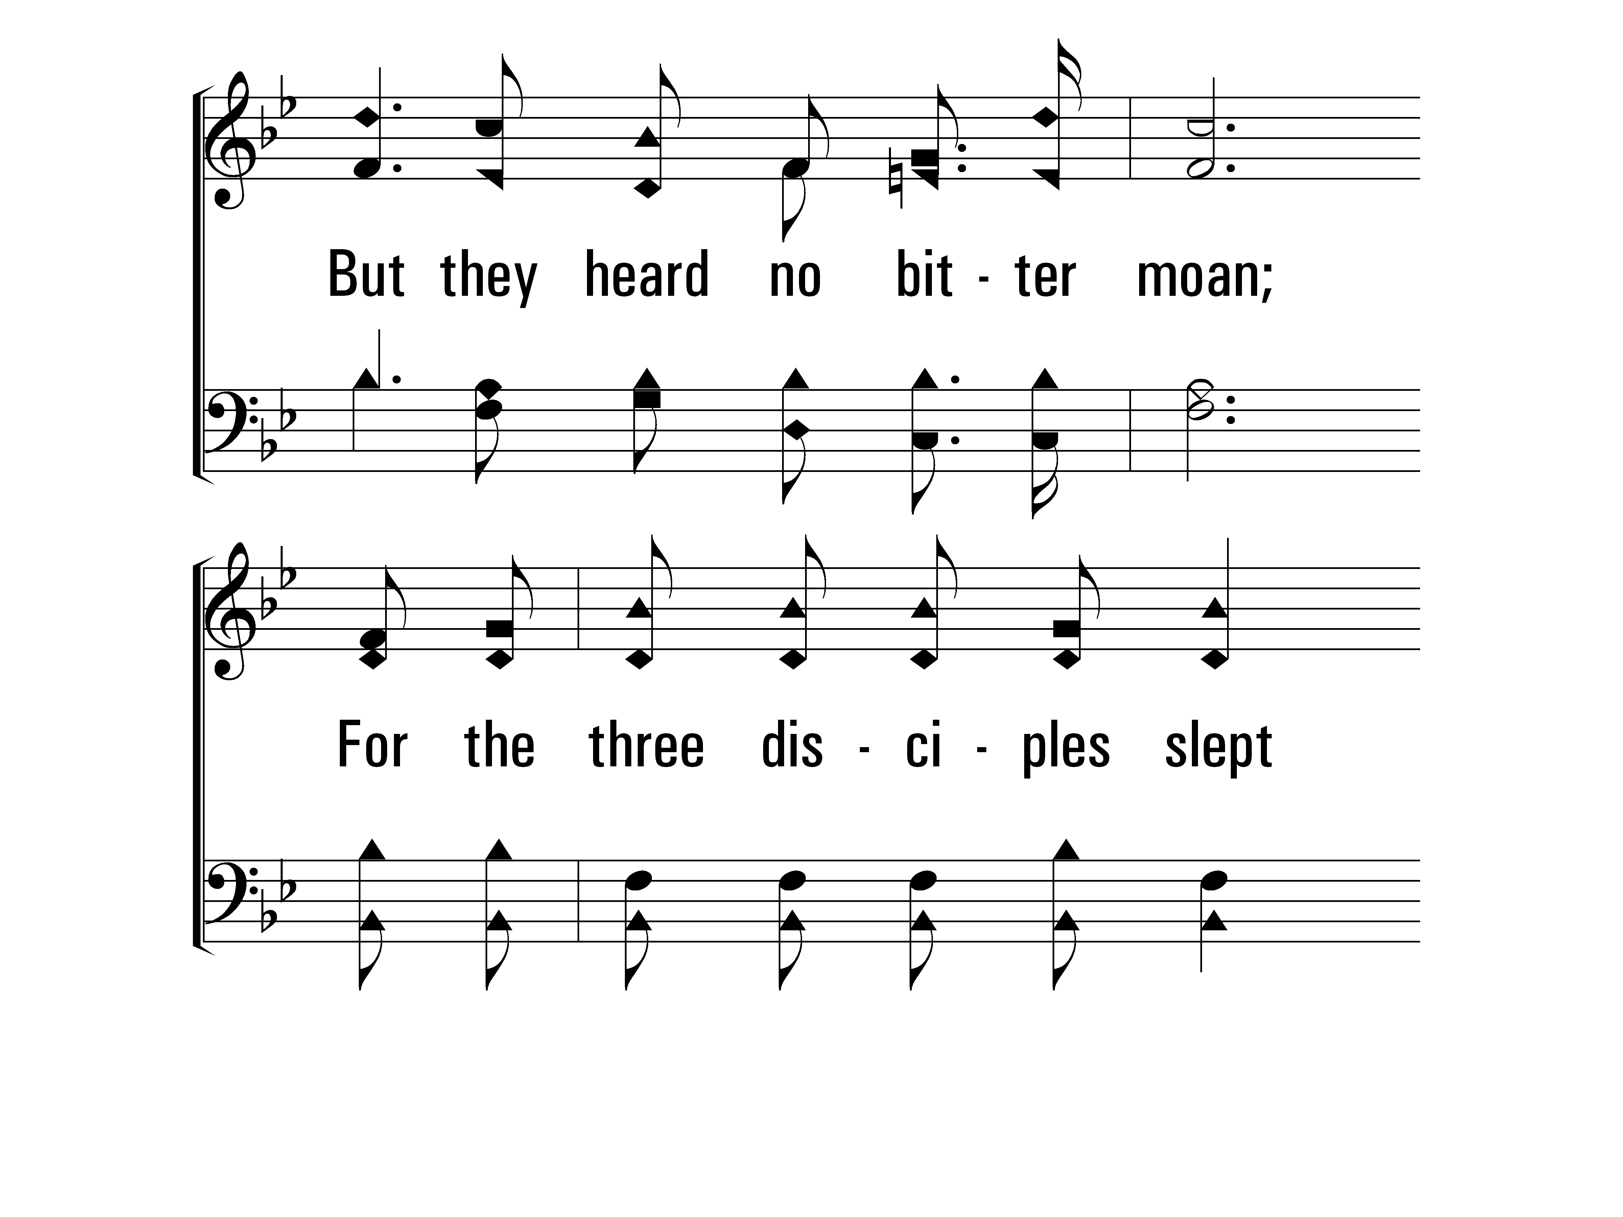
InGethsemaneAlone_st2_b
Vs 2
© 2014 Sumphonia Productions, LLC

Slide 47
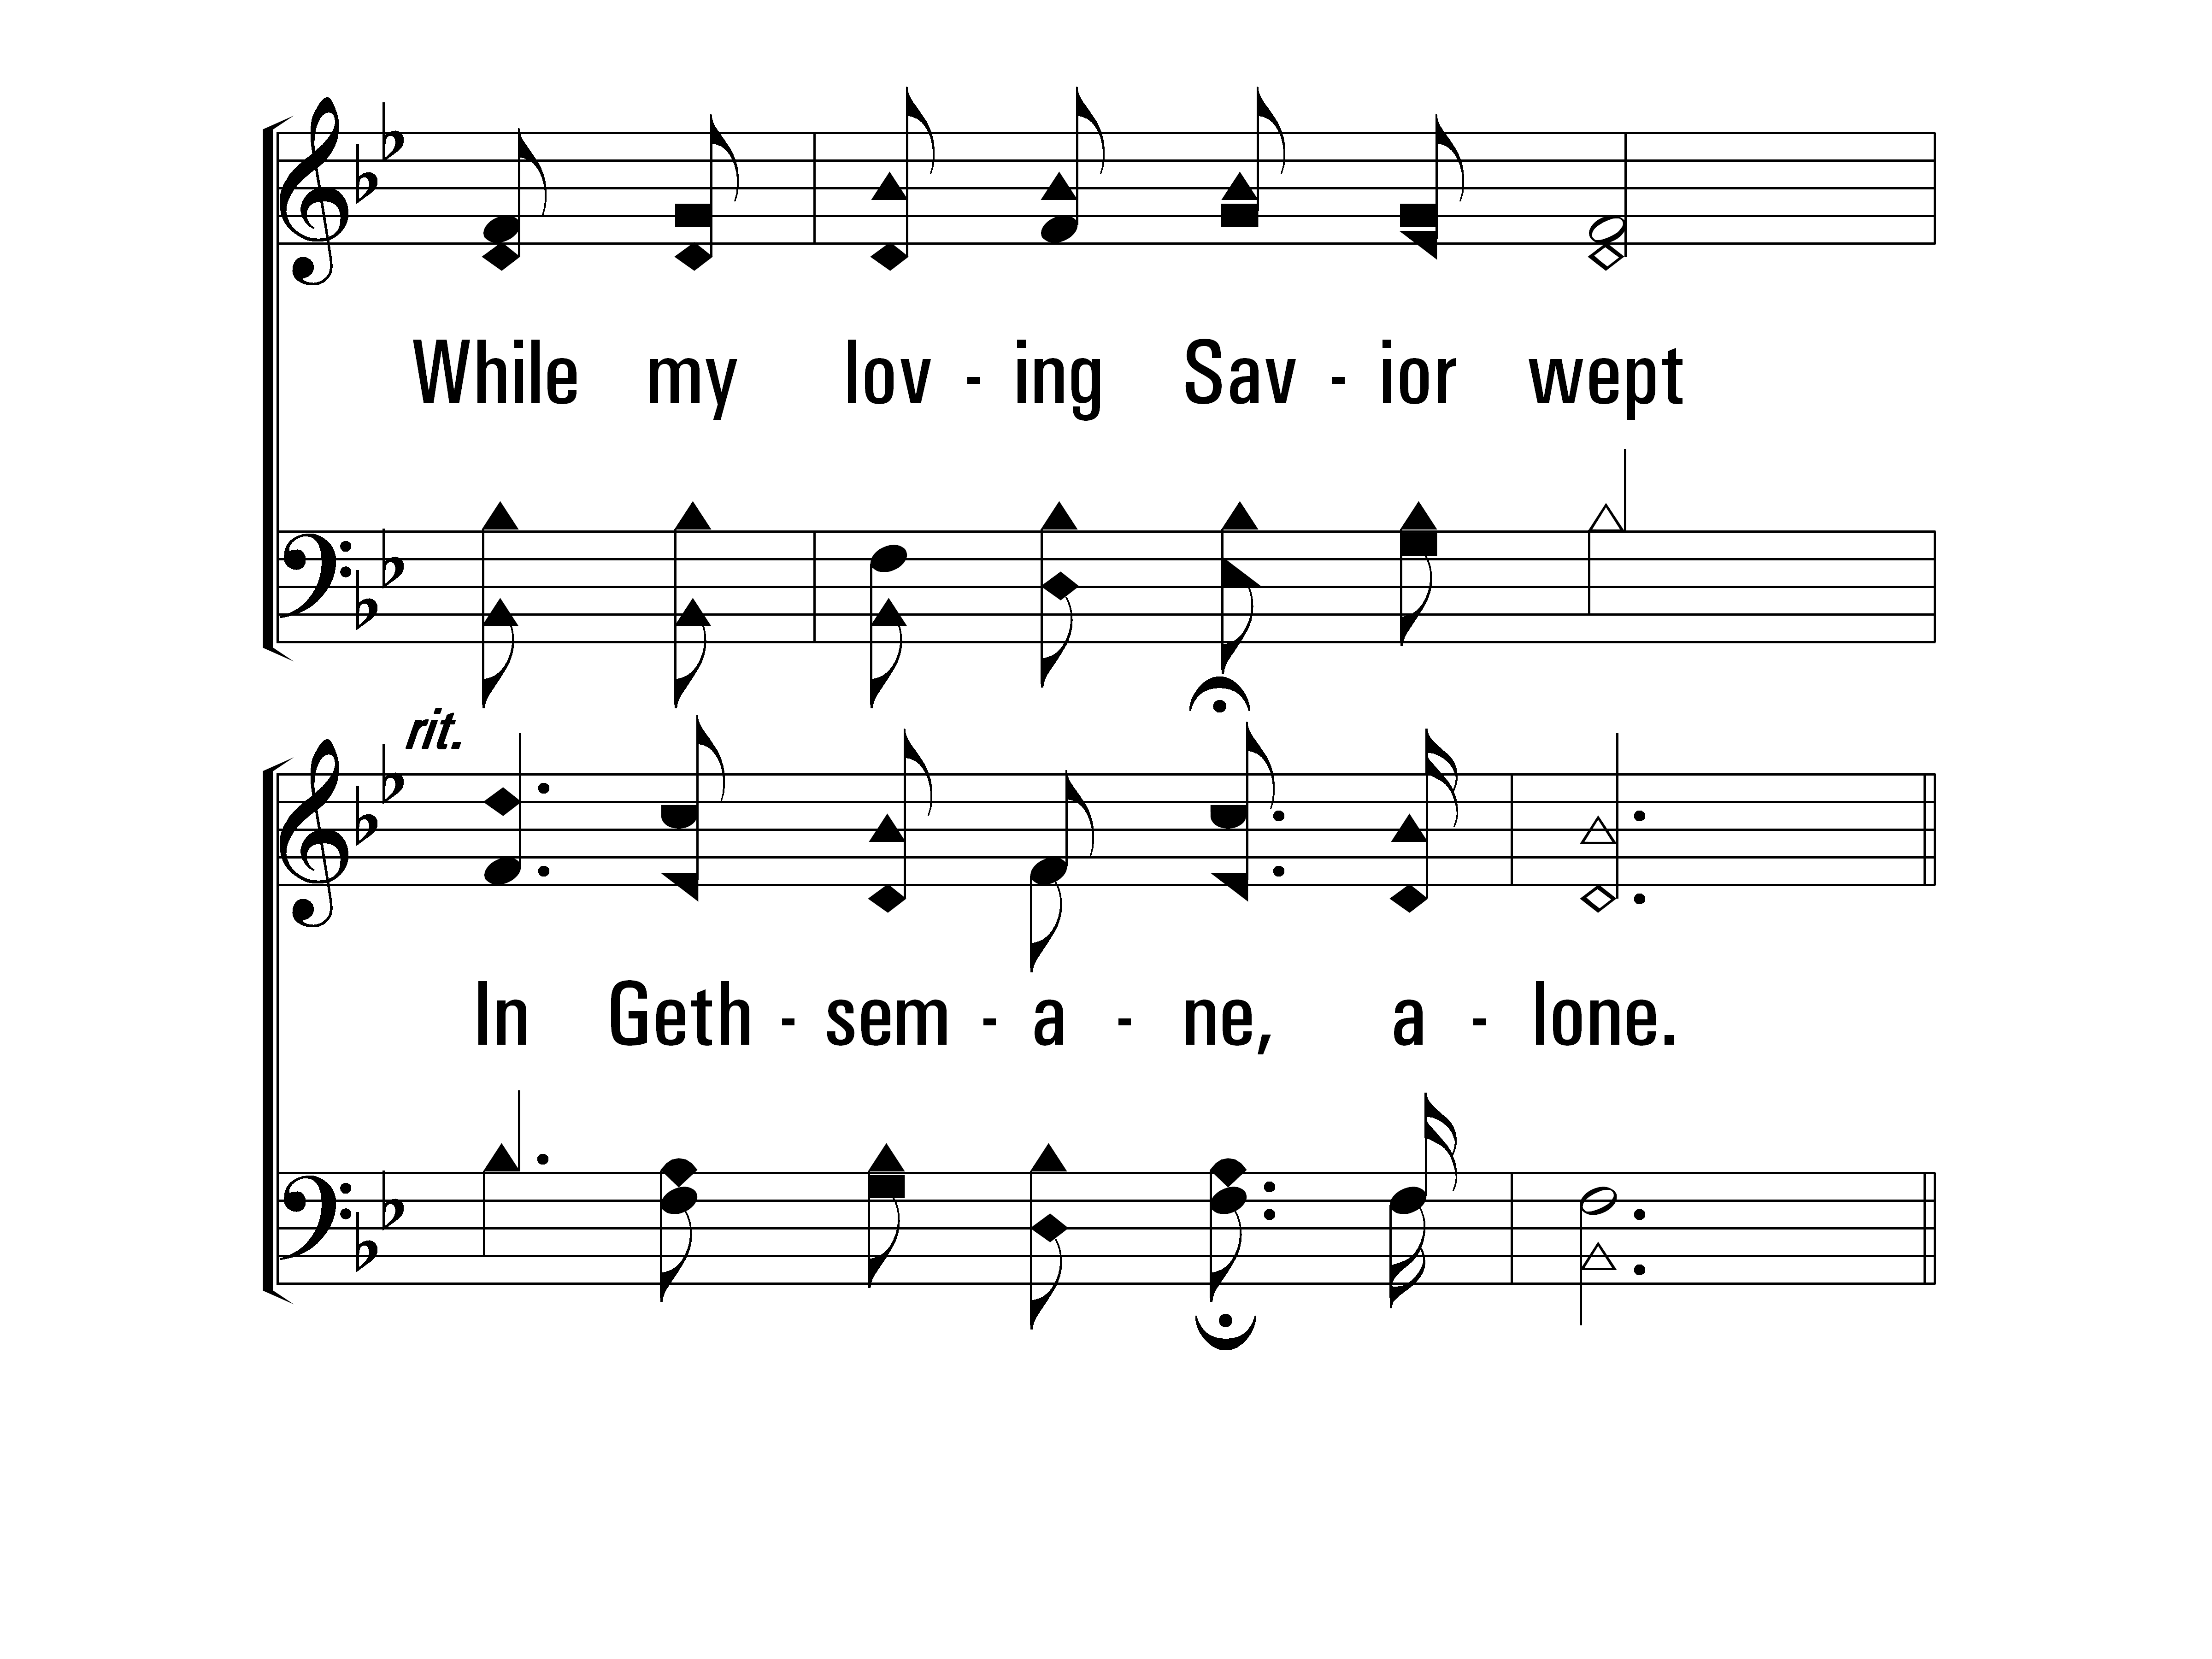
InGethsemaneAlone_st2_c
Vs 2
© 2014 Sumphonia Productions, LLC

Slide 48
InGethsemaneAlone_cho_a
Chorus
© 2014 Sumphonia Productions, LLC

Slide 49
InGethsemaneAlone_cho_b
Chorus
© 2014 Sumphonia Productions, LLC

Slide 50
InGethsemaneAlone_cho_c
Chorus
© 2014 Sumphonia Productions, LLC

Slide 51
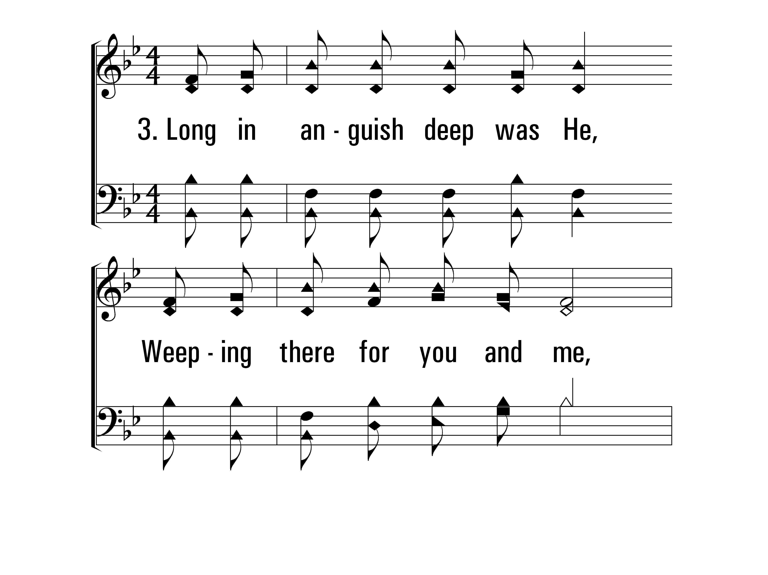
InGethsemaneAlone_st3_a
Vs 3
© 2014 Sumphonia Productions, LLC

Slide 52
InGethsemaneAlone_st3_b
Vs 3
© 2014 Sumphonia Productions, LLC

Slide 53
InGethsemaneAlone_st3_c
Vs 3
© 2014 Sumphonia Productions, LLC

Slide 54
InGethsemaneAlone_cho_a
Chorus
© 2014 Sumphonia Productions, LLC

Slide 55
InGethsemaneAlone_cho_b
Chorus
© 2014 Sumphonia Productions, LLC

Slide 56
InGethsemaneAlone_cho_c
Chorus
© 2014 Sumphonia Productions, LLC
End

Slide 57
Lord’s Supper
Offering
Song
Lesson
Song
Closing Prayer
For as often as you eat this bread and drink the cup, you proclaim the Lord's death until He comes.
- 1 Corinthians 11:26

Slide 58
Offering
Song
Lesson
Song
Closing Prayer
“Each one must do just as he has purposed in his heart, not grudgingly or under compulsion, for God loves a cheerful giver.”
- 2 Corinthians 9:7

Slide 59
The Solid Rock
412
Hymn: Edward Mote (1836)
Tune: SOLID ROCK • William B. Bradbury (1863)

Slide 60
TheSolidRock_st1_a
Vs 1
© 2014 Sumphonia Productions, LLC

Slide 61
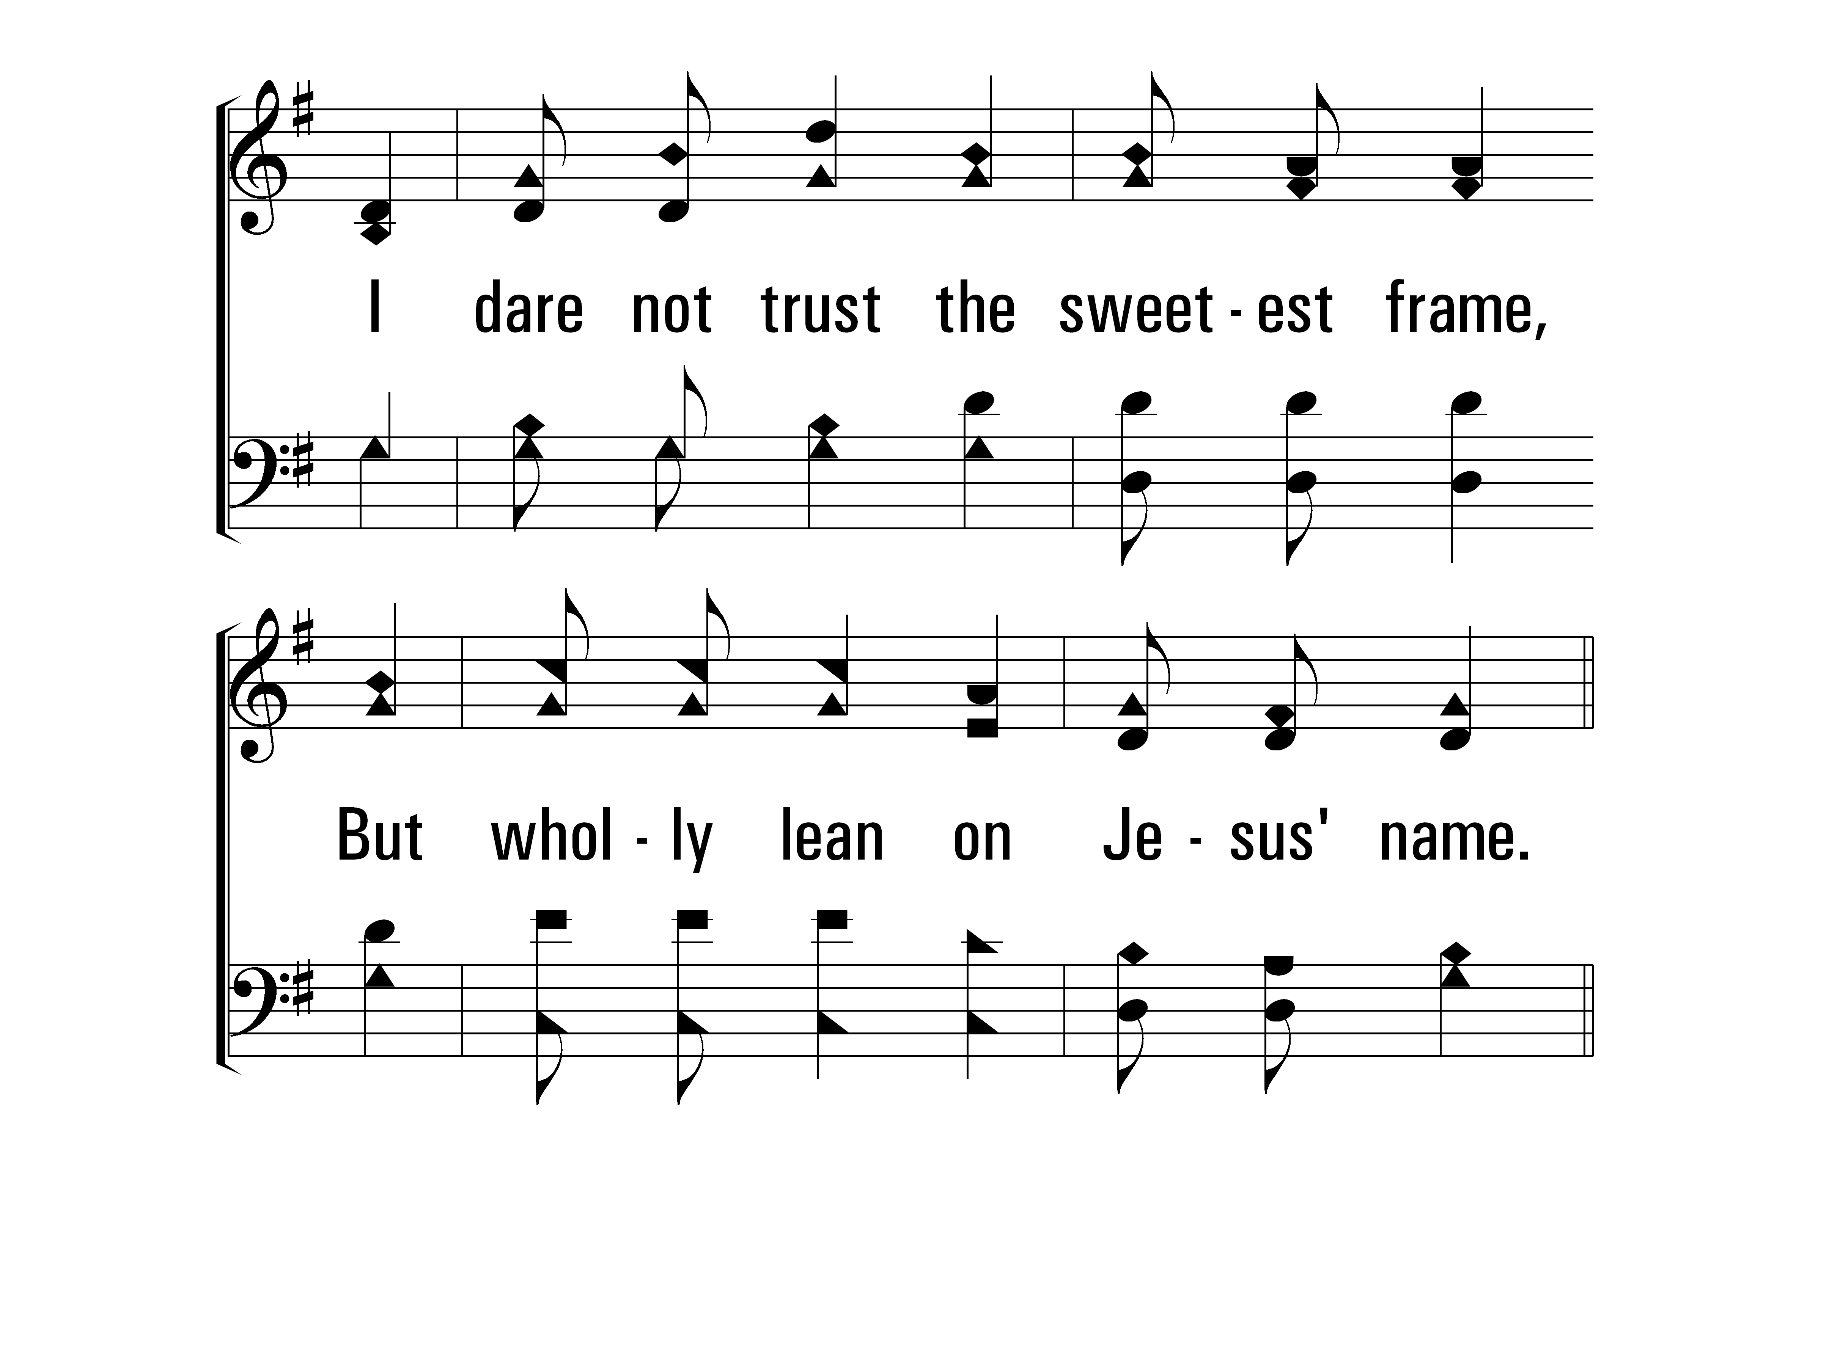
TheSolidRock_st1_b
Vs 1
© 2014 Sumphonia Productions, LLC

Slide 62
TheSolidRock_ref_a
Refrain
© 2014 Sumphonia Productions, LLC

Slide 63
TheSolidRock_ref_b
Refrain
© 2014 Sumphonia Productions, LLC

Slide 64
TheSolidRock_st2_a
Vs 2
© 2014 Sumphonia Productions, LLC

Slide 65
TheSolidRock_st2_b
Vs 2
© 2014 Sumphonia Productions, LLC

Slide 66
TheSolidRock_ref_a
Refrain
© 2014 Sumphonia Productions, LLC

Slide 67
TheSolidRock_ref_b
Refrain
© 2014 Sumphonia Productions, LLC

Slide 68
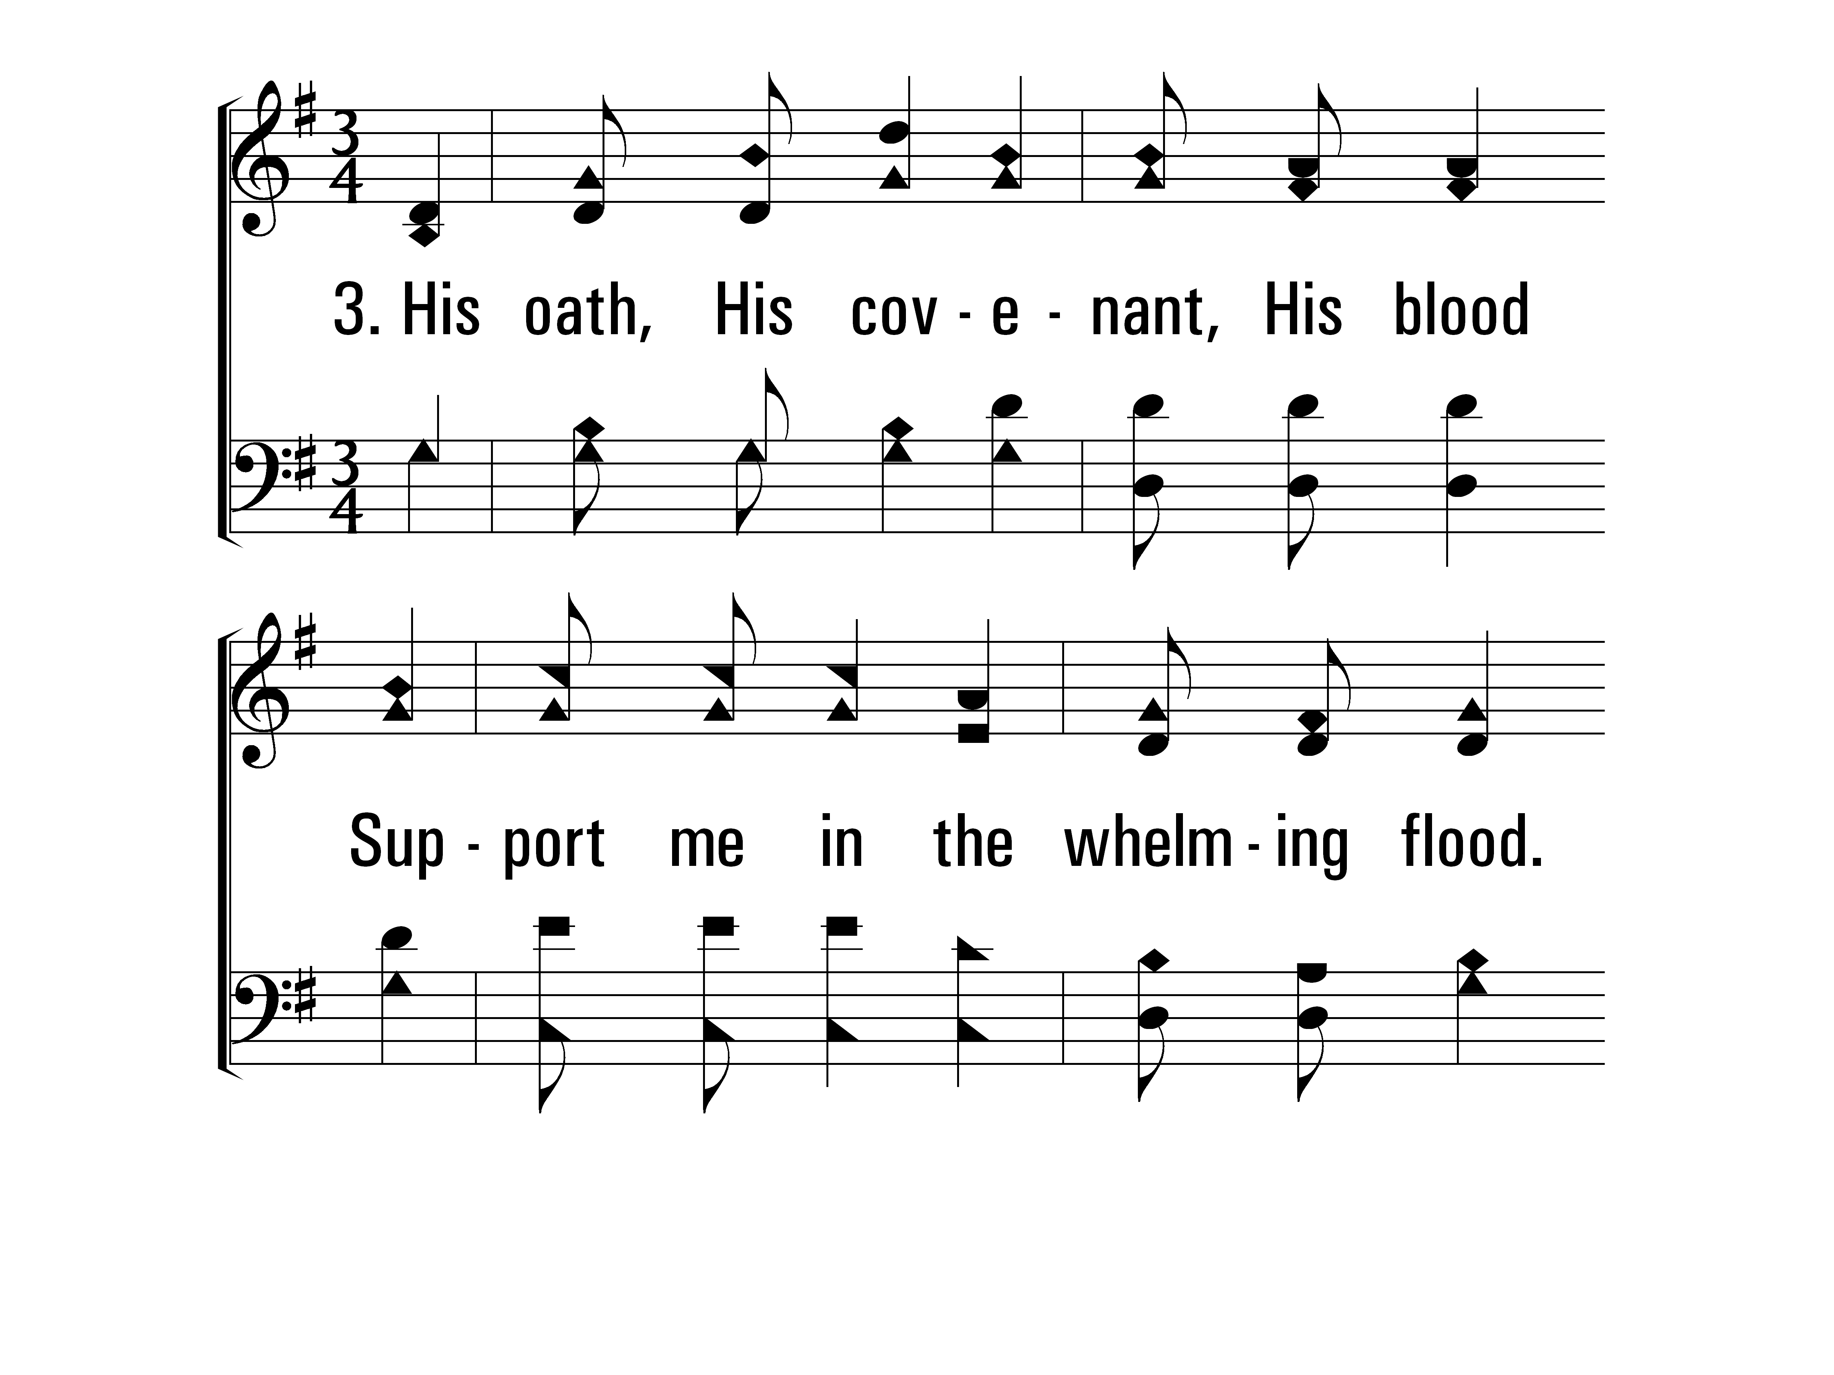
TheSolidRock_st3_a
Vs 3
© 2014 Sumphonia Productions, LLC

Slide 69
TheSolidRock_st3_b
Vs 3
© 2014 Sumphonia Productions, LLC

Slide 70
TheSolidRock_ref_a
Refrain
© 2014 Sumphonia Productions, LLC

Slide 71
TheSolidRock_ref_b
Refrain
© 2014 Sumphonia Productions, LLC

Slide 72
TheSolidRock_st4_a
Vs 4
© 2014 Sumphonia Productions, LLC

Slide 73
TheSolidRock_st4_b
Vs 4
© 2014 Sumphonia Productions, LLC

Slide 74
TheSolidRock_ref_a
Refrain
© 2014 Sumphonia Productions, LLC

Slide 75
TheSolidRock_ref_b
Refrain
© 2014 Sumphonia Productions, LLC
End

Slide 76
Lesson
Song
Closing Prayer
“It is good to give thanks to the Lord,
And to sing praises to Your name, O Most High” - Psalm 92:1

Slide 77
I’m a
Disciple

Slide 78
“A disciple is not above his teacher, but everyone when he is fully trained will be like his teacher.”
Luke 6:40

Slide 80
A disciple honors God by worshiping Him

Slide 81
A disciple honors God by doing the work He has assigned

Slide 82
A disciple honors God by keeping His Word

Slide 83
A disciple honors God by giving the proper credit to Him

Slide 84
A disciple honors God by standing out from the world

Slide 85
I’m a
Disciple

Slide 86
Why Keep Jesus Waiting?
830
Hymn: Christopher C. Cline (1882)
Tune: Christopher C. Cline (1882)

Slide 87
WhyKeepJesusWaiting_st1_a
Vs 1
© 2014 Sumphonia Productions, LLC

Slide 88
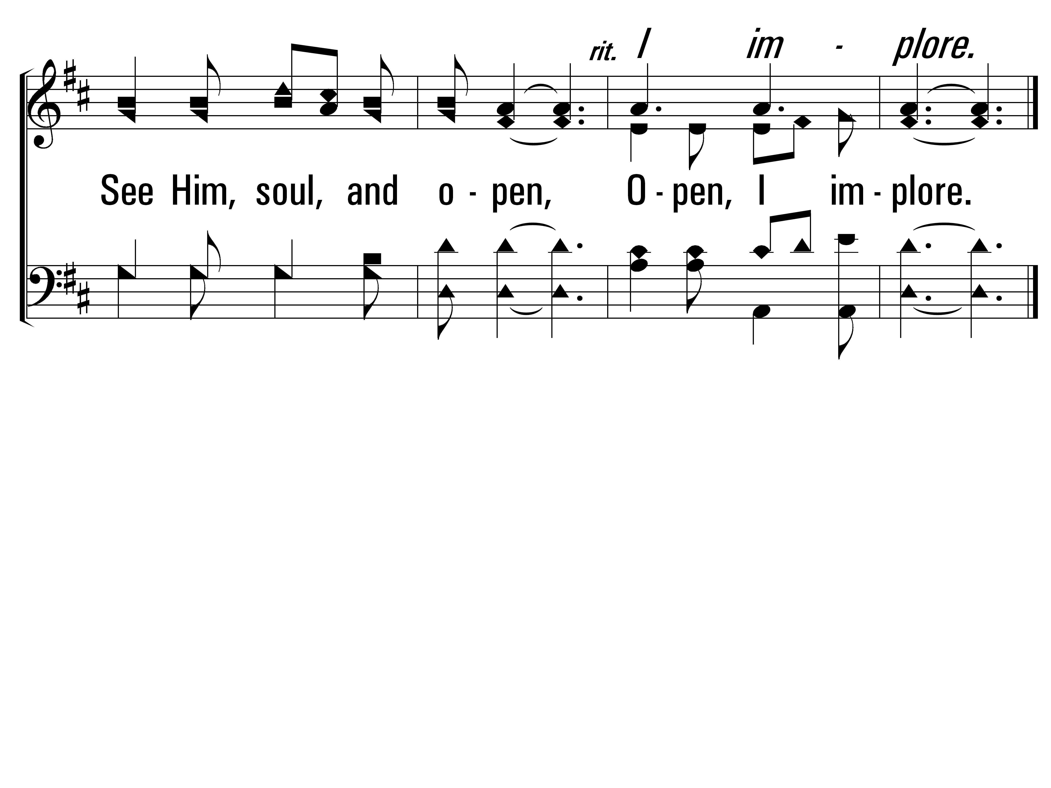
WhyKeepJesusWaiting_st1_b
Vs 1
© 2014 Sumphonia Productions, LLC

Slide 89
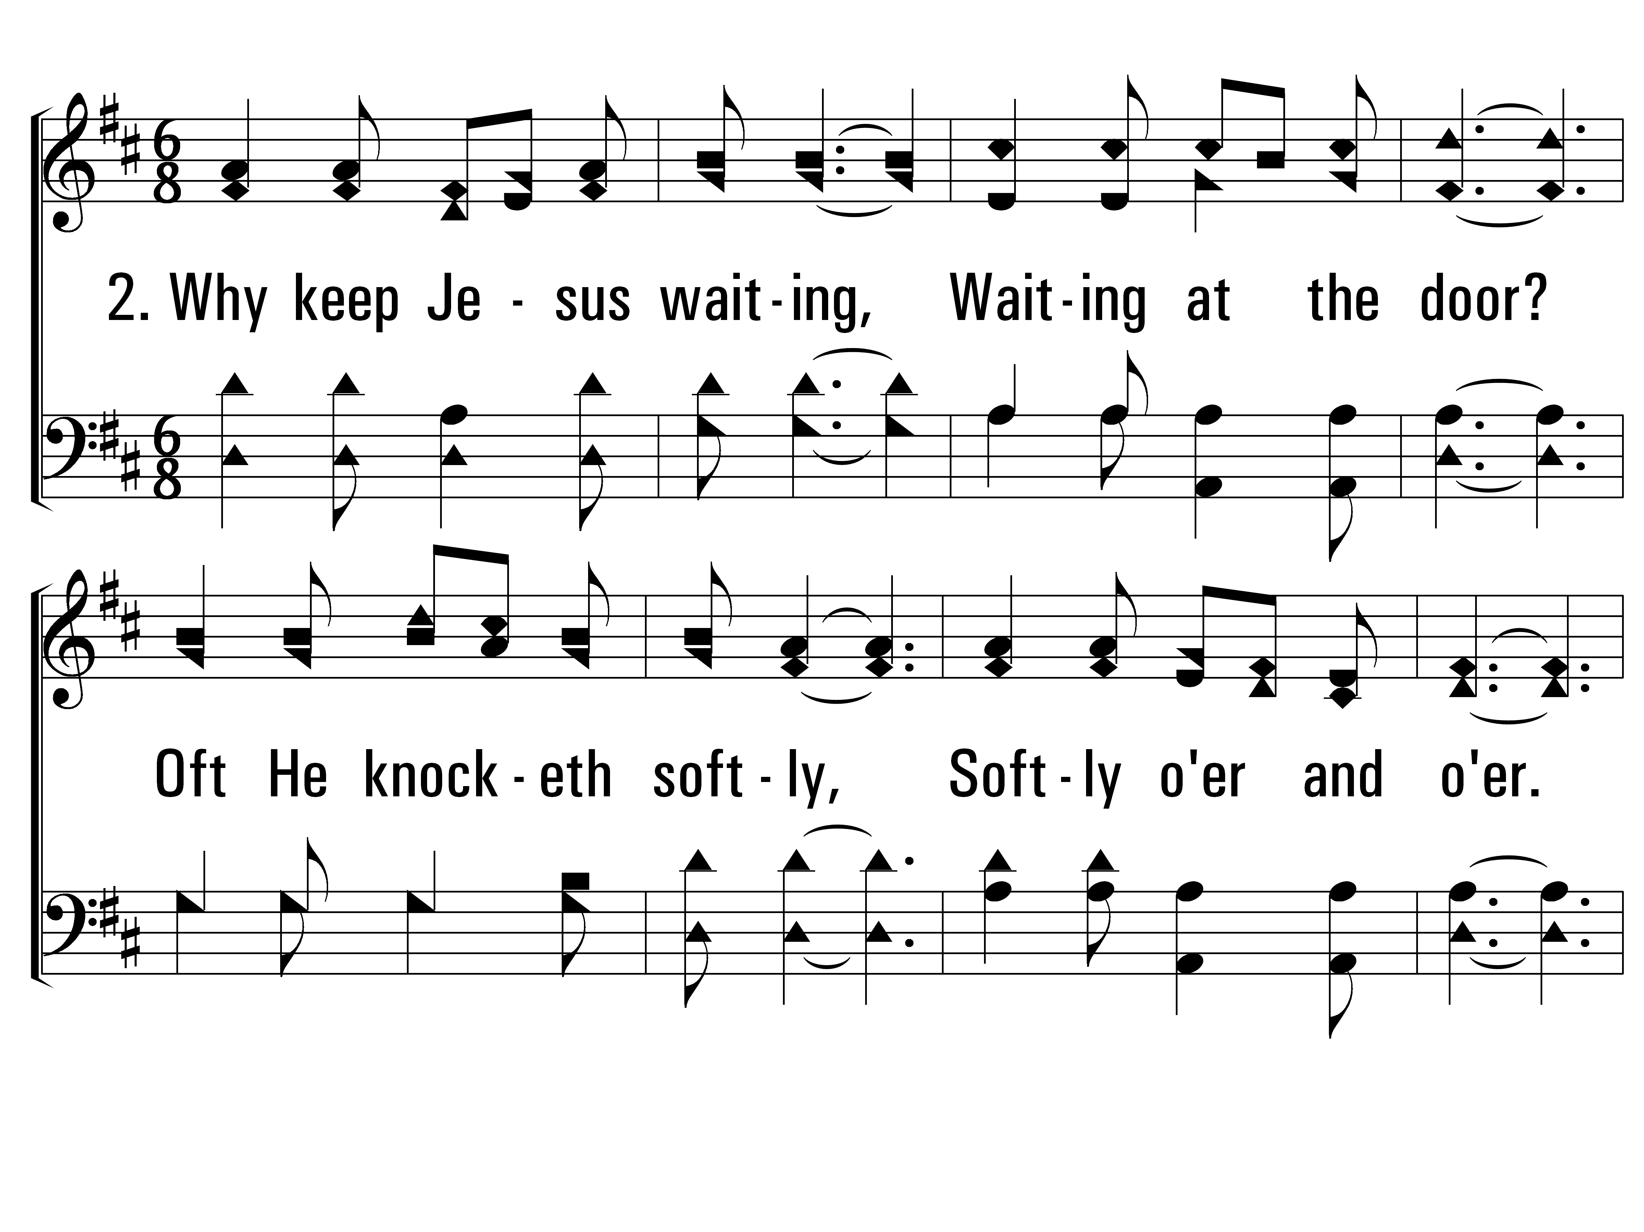
WhyKeepJesusWaiting_st2_a
Vs 2
© 2014 Sumphonia Productions, LLC

Slide 90
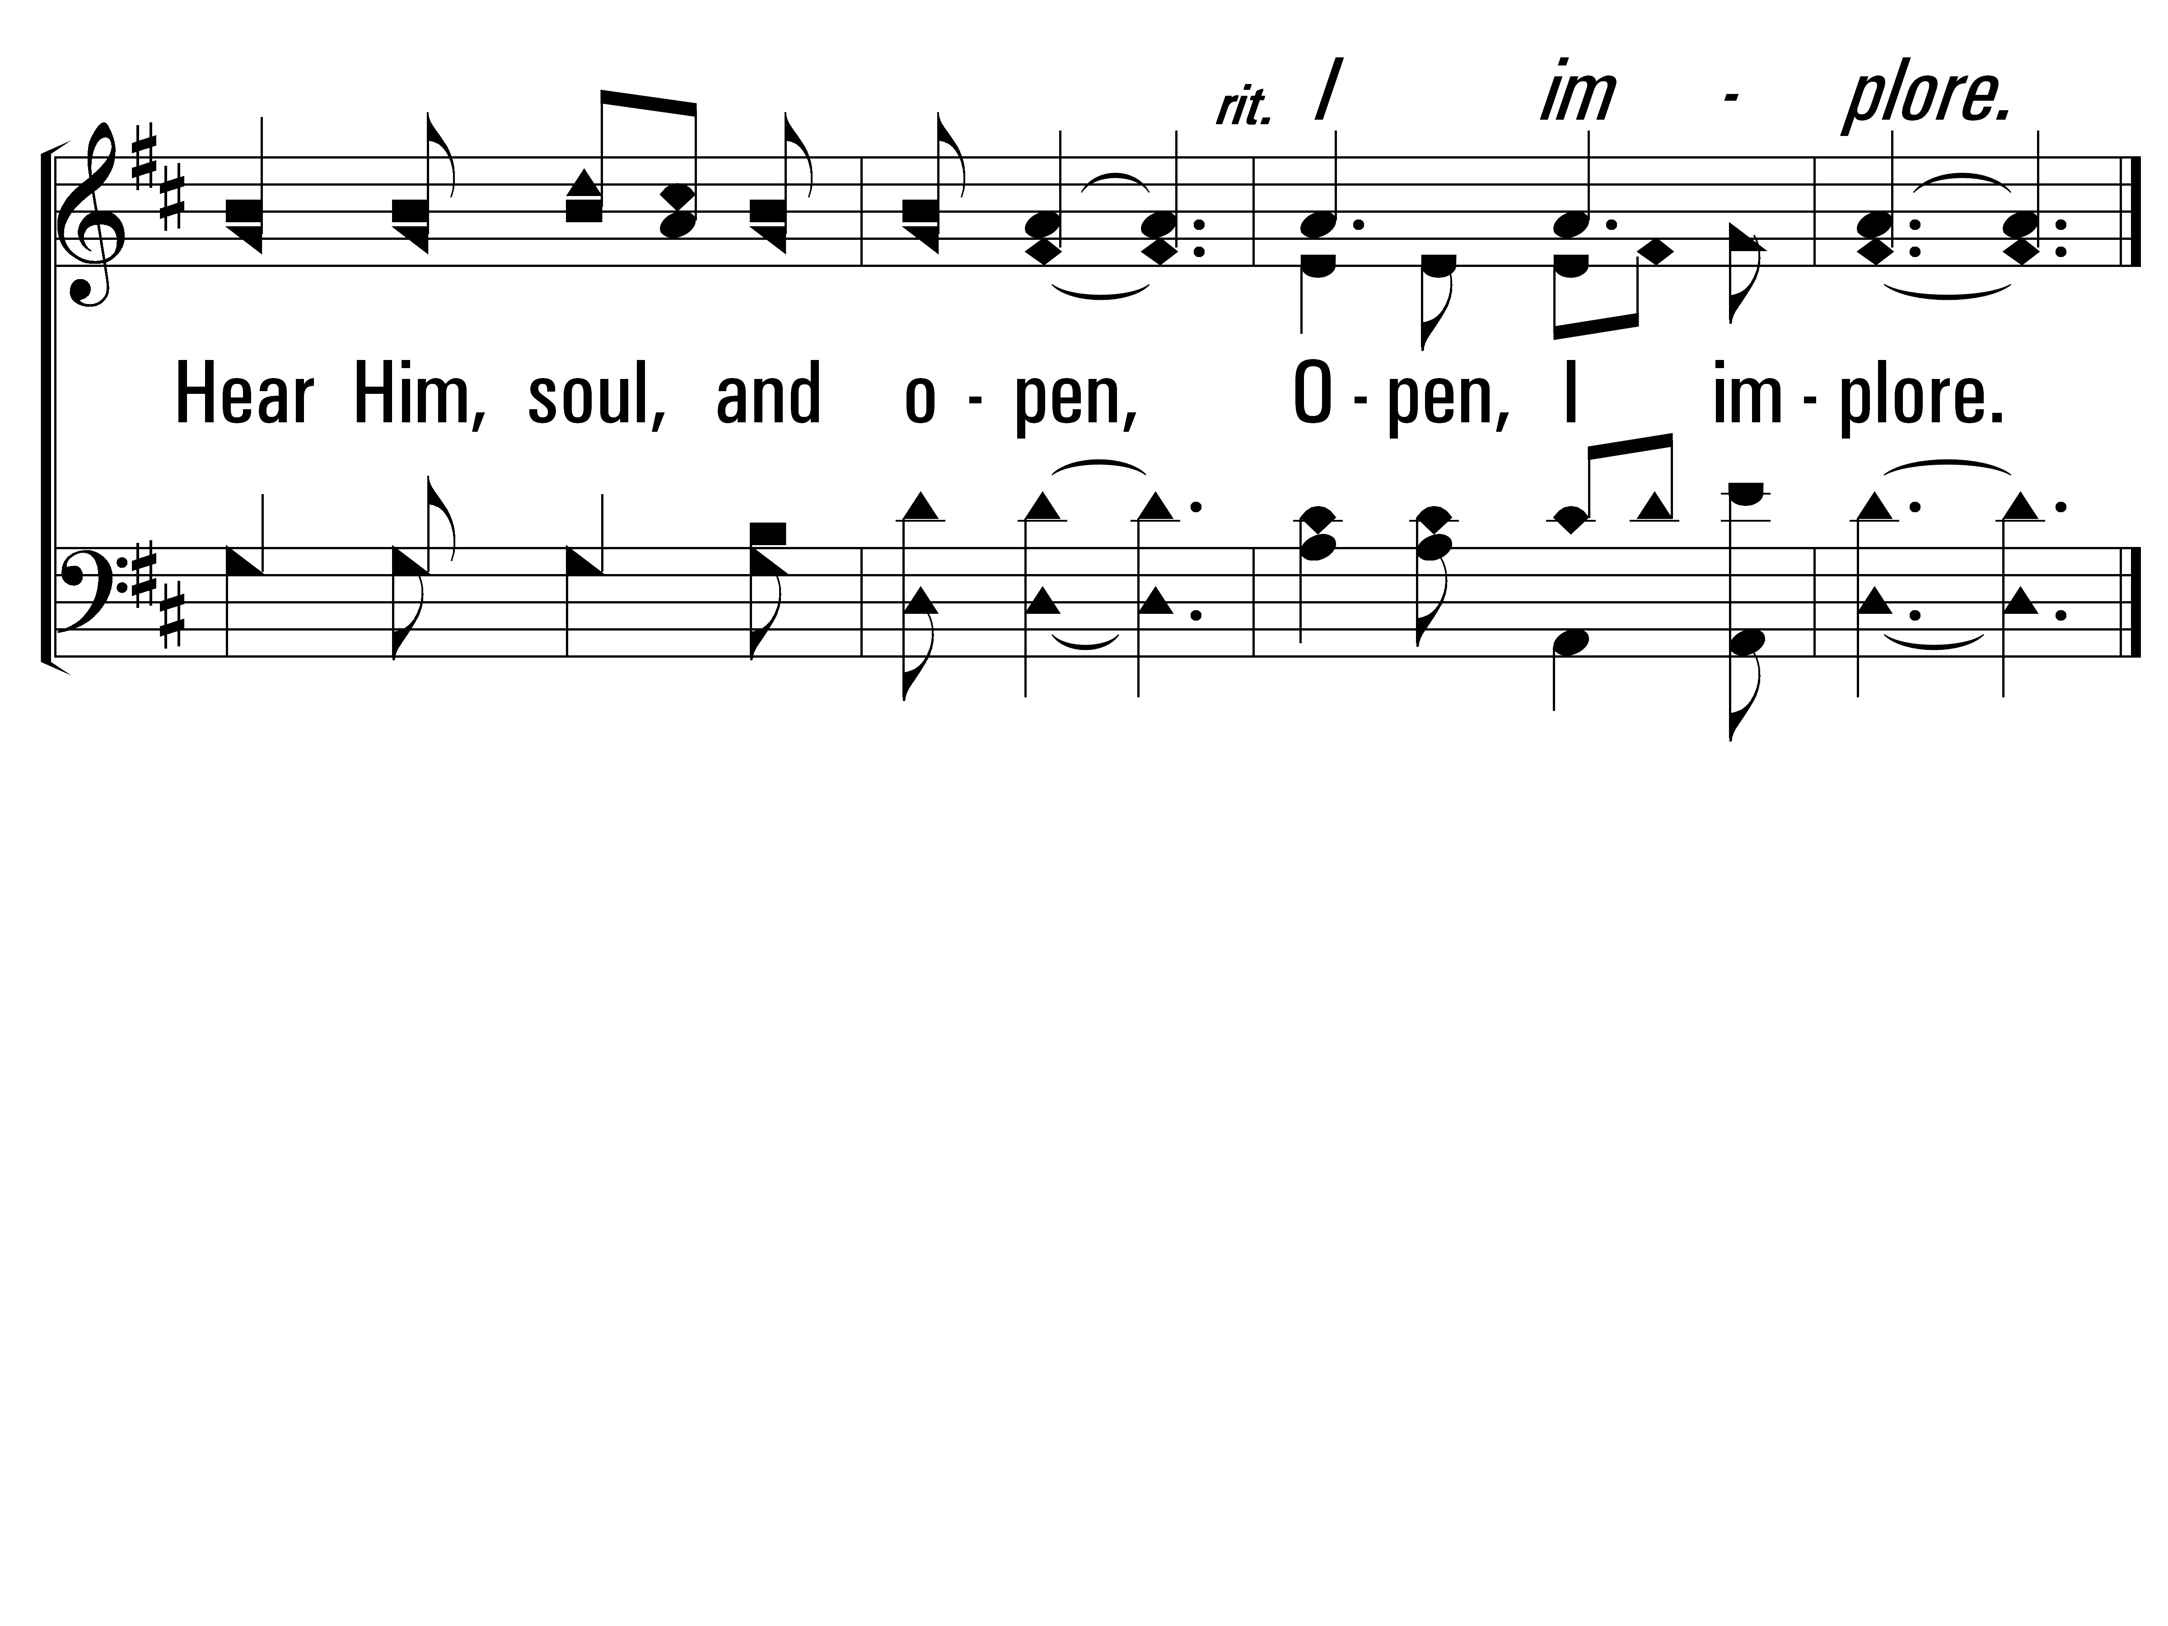
WhyKeepJesusWaiting_st2_b
Vs 2
© 2014 Sumphonia Productions, LLC

Slide 91
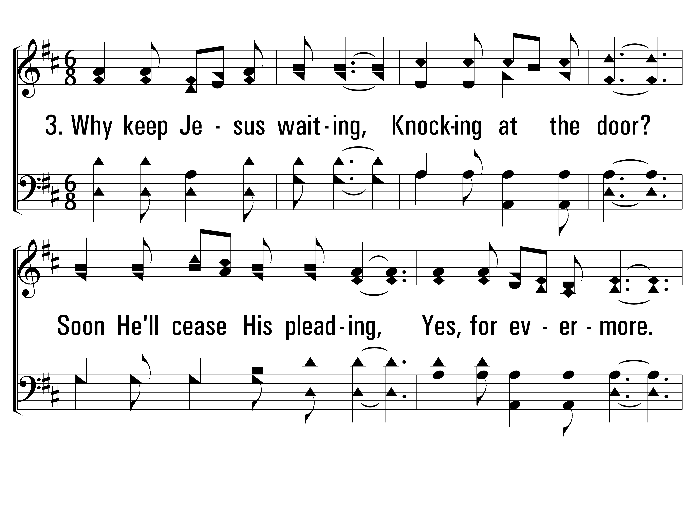
WhyKeepJesusWaiting_st3_a
Vs 3
© 2014 Sumphonia Productions, LLC

Slide 92
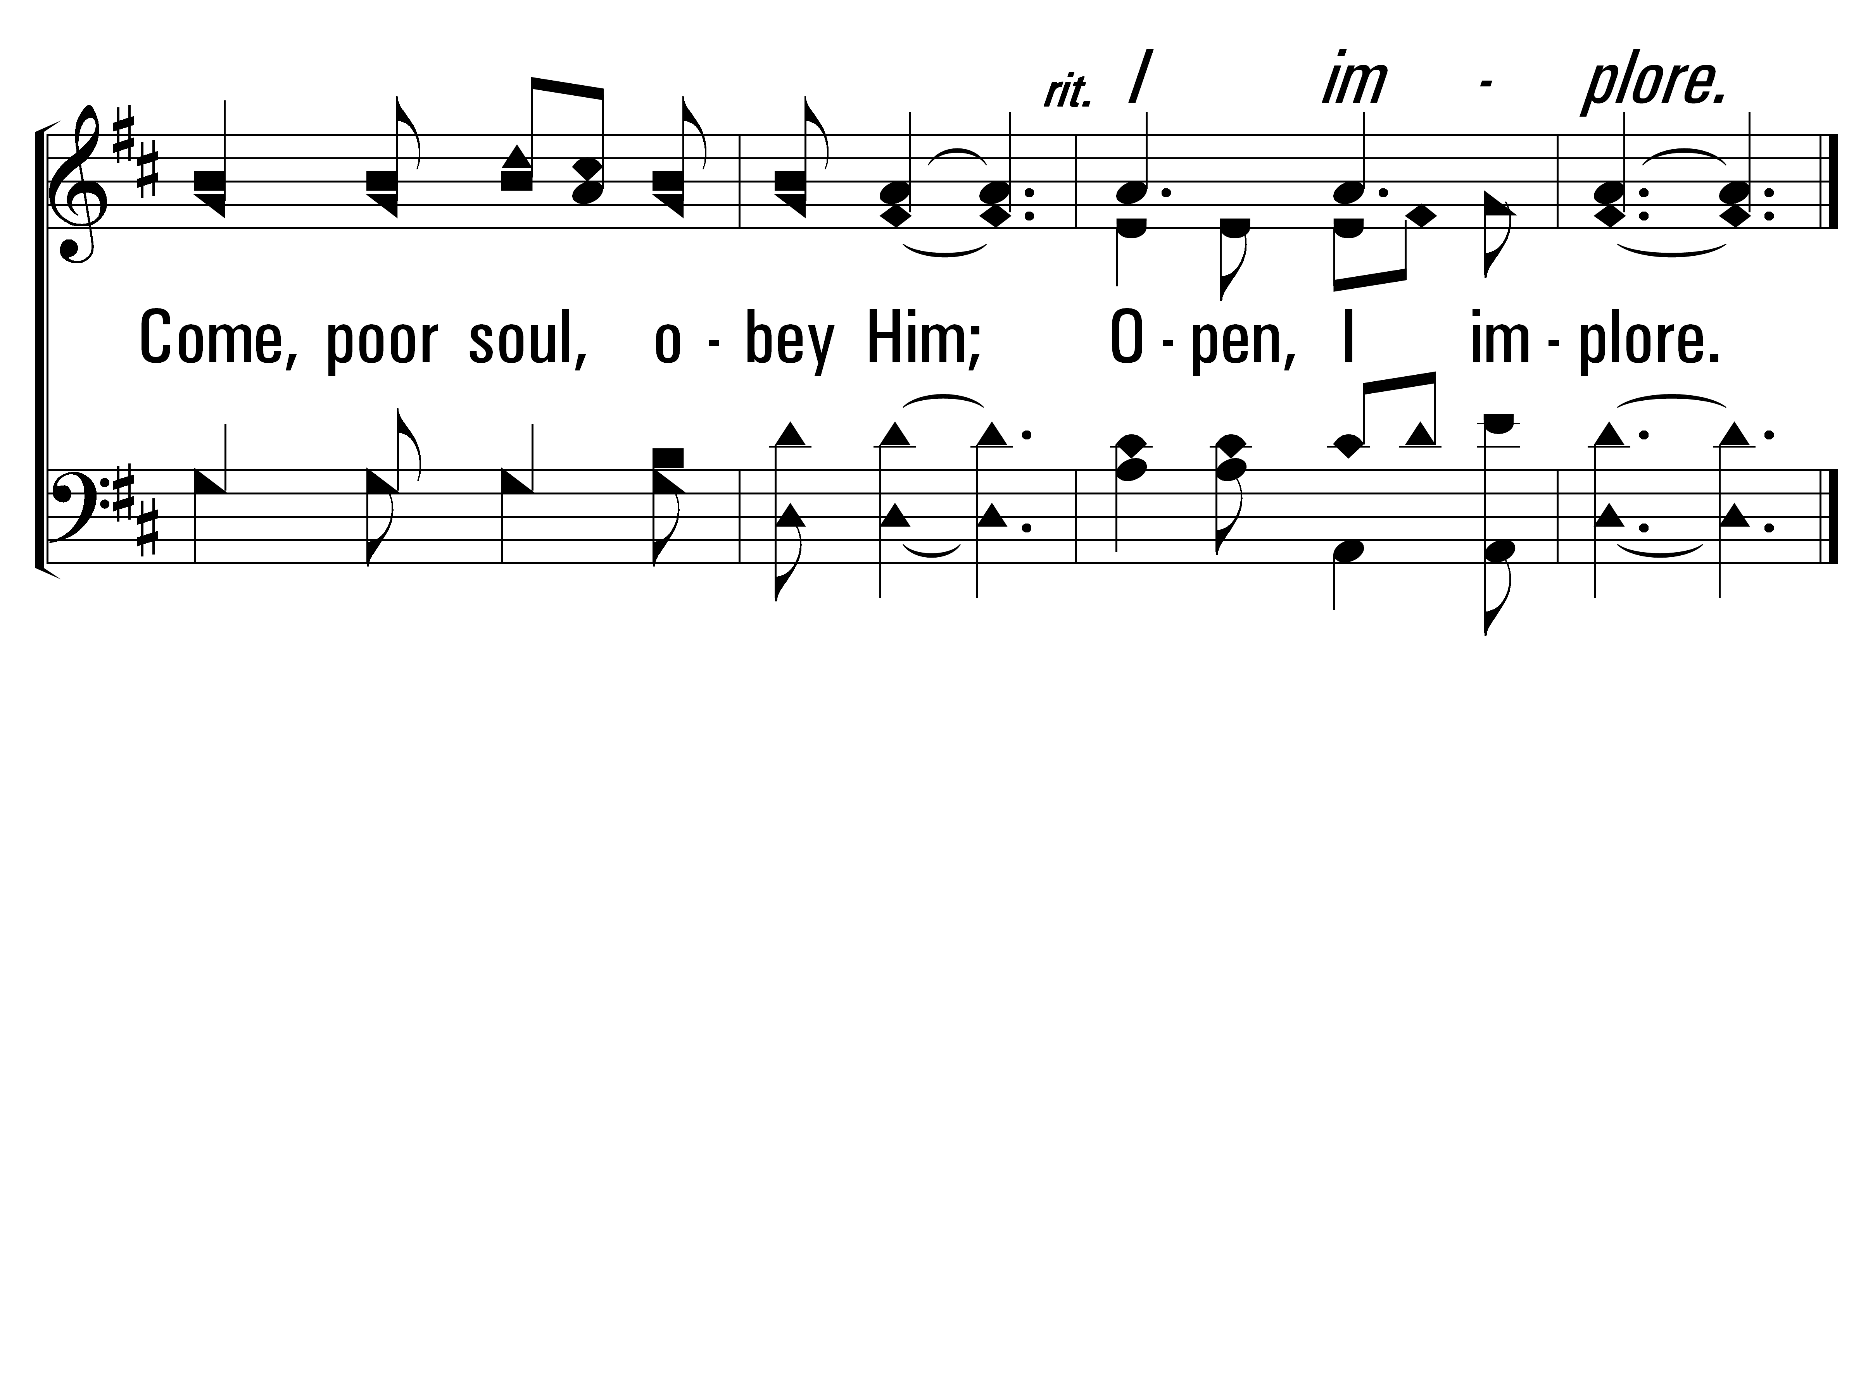
WhyKeepJesusWaiting_st3_b
Vs 3
© 2014 Sumphonia Productions, LLC
End

Slide 93
Closing Prayer
“Be anxious for nothing, but in everything by prayer and supplication, with thanksgiving, let your requests be made known to God”
– Philippians 4:6
Make plans for this afternoon’s services at 2:30 PM

