Slide 1
Hope Of The Empty Tomb
Luke 24:1-9
Notes:
By Nathan L Morrison for Sunday 04/17/2022
All Scripture given is from NASB unless otherwise stated
For further study, or if questions, please Call: 804-277-1983 or Visit: www.courthousechurchofchrist.com

Slide 2
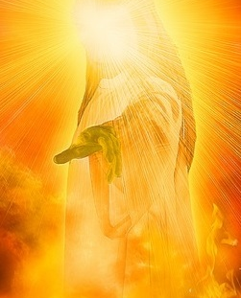
INTRO
Peter preached Jesus as:
The Man (Acts 2:22-23)
The Crucified (Acts 2:23)
The Resurrected (Acts 2:24, 32)
The Exalted (Acts 2:33)
The Divine (Acts 2:34-36)

Slide 3
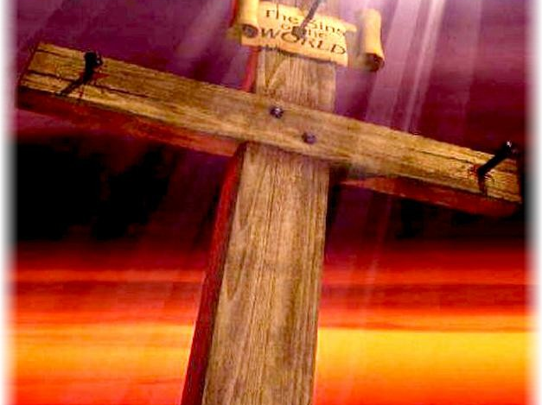
Intro
The death of Jesus is important (“of first importance” – I Cor. 15:3)
His blood washes away sin (I Cor. 1:23-24; 2:2; 15:3; Eph. 1:7; Rev. 1:5)

Slide 4
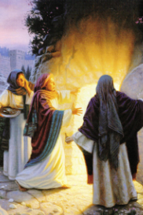
Intro
The resurrection of Jesus is CENTRAL to Christianity!
Jesus said He would rise the 3rd day (Jn. 2:19; Mt. 12:40; 27:63; Mk. 8:31-32; Lk. 24:7, 21)
If He didn’t, then He was a false prophet!

Slide 5
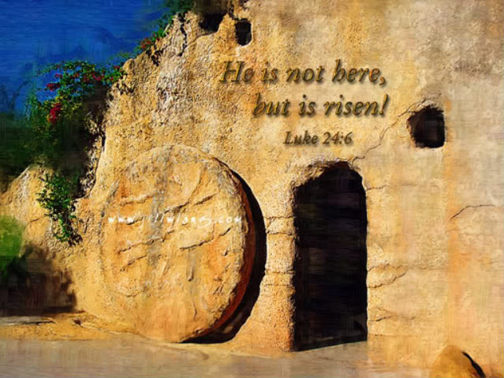
I Corinthians 15:12-15
12. Now if Christ is preached, that He has been raised from the dead, how do some among you say that there is no resurrection of the dead?
13. But if there is no resurrection of the dead, not even Christ has been raised;
14. and if Christ has not been raised, then our preaching is vain, your faith also is vain.
15. Moreover we are even found to be false witnesses of God, because we testified against God that He raised Christ, whom He did not raise, if in fact the dead are not raised.

Slide 6
I Corinthians 15:16-20
16. For if the dead are not raised, not even Christ has been raised;
17. and if Christ has not been raised, your faith is worthless; you are still in your sins.
18. Then those also who have fallen asleep in Christ have perished.
19. If we have hoped in Christ in this life only, we are of all men most to be pitied.
20. But now Christ has been raised from the dead, the first fruits of those who are asleep.

Slide 7
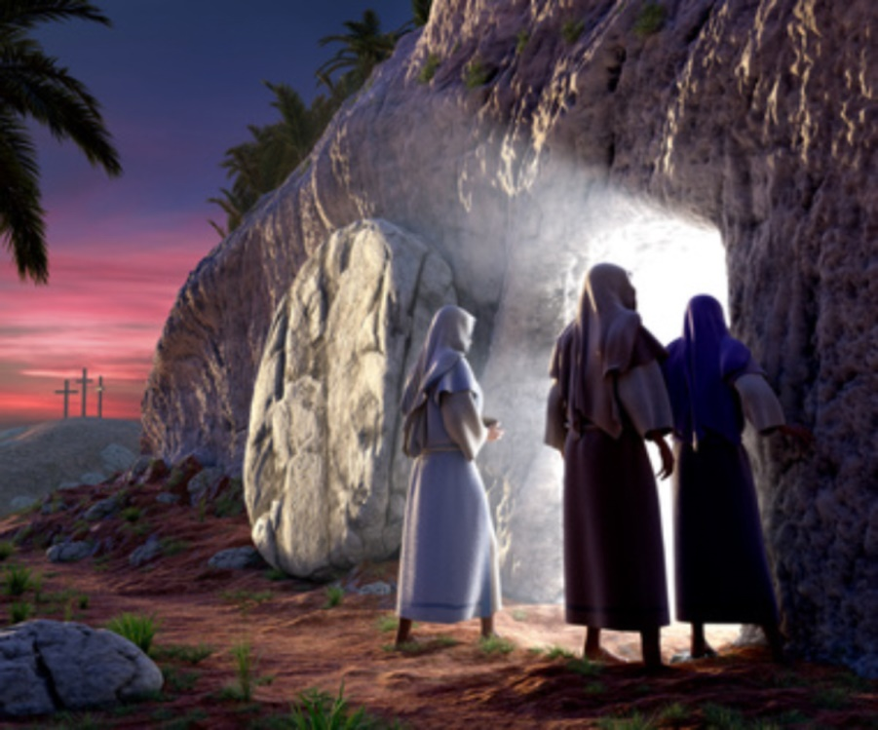
Luke 24:1-5
1. But on the first day of the week, at early dawn, they came to the tomb bringing the spices which they had prepared.
2. And they found the stone rolled away from the tomb,
3. but when they entered, they did not find the body of the Lord Jesus.
4. While they were perplexed about this, behold, two men suddenly stood near them in dazzling clothing;
5. and as the women were terrified and bowed their faces to the ground, the men said to them, "Why do you seek the living One among the dead?

Slide 8
Luke 24:6-9
6. "He is not here, but He has risen. Remember how He spoke to you while He was still in Galilee,
7. saying that the Son of Man must be delivered into the hands of sinful men, and be crucified, and the third day rise again."
8. And they remembered His words,
9. and returned from the tomb and reported all these things to the eleven and to all the rest.

Slide 9
INTRO
Numerous theories have been provided to explain
away His resurrection over the years:
The wrong tomb theory: Disciples discovered wrong tomb empty.
The stolen body: The disciples stole away His body.
The swoon theory: He didn’t really die but was comatose, then awoke.
The hallucination theory: His disciples didn’t really see Him alive.
None of these explains why the tomb was empty!
(Joseph of Arimathea knew where it was – Mt. 27:60)

Slide 10
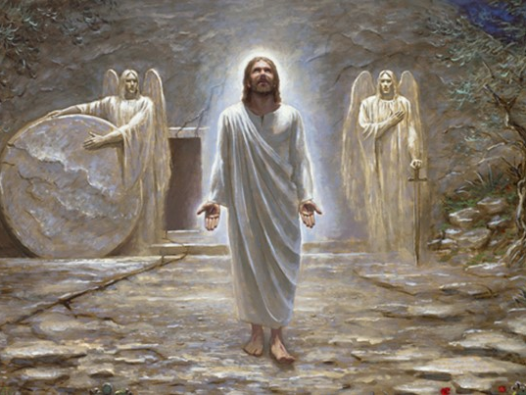
Intro
The empty tomb stands as evidence that
Jesus “is not here, but He has risen” and gives us hope!

Slide 11
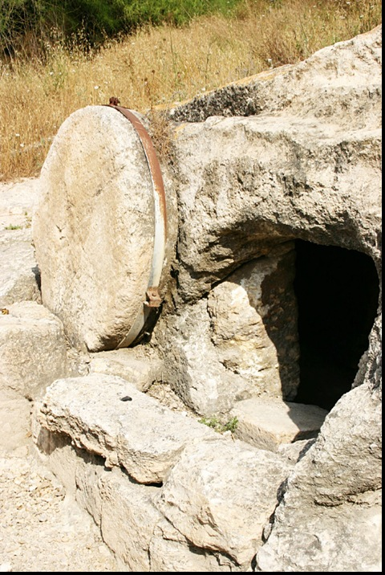
Physical Evidence: Tomb Of Jesus
A solid rock tomb (Mt. 27:60; Mk. 15:46; Lk. 23:53)
A new tomb
(Jn. 19:41; Lk. 23:53)

Slide 12
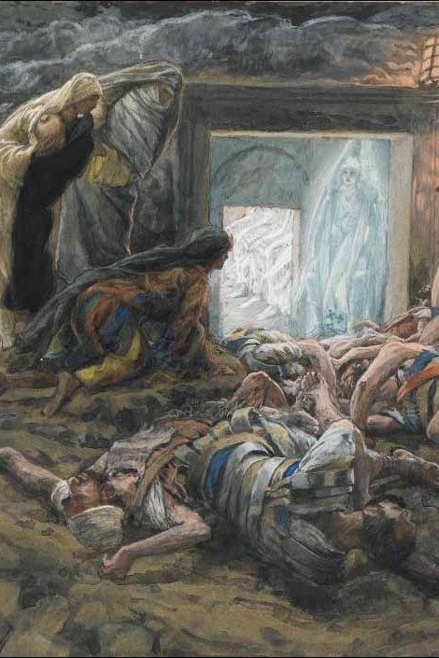
Physical Evidence: Tomb Of Jesus
A borrowed tomb (Is. 53:9; Mt.27:57-60; Lk. 23:50-53)
A guarded tomb (Mt. 27:65)

Slide 13
Physical Evidence: Tomb Of Jesus
A sealed tomb (Mt. 27:66)
An inspected tomb
(Mk. 15:47; Lk. 23:55-56)

Slide 14
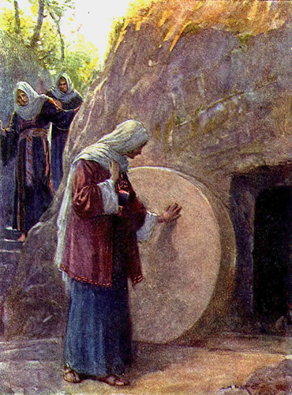
Physical Evidence: Tomb Of Jesus
An empty tomb (Lk. 24:1-3)
All parties to the burial of Jesus agree that He was dead (Mk. 15:42-47; Jn. 19:31-42)
All parties to the burial of Jesus agree that His body was in the tomb (Mt. 27:63-64; 27:66; Mk. 15:45-47)
All parties to the burial of Jesus agree that the tomb was empty on Sunday morning (Mt. 28:9, 11-15; Lk. 24:5-6; Jn. 20:2-8)

Slide 15
Physical Evidence: Tomb Of Jesus
Solid Rock
New
Borrowed
Guarded
Sealed
Inspected
Empty
The well-known tomb was verified as empty on the third day!

Slide 16
Eyewitness Testimony
Jesus appeared to individuals:
Mary Magdalene – Mk. 16:9-11; Jn. 20:11-18
Peter – Lk. 24:34; I Cor. 15:5
James, the Lord’s brother – I Cor. 15:7
Saul (Paul) of Tarsus – Acts 9:1-9; I Cor. 15:8

Slide 17
Eyewitness Testimony
Jesus appeared to small groups:
The women – Mt. 28:9
2 on the road to Emmaus – Mk. 16:12-13; Lk. 24:33-35
10 apostles (missing Thomas) – Jn. 20:19-23
11 apostles (including Thomas) – Jn. 20:24-29
7 disciples in Galilee – Jn. 21:1-14
11 apostles on Mt. of Olives – Acts 1:4-13; I Cor. 15:7

Slide 18
Eyewitness Testimony
Jesus appeared to over five hundred brethren at one time:
I Corinthians 15:6: “He appeared to more than five hundred brethren at one time”

Slide 19
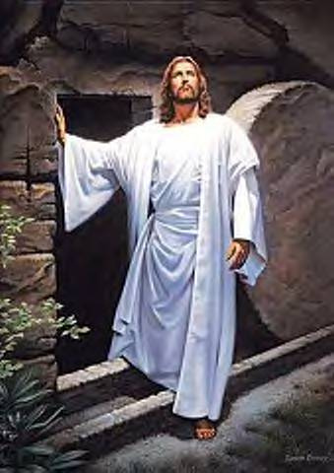
Eyewitness Testimony
Jesus appeared to many individuals
Jesus appeared to several small groups
Jesus appeared to over 500 brethren at one time!
Jesus was seen ALIVE by multitudes after His resurrection!

Slide 20
Are The Witnesses Credible?
What possible motive would they have to lie? (I Jn. 1:1-4; II Pet. 1:12, 15-16)
Their homes and property were seized – Heb. 10:34
Their families were tortured and put to death
They often lost their lives
Consider Paul’s trials – II Cor. 11:21-33; 15:8
Notes:
Early saints lost their lives…(Letter from Gov. Pliny the Younger to Emperor Trajan in A.D. 112 – http://faculty.georgetown.edu/jod/texts/pliny.html)

Slide 21
Are The Witnesses Credible?
It could have been put to rest if someone produced the body of Christ
If the disciples stole the body, why suffer death and torture for a lie?
If Jews stole body, why let Christianity spread?
If Romans stole body, why persecute people believing a lie?

Slide 22
Are The Witnesses Credible?
There wasn’t a body because the tomb was empty!

Slide 23
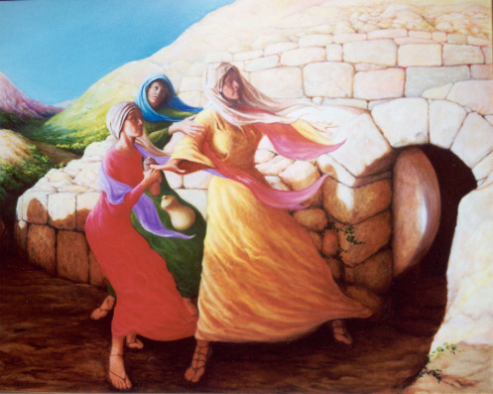
Conclusion
Every first day of the week Christians remember Jesus Who was fully God (Philippians 2:6) and fully man (Philippians 2:7-8), Who died, was buried, and ROSE the 3rd day according to the Scriptures (I Corinthians 15:3-4), and ascended to Heaven to return again one day (Acts 1:9-11)
We remember Jesus the Exalted!
(Philippians 2:9-11; Acts 2:33)
Notes:
Every first day of the week Christians remember Jesus Who was fully God (Philippians 2:6) and fully man (Philippians 2:7-8), Who died, was buried, and ROSE the 3rd day according to the Scriptures (I Corinthians 15:3-4), and ascended to Heaven to return again one day (Acts 1:9-11).
Jesus prayed in the Garden of Gethsemane alone. His tears, sweat, and agony were for us.
Jesus stood condemned before Pilate alone. His blood and pain were for us!
Jesus was crucified between two thieves and had a crowd standing all around made up of friends and enemies alike, and yet He felt all alone. His blood, pain, humiliation, and death were for us!
We remember Jesus the Exalted! (Philippians 2:9-11; Acts 2:33)
Jesus rose from the dead and conquered death for us!
He promises to return and bring the faithful to ever be with Him!

Slide 24
Conclusion
There is hope in the empty tomb:
Jesus is risen and will one day return!
He will bring reward and judgment: you must obey the gospel (II Thessalonians 1:7-9)
Are you ready?

Slide 25
Conclusion
Do you have the hope of the
empty tomb?

Slide 26
“What Must I Do To Be Saved?”
Hear The Gospel (Jn. 5:24; Rom. 10:17)
Believe In Christ (Jn. 3:16-18; Jn. 8:24)
Repent Of Sins (Lk. 13:3-5; Acts 2:38)
Confess Christ (Mt. 10:32; Rom. 10:10)
Be Baptized (Mk. 16:16; Acts 22:16)
Remain Faithful (Jn. 8:31; Rev. 2:10)
For The Erring Saint:
Repent (Acts 8:22), Confess (I Jn. 1:9),
Pray (Acts 8:22)

