Slide 1
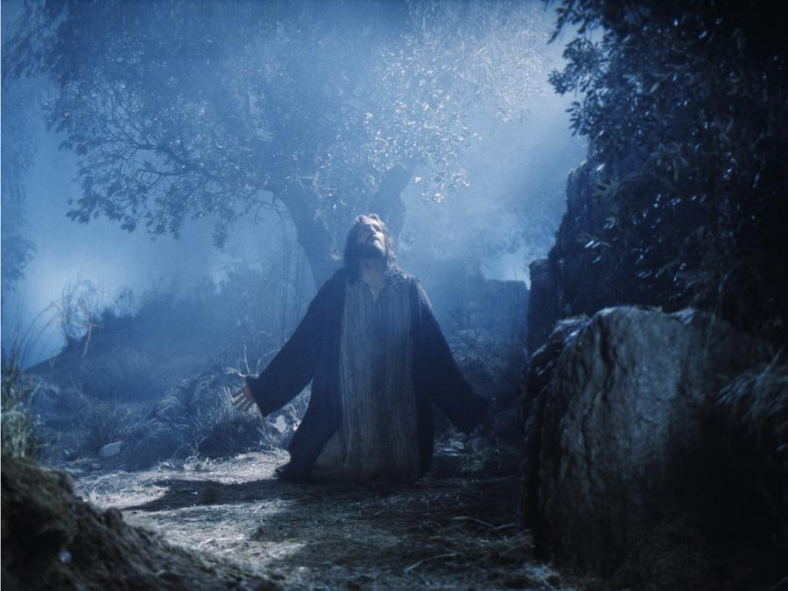
Alone
Text:
John 16:30-33
Notes:
Prepared by Nathan L Morrison for Sunday April 24, 2022
All Scripture given is from NASB unless otherwise stated
For further study, or if questions, please Call: 804-277-1983 or Visit: www.courthousechurchofchrist.com

Slide 2
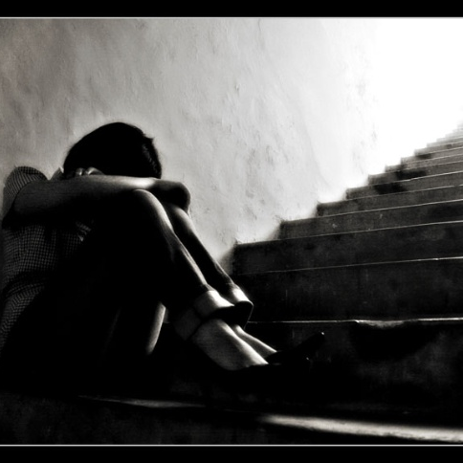
INTRO
Loneliness
Loneliness can cause depression and pain – most people don’t want to feel all alone!
Saints need to know that no matter how “alone” we may feel in this life, God is always with us!
Notes:
“Where No One Stands Alone” Stanza 2 (Hymn by Mosie Lister)
“Like a king, I may live in a palace so tall With great riches to call my own But I don't know a thing In this whole wide world That's worse than being alone”

Slide 3
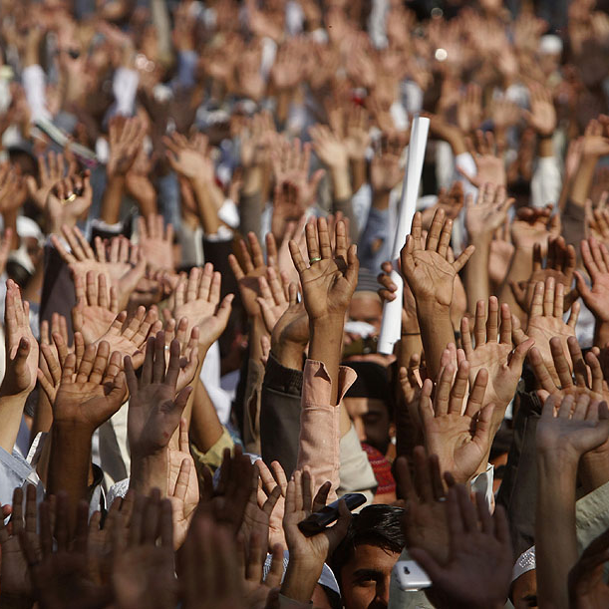
INTRO
Jesus was popular
Mark 2:4: The crowd was so large the paralytic man was lowered down through the roof!
John 6:2: Crowds followed Him because of the miracles and healing He performed
John 6:5-14: Jesus fed the 5,000 – people were amazed and called Him, “the Prophet”
John 6:15: The people were about to grab Jesus and make Him their king! He went to be alone

Slide 4
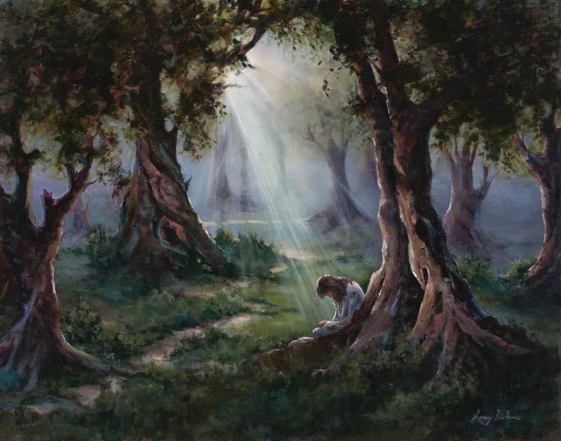
Intro
John 16:30-33
30. "Now we know that You know all things, and have no need for anyone to question You; by this we believe that You came from God."
31. Jesus answered them, "Do you now believe?
32. "Behold, an hour is coming, and has already come, for you to be scattered, each to his own home, and to leave Me alone; and yet I am not alone, because the Father is with Me.
33. "These things I have spoken to you, so that in Me you may have peace. In the world you have tribulation, but take courage; I have overcome the world."
Jesus suffered being alone so that we never have to!
Notes:
John 16:30-33:
Jesus knew the popularity would end – His hour would come.
He would be left alone by those He called “Friends,” “Apostles,” and “Disciples.”
Though He would be left “alone” He would never leave His people (Matthew 28:20).
Jesus suffered being alone so that we never have to!

Slide 5
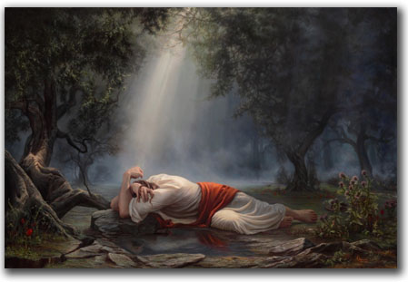
ALONE IN THE GARDEN
Matthew 26:36-46
Isaiah 53:3
Matthew 26:40 (NKJV)
Luke 22:45
Matthew 26:45-50
Notes:
Mat 26:36 Then Jesus came with them to a place called Gethsemane, and said to His disciples, "Sit here while I go over there and pray."
Mat 26:37 And He took with Him Peter and the two sons of Zebedee, and began to be grieved and distressed.
Mat 26:38 Then He said to them, "My soul is deeply grieved, to the point of death; remain here and keep watch with Me."
Mat 26:39 And He went a little beyond them, and fell on His face and prayed, saying, "My Father, if it is possible, let this cup pass from Me; yet not as I will, but as You will."
Mat 26:40 And He came to the disciples and found them sleeping, and said to Peter, "So, you men could not keep watch with Me for one hour?
Mat 26:41 "Keep watching and praying that you may not enter into temptation; the spirit is willing, but the flesh is weak."
Mat 26:42 He went away again a second time and prayed, saying, "My Father, if this cannot pass away unless I drink it, Your will be done."
Mat 26:43 Again He came and found them sleeping, for their eyes were heavy.
Mat 26:44 And He left them again, and went away and prayed a third time, saying the same thing once more.
Mat 26:45 Then He came to the disciples and said to them, "Are you still sleeping and resting? Behold, the hour is at hand and the Son of Man is being betrayed into the hands of sinners.
Mat 26:46 "Get up, let us be going; behold, the one who betrays Me is at hand!"

Slide 6
Alone In the Garden
“Night With Ebon Pinion” Stanza 2
(Hymn by Love H. Jameson)
“Smitten for offenses Which were not His own, He, for our transgressions, Had to weep alone; No friend with words to comfort, Nor hand to help was there, When the Meek and Lowly Humbly bowed in prayer.”
Notes:
“Night With Ebon Pinion” Stanza 2 (Hymn by Love H. Jameson)
“Smitten for offenses Which were not His own, He, for our transgressions, Had to weep alone; No friend with words to comfort, Nor hand to help was there, When the Meek and Lowly Humbly bowed in prayer.”

Slide 7
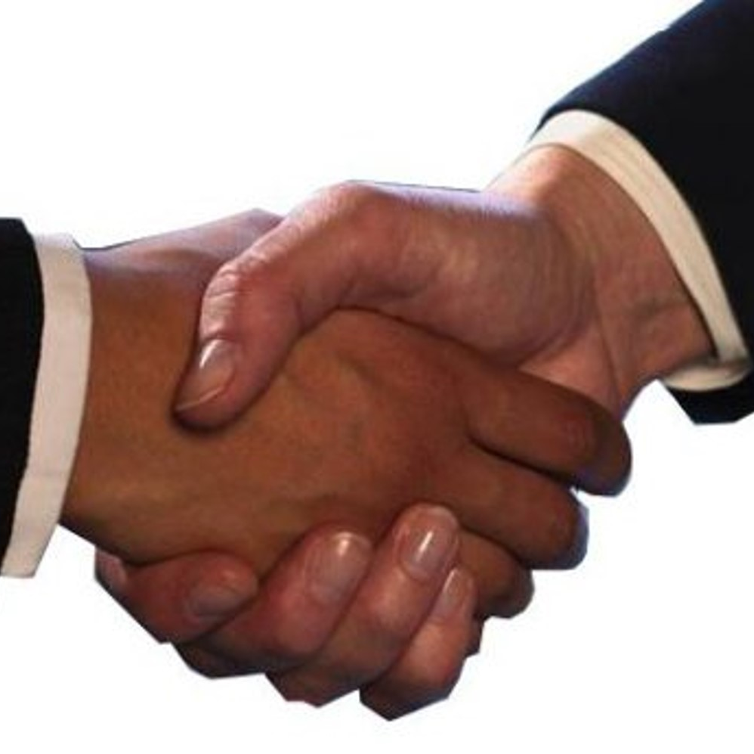
Though the world may turn against Him, we must ever be His friend!
John 1:10-11: The world hates Him – He came to His own and His own received Him not.
John 15:18-21: We need to remember that the world will hate those who follow Christ, but we must determine to serve Him no matter what and be willing to suffer for His sake!
John 14:15; 15:14: To be friends of Jesus, we must keep His commandments!

Slide 8
ALONE IN THE GARDEN
Jesus was alone in the Garden, but He will never leave His friends! (Those who obey His word – Mt. 28:20)

Slide 9
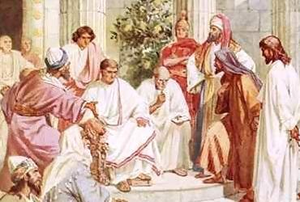
ALONE AT HIS TRIAL
Matthew 26:55-57
Luke 22:54-62
John 19:12-16
Mark 14:50-52
Matthew 26:73-74
Luke 22:60-62
Luke 23:20-23
Notes:
Mat 26:55 At that time Jesus said to the crowds, "Have you come out with swords and clubs to arrest Me as you would against a robber? Every day I used to sit in the temple teaching and you did not seize Me.
Mat 26:56 "But all this has taken place to fulfill the Scriptures of the prophets." Then all the disciples left Him and fled.
Mat 26:57 Those who had seized Jesus led Him away to Caiaphas, the high priest, where the scribes and the elders were gathered together.
Luk 22:54 Having arrested Him, they led Him away and brought Him to the house of the high priest; but Peter was following at a distance.
Luk 22:55 After they had kindled a fire in the middle of the courtyard and had sat down together, Peter was sitting among them.
Luk 22:56 And a servant-girl, seeing him as he sat in the firelight and looking intently at him, said, "This man was with Him too."
Luk 22:57 But he denied it, saying, "Woman, I do not know Him."
Luk 22:58 A little later, another saw him and said, "You are one of them too!" But Peter said, "Man, I am not!"
Luk 22:59 After about an hour had passed, another man began to insist, saying, "Certainly this man also was with Him, for he is a Galilean too."
Luk 22:60 But Peter said, "Man, I do not know what you are talking about." Immediately, while he was still speaking, a rooster crowed.
Luk 22:61 The Lord turned and looked at Peter. And Peter remembered the word of the Lord, how He had told him, "Before a rooster crows today, you will deny Me three times."
Luk 22:62 And he went out and wept bitterly.
Joh 19:12 As a result of this Pilate made efforts to release Him, but the Jews cried out saying, "If you release this Man, you are no friend of Caesar; everyone who makes himself out to be a king opposes Caesar."
Joh 19:13 Therefore when Pilate heard these words, he brought Jesus out, and sat down on the judgment seat at a place called The Pavement, but in Hebrew, Gabbatha.
Joh 19:14 Now it was the day of preparation for the Passover; it was about the sixth hour. And he *said to the Jews, "Behold, your King!"
Joh 19:15 So they cried out, "Away with Him, away with Him, crucify Him!" Pilate *said to them, "Shall I crucify your King?" The chief priests answered, "We have no king but Caesar."
Joh 19:16 So he then handed Him over to them to be crucified.

Slide 10
Alone AT HIS TRIAL
“I’ll Be A Friend To Jesus” Stanza 1 (Hymn by Johnson Oatman, Jr.)
“They tried my Lord and Master, With no one to defend; Within the halls of Pilate, He stood without a friend.”
Notes:
“I’ll Be A Friend To Jesus” Stanza 1 (Hymn by Johnson Oatman, Jr.)
“They tried my Lord and Master, With no one to defend; Within the halls of Pilate, He stood without a friend.”

Slide 11
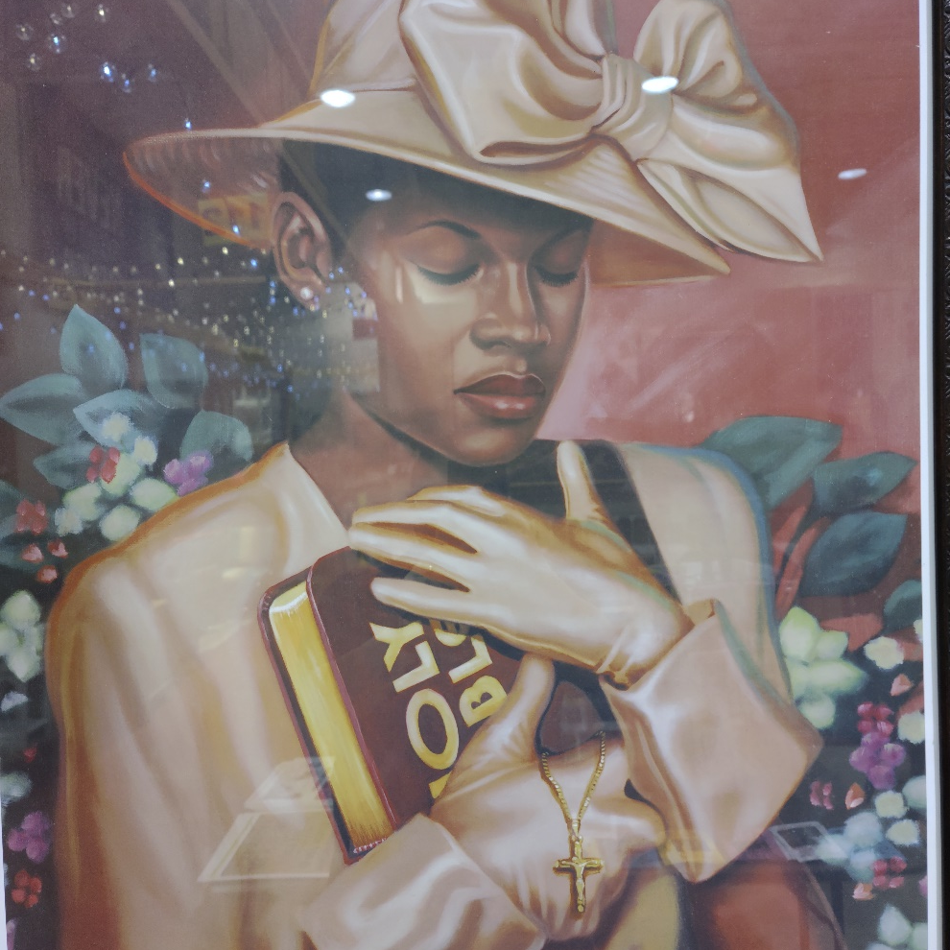
The world will forsake and deny Him (John 1:10; 15:18), but saints must confess Him!
Mt. 10:32-33: Confess him to be confessed to the Father; Deny Him to be denied to the Father!
II Tim. 2:3: We need to be willing to suffer for the cause of Christ as He had suffered for us! (I Peter 2:21-25: An example left to follow)

Slide 12
ALONE AT HIS TRIAL
Jesus stood alone in the judgment halls of Pilate, but He will never desert or forsake His friends!
(Those who keep His commands – Jn. 15:14; Heb. 13:5-6)

Slide 13
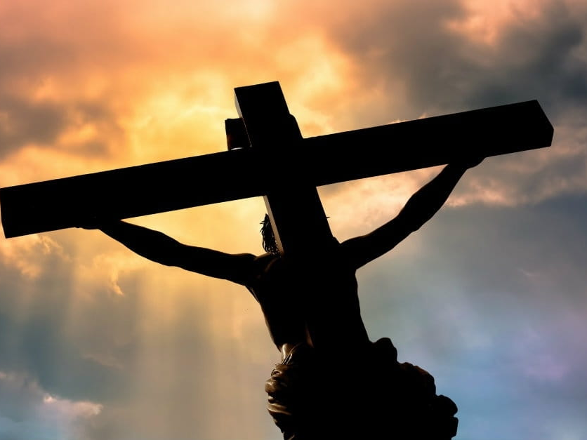
ALONE AT THE CROSS
Matthew 27:45-46
There were crowds watching & mocking Him (Mark 15:29-32), soldiers (John 19:23-24), even His mother and the apostle John (John 19:25-27), and two thieves, one of which was mocking Him too (Luke 23:39-43)
Notes:
Mat 27:45 Now from the sixth hour darkness fell upon all the land until the ninth hour.
Mat 27:46 About the ninth hour Jesus cried out with a loud voice, saying, "ELI, ELI, LAMA SABACHTHANI?" that is, "MY GOD, MY GOD, WHY HAVE YOU FORSAKEN ME?"

Slide 14
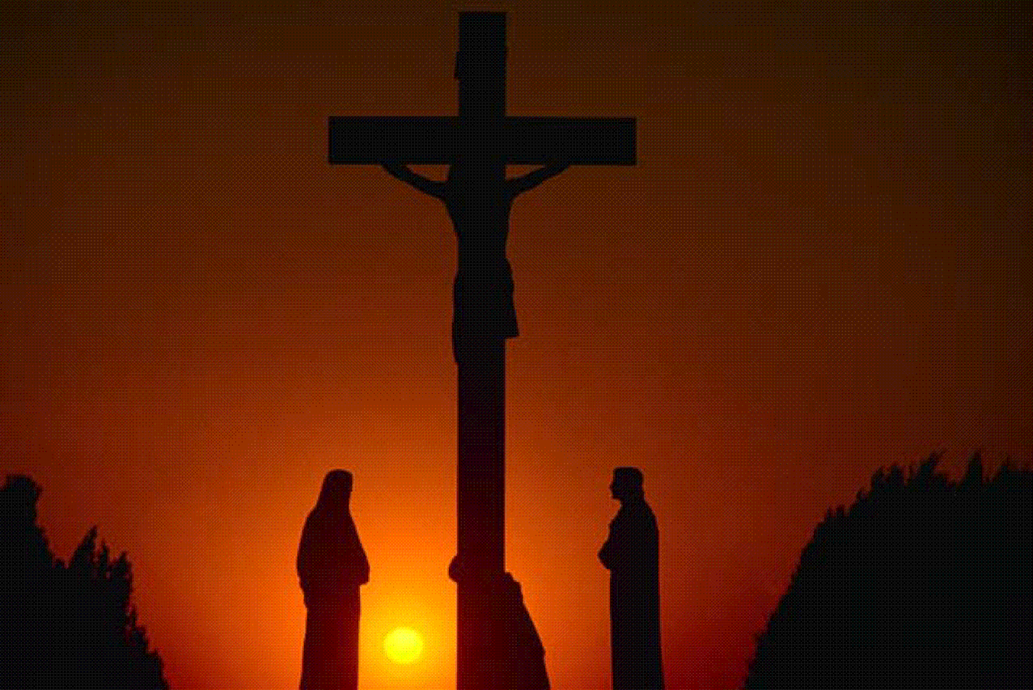
List of those standing by Him at the cross
John 19:25-27
Mary (Jesus' mother)
Jesus' aunt (Mary's sister)
Mary (wife of Clopas)
Mary Magdalene
Apostle John (“disciple whom He loved;” son of Zebedee)

Slide 15
List of women watching from a distance who followed Him from Galilee
Mark 15:40-41
Mary Magdalene (apparently doesn't stay distant the whole time)
Mary (the mother of James the younger/less and Joseph)
Mother of James and John (sons of Zebedee)
Salome
Many other women who came up with him to Jerusalem

Slide 16
ALONE AT THE CROSS
There were thieves on either side of Him, crowds of soldiers, enemies, friends, and disciples all around Him by the cross and from a distance, and yet, hanging there on the cross, He was alone!

Slide 17
ALONE AT THE CROSS
“Ten Thousand Angels” Stanza 4 and Chorus
(Hymn by Ray Overholt)
“To the howling mob He yielded; He did not for mercy cry.
The cross of shame He took alone.
And when He cried, “It’s finished,” and gave Himself to die;
Salvation’s wondrous plan was done.
He could have called ten thousand angels
To destroy the world and set Him free.
He could have called ten thousand angels,
But He died alone, for you and me.”
Notes:
“Ten Thousand Angels” Stanza 4 and Chorus (Hymn by Ray Overholt)
To the howling mob He yielded; He did not for mercy cry.
The cross of shame He took alone.
And when He cried, “It’s finished,” and gave Himself to die;
Salvation’s wondrous plan was done.
He could have called ten thousand angels
To destroy the world and set Him free.
He could have called ten thousand angels,
But He died alone, for you and me.

Slide 18
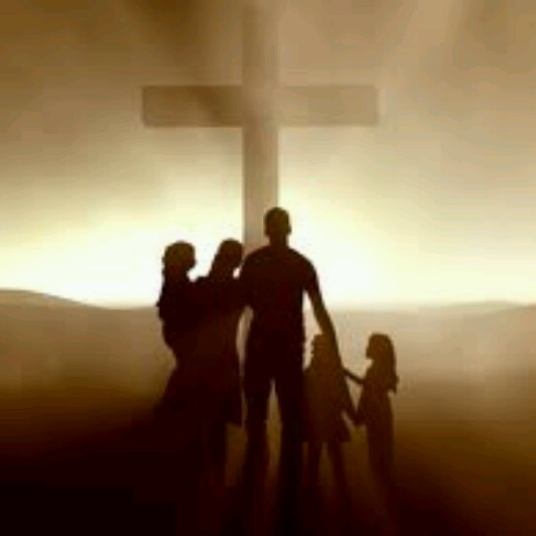
The world continues to mock Jesus, but disciples must never be ashamed of Him!
Romans 1:16: The gospel is God’s power to save – must never be ashamed of its message.
Mark 8:34-38: Saints must never be ashamed of the One who took the curse of sin away (Galatians 3:13: The curse of the cross), but “take up his cross and follow” Christ! (Luke 9:23)

Slide 19
ALONE AT THE CROSS
Jesus hung on the cross alone for the sins of the world, but was raised and ever lives to make intercession for us so that we never stand alone!
(Those who obey His word –Heb. 7:25)

Slide 20
CONCLUSION
Christ suffered all these things alone so that no Christian ever has to – He has made a promise:
Hebrews 13:5-8: “I will never desert you, nor will I ever forsake you.”
Christ is the same yesterday, today, and forever!
There is no need for any Christian to ever be alone
Alone in the Garden
Alone at His Trial
Alone at the Cross

Slide 21
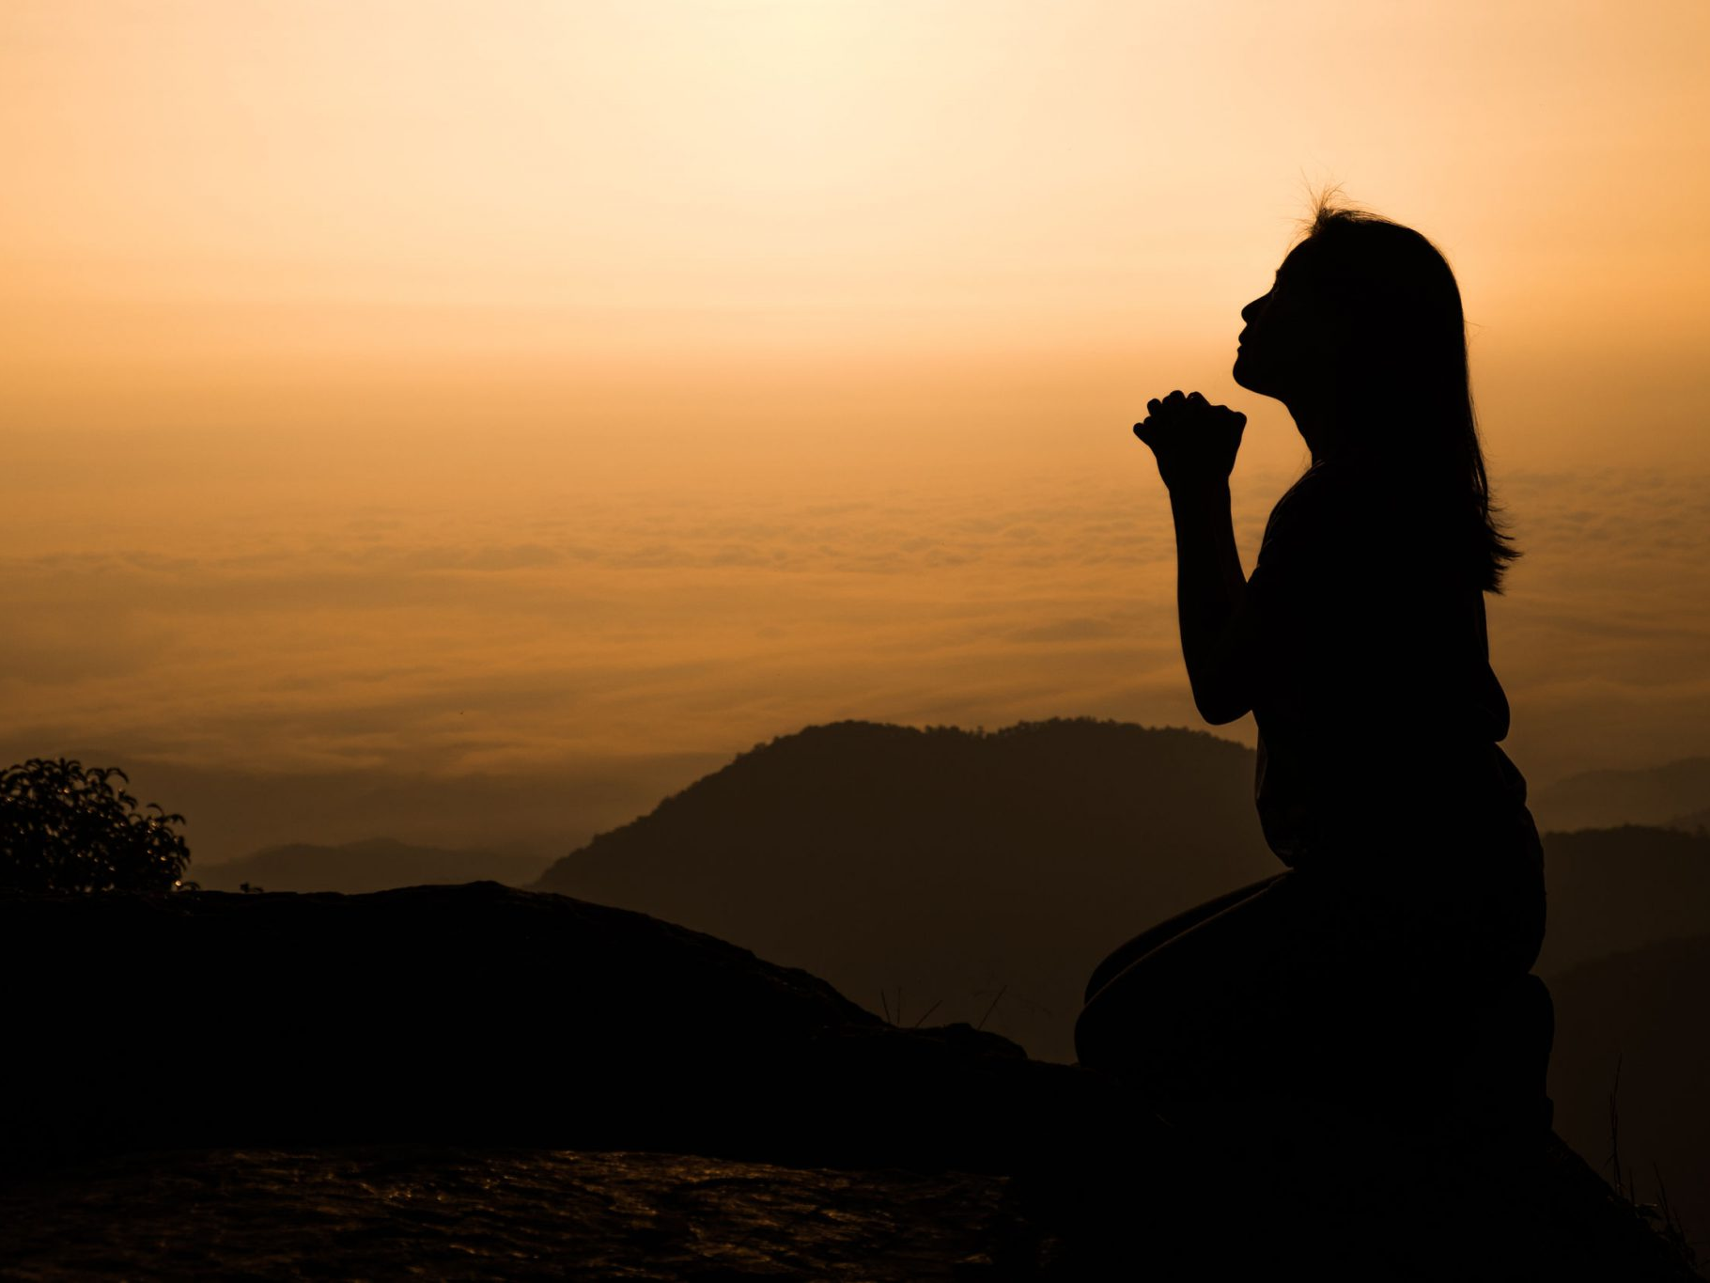
CONCLUSION
I Peter 5:6-7
6. Therefore humble yourselves under the mighty hand of God, that He may exalt you at the proper time,
7. casting all your anxiety on Him, because He cares for you."
While man failed Christ, He will not fail His followers!
Notes:
1Pe 5:6 Therefore humble yourselves under the mighty hand of God, that He may exalt you at the proper time,
1Pe 5:7 casting all your anxiety on Him, because He cares for you.

Slide 22
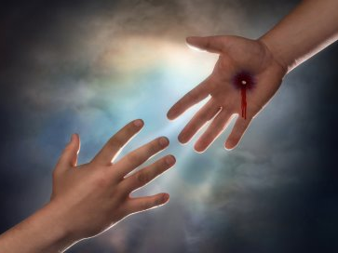
CONCLUSION
Let us not forsake Christ but live in such a way that we are His friends, and as such we will never have to stand alone!
“Where No One Stands Alone” Chorus (Hymn by Mosie Lister)
“Hold my hand all the way, every hour, every day, From here to the great unknown, Take my hand; Let me stand Where no-one stands alone!”
Notes:
“Where No One Stands Alone” Chorus (Hymn by Mosie Lister)
“Hold my hand all the way, every hour, every day, From here to the great unknown, Take my hand; Let me stand Where no-one stands alone!”

Slide 23
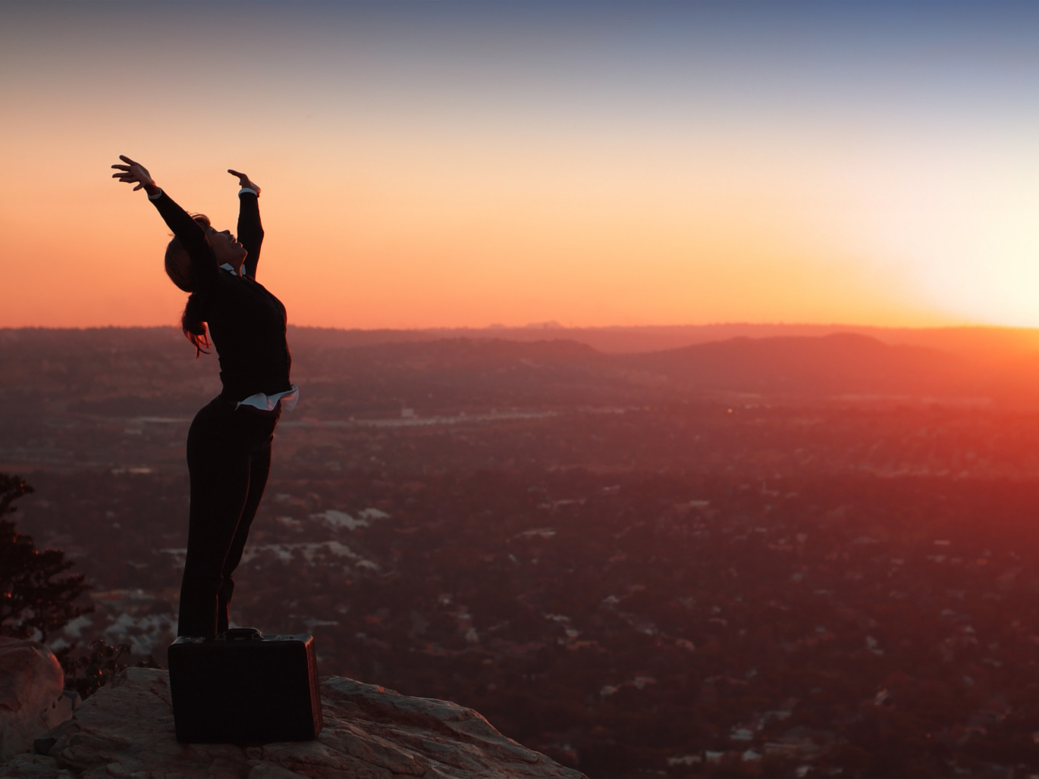
“What Must I Do To Be Saved?”
Hear The Gospel (Jn. 5:24; Rom. 10:17)
Believe In Christ (Jn. 3:16-18; Jn. 8:24)
Repent Of Sins (Lk. 13:3-5; Acts 2:38)
Confess Christ (Mt. 10:32; Rom. 10:10)
Be Baptized (Mk. 16:16; Acts 22:16)
Remain Faithful (Jn. 8:31; Rev. 2:10)
For The Erring Saint:
Repent (Acts 8:22), Confess (I John 1:9),
Pray (Acts 8:22)

