Slide 1
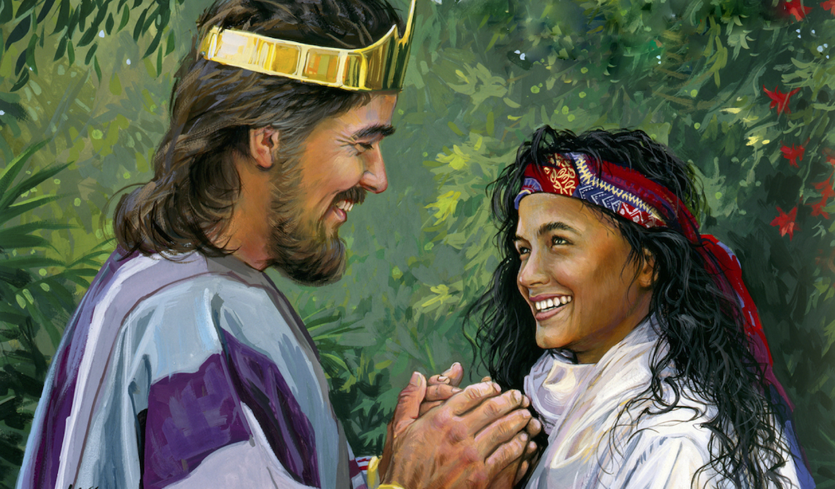
Love Is In The Air
(Part 2: Lessons)
Text:
Song Of Solomon
Notes:
By Nathan L Morrison
All Scripture given is from NASB unless otherwise stated
For further study, or if questions, please Call: 804-277-1983 or Visit www.courthousechurchofchrist.com
Some points taken from multiple sources, most notably an article by Aaron Menikoff
Image: Painting by Lars Nustinez

Slide 2
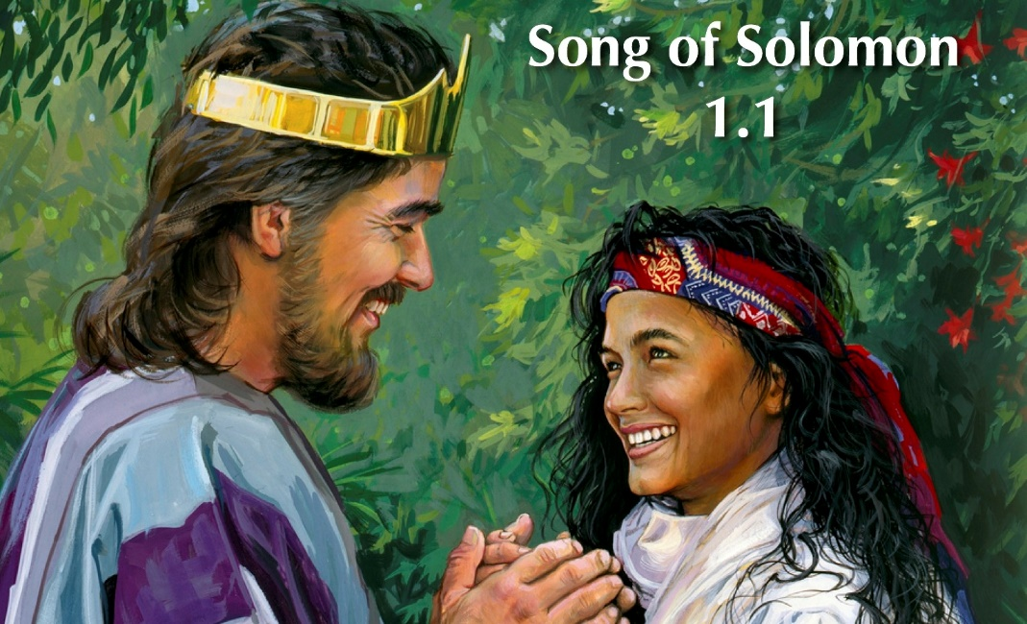
Intro
“The Song of Songs, which is Solomon’s”
The Song of Songs is an explicit but tasteful love song designed to point singles to patience, spouses to each other, and everyone to God
It is not an allegory nor is it a sex manual; it is the poetic description of a romance between a husband and a wife!

Slide 3
Intro
Good news! Recent trends show the divorce rate has decreased in the U.S.
It used to be reported that 50% of all marriages end in divorce but is now somewhere in the 39% bracket
Divorce rates are dropping but mostly because marriages are also decreasing in the U.S. and other western countries in favor of living together (“cohabiting”)
Notes:
III. Good news! Recent trends show the divorce rate has decreased in the U.S.
A. It used to be reported that 50% of all marriages end in divorce (beginning back in the 1980’s) but is now somewhere in the 39% bracket.
B. Time Magazine article by Belinda Luscombe, 11/26/2018: https://time.com/5434949/divorce-rate-children-marriage-benefits/
C. Divorce rates are dropping but mostly because marriages are also decreasing in the U.S. and other western countries in favor of living together (“cohabiting”).
D. Studies show that couples that cohabit first are less likely to get married, even when children are involved.

Slide 4
Intro
Most people have a grotesquely distorted view of sex & marriage!
Cohabiting is the cause for many children being born and raised by single parents!
Notes:
IV. Most people have a grotesquely distorted view of sex & marriage.
A. Cohabiting, either as a means to “try out” married life or just to circumvent it altogether for a host of reasons, is the cause for many children being born and raised by single parents.
B. Remember the playground song: “Jack and Jill, Sitting in a tree, K-I-S-S-I-N-G, First comes love, then comes marriage, then comes baby in a baby carriage!”
C. In our culture today and the world over, the verse would go something like: first you hook up, then you move in together, love has nothing to do with it, and you can have a baby any time you want, or not (or in any order)!
D. “Free love” was the mantra of the 1960’s and has done a lot of harm to the family.

Slide 5
Intro
The theme of commitment runs throughout the song, from when they were betrothed, to the wedding day and their marriage afterwards, commitment to each other is highlighted!

Slide 6
Song of Solomon: Lessons
Commitment is Foundational to an Intimate Relationship
Song of Songs

Slide 7
Commitment is Foundational to an Intimate Relationship
Depictions of intimacy are found throughout the song but is tastefully done and gets its point across without being vulgar
The wife enjoys being with her husband.
While betrothed, she exclaims in 2:3: “With great delight I sat in his shadow and his fruit was sweet to my taste.”
After the wedding, she says in 5:16: “His mouth is full of sweetness. And he is wholly desirable. This is my beloved and this is my friend, O daughters of Jerusalem.”

Slide 8
Commitment is Foundational to an Intimate Relationship
Depictions of intimacy are found throughout the song but is tastefully done and gets its point across without being vulgar
The husband is equally intoxicated by her.
While betrothed, he told her she was “most beautiful among women” (1:8) and said to her in 1:15: “How beautiful you are, my darling, How beautiful you are! Your eyes are like doves!”
After the wedding he says in 4:3: “Your lips are like a scarlet thread, And your mouth is lovely. Your temples are like a slice of a pomegranate Behind your veil.”

Slide 9
Commitment is Foundational to an Intimate Relationship
The intimate activity described is always experienced in the context of a marriage covenant
The bride, even while still betrothed says of her groom, “his banner over me is love” (2:4).
It’s her way of saying, “I belong to him and he belongs to me” (2:16).
This commitment was there while engaged/betrothed.
She is pure and chaste prior to the wedding day: SoS 4:12; 6:9-10; 8:8-10

Slide 10
Commitment is Foundational to an Intimate Relationship
The intimate activity described is always experienced in the context of a marriage covenant
The wife says of her husband, “My beloved is mine, and I am his” (6:3).
She says this before noting how he “grazes among the lilies” (another less-than-subtle allusion to physical intimacy).
Their marriage is marked and blessed by intimacy and commitment—and these two are not to be severed (Backwards thinking to our society today!)

Slide 11
Commitment is Foundational to an Intimate Relationship
The intimate activity described is always experienced in the context of a marriage covenant
The song ends with a similar sentiment in 8:6: “Set me as a seal upon your heart, as a seal upon your arm, for love is strong as death, jealousy is fierce as the grave.”
Real love lasts: because it’s not a one-night stand but a life-long commitment.
Real love cannot be bought (8:7): “Many waters cannot quench love, Nor will rivers overflow it; If a man were to give all the riches of his house for love, It would be utterly despised.”
Solomon also warned young men against the adulteress woman or against prostitution in Proverbs 7, and its wisdom is repeated in I Corinthians 6:15-20!

Slide 12
“Free love” was the mantra of the 1960’s – How different is the wisdom of the Bible!
True love is sealed by commitment!

Slide 13
Song of Solomon: Lessons
Practical Wisdom for Married Couples
Song of Songs

Slide 14
Godly spouses use words to encourage one another

Slide 15
Practical Wisdom for Married Couples
Godly spouses use words to encourage one another
The husband calls his wife the “most beautiful among women” (1:8).
He repeatedly uses speech to express his appreciation for her, “You have captivated my heart, my sister, my bride; you have captivated my heart with one glance of your eyes, with one jewel of your necklace” (ESV: 4:9). NET says, “You have stolen my heart.”
The point is he ought to use words to show how much he cares for his wife, “How beautiful is your love, my sister, my bride! How much better is your love than wine, and the fragrance of your oils than any spice!” (4:10)

Slide 16
Practical Wisdom for Married Couples
Godly spouses use words to encourage one another
The wife lavishes praise on her husband, “Your love is better than wine” (1:2), and calls on him to pursue her, “Draw me after you; let us run” (1:4).
She tells him how she sees him, “My beloved is dazzling and ruddy, Outstanding among ten thousand” (5:10).

Slide 17
Practical Wisdom for Married Couples
Godly spouses use words to encourage one another
In a good marriage, a husband and wife are never stingy with kind words!
Husbands and wives, do you praise one another and tell your spouse what they mean to you?

Slide 18
Godly spouses also guard against the sin of a fallen world

Slide 19
Practical Wisdom for Married Couples
Godly spouses also guard against the sin of a fallen world
In 2:15, the wife urges her husband to “Catch the foxes for us, The little foxes that are ruining the vineyards.”
The vineyard is their marriage, and it’s a field that needs to be tended or it will be destroyed by hungry invaders.
This means admitting when the relationship is strained, “I sought him whom my soul loves; I sought him but did not find him” (3:1).
It means working hard to improve it, “When I found him whom my soul loves; I held on to him and would not let him go” (3:4).

Slide 20
Practical Wisdom for Married Couples
Godly spouses also guard against the sin of a fallen world
They guard against sin by pursuing each other physically (4:1–5:1), “I am my beloved's, And his desire is for me” (7:10)
Regularly reaffirming their commitment to one another (4:9-10; 7:10; 8:6-7).

Slide 21
Practical Wisdom for Married Couples
Godly spouses also guard against the sin of a fallen world
Godly spouses cling to one another and desire to spend time with each other!
Husbands and wives, does your spouse know you desire them?

Slide 22
Song of Songs is wisdom literature. It’s here to help us live as well as we can in a fallen, broken world!
King Solomon, guided by the Holy Spirit, calls married couples to commitment and to do the hard work required for fidelity!

Slide 23
Song of Solomon: Lessons
Marriage as a Foretaste of Perfect Union with God
Song of Songs

Slide 24
In the Garden of Eden, Adam and Eve were naked and unashamed (Gen. 2:25). The purity of their relationship was possible because they enjoyed, if only for a short season, an uncorrupted relationship with their Maker!

Slide 25
Marriage as a Foretaste of Perfect Union with God
The Garden of Eden
Edenic terms are used to describe the intimate relationship between the husband and wife in The Song of Songs:
“How handsome you are, my beloved, And so pleasant! Indeed, our couch is luxuriant! The beams of our houses are cedars, Our rafters, cypresses” (1:16–17).
“Your lips, my bride, drip honey; Honey and milk are under your tongue” (4:11).
“Your shoots are an orchard of pomegranates with choice fruits, henna with nard plants, Nard and saffron, calamus and cinnamon, With all the trees of frankincense, Myrrh and aloes, along with all the finest spices. You are a garden spring, A well of fresh water, and streams flowing from Lebanon” (4:13-15).
In the Old Testament, the Promised Land is described as a land flowing with milk and honey (Exodus 3:8).
So is the marriage in the Song of Songs: This husband and wife have recaptured something of the delight and innocence of the Garden!

Slide 26
The Song of Songs can be understood through the lens of Ephesians 5:22-33 where we learn marriage is a mystery that “refers to Christ and the Church” (Ephesians 5:31-33)

Slide 27
Marriage as a Foretaste of Perfect Union with God
Mystery that “refers to Christ and the Church” (Ephesians 5:31-33)
It is through Christ that justified sinners find their home in a new Promised Land (Hebrews 4:1-13).
For the celibate seeking physical intimacy, marriage is a way to that Promised Land (SoS 4:11; I Corinthians 7:8-9)

Slide 28
Marriage as a Foretaste of Perfect Union with God
Mystery that “refers to Christ and the Church” (Ephesians 5:31-33)
The Song of Songs, like other O.T. books, really does point forward to Christ
As the wife longs to be with her husband (SoS 1:4; 3:1–4), so the Christian longs to be with Christ, “But I am hard-pressed from both directions, having the desire to depart and be with Christ, for that is very much better” (Philippians 1:23).
As the husband woos his wife with words (SoS 4:1–15), so Christ woos us with His Word, “My sheep hear My voice, and I know them, and they follow Me; and I give eternal life to them, and they will never perish; and no one will snatch them out of My hand (John 10:27-28).

Slide 29
Marriage as a Foretaste of Perfect Union with God
Mystery that “refers to Christ and the Church” (Ephesians 5:31-33)
The Song of Songs, like other O.T. books, really does point forward to Christ
As the love of a husband and wife is to be inseparable (SoS 8:6-7) so nothing can separate us from the love of Christ Jesus our Lord, “But in all these things we overwhelmingly conquer through Him who loved us. For I am convinced that neither death, nor life, nor angels, nor principalities, nor things present, nor things to come, nor powers, nor height, nor depth, nor any other created thing, will be able to separate us from the love of God, which is in Christ Jesus our Lord” (Romans 8:37–39)

Slide 30
For centuries the Jewish people read the Song of Songs aloud in preparation for the Passover

Slide 31
Marriage as a Foretaste of Perfect Union with God
Song of Songs read aloud in preparation for the Passover
Why did they do this?
Jewish tradition reads it as an allegory of the relationship between God and Israel
God’s covenantal love for his people as is stated by the prophet Isaiah, “For your husband is your Maker, Whose name is the LORD of hosts; And your Redeemer is the Holy One of Israel, Who is called the God of all the earth” (Isaiah 54:5)
Notes:
E. For centuries the Jewish people read the Song of Songs aloud in preparation for the Passover.
1. Why did they do this?
2. Because in the Song of Songs they saw more than wisdom for marital living, they saw something of God’s covenantal love for his people as is stated by the prophet Isaiah, “For your husband is your Maker, Whose name is the LORD of hosts; And your Redeemer is the Holy One of Israel, Who is called the God of all the earth” (Isaiah 54:5).
3. “Why Do We Sing the Song of Songs on Passover?” by Benjamin Edidin Scolnic (https://www.rabbinicalassembly.org/sites/default/files/public/jewish-law/holidays/pesah/why-do-we-sing-the-song-of-songs- on-passover.pdf )
4. Jewish tradition reads it as an allegory of the relationship between God and Israel.

Slide 32
A godly marriage will mirror the church’s relationship with Christ, which is to be pure and delightful!

Slide 33
Conclusion
Marriage is a gift from God so we can enjoy & delight in the one whom our soul loves (SoS 3:4)

Slide 34
Conclusion
Marriage is a gift from God
“In love, every groom is a King Solomon, a shepherd, and even a gazelle, and every bride is a princess and country maiden” (Duane Garret, Proverbs, Ecclesiastes, Song of Songs)
Hebrews 13:4: Marriage is to be held in honor among all, and the marriage bed is to be undefiled; for fornicators and adulterers God will judge.
Notes:
II. Duane Garrett, the author of Proverbs, Ecclesiastes, Song of Songs (Broadman, 1993), said that Song of Songs, as a love song, presents a pattern for marriage every couple can appreciate:
A. “In love, every groom is a King Solomon, a shepherd, and even a gazelle, and every bride is a princess and country maiden.”

Slide 35
Conclusion
May Solomon’s “Song of Songs” encourage couples to have patience while dating, to delight in your spouse on the wedding day, and to commit to have a joyful marriage where you enjoy spending time with your spouse and adventure together!

Slide 36
“What Must I Do To Be Saved?”
Hear The Gospel (Jn. 5:24; Rom. 10:17)
Believe In Christ (Jn. 3:16-18; Jn. 8:24)
Repent Of Sins (Lk. 13:3-5; Acts 2:38)
Confess Christ (Mt. 10:32; Rom. 10:10)
Be Baptized (Mk. 16:16; Acts 22:16)
Remain Faithful (Jn. 8:31; Rev. 2:10)
For The Erring Saint:
Repent (Acts 8:22), Confess (I Jn. 1:9),
Pray (Acts 8:22)

