Slide 1
I Am Resolved Text: II Corinthians 13:5
Notes:
By Nathan L Morrison
All Scripture given is from NASB unless otherwise stated
For further study, or if questions, please Call: 804-277-1983 or Visit www.courthousechurchofchrist.com
From I Am Resolved hymn by Palmer Hartsough

Slide 2
Intro
As one year fades into the archives of history, many people turn their attention to the new year!

Slide 3
Intro
Many will make resolutions – most or all won’t be kept
Resolution: To declare one’s opinion, intent or purpose; determination (Webster’s)

Slide 4
II Corinthians 13:5
Intro
Test yourselves to see if you are in the faith; examine yourselves! Or do you not recognize this about yourselves, that Jesus Christ is in you--unless indeed you fail the test?

Slide 5
Intro
There are resolutions that must be kept if we are to spend eternity with God
Resolved: Firm in purpose or intent; determined (Webster’s)

Slide 6
Intro
In our walk with God there are many things to which we must say, “I Am Resolved!”

Slide 7
Not to be Charmed by the World
Linger no longer because now is the Day of salvation
II Corinthians 6:2; Hebrews 3:1
The world tempts us
I John 2:15-16
Hebrews 11:25; I John 2:17
Set your affections on things that are higher and nobler
II Corinthians 4:16-18
Philippians 4:8
Colossians 3:1-2
The world and all that it contains will one day perish: Where is your treasure laid up?

Slide 8
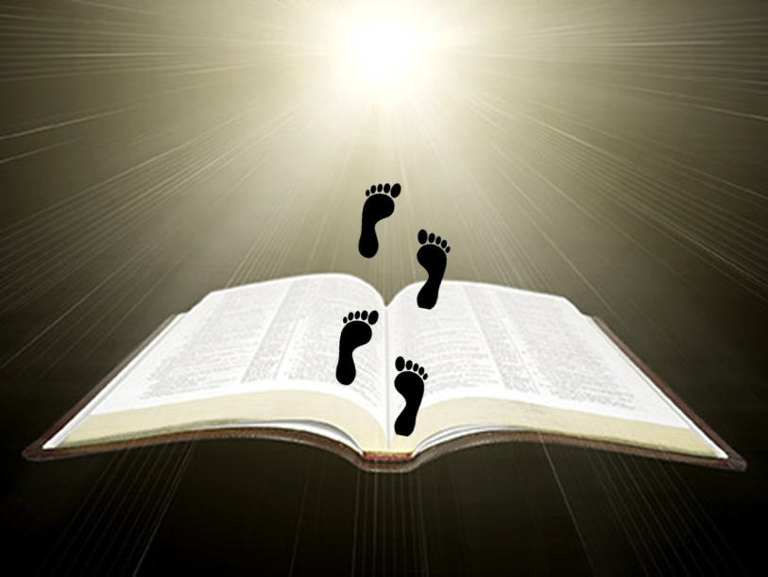
To Follow the Savior
Jesus came as Savior & Lord
Matthew 7:21, Luke 2:10-11; John 20:28
Must obey Him & Follow Him
Luke 9:23
John 8:31
Revelation 2:10
He is our ultimate example!
John 13:13-15
Many follow their own path: Are you resolved to follow after Him each day?

Slide 9
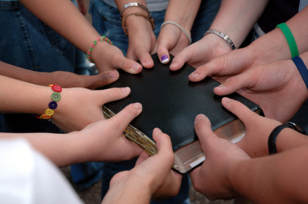
To Enter the Kingdom
The kingdom of the Lord is His church
Matthew 16:18-19
Colossians 1:13
The church sounds forth the truth to save others!
Ephesians 3:8-10
I Thessalonians 1:8
I Timothy 3:15
Live godly to enter into the “eternal kingdom!”
II Peter 1:10-11
Many don’t plan on their eternal destination: Are you resolved to enter Heaven?

Slide 10
Conclusion
Nothing wrong with making resolutions, but let us make sure to keep the eternal ones!
(Acts 11:23)
Let us all be able to say, “I Am Resolved” to walk “the Heavenly way!”
(Philippians 4:1; I Corinthians 15:58)

Slide 11
“What Must I Do To Be Saved?”
Hear The Gospel (Jn. 5:24; Rom. 10:17)
Believe In Christ (Jn. 3:16-18; Jn. 8:24)
Repent Of Sins (Lk. 13:3-5; Acts 2:38)
Confess Christ (Mt. 10:32; Rom. 10:10)
Be Baptized (Mk. 16:16; Acts 22:16)
Remain Faithful (Jn. 8:31; Rev. 2:10)
For The Erring Saint:
Repent (Acts 8:22), Confess (I Jn. 1:9),
Pray (Acts 8:22)

