Slide 1
The Gospel Saves! (To The Jews First & Also The Greeks!)
Text: Acts 15:7-20
Notes:
By Nathan L Morrison
All Scripture given is from NASB unless otherwise stated
For further study, or if questions, please Call: 804-277-1983 or Visit www.courthousechurchofchrist.com

Slide 2
Romans 1:16-17
Intro
For I am not ashamed of the gospel, for it is the power of God for salvation to everyone who believes, to the Jew first and also to the Greek. For in it the righteousness of God is revealed from faith to faith; as it is written, “BUT THE RIGHTEOUS man SHALL LIVE BY FAITH.”

Slide 3
Intro
How do we know that the gospel is for all?
Even with established teaching and apostolic examples Jewish believers contended that the gospel mixed with parts of the Old Law were to be taught to Gentile saints!

Slide 4
intro
Acts 15:1-6
Gentiles were taught circumcision was needed to be saved
Paul & Barnabas sent to Jerusalem
They reported all that God had done with them
Jews told Gentile converts they needed to be circumcised and observe the Law of Moses
A doctrinal disagreement arose. No divine help from God, but men came together to “look into this matter”
The apostles and the elders of the church of Jerusalem looked into the matter
When disagreements arise today, how do we establish authority for what we believe and practice?

Slide 5
Establishing Authority
Jesus established His authority over Heaven and earth – Matthew 28:28-20
He is Head over the church; therefore, the church is to be in subjection to Him (Ephesians 1:18-23; 5:23-24)

Slide 6
Establishing Authority
The authority of Christ:
The source of all truth (Jn. 16:13)
Saints to all speak the same thing (I Cor. 1:10)
Saints to teach the words of the Holy Spirit (I Cor. 2:12-13)
Boundaries in this Law of Liberty (James 1:25):
Not to exceed what is written (I Cor. 4:6)
No other message than the gospel (Gal. 1:8-9)
Must continue in the teaching of Christ or one doesn’t have God! (II John 9)
Saints are to contend for the faith that was once delivered (Jude 3)

Slide 7
Establishing Authority
How it is expressed:
Two Kinds:
General – “Go & Teach” in Matthew 28:18-20 (Many modes of transportation to “Go” & many styles to “Teach” from)
Specific – “Singing and making melody with your heart to the Lord” in Ephesians 5:19 (The melody comes from the heart, not an instrument, so we sing a cappella so as to not add to the word of God)

Slide 8
Establishing Authority
How it is expressed:
Three Ways:
Direct statement (Command)
Approved Example (Apostolic Example)
Necessary Implication (Necessary Inference)
Those three ways can also be established or seen in a pattern or principle (like the collection in I Corinthians 16:1)

Slide 9
Establishing Authority
Which one of those ways was the authority to simply teach just the gospel to the Gentiles established?
Notes:
Trick Question: All of the Above! (Acts 15:7-20)

Slide 10
Acts 15:7-11
The Gospel Saves!
7. After there had been much debate, Peter stood up and said to them, "Brethren, you know that in the early days God made a choice among you, that by my mouth the Gentiles would hear the word of the gospel and believe.
8. "And God, who knows the heart, testified to them giving them the Holy Spirit, just as He also did to us;
9. and He made no distinction between us and them, cleansing their hearts by faith.
10. "Now therefore why do you put God to the test by placing upon the neck of the disciples a yoke which neither our fathers nor we have been able to bear?
11. "But we believe that we are saved through the grace of the Lord Jesus, in the same way as they also are."

Slide 11
The Gospel Saves!
Necessary Implication: God accepts the Gentiles; Jews must too!
Peter defended this concept before in Jerusalem after the conversion of Cornelius, saying to the Jewish believers there, “Therefore if God gave to them the same gift as He gave to us also after believing in the Lord Jesus Christ, who was I that I could stand in God's way?” (Acts 11:17)
The Jewish believers at that time rejoiced that God granted the Gentiles repentance that leads to life! (Acts 11:18)
Law of Moses: No Necessary Implication – Silent! (Acts 15:24: “To whom we gave no instruction”)
Peter’s Defense

Slide 12
In Action Today!
The Gospel Saves!
Baptism is Immersion!
John 3:23
Acts 8:38-39
Immersion is Necessarily Implied with the phrases, “much water,” “both went down into the water,” and “both came up out of the water”
The Gospel Saves!

Slide 13
Acts 15:3, 7, 12
The Gospel Saves!
3. Therefore, being sent on their way by the church, they were passing through both Phoenicia and Samaria, describing in detail the conversion of the Gentiles, and were bringing great joy to all the brethren.
7. After there had been much debate, Peter stood up and said to them, "Brethren, you know that in the early days God made a choice among you, that by my mouth the Gentiles would hear the word of the gospel and believe.
12. All the people kept silent, and they were listening to Barnabas and Paul as they were relating what signs and wonders God had done through them among the Gentiles.

Slide 14
The Gospel Saves!
Approved Example: Preaching the gospel to the Gentiles!
Remember the purpose of miracles: To confirm the word of God!
Mark 16:20: “And they went out and preached everywhere, while the Lord worked with them, and confirmed the word by the signs that followed.”
Hebrews 2:1-4: “For if the word spoken…” (2:2) “After it was at the first spoken through the Lord, it was confirmed to us by those who heard” (2:3), “God also testifying with them, both by signs and wonders and by various miracles and by gifts of the Holy Spirit according to His own will” (2:4).
Law of Moses: No Approved Example – Silent! (Acts 15:24: “To whom we gave no instruction”)
The Apostles’ (Peter and Paul with Barnabas) Defense

Slide 15
In Action Today!
The Gospel Saves!
Baptism is for the forgiveness of sin and how one calls on the name of the Lord!
Acts 2:38
Acts 22:16
Baptism for the forgiveness of sins is seen by Apostolic Example by apostles teaching it and obeying it
The Gospel Saves!

Slide 16
Acts 15:13-20
The Gospel Saves!
13. After they had stopped speaking, James answered, saying, "Brethren, listen to me.
14. "Simeon has related how God first concerned Himself about taking from among the Gentiles a people for His name.
15. "With this the words of the Prophets agree, just as it is written,
16. 'AFTER THESE THINGS I will return, AND I WILL REBUILD THE TABERNACLE OF DAVID WHICH HAS FALLEN, AND I WILL REBUILD ITS RUINS, AND I WILL RESTORE IT,
17. SO THAT THE REST OF MANKIND MAY SEEK THE LORD, AND ALL THE GENTILES WHO ARE CALLED BY MY NAME,'
18. SAYS THE LORD, WHO MAKES THESE THINGS KNOWN FROM LONG AGO.
19. "Therefore it is my judgment that we do not trouble those who are turning to God from among the Gentiles,
20. but that we write to them that they abstain from things contaminated by idols and from fornication and from what is strangled and from blood.

Slide 17
The Gospel Saves!
Direct Statement: God made a direct statement that the Gentiles would be called by His name (Acts 15:17-18)!
James declares the matter settled (15:19)
Peter sent by God to Cornelius (Acts 10:33-34, 43; 11:11-12)
Law of Moses: No direct Statement – Silent! (Acts 15:24: “To whom we gave no instruction”)
James’ Defense

Slide 18
In Action Today!
The Gospel Saves!
Baptism is commanded and so is essential to salvation!
Mark 16:15-16
Acts 2:38
Acts 10:48
Baptism is a Command for all people as seen by Peter teaching it to the Jews and ordering the Gentiles
The Gospel Saves!

Slide 19
The Gospel Saves!
The apostles and elders in Jerusalem solved the doctrinal problem of whether the Gentile converts must be circumcised and obey the Law of Moses in addition to obeying the gospel by appealing to Necessary Implication, Approved Example, and Direct Statement
They then saw to it a Pattern or Principle was taught by writing a letter to Gentile converts telling them not to listen to Judaizers to whom were given “no instruction” and that the letter was approved by the Holy Spirit
(Acts 15:22-33)

Slide 20
The Gospel Saves!
The gospel is for all: To the Jew first and also the Greek!
(Romans 1:16-17)
Notes:
Trick Question: All of the Above! (Acts 15:7-20)

Slide 21
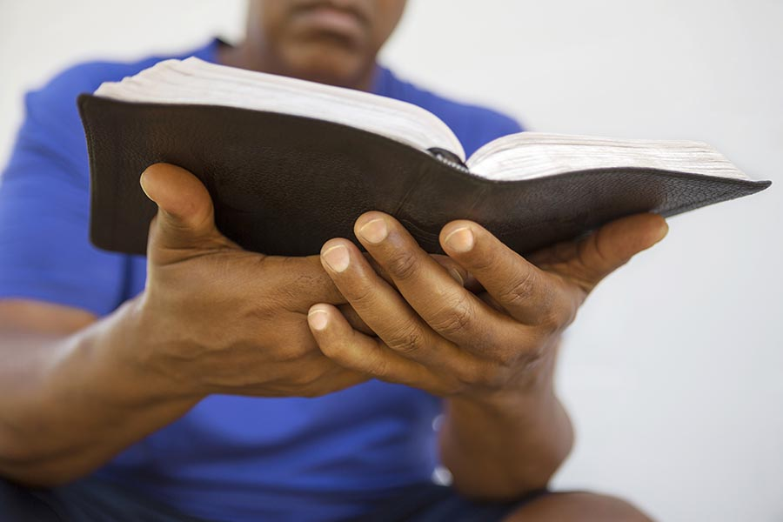
Conclusion
When a question of authority or doctrinal matter arises, let us consult the absolute authority source – God’s word!
No need for wisdom of man or man-made creeds or doctrines, etc…
We can follow the pattern that the council at Jerusalem followed!
The authority has been established: Let us teach the gospel to all people!

Slide 22
“What Must I Do To Be Saved?”
Hear The Gospel (Jn. 5:24; Rom. 10:17)
Believe In Christ (Jn. 3:16-18; Jn. 8:24)
Repent Of Sins (Lk. 13:3-5; Acts 2:38)
Confess Christ (Mt. 10:32; Rom. 10:10)
Be Baptized (Mk. 16:16; Acts 22:16)
Remain Faithful (Jn. 8:31; Rev. 2:10)
For The Erring Saint:
Repent (Acts 8:22), Confess (I Jn. 1:9),
Pray (Acts 8:22)

