Slide 1
Spirit Of Competition Text: I Corinthians 9:24-27
Notes:
By Nathan L Morrison
All Scripture given is from NASB unless otherwise stated
For further study, or if questions, please Call: 804-277-1983 or Visit: www.courthousechurchofchrist.com

Slide 2
INTRO
Is competition good or bad?
An Oxford Journal article on Competition had this to say:
“Competition is the backbone of US economic policy. Competition advocacy is also thriving internationally. Promoting competition is broadly accepted as the best available tool for promoting consumer well-being.”
Competition can yield:
Lower costs and prices for goods and services (opposed to a monopoly)
Better quality
More choices and variety
More innovation
Greater efficiency and productivity
Economic development and growth
Greater wealth equality
A stronger republic by dispersing economic power
Greater wellbeing by promoting individual initiative, liberty, and free association
Notes:
Source:
(http://antitrust.oxfordjournals.org/content/1/1/162.full)

Slide 3
INTRO
Competition is good for:
Individuals seeking jobs, raises, and promotions
People physically & mentally as it pushes them to grow, to be fit, to better themselves!
Good sportsmanship!

Slide 4
INTRO
Dark side of competition:
Businesses: Resort to stealing either product ideas or poaching employees
Individuals climbing the corporate ladder: cheat, steal or hurt others
Athletes: Cheat in some form or another (performance-enhancing drugs)
Athletes young and old: Throw tantrums or break down when they lose (Unsportsmanlike behavior)
Individuals with a perpetual competitive spirit: Look down on others, compare themselves with others, and it leads to jealousy (envy) and strife!
Should saints have a competitive spirit?

Slide 5
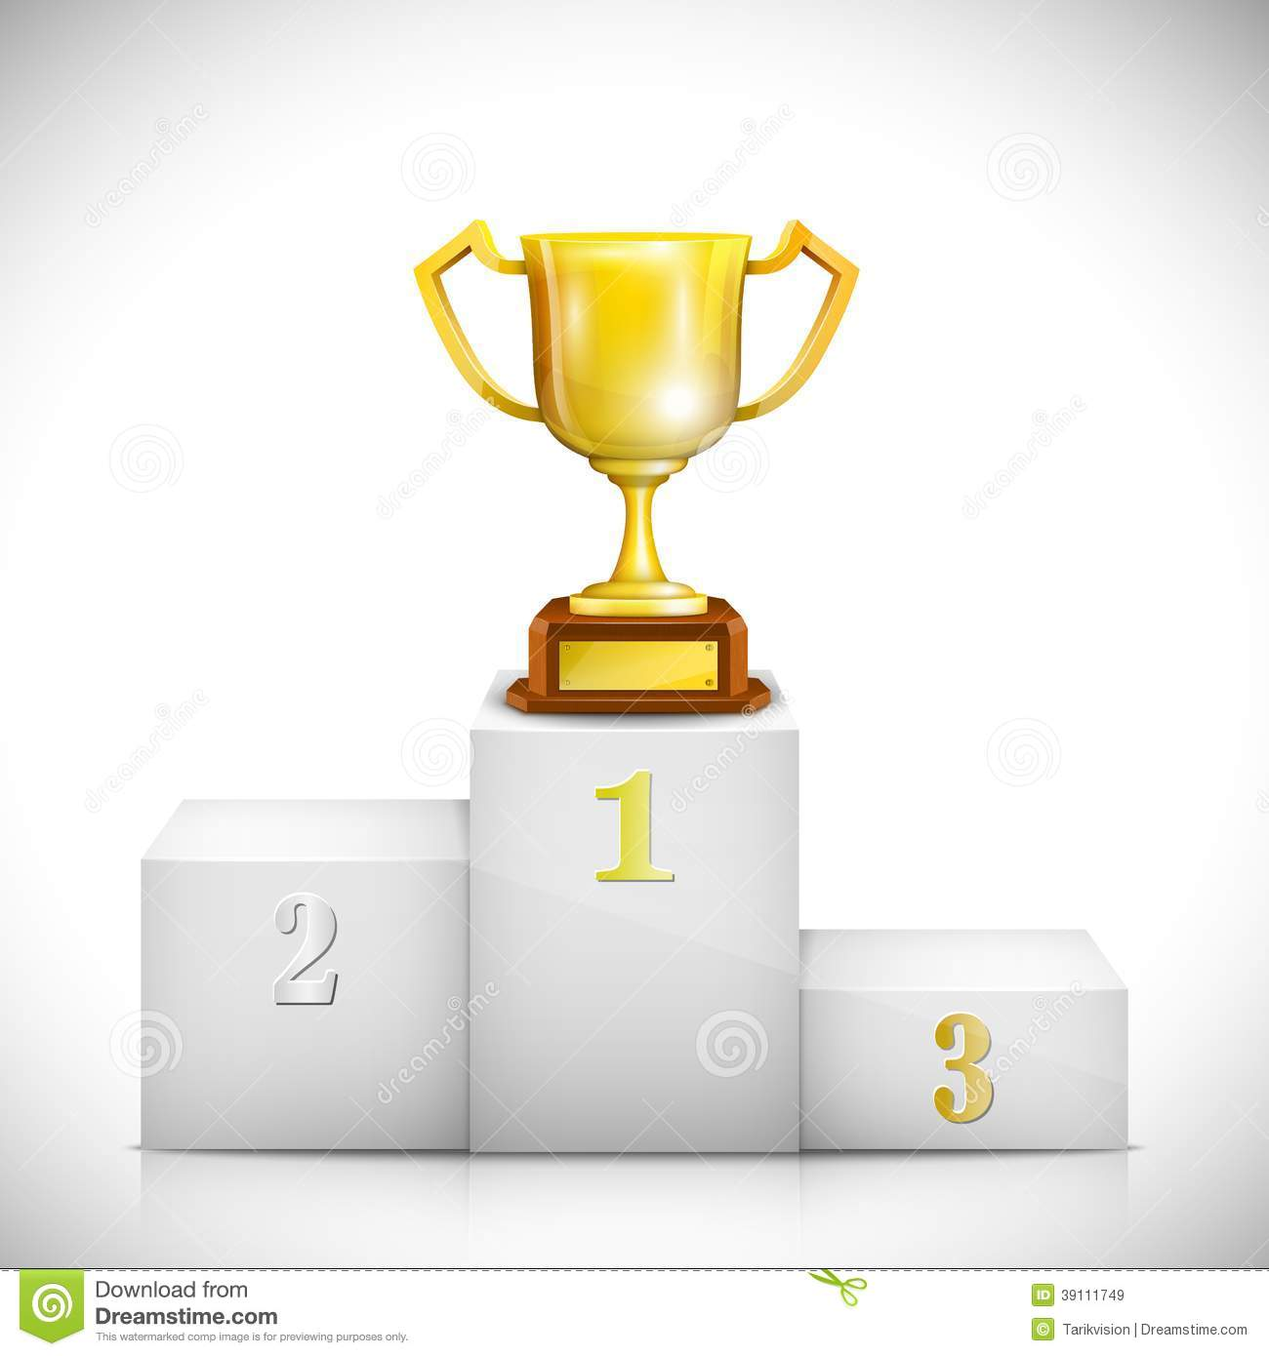
What Does God Say About Competition?
Proverbs 27:17: One man sharpens another – a little competition helps us to grow!
Jeremiah 12:5: Competing with horses used as an example of having stamina and endurance
I Corinthians 9:24-27: Competition used as metaphor for Christian life!
I Corinthians 9:24-27
24. Do you not know that those who run in a race all run, but only one receives the prize? Run in such a way that you may win.
25. Everyone who competes in the games exercises self-control in all things. They then do it to receive a perishable wreath, but we an imperishable.
26. Therefore I run in such a way, as not without aim; I box in such a way, as not beating the air;
27. but I discipline my body and make it my slave, so that, after I have preached to others, I myself will not be disqualified.
Notes:
I Corinthians 9:24-27
The Corinthians would have been used to the games as Corinth hosted the Isthmian Games every 3 years (some sources say every 5 years).
The Isthmian games consisted of: Leaping, running, throwing the discus, boxing, and wrestling (could also consist of horse and chariot races).
Winning a race requires purpose and discipline.
Paul uses this illustration to explain that the Christian life takes hard work, self-denial, and grueling preparation.
As Christians, we are running toward our heavenly reward.
Don't merely observe from the grandstand; don't just turn out to jog a couple of laps each morning. Train diligently—your spiritual progress depends upon it.
Not just one winner, just that we should all run as winners – We should all practice the same kind of self-denial that the Apostle Paul himself practiced!

Slide 6
What Does God Say About Competition?
II Timothy 2:5: Compete according to the rules used as a metaphor
Hebrews 12:1-2: To win this race requires self-discipline to set aside sin and run with endurance!
II Timothy 2:5
5. Also if anyone competes as an athlete, he does not win the prize unless he competes according to the rules.
The Scriptures say there’s nothing wrong with a little good honest competition, and even compares our walk with God to competing according to the rules!
Notes:
II Timothy 2:5
There are rules for the conduct of our life as Christians and we are to heed them in our race “to win.”
Christianity requires the same preparation and determination to win that athletes possess!

Slide 7
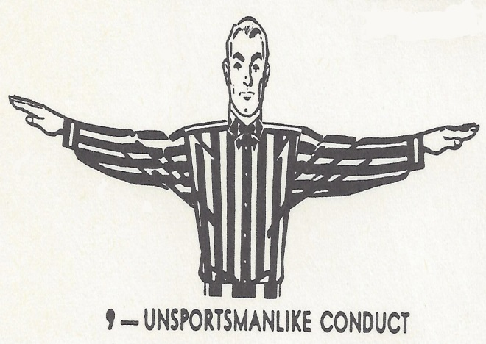
What Does God Say About a Constant Spirit of Competition?
Matthew 18:1-4: The greatest is the one who is humble!
Matthew 19:30: First will be last!
Matthew 20:25-28: Do not seek to be the greatest – serve!
Luke 18:9-14: Trust in own righteousness and view others with contempt is condemned
Matthew 20:25-28
25. But Jesus called them to Himself and said, "You know that the rulers of the Gentiles lord it over them, and their great men exercise authority over them.
26. "It is not this way among you, but whoever wishes to become great among you shall be your servant,
27. and whoever wishes to be first among you shall be your slave;
28. just as the Son of Man did not come to be served, but to serve, and to give His life a ransom for many."
Notes:
Matthew 20:25-28
25. But Jesus called them to Himself and said, "You know that the rulers of the Gentiles lord it over them, and their great men exercise authority over them.
26. "It is not this way among you, but whoever wishes to become great among you shall be your servant,
27. and whoever wishes to be first among you shall be your slave;
28. just as the Son of Man did not come to be served, but to serve, and to give His life a ransom for many."

Slide 8
What Does God Say About a Constant Spirit of Competition?
Romans 2:11: God does not show partiality
I Corinthians 1:10-13: Not be divided over who is better!
I Corinthians 3:3-4: Jealousy and fighting with one another are condemned as fleshly
Galatians 5:13-15: Do not bite and devour one another
Galatians 5:13-15
13. For you were called to freedom, brethren; only do not turn your freedom into an opportunity for the flesh, but through love serve one another.
14. For the whole Law is fulfilled in one word, in the statement, "YOU SHALL LOVE YOUR NEIGHBOR AS YOURSELF."
15. But if you bite and devour one another, take care that you are not consumed by one another.
Notes:
Galatians 5:13-15
13. For you were called to freedom, brethren; only do not turn your freedom into an opportunity for the flesh, but through love serve one another.
14. For the whole Law is fulfilled in one word, in the statement, "YOU SHALL LOVE YOUR NEIGHBOR AS YOURSELF."
15. But if you bite and devour one another, take care that you are not consumed by one another.

Slide 9
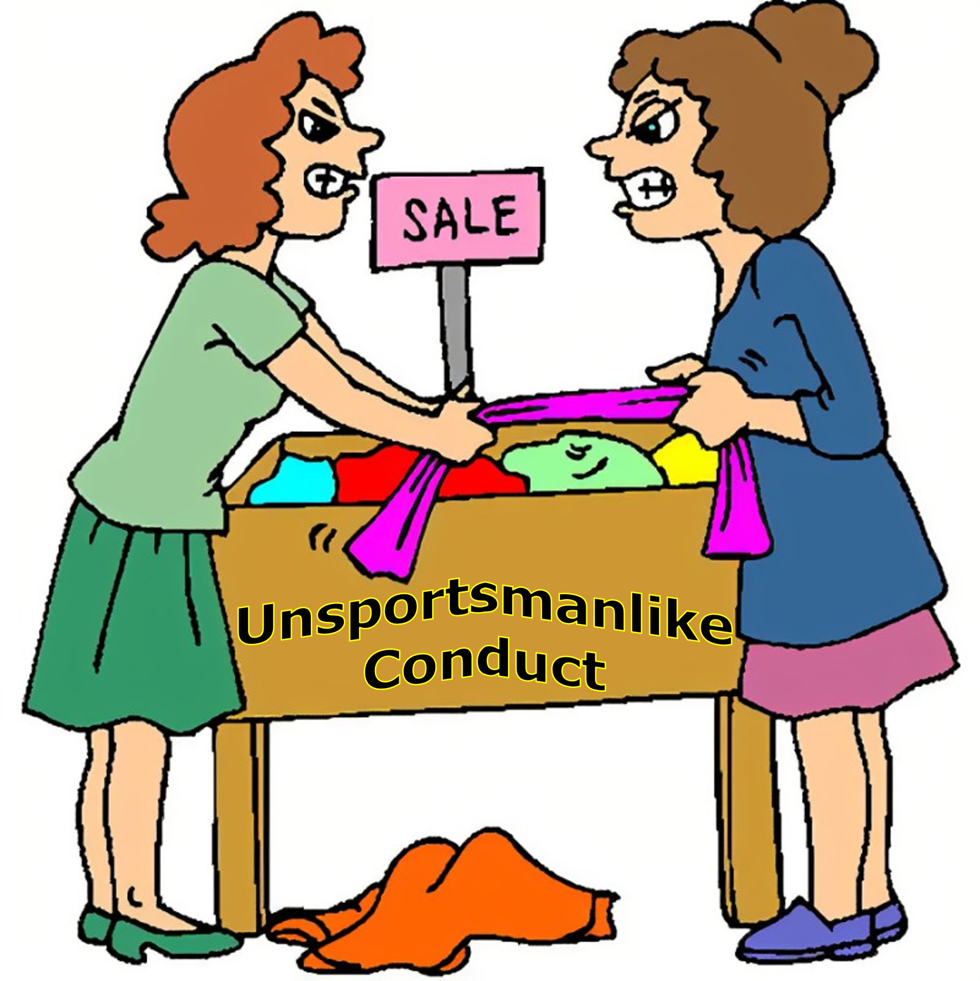
What Does God Say About a Constant Spirit of Competition?
Galatians 5:26: Not to challenge or envy one another
Philippians 2:3-4: Do nothing out of rivalry, but think of others as better than yourself
James 3:14-16: Jealousy and selfish ambition cause every evil thing
Philippians 2:3-4
3. Do nothing from selfishness or empty conceit, but with humility of mind regard one another as more important than yourselves;
4. do not merely look out for your own personal interests, but also for the interests of others.
We should NOT be looking for ways in which we are “better” than others!
Notes:
Philippians 2:3-4
3. Do nothing from selfishness or empty conceit, but with humility of mind regard one another as more important than yourselves;
4. do not merely look out for your own personal interests, but also for the interests of others.
Constantly competing against other people will cause one to suffer unproductive exhaustion and bitterness!
Having an attitude of competition all the time or selfish ambition is condemned in the Scriptures.

Slide 10
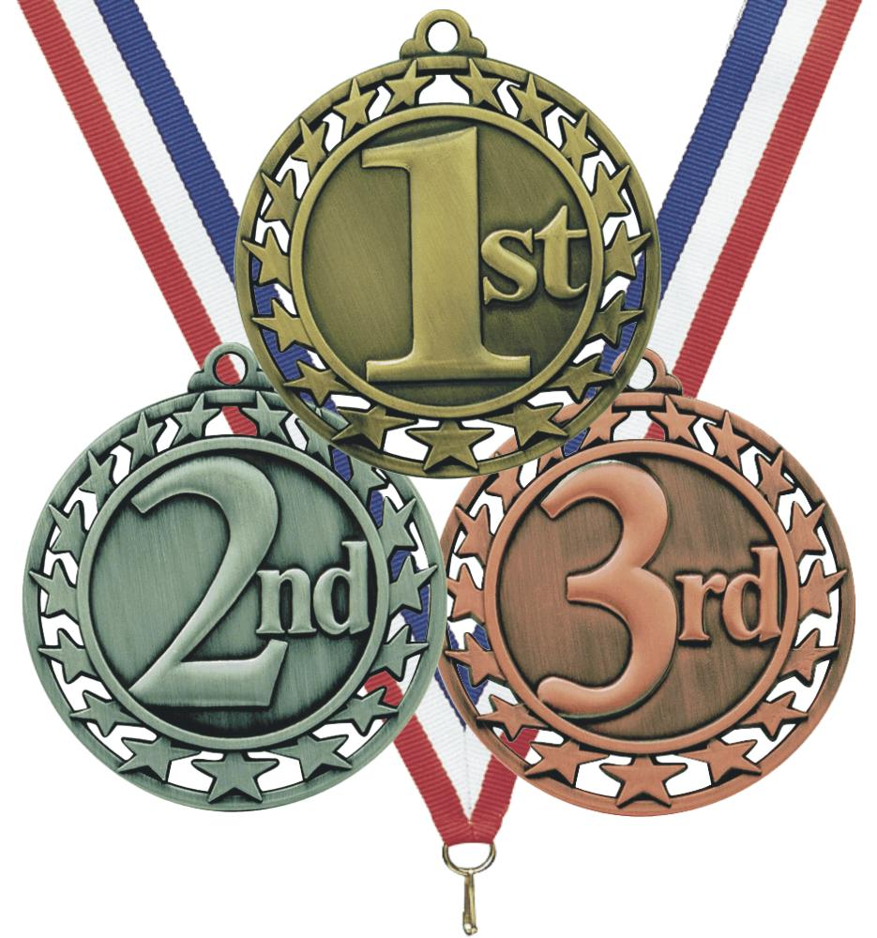
How Should We Think of One Another?
I Corinthians 12:12-26: All members of one body with different functions – One is not above the other
I Corinthians 12:18-20
18. But now God has placed the members, each one of them, in the body, just as He desired.
19. If they were all one member, where would the body be?
20. But now there are many members, but one body.
Notes:
I Corinthians 9:24-27
The Corinthians would have been used to the games as Corinth hosted the Isthmian Games every 3 years (some sources say every 5 years).
The Isthmian games consisted of: Leaping, running, throwing the discus, boxing, and wrestling (could also consist of horse and chariot races).
Winning a race requires purpose and discipline.
Paul uses this illustration to explain that the Christian life takes hard work, self-denial, and grueling preparation.
As Christians, we are running toward our heavenly reward.
Don't merely observe from the grandstand; don't just turn out to jog a couple of laps each morning. Train diligently—your spiritual progress depends upon it.
Not just one winner, just that we should all run as winners – We should all practice the same kind of self-denial that the Apostle Paul himself practiced!

Slide 11
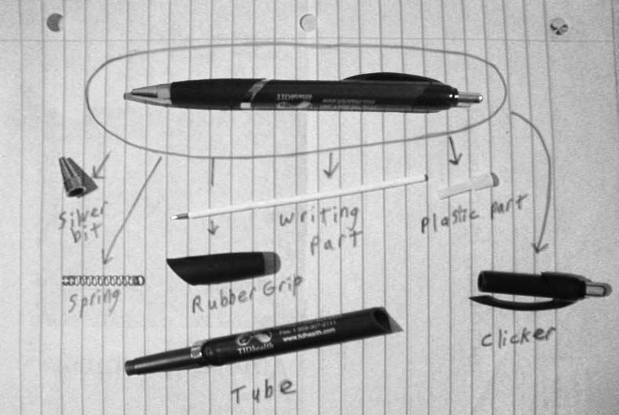
How Should We Think of One Another?
Ball-Point Pen Analogy:
Even the tiniest part, the spring, is needed for it to work right!

Slide 12
How Should We Think of One Another?
Romans 12:3-8: Not think more highly of self – Each has different gifts (I Pet. 4:10)
Romans 14:19: Pursue that which builds up, not tears down
I Thessalonians 5:11: Build each other up
I Corinthians 13:4-6: Love is not jealous or proud, it rejoices in the truth!
Ephesians 4:11-16: Each has different talents (I Cor. 15:58: Work together!)
Spiritually, we must work together, not compete against each other – Build each other up in love!
Notes:
Eph. 4:11-16: Each has different talents (I Cor. 15:58: Work together!)
Use your talents to build others up (I Pet. 4:10: Serve one another!)
Each individual doing their part will cause the entire body to grow

Slide 13
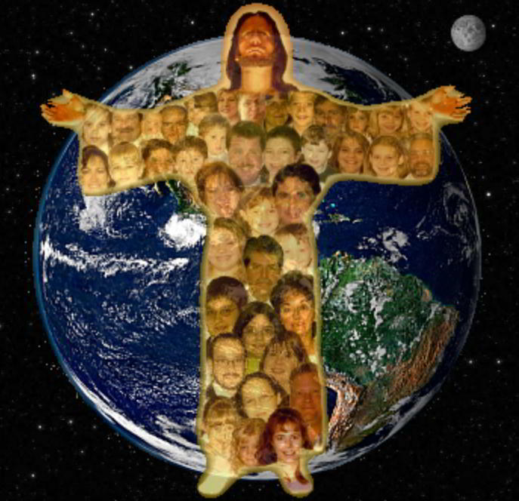
Conclusion
Competition is good when it is used for personal growth but can be bad if you constantly compare yourself to others for selfish motives!
We all have our own unique abilities that are all useful in different ways
We should never envy each other or put each other down because we feel we are “better”
Instead of trying to be “the greatest” we should look for ways to serve!
Celebrate each other’s differences and encourage one another to use their individual talents for building each other up and for the growth of the church!
Notes:
Don’t compare yourself to others!
Compare yourself to Jesus!
A whole different mindset will develop!

Slide 14
“What Must I Do To Be Saved?”
Hear The Gospel (Jn. 5:24; Rom. 10:17)
Believe In Christ (Jn. 3:16-18; Jn. 8:24)
Repent Of Sins (Lk. 13:3-5; Acts 2:38)
Confess Christ (Mt. 10:32; Rom. 10:10)
Be Baptized (Mk. 16:16; Acts 22:16)
Remain Faithful (Jn. 8:31; Rev. 2:10)
For The Erring Saint:
Repent (Acts 8:22), Confess (I Jn. 1:9),
Pray (Acts 8:22)

