Slide 1
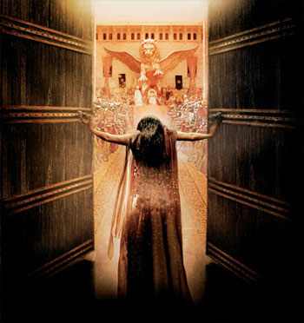
In The Kingdom: “For Such A Time As This”
Text: Esther 4:14
Notes:
By Nathan L Morrison
All Scripture given is from NASB unless otherwise stated
For further study, or if questions, please Call: 804-277-1983 or Visit: www.courthousechurchofchrist.com
Picture: Courtesy of Gener8Xion Entertainment and Fox Faith, movie poster for ‘One Night With The King’

Slide 2
Intro
Mordecai told Esther, concerning her need to act to save her people:
“If you remain silent at this time, relief
and deliverance will arise for the Jews
from another place and you and your
father's house will perish. And who
knows whether you have not attained
royalty for such a time as this?”
(Esther 4:14)

Slide 3
Esther 4-10
Esther 4:1-9
Mordecai learned of Haman’s plan to eradicate the Jews (Est. 3), and put on sackcloth and ashes and wailed and wept loudly!
Esther finds out Mordecai wants her to talk to the king!
Esther 4:11-14
Esther reminded Mordecai that anyone that goes to the king not summoned will be put to death unless he holds out his golden scepter. She had not been summoned for 30 days!
Mordecai responded with that she will perish too, despite being queen.
Then he asked her if she may be queen “for such a time as this?” (Esther 4:14)
Esther 4:15-17
Esther told Mordecai she would go after three days of fasting.
She told them to fast, which often included praying, for her for 3 days.

Slide 4
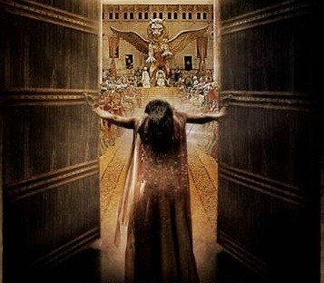
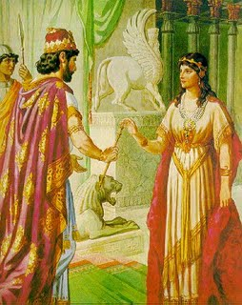
Esther 4-10
Esther 5:1-4
Esther braved the law and entered the king’s throne room. She found favor and touched his outstretched scepter.
The king offered anything and she invited him and Haman to a banquet!
From there her plan went into motion to save her
people (Est. 5:5-10:3), but it started from the motivation
that she was put where she was by God
“for such a time as this!”

Slide 5
Intro
Mordecai told Esther, concerning her need to act to save her people:
“If you remain silent at this time, relief and deliverance will arise for the Jews from another place and you and your father's house will perish. And who knows whether you have not attained royalty for such a time as this?” (Esther 4:14)
What if we are in the kingdom of Christ with our unique
talents and abilities “for such a time as this?”

Slide 6
In The Kingdom: “For Such A Time As This”
Encourager – Like Barnabas
(Acts 4:36-37; 9:26-28)
Acts 4:36-37
36. Now Joseph, a Levite of Cyprian birth, who was also called Barnabas by the apostles (which translated means Son of Encouragement),
37. and who owned a tract of land, sold it and brought the money and laid it at the apostles' feet.
Notes:
A. Encourager
1. Like Barnabas – Acts 4:36-37; 9:26-28
a. He was a man from Cyprus named Joseph who must have been a man with such a personality that he built people up because the apostles renamed him Barnabas, which means, “Son of Encouragement.”
b. He took a strained situation, where Saul of Tarsus was trying to join with the disciples at Jerusalem and they were afraid of him, and he brought Saul to the apostles and vouched for him. Saul moved freely among them afterwards!
2. Col. 4:7-8: Paul said Tychicus was sent to encourage the saints at Colosse.
3. Encouragement is important – lest we grow weary and become discouraged!
a. I Thess. 5:11, 14; Heb. 3:13; 10:23-25: We are to encourage one another!
4. Perhaps you are in the kingdom because you have a gift to build people up – Use it!

Slide 7
In The Kingdom: “For Such A Time As This”
Encourager – Like Barnabas
(Acts 4:36-37; 9:26-28)
Heart of a Servant – Like Tabitha (Acts 9:36-43) & Phoebe (Rom. 16:1-2)
Acts 9:36, 39
36. Now in Joppa there was a disciple named Tabitha (which translated in Greek is called Dorcas); this woman was abounding with deeds of kindness and charity which she continually did.
39. So Peter arose and went with them. When he arrived, they brought him into the upper room; and all the widows stood beside him, weeping and showing all the tunics and garments that Dorcas used to make while she was with them.
Notes:
B. Heart of a Servant
1. Like Tabitha (Greek = Dorcas) – Acts 9:36-43 & Phoebe – Rom. 16:1-2
a. Tabitha: She was a woman who was “was abounding with deeds of kindness and charity which she continually did.”
b. When she died they brought Peter to bring her back to life – She was missed!
c. When Peter arrived the widows showed him all that she had made for them.
d. She was a woman who served others!
e. Phoebe: Paul introduces her as a woman who was a “servant of the church which is at Cenchrea” (City on an isthmus 8 miles from Corinth).
f. Paul said of her that she was “a helper of many, and of myself as well.”
2. John 13:12-16: Jesus washed His disciples’ feet as an example; Not of washing feet but of taking on the role of the lowly house servant. An example of servitude to one another!
3. Gal. 5:13: From love we are to serve one another! (I Pet. 4:9-10)
4. It is Christ Whom we truly serve – Col. 3:24; I Jn. 4:15-21(We love God & brethren)
5. Phil. 2:3-4: Saints are to “regard one another as more important than yourselves.”
6. We ought to see the needs of one another and fill them (Js. 2:15-16; I Jn. 3:17-18)!
7. You may be in the kingdom with an ability to serve God and serve one another – Use it!
Phoebe, a servant of the church at Cenchrea, an isthmus city 8 miles away from Corinth.
An isthmus is a narrow strip of land with sea on either side, forming a link between two larger areas of land.
The isthmus at Corinth was several miles across, and Cenchrea was the port city on the east side of the isthmus.
This is where the Isthmian Games were held, and probably to what Paul referred to in I Cor. 9:24-27.

Slide 8
In The Kingdom: “For Such A Time As This”
Encourager – Like Barnabas
(Acts 4:36-37; 9:26-28)
Heart of a Servant – Like Tabitha (Acts 9:36-43) & Phoebe (Rom. 16:1-2)
Preacher/Teacher to save the lost – Like Paul
(Acts 9:15-16; II Cor. 5:10-11; Eph. 6:18-20; Col. 4:2-4)
Acts 9:15-16
15. But the Lord said to him, "Go, for he is a chosen instrument of Mine, to bear My name before the Gentiles and kings and the sons of Israel;
16. for I will show him how much he must suffer for My name's sake."
Notes:
C. Preacher/Teacher to save the lost
1. Like Paul the Apostle – Acts 9:15-16; II Cor. 5:10-11; Eph. 6:18-20; Col. 4:2-4
a. Ananias obeyed God and went to tell Saul of Tarsus what Jesus had said, that he was a chosen instrument to bear Christ’s name “before the Gentiles and kings and the sons of Israel.”
b. Paul took the gospel to the Jews and Gentiles and before kings, all the way to Caesar! (Phil. 4:22: There were saints in Caesar's household)
2. Some people have the ability to study one-on-one more than others (able to connect).
3. Mt. 4:19: Jesus called His apostles to be “fishers of men.” (Lk. 19:10: Jesus’ mission)
4. There are some people that seem to have the ability to “fish” for men more than others!
5. II Tim. 2:24-26: As “bondservants” of the Lord we are to be able (apt) to teach to save men from the snare of the devil! (II Cor. 5:10-11; Col. 1:28)
6. Perhaps you are in the kingdom because you have the ability to teach and save the lost – Use it!

Slide 9
In The Kingdom: “For Such A Time As This”
Encourager – Like Barnabas
(Acts 4:36-37; 9:26-28)
Heart of a Servant – Like Tabitha (Acts 9:36-43) & Phoebe (Rom. 16:1-2)
Preacher/Teacher to save the lost – Like Paul (Acts 9:15-16; II Cor. 5:10-11; Eph. 6:18-20; Col. 4:2-4)
Preacher/Teacher to defend the faith – Like Timothy
(I Tim. 4:1-6; II Tim. 4:1-5)
II Timothy 4:3-4
3. For the time will come when they will not endure sound doctrine; but wanting to have their ears tickled, they will accumulate for themselves teachers in accordance to their own desires,
4. and will turn away their ears from the truth and will turn aside to myths.
Notes:
D. Preacher/Teacher to defend the faith
1. Like Timothy – I Tim. 4:1-6; II Tim. 4:1-5
a. Paul warned Timothy that apostasy would come from within “the faith.”
2. Some people have the ability to defend the truth (Jude 3); debates, studies, etc.
3. This may happen while teaching to save the lost, and is not mutually exclusive, but some people really have the ability to defend the truth against error! (Paul did both!)
Eph. 4:14-16; II Tim. 2:15: Saints are to be studied enough to see truth from error.
KJV: II Tim. 2:15 (Eph. 4:14-16)
15. Study to shew thyself approved unto God, a workman that needeth not to be ashamed, rightly dividing the word of truth.
5. You may be in the kingdom with the ability to defend the faith – Use it!

Slide 10
In The Kingdom: “For Such A Time As This”
Encourager – Like Barnabas
(Acts 4:36-37; 9:26-28)
Heart of a Servant – Like Tabitha (Acts 9:36-43) & Phoebe (Rom. 16:1-2)
Preacher/Teacher to save the lost – Like Paul (Acts 9:15-16; II Cor. 5:10-11; Eph. 6:18-20; Col. 4:2-4)
Preacher/Teacher to defend the faith – Like Timothy
(I Tim. 4:1-6; II Tim. 4:1-5)
Use Talents and Abilities as Members of the Body
(I Cor. 12:12-27; Eph. 4:14-16)
I Corinthians 12:14, 27
For the body is not one member, but many.
27. Now you are Christ's body, and individually members of it.
Notes:
E. Use Talents and Abilities as Members of the Body
1. As members of the body all have functions to fulfill – I Cor. 12:12-27; Eph. 4:14-16
a. The body of Christ is made up of individual members with different functions and we are to grow up together in love! (I Pet. 4:10)
2. For the body to function properly, every member must act according to its role or ability.
3. Our example in our daily lives to those around us (Mt. 5:16; Eph. 5:11) can demonstrate our abilities to teach and serve!
4. When we assemble together, all things can be done properly & in order (I Cor. 14:40):
a. The building maintained for the purpose of meeting together.
b. The Lord’s Supper prepared.
c. The Song Leader ready and prepared.
d. Teachers and preacher ready and prepared for their classes and sermon.
e. Members ready to participate and serve as needed!
5. I Cor. 15:58: To have fellowship in work, all must work!
6. You may be in the kingdom because you fill a role & ability of the body – Use it!

Slide 11
In The Kingdom: “For Such A Time As This”
Encourager – Like Barnabas
(Acts 4:36-37; 9:26-28)
Heart of a Servant – Like Tabitha (Acts 9:36-43) & Phoebe (Rom. 16:1-2)
Preacher/Teacher to save the lost – Like Paul (Acts 9:15-16; II Cor. 5:10-11; Eph. 6:18-20; Col. 4:2-4)
Preacher/Teacher to defend the faith – Like Timothy
(I Tim. 4:1-6; II Tim. 4:1-5)
Use Talents and Abilities as Members of the Body
(I Cor. 12:12-27; Eph. 4:14-16)
Just as Esther was queen “For such a time as this” you may be in the Kingdom of Christ “For such a time as this”
– Like Esther, fulfill your role and ability as God has given it to you!

Slide 12
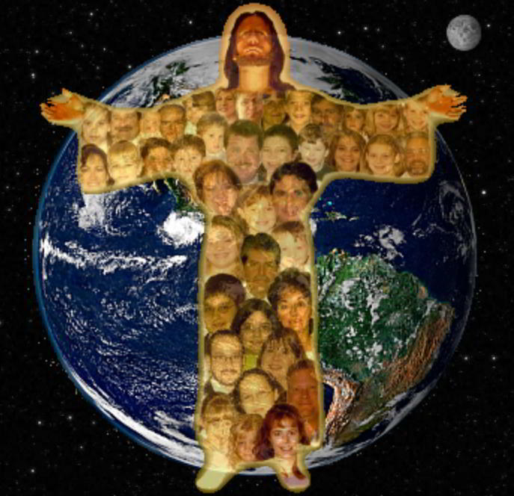
Conclusion
When all the members of the body work together as
“every joint supplies” (Ephesians 4:16) saints are edified and ready for the work God has given us to do!
Let us work for the
Lord in His kingdom
supposing we are
here “for such a time
as this!”
Notes:
I. When all the members of the body work together as “every joint supplies” (Ephesians 4:16) saints are edified and ready for the work God has given us to do!
II. Let us work for the Lord in His kingdom supposing we are here “For such a time as this!”

Slide 13
“What Must I Do To Be Saved?”
Hear The Gospel (Jn. 5:24; Rom. 10:17)
Believe In Christ (Jn. 3:16-18; Jn. 8:24)
Repent Of Sins (Lk. 13:3-5; Acts 2:38)
Confess Christ (Mt. 10:32; Rom. 10:10)
Be Baptized (Mk. 16:16; Acts 22:16)
Remain Faithful (Jn. 8:31; Rev. 2:10)
For The Erring Saint:
Repent (Acts 8:22), Confess (I Jn. 1:9),
Pray (Acts 8:22)
Notes:
If you are not a Christian, you need to be. Repent and be baptized!
If a Christian living with sin, repent and He will forgive you.
Whatever your requests, let them be made known NOW while we stand & sing!

