Slide 1
Confirmed By Four Testimonies Of Jesus As The Christ
Text:
John 5:33-47
Notes:
By Nathan L Morrison
All Scripture given is from NASB unless otherwise stated
For further study, or if questions, please Call: 804-277-1983 or Visit: www.courthousechurchofchrist.com
PowerPoint Background from Rod MacArthur

Slide 2
Testimonies Of Jesus As The Christ
Jesus cited 4 testimonies
that prove He is the Christ
In spite of all the proof,
many of the Jews refused
to come to Jesus
John 5:33-47
John the Baptist
Jesus’ miracles
God the Father
The Scriptures
John 5:31-47
They didn’t have love for God but for men (Jn. 5:41-43; 12:42-43)
They cherished the glory of man over the glory of God (Jn. 5:44)
They hoped in the wrong man – Moses (Jn. 5:45-47

Slide 3
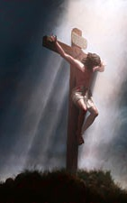
Testimonies Of Jesus As The Christ
Two opposite attitudes are evident in this passage:
Do you reject or accept Jesus?!
A willing Savior who offers Himself as a sacrifice and then offers life eternal!
Stubborn and rebellious people who let the invitation of Christ fall on deaf ears

Slide 4
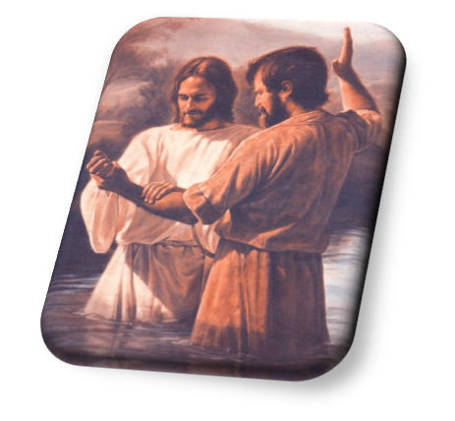
John the Baptist
Testimony of John
John 5:33-35 (Jn. 1:19-29)
33. "You have sent to John, and he has testified to the truth.
34. "But the testimony which I receive is not from man, but I say these things so that you may be saved.
35. "He was the lamp that was burning and was shining and you were willing to rejoice for a while in his light.
Matthew 11:2-6
While John was imprisoned he sent his disciples to confirm who Jesus was.
Jesus tells John’s disciples to report what they heard! (Is. 42:6-7; 61:1)

Slide 5
John the Baptist
Testimony of John
John 5:33-35 (Jn. 1:19-29)
33. "You have sent to John, and he has testified to the truth.
34. "But the testimony which I receive is not from man, but I say these things so that you may be saved.
35. "He was the lamp that was burning and was shining and you were willing to rejoice for a while in his light.
John repeatedly told the Jews to repent for the kingdom of Heaven was at hand
Mt. 3:1-2, 8: Preached
Mt. 3:7, 10, 12: Warned
Mt. 3:11-12: Foretold
John the Baptist told the Jews who Jesus was and what He came to do – They were without excuse!

Slide 6
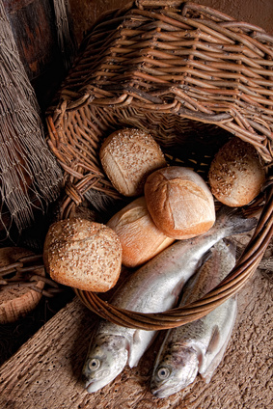
Jesus’ Miracles
Testimony of Miracles
Miracles Confirm
Miracles confirmed Jesus was who He said He was! (Jn. 3:2; 9:29-33)
Miracles cause man to believe in Jesus (Jn. 20:30-31; 21:25; 11:45-48; 12:11)
Miracles confirm the Word (Mk. 16:17-20; Heb. 2:1-4)
John 5:36 (Jn. 3:2)
36. "But the testimony which I have is greater than the testimony of John; for the works which the Father has given Me to accomplish--the very works that I do--testify about Me, that the Father has sent Me.
Miracles demonstrated Jesus’ power and authority –
They were without excuse!

Slide 7
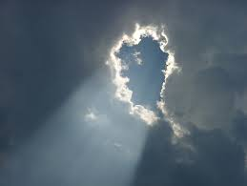
God The Father
Testimony of God
God’s Testimony
At time of Christ’s baptism
Mt. 3:16-17: “This is My beloved Son, in whom I am well- pleased.”
On Mt. Of Transfiguration
Mt. 17:1-8: (Vs. 5) “This is My beloved Son, with whom I am well-pleased; listen to Him!”
Christ in Jerusalem
Jn. 12:28: “Father, glorify Your name.” Then a voice came out of heaven: “I have both glorified it, and will glorify it again.”
John 5:37-38
37. "And the Father who sent Me, He has testified of Me. You have neither heard His voice at any time nor seen His form.
38. "You do not have His word abiding in you, for you do not believe Him whom He sent.
God’s audible voice was heard by men three times while Christ was on earth!

Slide 8
God the Father
Testimony of God
John 5:37-38
37. "And the Father who sent Me, He has testified of Me. You have neither heard His voice at any time nor seen His form.
38. "You do not have His word abiding in you, for you do not believe Him whom He sent.
Jesus is the final say and authority for man’s purpose and destiny
Heb. 1:1-2: “Spoken in His Son”
Jesus spoke for all mankind of every time period – John 12:48; Acts 17:30-31
Rom. 3:23; 6:23
Jn. 6:68 (Jn. 16:13)
Col. 2:9-10
Over and over God the Father confirmed who Jesus was and what He came to do – They were without excuse!

Slide 9
The Scriptures
Testimony of the Scriptures
Hebrews 1:1-2
The prophets were “holy men of God” – II Peter 1:20-21
Their message looked toward the coming of “The Prophet” – Acts 3:22-24
John 5:39-40 (5:45-47)
39. "You search the Scriptures because you think that in them you have eternal life; it is these that testify about Me;
40. and you are unwilling to come to Me so that you may have life.

Slide 10
The Scriptures
Testimony of the Scriptures
The Scriptures confirmed Christ (Luke 4:21)
Mt. 2:1-6: The wise men from the East
Lk. 16:27-31: Scriptures (Moses & Prophets) could prevent the rich man’s five brothers from torment
Lk. 24:44-48: The Scriptures pointed to Christ – He fulfilled them
John 5:39-40 (5:45-47)
39. "You search the Scriptures because you think that in them you have eternal life; it is these that testify about Me;
40. and you are unwilling to come to Me so that you may have life.
The Scriptures told Who Christ was and His mission –
They were without excuse!

Slide 11
Conclusion
Christ’s blood “speaks better than the blood of Abel” (Heb. 12:24) and speaks of:
God’s love for mankind
The sinfulness of mankind
The inability (helplessness) of mankind to save itself from sin
There are many reasons why a person will refuse to listen to Christ –
#1 is lack of love!
Jn. 5:42: They did not love God enough to believe the Scriptures
Jn. 14:23-24; I Jn. 5:3: Those who do not obey Christ do not truly love God
Mankind is to “not refuse
Him who is speaking!”
(Heb. 12:25)

Slide 12
Conclusion
Despite all the evidence of Jesus being the Christ
and Son of God, the Jews rejected Him, and
many today continue to do so!
John the Baptist
Jesus’ miracles
God the Father
The Scriptures
Those who refuse to come to Christ, even when they know the truth, are (like the Jews) without excuse!
John 12:48: Those who reject Him will be held accountable to His word
With Jesus confirmed by these four testimonies,
let us obey Him as Christ and Lord!

Slide 13
“What Must I Do To Be Saved?”
Hear The Gospel (Jn. 5:24; Rom. 10:17)
Believe In Christ (Jn. 3:16-18; Jn. 8:24)
Repent Of Sins (Lk. 13:3-5; Acts 2:38)
Confess Christ (Mt. 10:32; Rom. 10:10)
Be Baptized (Mk. 16:16; Acts 22:16)
Remain Faithful (Jn. 8:31; Rev. 2:10)
For The Erring Saint:
Repent (Acts 8:22), Confess (I Jn. 1:9),
Pray (Acts 8:22)

