Slide 1
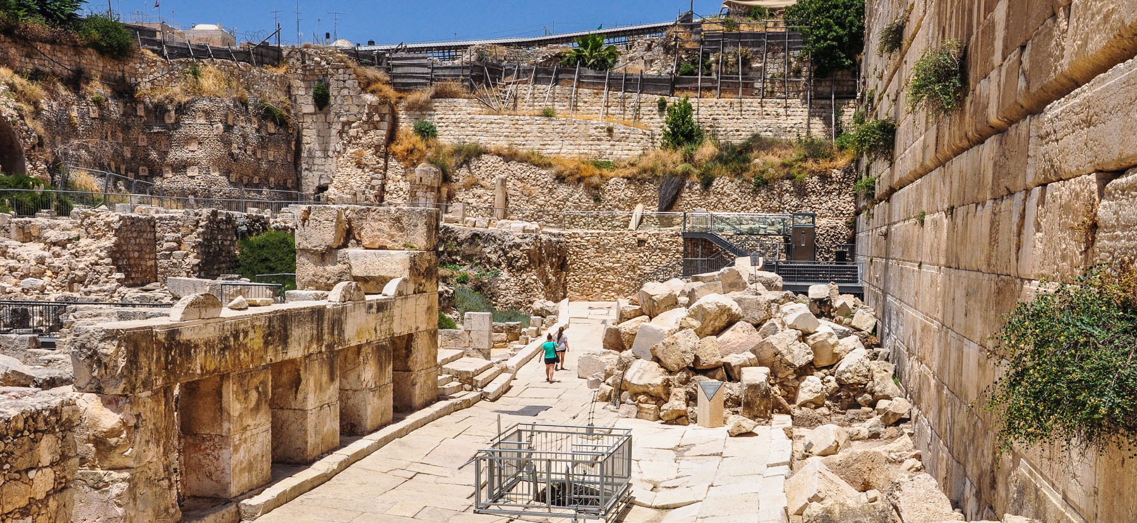
The Stones Cry Out
Text:
Luke 19:40
Notes:
Prepared by Nathan L Morrison, Sunday July 11, 2021
All Scripture given is from NASB unless otherwise stated
For further study, or if questions, please Call: 804-277-1983 or Visit: www.courthousechurchofchrist.com
Image: Ruins of ancient Jerusalem

Slide 2
Intro
If the Scriptures are the word of God, one would expect it to be accurate, even where it touches upon science, geography, history, peoples, and events!
Secularists constantly deny the reliability of the Scriptures and consider the Bible historically inaccurate
Archaeology is one way that is used to provide evidences of the Bible’s historicity and reliable witness to world events, peoples and places

Slide 3
Intro
The scientific study of material remains (such as tools, pottery, jewelry, stone walls, and monuments) of past human life and activities
Remains of the culture of a people : ANTIQUITIES
Merriam-Webster
Archaeology Defined
According to Howard F. Vos, Archaeology literally means “A study of ancient things, but the term has come to signify much more than that.”
Notes:
Sources:
https://www.merriam-webster.com/dictionary/archaeology
Howard F. Vos, Archaeology in Bible Lands, 13 from Archaeology and the Bible by Mike Willis, p. 6
HOWARD VOS (1925-2019)
“Howard F. Vos has had a distinguished career as an expert in historical, geographical, biblical, and archeological research. A prolific author and editor, he is responsible for twenty-five books that are standards in their field, including the Wycliffe Bible Dictionary. He has traveled extensively in the Bible lands and excavated many sites in Israel.”
https://www.zondervan.com/author/2129/howard-vos/

Slide 4
Intro
Many Bible statements are not verifiable (IE: the death of Jesus was an atonement)
If archaeology is used to “prove” the Bible, we put the authority of Scripture under that of Archaeology.
The Bible does not need archaeology to prove it!
Most often the archaeologists did not set out to “prove” the Bible
Archaeology has often proven something years and years after it was under scrutiny by critics!
The Limits of Biblical Archaeology
Notes:
Sources:
Archaeology and the Bible by Mike Willis, p. 6-8

Slide 5
Intro
Luke 19:37-40
37. As soon as He was approaching, near the descent of the Mount of Olives, the whole crowd of the disciples began to praise God joyfully with a loud voice for all the miracles which they had seen,
38. shouting: "BLESSED IS THE KING WHO COMES IN THE NAME OF THE LORD; Peace in heaven and glory in the highest!"
39. Some of the Pharisees in the crowd said to Him, "Teacher, rebuke Your disciples."
40. But Jesus answered, "I tell you, if these become silent, the stones will cry out!"
Sometimes the stones cry out!

Slide 6
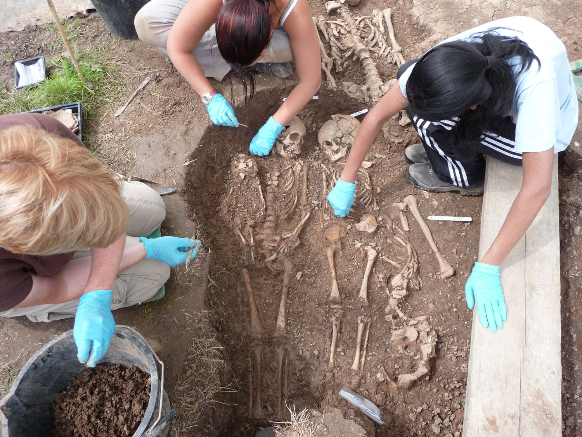
Old Testament Archaeology
Notes:
Sources:
Archaeology and the Bible by Mike Willis
https://biblearchaeologyreport.com/2019/01/12/top-ten-discoveries-in-biblical-archaeology-relating-to-the-old-testament/

Slide 7
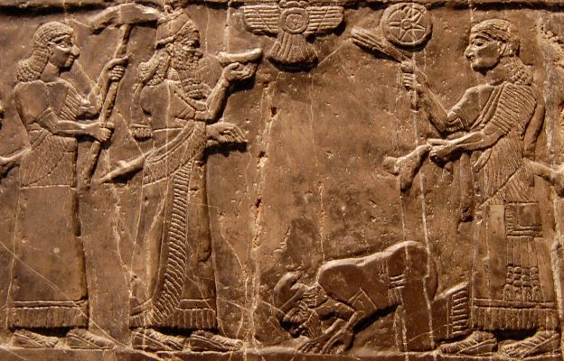
Old Testament Archaeology
Collection: Annals of the Assyrian Kings
Who Discovered it: Austen Henry Layard
Date of Discovery: 1846
Location of Discovery: Nineveh
Date of Event: ca. 841 B.C.
Significance: The only ancient depiction of a biblical figure – King Jehu of Israel
Black Obelisk of Shalmaneser III
The Black Obelisk depicts King Jehu bowing before Shalmaneser III, King of Assyria.
The inscription reads, “The tribute of Jehu, son of Omri: I received from him silver, gold, a golden bowl, a golden vase with pointed bottom, golden tumblers, golden buckets, tin, a staff for a king [and] spears.”
Notes:
Sources:
Archaeology and the Bible by Mike Willis, p. 66
https://www.britishmuseum.org/collection/object/W_1848-1104-1
http://www.rcyoung.org/articles/threev.pdf
Photo Credit: Steven G. Johnson / Wikimedia Commons / CC-BY-SA-3.0
The Black Obelisk of Shalmaneser III, king of Assyria
The nation of Israel had numerous interactions with the Assyrians which are recorded in their annals. One inscription – the Kurkh Monolith of Shalmaneser III – lists King Ahab as one of the kings of a western coalitions that fought against Shalmaneser III in the battle of Qarqar, which has been dated to 853 BC. Part of the Annals of the Assyrian Kings.
Another inscription – the Black Obelisk of Shalmaneser III (found in Nineveh by Austen Henry Layard in 1846) – states that King Jehu brought tribute to Shalmaneser in 841 B.C. In fact, the Black Obelisk includes a carving of Jehu bowing before Shalmaneser and is the only depiction yet discovered of a Hebrew king. It is one of two complete Assyrian obelisks yet discovered!
The inscription reads, “The tribute of Jehu, son of Omri: I received from him silver, gold, a golden bowl, a golden vase with pointed bottom, golden tumblers, golden buckets, tin, a staff for a king [and] spears.”
The dating of these inscriptions allows us to date the chronology of kings of Israel and Judah as listed in the biblical books of Kings and Chronicles. In his book, The Mysterious Numbers of the Hebrew Kings, scholar Edwin Thiele successfully reconstructed the chronology of the entire Hebrew monarchy (both the united monarchy and the divided kingdoms) from these dates.
The Assyrian Limmu Lists and the Annals of the Assyrian Kings have allowed scholars to establish an absolute chronology for many events in the Old Testament. That’s significant!

Slide 8
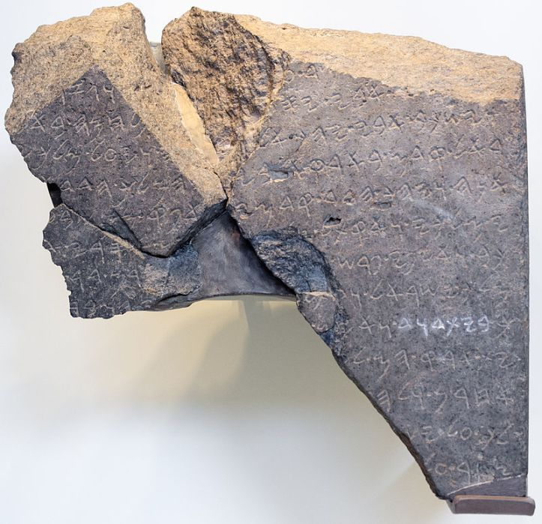
Old Testament Archaeology
Collection: The Tel Dan Inscription
Who Discovered it: Israeli archaeologist Avraham Biran
Date of Discovery: 1993
Location of Discovery: Tel Dan, upper Galilee
Date of Event: ca. 841 B.C.
Significance: The First Historical Evidence of King David outside the Bible
Tel Dan Stele
The stele records the victory of the King of Aram over the King of Israel, and his ally, the king of the “House of David.”
Notes:
Sources:
Archaeology and the Bible by Mike Willis, p. 53
http://www.biblearchaeology.org/post/2011/05/04/The-Tel-Dan-Stela-and-the-Kings-of-Aram-and-Israel.aspx
https://www.biblicalarchaeology.org/daily/biblical-artifacts/the-tel-dan-inscription-the-first-historical-evidence-of-the-king-david-bible-story/
Photo Credit: Oren Rozen / Wikimedia Commons / CC-BY-SA-4.0
Tel Dan Stele
Throughout the 1980’s and early 1990’s a movement called Bible minimalism was growing. Minimalists believe the Bible is of minimal value historically, given that it’s not really reliable, in their opinion. One of their prime targets was King David.
For example, University of Sheffield Professor, Dr. Philip R. Davies, stated, “I’m not the only scholar who suspects that the figure of King David is about as historical as King Arthur.” Archaeologist, Israel Finkelstien has claimed, “The united kingdom of David and Solomon, described in the Bible as a regional power, was at most, a small tribal kingdom….David’s kingdom was simply 500 people with sticks in their hands shouting and cursing and spitting.”
Bible minimalists asserted that King David’s expanded kingdom, as described in the Bible were nothing more than legend and myth.
In 1993 archaeologists were digging at Tel Dan, the site of the ancient city of Dan in northern Israel, led by Israeli archaeologist Avraham Biran. While excavating part of a wall, they discovered a broken stone, approximately 32 cm high by 22 cm wide, with an Aramaic inscription on it. The next year, two more fragments of the stele were unearthed. The inscription caused an instant sensation, and put minimalists, who had crowed about the fact that there was no evidence for King David outside of the Bible, squarely on the defensive.
The stele records the victory of the King of Aram (most likely Hazael, although he is not named) over the King of Israel, and his ally, the king of the “House of David.”
The most important part of the inscription is the king of Aram, most likely King Hazael of Damascus, boasting of defeating his enemies in Israel & Judah. He said, “I killed Jehoram son of Ahab king of Israel, and I killed Ahaziahu son of Jehoram king of the house of David. And I set their town into ruins and turned their land into desolation” (Finkelstein and Silberman, 129, from Archaeology and the Bible, by Mike Willis, p. 53), referring to the deaths of the kings of Israel & Judah by King Jehu of Israel, around 841 B.C.
We know from the biblical record, II Kings 9, that King Jehu killed both those kings at Jezreel. But King Jehoram of the house of Ahab had been wounded in a fight by King Hazael and taken to Jezreel to heal (II Kings 8:28-29). King Ahaziah of Judah was the grandson of the godly king of Judah, King Jehoshaphat, of the house of David.
It dates to the ninth century B.C., about 200 years after David’s rule (circa 841 B.C.). The phrase, “House of David,” set the archaeological world afire. For the first time, there was a clear, widely-acknowledged reference to David.
Archaeologist, Yosef Garfinkel explains the importance of the inscription: “‘House of David’ means ‘dynasty of David’. So now we know that there was a guy called David and he had a dynasty…this is absolutely clear that David is not a mythological figure. So the mythological paradigm collapsed in one moment.”

Slide 9
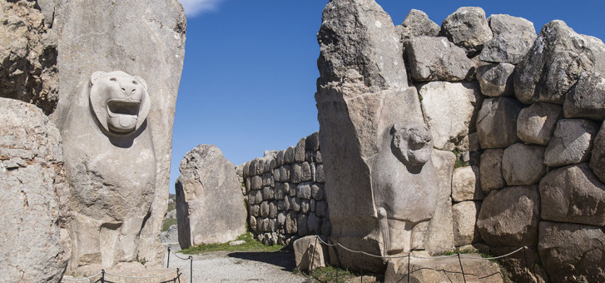
Old Testament Archaeology
Collection: Hittites Artifact Collections
Who Discovered it: Archibald Henry Sayce, Hugo Winckler
Date of Discovery: 1876, 1906
Location of Discovery: Carchemish; Turkey; Multiple sites
Date of Event: Mentioned in Bible 47 times
Significance:
5 temples
A fortified citadel
Many monumental sculptures
Over 10,000 clay tablets
Whole libraries were found
Complete genealogies of the people of the city
The Hittites
Notes:
Sources:
https://www.hopechannel.com/au/read/the-hittites-a-civilisation-lost-and-found
https://www.khanacademy.org/humanities/world-history/world-history-beginnings/ancient-egypt-hittites/a/the-hittites
Image: Hattusas: Lion Gate, The Lion Gate at Hattusas in Boğazköy, Turkey.
https://www.britannica.com/place/Anatolia/The-rise-and-fall-of-the-Hittites
The Hittites
1876: Archibald Sayce (1846-1933) claimed an un-deciphered script from Carchemish might be the evidence of the Hittites.
1906: Clay tablets were discovered in Turkey.
In 1906 Hugo Winckler (1863-1913) used the clay tablets and uncovered the capital of the Hittite Empire (Hattusas) at Boğazkale, Turkey:
5 temples
A fortified citadel
Many monumental sculptures
Over 10,000 clay tablets
Whole libraries were found
Complete genealogies of the people of the city
He announced to the world that the Hittites had been found!
It became one of the largest ancient discoveries ever made!

Slide 10
New Testament Archaeology
Notes:
Sources:
Archaeology and the Bible by Mike Willis
https://biblearchaeologyreport.com/2019/01/19/top-ten-discoveries-in-biblical-archaeology-relating-to-the-new-testament/

Slide 11
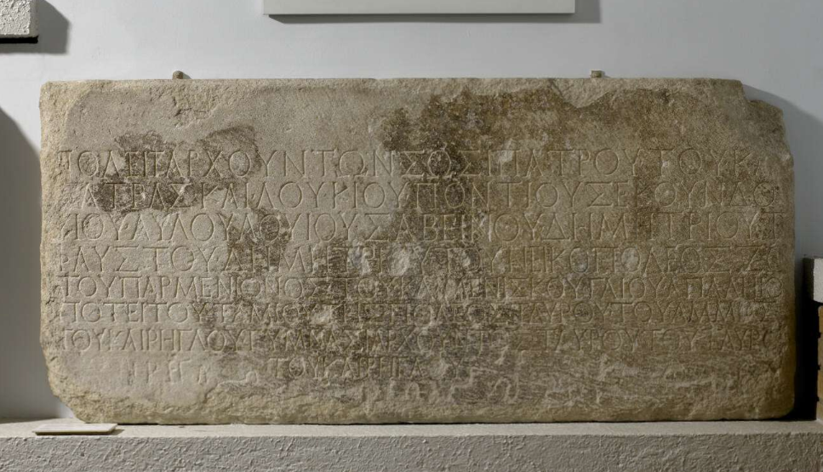
New Testament Archaeology
Collection: Politarch Inscriptions
Who Discovered it: Ottoman Empire
Date of Discovery: 1867
Location of Discovery: Thessalonica
Date of Event: ca. A.D. 2nd century
Significance: Luke was an accurate, well-informed, eye-witness, and credible historian!
Politarch Inscription on the Vardar Gate in Thessalonica
Acts 17:6-8 (ESV, NAS): The “city authorities”
The Greek word occurs here twice but nowhere else in extant Greek literature. This led earlier critics to claim Luke was in error, a claim that persisted for hundreds of years.
The inscription says, “In the time of the Politarchs…”
Notes:
Sources:
Archaeology and the Bible by Mike Willis, p. 114
http://en.wikipedia.org/wiki/Historical_reliability_of_the_Acts_of_the_Apostles
http://www.macedoniantruth.org/forum/showthread.php?t=5630
http://bethyada.blogspot.com/2010/10/politarches-and-vardar-gate-inscription.html
https://www.britishmuseum.org/collection/object/G_1877-0511-1
Image: From the British Museum
Politarch Inscription on the Vardar Gate in Thessalonica
Acts 17:6-8 (ESV, NAS): The “city authorities”
(ASV, KJV, NKJ: “the rulers of the city”).
The word he used was G4173 politarchēs [pol-it-ar'-khace]: a town officer, that is, magistrate: ruler of the city. (Compound word: from polis (city) and arche (ruler)).
It occurs here twice but nowhere else in extant Greek literature. This led earlier critics to claim Luke was in error, a claim that persisted for hundreds of years.
1867: During the Ottoman Empire (1299-1923), in an effort to expand the city walls of Thessalonica, the city gate and ancient walls were torn down:
An inscription was found on the city gate, known as the Vardar Gate that says, “In the time of the Politarchs…”
It was sent to the British Museum
Since then, archaeologists in Thessalonica have unearthed several inscriptions using this term.
Seventeen other inscriptions were found in Salonika (modern name of Thessalonica), showing the use of this term. “The rare title ‘politarchs’ was given to the supreme board of magistrates at Thessalonica, as is proved by inscriptions” (Joseph Free, Archaeology and the Bible by Mike Willis, p. 114)
Luke was an accurate, well-informed, eye-witness, and credible historian!

Slide 12
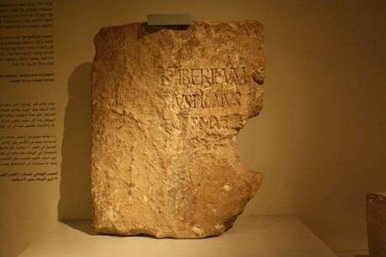
New Testament Archaeology
Collection: Holy Land Artifacts
Who Discovered it: Italian archaeologist Antonio Frova
Date of Discovery: 1961
Location of Discovery: Caesarea
Date of Event: ca. A.D. 30
Significance: The Pilate Stone confirms that Pontius Pilate was Prefect of Judea, authority to sentence to death
Pilate Stone
Centuries-long debate over title & existence of Pilate
Was he governor, prefect or procurator?
What is the difference?
Procurator: Unable to sentence to death
Prefect: Able to sentence to death
The Latin inscription says, “…Pontius Pilate, Prefect of Judea”
Notes:
Sources:
Archaeology and the Bible by Mike Willis, p. 102-103
http://en.wikipedia.org/wiki/Pilate_Stone
https://ferrelljenkins.blog/2015/02/25/pilate-erected-a-tiberium-in-caesarea-maritima/Image: From the British Museum
https://www.deseret.com/2018/5/3/20644446/the-pilate-stone-in-israel-s-caesarea-by-the-sea#a-stone-with-a-latin-dedicatory-inscription-of-pontius-pilate-was-part-of-an-exhibit-of-holy-land-artifacts-at-emory-universitys-michael-c-carlos-museum-in-atlanta-in-june-2007-ap-photo-john-bazemore
Photo Credit: BRBurton / Wikimedia Commons / Public Domain
The “Pilate Inscription” (“Pilate Stone”)
Mt. 27:2: “…to Pilate the governor.”
For centuries, there has been a debate over the existence of a historical Pilate.
“Until the summer of 1961, absolutely no archaeological evidence existed that would demonstrate that Pontius Pilate, a pivotal figure in the New Testament gospels, ever really existed. Some literary sources mention him — including a few brief allusions in Jewish material (e.g., Josephus) and in late Roman chronicles (e.g., Tacitus) — but no administrative records survive from him and no genuine letters of his have been preserved.”
(Daniel Peterson, Columnist; https://www.deseret.com/2018/5/3/20644446/the-pilate-stone-in-israel-s-caesarea-by-the-sea#a-stone-with-a-latin-dedicatory-inscription-of-pontius-pilate-was-part-of-an-exhibit-of-holy-land-artifacts-at-emory-universitys-michael-c-carlos-museum-in-atlanta-in-june-2007-ap-photo-john-Bazemore)
There has been an ongoing debate over his rank: was he governor, prefect or procurator?
The gospels refer to him as “Governor” (Mt. 27:2; Lk. 3:1).
Josephus calls him “governor,” and “procurator” (Josephus, Book 18, Ch. 2-4, 6).
What is the difference?
A huge difference: as Procurator he would not have had authority to sentence anyone to death. As Prefect he would.
1961: A block of limestone was found in the Roman theatre at Caesarea Palaestina, led by Italian archaeologist Antonio Frova, the capital of the province of Judea, bearing a damaged dedication by Pilate of Tiberieum from about A.D. 30 written in Latin.
It read, “…Pilate, Prefect of Judea.” (Proof he had authority to sentence to death)
It reads,
“To the Divine Augusti (this) Tiberieum
... Pontius Pilate
... prefect of Judea
... has dedicated (this)”
Now from other records the question as to his title is easily explained:
Before 4 BC the title was Governor or Procurator.
4 B.C. – A.D. 44: Governor or Prefect. Pilate’s time period.
After A.D. 44: Governor, Prefect, or Procurator; only this time Procurator held the same power as Prefect.
Josephus wrote after the fall of Jerusalem in A.D. 70 so in his time the governor could be called all three titles.
“The so-called “Pilate Stone” is historically significant because it dates to Pilate’s own lifetime. It is contemporary evidence. Yet — powerfully illustrating the distinctly random nature of archaeological discovery — the excavators could easily have missed it, simply discarding it as rubble. By the fourth century, it had been incorporated into a set of stairs in Caesarea’s Herodian theater. There, the inscription faced downward — fortunately, because that position preserved it from being worn away.”
(Daniel Peterson, Columnist; https://www.deseret.com/2018/5/3/20644446/the-pilate-stone-in-israel-s-caesarea-by-the-sea#a-stone-with-a-latin-dedicatory-inscription-of-pontius-pilate-was-part-of-an-exhibit-of-holy-land-artifacts-at-emory-universitys-michael-c-carlos-museum-in-atlanta-in-june-2007-ap-photo-john-Bazemore)

Slide 13
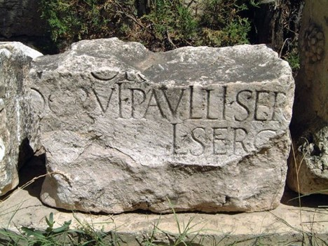
New Testament Archaeology
Collection: Sergius Paulus Family Inscriptions
Who Discovered it: American consul, Louis P. di Cesnola
Date of Discovery: 1865-1887
Location of Discovery: Soli on Cyprus
Date of Event: ca. A.D. 46-48 (A.D. 55)
Significance: Confirms the historicity of the Sergii Paulii family and may reference the very Sergius Paulus mentioned in the Bible!
Sergius Paulus Inscription
Acts 13
Saul and Barnabas go to the Island of Cyprus and meet the proconsul, Sergius Paulus
Numerous inscriptions have been discovered that may refer to Sergius Paulus
The Sergii Paulii family seems to have been a prominent family in the Roman Empire
Notes:
Sources:
Archaeology and the Bible by Mike Willis, p. 113
http://www.biblearchaeology.org/post/2016/05/31/Cypriots-Sorcerers-and-Sergius.aspx
Photo Credit: HolyLandPhotos.org
Sergius Paulus Inscription
In Acts 13, we read of how Saul and Barnabas set off on a missionary journey to the Island of Cyprus. Upon arriving at Paphos, they meet the proconsul, Sergius Paulus, leading him to faith in Christ. Luke describes him as “a man of intelligence” (Acts 13:7). This is true as Sergius Paulus was also a first-century author and is one of the authorities referenced by Pliny the Elder in his classic, Naturalis Historia.
Numerous inscriptions have been discovered that may refer to Sergius Paulus; the Sergii Paulii’s seem to have been a prominent family in the Roman Empire.
Between 1865-1887 an American consul Louis P. di Cesnola’s explorations led to an inscription to be discovered at Soli, north of Paphos that references, “the proconsul Paulus” and is dated A.D. 55, but describes an event that took place during Paulus’ tenure of office (about A.D. 46-48).
Another inscription from Rome, dating to the mid-40’s, names Lucius Sergius Paulus as one of the curators of the Tiber River under the Emperor Claudius. Finally, numerous inscriptions, most famous of which names a “L. Sergius Paulus” have been discovered near Pisidian Antioch.
All three of these inscriptions intersect with the biblical account in very interesting ways:
The Soli inscription confirms Paulus family on Cyprus and that one of them was a proconsul.
The inscriptions from Pisidian Antioch indicate that the Paulus family estate was located nearby. In Acts 13, Saul’s name is changed to Paul immediately after leading Sergius Paulus to the Lord. Furthermore, immediately after leaving Cyprus, Paul and Barnabas make their way to Pisidian Antioch. Scholars have suggested that Paul made his way to Pisidian Antioch to share the gospel with the rest of Sergius Paulus’ family.
Finally, the Tiber River Inscription from Rome suggests that Sergius Paulus held other roles within the Roman Empire
Regardless of how one interprets the data, the numerous Sergius Paulus inscriptions confirm the historicity of the Sergius Paulus family and may reference the very Sergius Paulus mentioned in the Bible.

Slide 14
Conclusion
Archaeology and secular history confirm the Bible as the word of God
God has preserved evidences of His word
While our faith does not rest on what can be seen (John 20:29; II Cor. 5:7), God is faithful to provide many forms of confirmation of His Word that strengthen our faith!
These archaeological finds, and many others, continue to point to the truthfulness of the Bible as the Word of God!

Slide 15
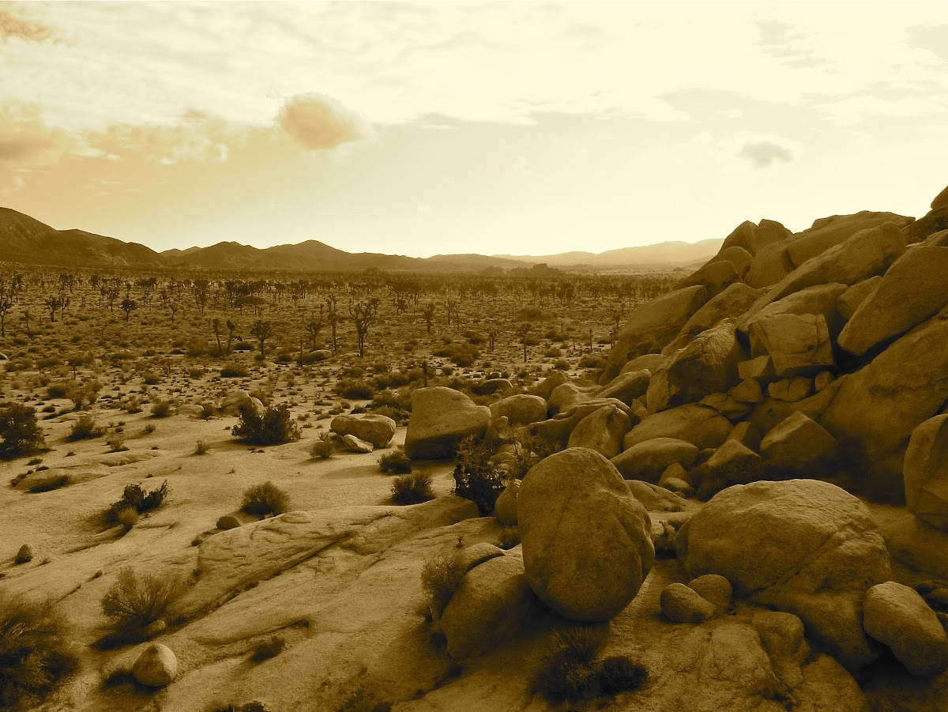
“What Must I Do To Be Saved?”
Hear The Gospel (Jn. 5:24; Rom. 10:17)
Believe In Christ (Jn. 3:16-18; Jn. 8:24)
Repent Of Sins (Lk. 13:3-5; Acts 2:38)
Confess Christ (Mt. 10:32; Rom. 10:10)
Be Baptized (Mk. 16:16; Acts 22:16)
Remain Faithful (Jn. 8:31; Rev. 2:10)
For The Erring Saint:
Repent (Acts 8:22), Confess (I Jn. 1:9),
Pray (Acts 8:22)

Slide 16
Other Finds…
Time would fail us to mention…
(From Hebrews 11:32)

Slide 17
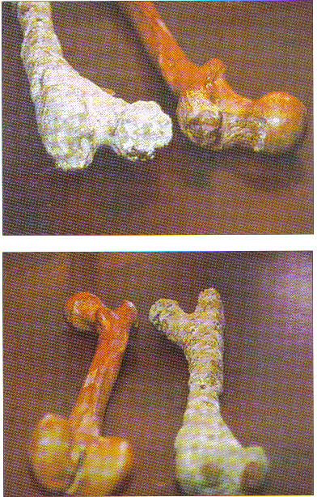
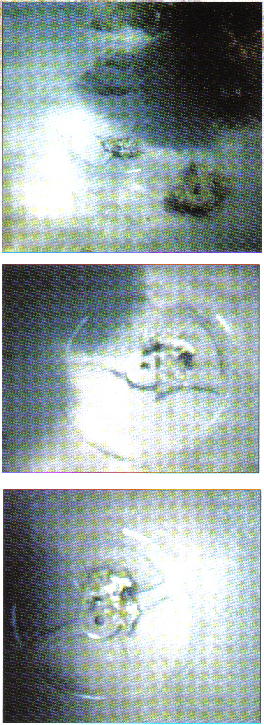
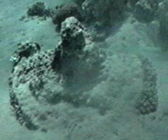
The Exodus
The Exodus Case, by Dr. Lennert Moller
Notes:
The Exodus Case by Dr. Lennart Moller
Remains of humans, horses and bulls
Chariots and chariot wheels
Underneath a covering of over a mile of water in the Gulf of Aqaba

Slide 18
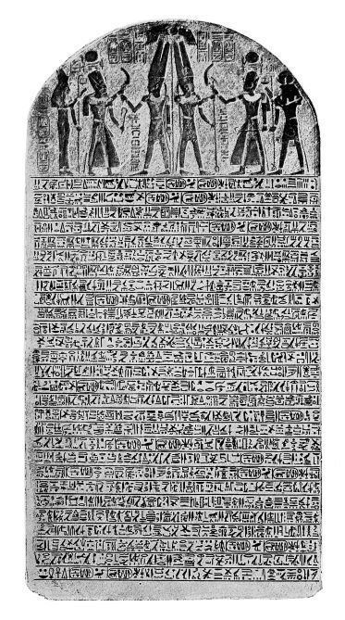
Merneptah Stele
Archaeology and the Bible by Mike Willis, p. 37
Notes:
Sources:
Archaeology and the Bible by Mike Willis, p. 37
https://biblearchaeologyreport.com/2019/01/12/top-ten-discoveries-in-biblical-archaeology-relating-to-the-old-testament/
http://www.biblearchaeology.org/post/2006/03/15/The-Merenptah-Stela.aspx

Slide 19
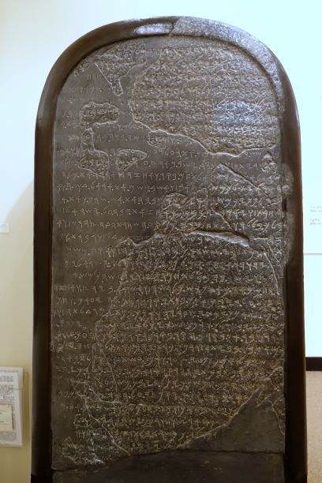
Moabite Stone
Top Ten Discoveries in Biblical Archaeology Relating to the Old Testament
https://biblearchaeologyreport.com/2019/01/12/top-ten-discoveries-in-biblical-archaeology-relating-to-the-old-testament/
Notes:
Sources:
Archaeology and the Bible by Mike Willis, p. 64
https://biblearchaeologyreport.com/2019/01/12/top-ten-discoveries-in-biblical-archaeology-relating-to-the-old-testament/
http://www.biblearchaeology.org/post/2006/09/27/Mesha-King-of-Moab.aspx

Slide 20
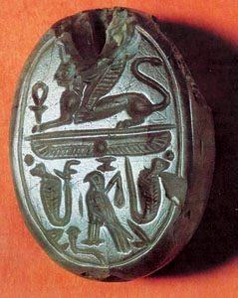
Seal of Queen Jezebel
Archaeology and the Bible by Mike Willis, p. 65
Notes:
Sources:
Archaeology and the Bible by Mike Willis, p. 65
https://www.biblicalarchaeology.org/daily/biblical-artifacts/inscriptions/fit-for-a-queen-jezebels-royal-seal/

Slide 21
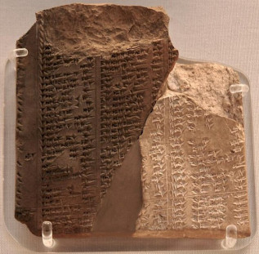
Assyrian Limmu Lists
Top Ten Discoveries in Biblical Archaeology Relating to the Old Testament
https://biblearchaeologyreport.com/2019/01/12/top-ten-discoveries-in-biblical-archaeology-relating-to-the-old-testament/
Notes:
Sources:
https://biblearchaeologyreport.com/2019/01/12/top-ten-discoveries-in-biblical-archaeology-relating-to-the-old-testament/
Assyrian Limmu Lists
In the Old Testament no absolute dates are given…only relative dates (ie. a prophecy in relation to the specific year of a king’s reign or Nadab the son of Jeroboam beginning his reign over Israel “in the second year of Asa king of Judah” – 1 Ki 15:25)
Can we establish any absolute dates in order to reconstruct an accurate biblical chronology? Yes we can, thanks to the discovery of numerous Assyrian Limmu Lists.
The Assyrians had a practice of naming each year after a person which the called the limmu: a high official of the court, the governor of a province or the king himself. Historical events were then dated in terms of the year named after the particular limmu.
When Austen Henry Layard excavated at Ninevah he discovered many cuneiform tablets including four copies of the Assyrian Limmu Lists which listed the over 250 years of Assyrian history dated to specific years named after specific individuals.
Numerous other Assyrian Limmu Lists have been discovered and these have allowed scholars to cross-reference each year and expanded what we know about Assyrian history.
One tablet in particular listed an eclipse of the sun that took place in the month of Simanu in the year of the limmu Bur-Sagale. Astronomy has fixed the date for this eclipse as having occurred on June 15, 763 BC. This is significant because it allows us to absolutely date over 250 years of Assyrian History.

Slide 22
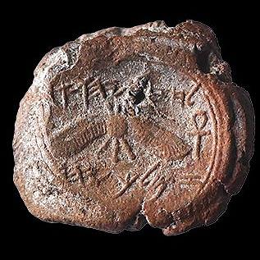
Seal of King Hezekiah
https://www.biblicalarchaeology.org/daily/news/king-hezekiah-in-the-bible-royal-seal-of-hezekiah-comes-to-light/
Notes:
Sources:
https://www.biblicalarchaeology.org/daily/news/king-hezekiah-in-the-bible-royal-seal-of-hezekiah-comes-to-light/

Slide 23
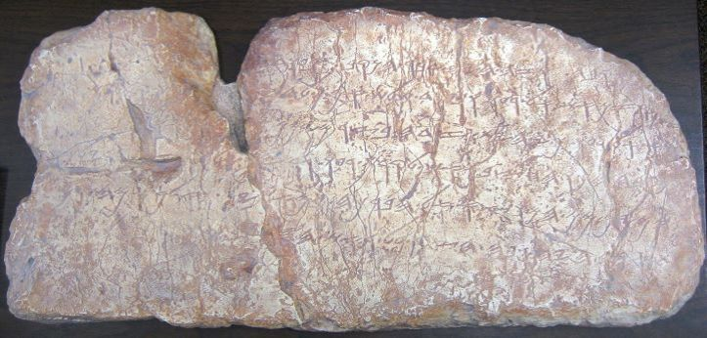
King Hezekiah’s Tunnel
Top Ten Discoveries in Biblical Archaeology Relating to the Old Testament
https://biblearchaeologyreport.com/2019/01/12/top-ten-discoveries-in-biblical-archaeology-relating-to-the-old-testament/
Notes:
Sources:
https://biblearchaeologyreport.com/2019/01/12/top-ten-discoveries-in-biblical-archaeology-relating-to-the-old-testament/
https://www.bibleplaces.com/heztunnel/

Slide 24
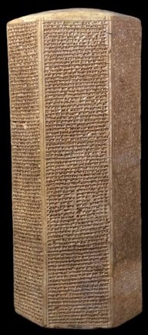
Taylor Prism, AKA The Sennacherib Prism
Archaeology and the Bible by Mike Willis, p. 76
Notes:
Sources:
Archaeology and the Bible by Mike Willis, p. 76
https://www.britishmuseum.org/collection/object/W_1855-1003-1 (Image also here)
Collection: Also called, The Sennacherib Prism
Who Discovered it: Col. Robert Taylor
Date of Discovery: 1830
Location of Discovery: Nineveh, at Nebi Yunus
Date of Event: ca. 691 B.C.
Significance: 6-column journal of King Sennacherib of Assyria (705-681 BC) boasting of his siege of Jerusalem (II Kings 18-19; Isaiah 36-37)

Slide 25
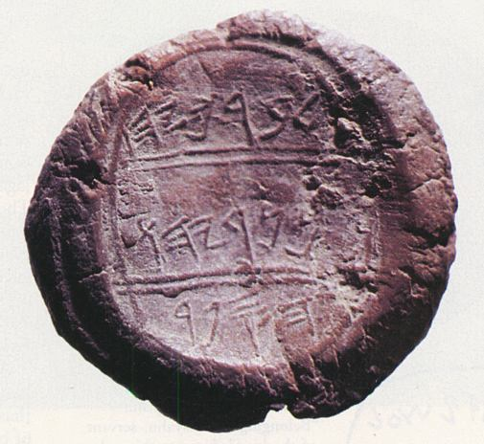
Bulla (Seal) of Baruch
Archaeology and the Bible by Mike Willis, p. 79
Notes:
Sources:
Archaeology and the Bible by Mike Willis, p. 79
https://www.biblehistory.net/newsletter/baruch_jeremiah.htm

Slide 26
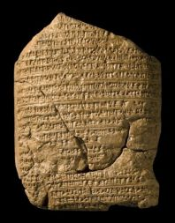
“Jerusalem Chronicle” (Babylonian Chronicle, 605-595 B.C.)
Top Ten Discoveries in Biblical Archaeology Relating to the Old Testament
https://biblearchaeologyreport.com/2019/01/12/top-ten-discoveries-in-biblical-archaeology-relating-to-the-old-testament/
Notes:
Sources:
https://biblearchaeologyreport.com/2019/01/12/top-ten-discoveries-in-biblical-archaeology-relating-to-the-old-testament/
http://www.biblearchaeology.org/post/2006/09/27/Mesha-King-of-Moab.aspx

Slide 27
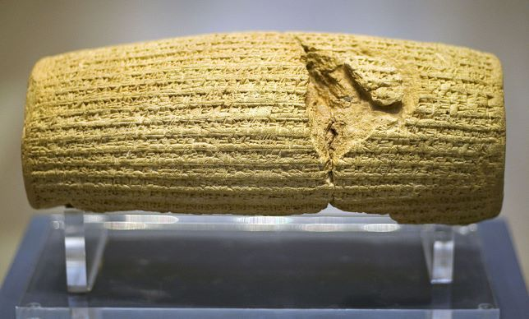
Cyrus Cylinder
Top Ten Discoveries in Biblical Archaeology Relating to the Old Testament
https://biblearchaeologyreport.com/2019/01/12/top-ten-discoveries-in-biblical-archaeology-relating-to-the-old-testament/
Notes:
Sources:
Archaeology and the Bible by Mike Willis, p. 85
https://biblearchaeologyreport.com/2019/01/12/top-ten-discoveries-in-biblical-archaeology-relating-to-the-old-testament/
http://www.biblearchaeology.org/post/2010/08/18/The-Ongoing-Saga-of-the-Cyrus-Cylinder-The-Internationally-Famous-Grande-Dame-of-Ancient-Texts.aspx

Slide 28
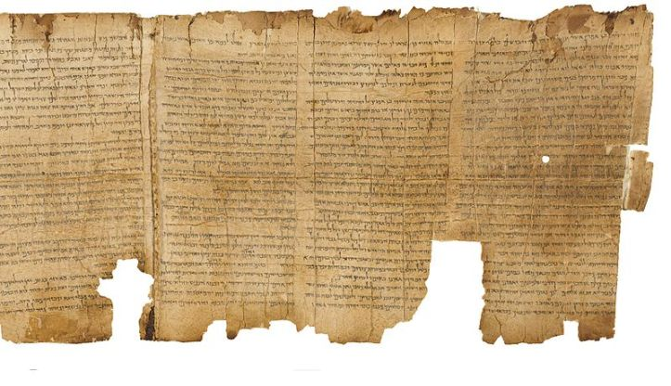
Dead Sea Scrolls
Archaeology and the Bible by Mike Willis, p. 91-97
Notes:
Sources:
Archaeology and the Bible by Mike Willis, p. 91-97
https://biblearchaeologyreport.com/2019/01/12/top-ten-discoveries-in-biblical-archaeology-relating-to-the-old-testament/
https://www.deadseascrolls.org.il/learn-about-the-scrolls/introduction?locale=en_US

Slide 29
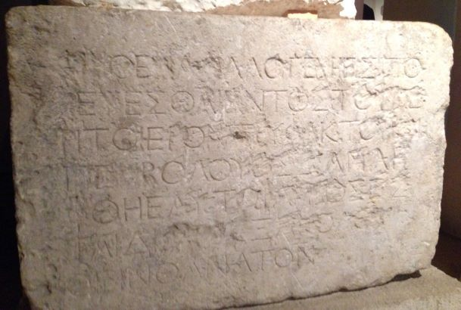
Temple Warning Inscriptions
Archaeology and the Bible by Mike Willis, p. 101
Notes:
Sources:
Archaeology and the Bible by Mike Willis, p. 101
https://biblearchaeologyreport.com/2019/01/19/top-ten-discoveries-in-biblical-archaeology-relating-to-the-new-testament/
https://holylandphotos.wordpress.com/2018/12/17/warning-to-gentiles-from-the-days-of-jesus-inscriptions/

Slide 30
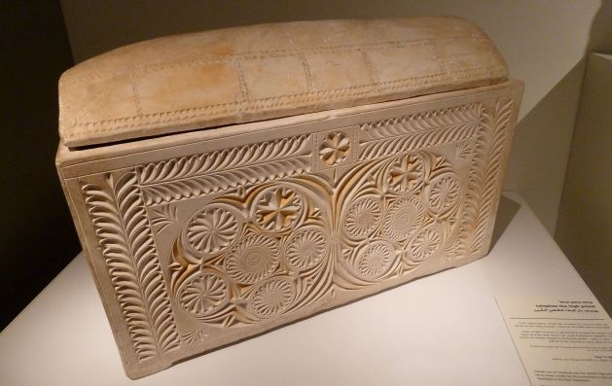
Caiaphas Ossuary
Archaeology and the Bible by Mike Willis, p. 102
Notes:
Sources:
Archaeology and the Bible by Mike Willis, p. 102
https://biblearchaeologyreport.com/2019/01/19/top-ten-discoveries-in-biblical-archaeology-relating-to-the-new-testament/
https://holylandphotos.wordpress.com/2017/04/05/bone-box-of-caiaphas-the-high-priest/

Slide 31
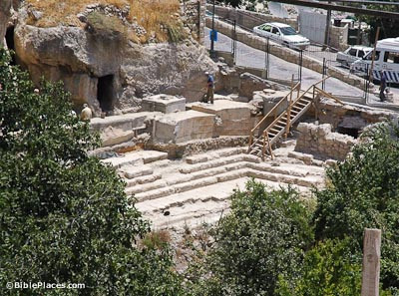
Pool of Siloam
Archaeology and the Bible by Mike Willis, p. 104
Notes:
Sources:
Archaeology and the Bible by Mike Willis, p. 104
https://biblearchaeologyreport.com/2019/01/19/top-ten-discoveries-in-biblical-archaeology-relating-to-the-new-testament/
https://www.bibleplaces.com/poolofsiloam/

Slide 32
Further Study
Top Ten Discoveries in Biblical Archaeology Relating to the Old Testament by Bryan Windle
https://biblearchaeologyreport.com/2019/01/19/top-ten-discoveries-in-biblical-archaeology-relating-to-the-new-testament/
Top Ten Discoveries in Biblical Archaeology Relating to the New Testament by Bryan Windle
https://biblearchaeologyreport.com/2019/01/12/top-ten-discoveries-in-biblical-archaeology-relating-to-the-old-testament/
www.bibleplaces.com
www.biblearchaeology.org
Archaeology and the Bible by Mike Willis
Dead Sea Scrolls by San Diego Natural History Museum
The Exodus Case by Dr. Lennert Moller
The Stones Cry Out: How Archaeology Reveals the Truth of the Bible by Randall Price

