Slide 1
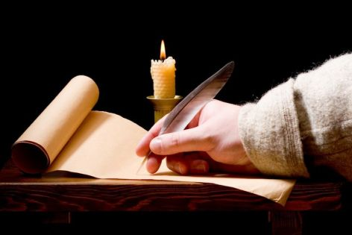
Confirmed By Three Proof For Our Faith
Text:
II Peter 1:12-21
Notes:
By Nathan L Morrison
All Scripture given is from NASB unless otherwise stated
For further study, or if questions, please Call: 804-277-1983 or Visit: www.courthousechurchofchrist.com
PowerPoint Background from Rod MacArthur

Slide 2
Mankind Has Always Questioned God
Recent attempts to reject
Jesus as historical fact
Writer Michael Paulkovich says, “'Jesus NEVER existed” (2014)
Claimed there is little evidence for Jesus existing.
Says he found little to no mention of Him in 126 texts from the 1st to 3rd centuries.
Says the account of Jesus in Josephus was added by later editors.
Claims Jesus was a “mythical character”
Caesar's Messiah: The Roman Conspiracy to Invent Jesus by Joseph Atwill (2011)
Says Jesus in N.T. are actually stories of Titus' campaign against the Jews
The Gospels are clever satires created by the Flavian Emperors.
The emperors created a pacifist Messiah to end the Jewish war (66-73 A.D.) with creation of Jesus.
Notes:
Writer Michael Paulkovich says, “'Jesus NEVER existed” (2014)
http://www.dailymail.co.uk/sciencetech/article-2776194/Jesus-never-existed-Writer-finds-no-mention-Christ-126-historical-texts-says-mythical-character.html http://www.blippitt.com/jesus-discovery/
Caesar's Messiah: The Roman Conspiracy to Invent Jesus by Joseph Atwill (2011)
http://www.dailymail.co.uk/sciencetech/article-2776194/Jesus-never-existed-Writer-finds-no-mention-Christ-126-historical-texts-says-mythical-character.html
http://www.amazon.com/Caesars-Messiah-Conspiracy-Flavian-Signature/dp/1461096405/ref=sr_1_1?ie=UTF8&qid=1439429961&sr=8-1&keywords=ceasar%27s+messiah

Slide 3
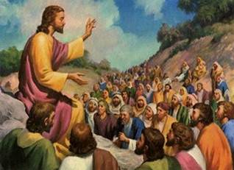
Mankind Has Always Questioned God
Peter says “the truth” is confirmed by three things &
provides proof for our faith! (II Peter 1:12-21)
Both attempts fail in light of the overwhelming evidence that Jesus existed!
Justin Martyr’s First & Second Apologetics were to Caesar Antoninus Pius, who reigned AD 138-161
Notes:
III. Both attempts fail in light of the overwhelming evidence that Jesus existed. Even other scholars and historians don’t take these two men seriously.
A. There were early church writers such as Justin Martyr (AD 100- 165) who wrote to Caesar to defend their faith (Justin Martyr’s First & Second Apologetics were to Caesar Antoninus Pius, who reigned AD 138-161)

Slide 4
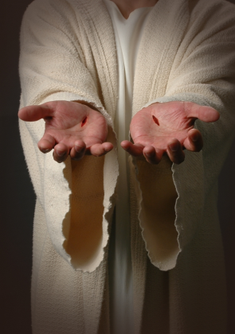
Eyewitness Testimony
II Peter 1:12, 16
12. Therefore, I will always be ready to remind you of these things, even though you already know them, and have been established in the truth which is present with you.
16. For we did not follow cleverly devised tales when we made known to you the power and coming of our Lord Jesus Christ, but we were eyewitnesses of His majesty.
The force of human testimony rests upon three things
Honesty of witnesses
Competency
Number of witnesses

Slide 5
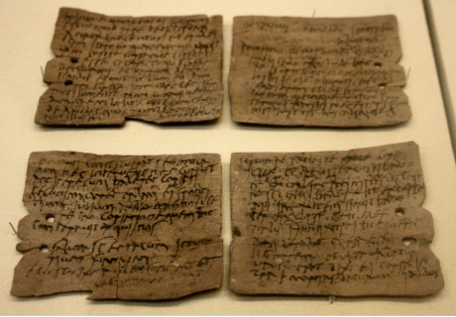
Eyewitness Testimony
More than one eyewitness?
“Newly Found Document Holds Eyewitness Account Of Jesus Performing Miracle!”
I Cor. 15:3-8:
All the apostles, and more than 500 witnesses at the same time
John 20:30-31:
Not all miracles recorded but some were “…so that you may believe that Jesus is the Christ, the Son of God; and that believing you may have life in His name”
(Roman historian Marcus Velleius Paterculus)
Notes:
Source:
Headlines in 2012 read: “Newly Found Document Holds Eyewitness Account Of Jesus Performing Miracle!”
http://worldnewsdailyreport.com/newly-found-document-holds-eyewitness-account-of-jesus-performing-miracle/
In 2012 Historian Ignazio Perrucci, was hired by the Vatican authorities to sort, analyze and classify 6,000 ancient documents that had been uncovered in the gigantic archive vaults (History repeating: Codex Vaticanus given to scholars in A.D. 1889).
He found a manuscript written by the famous Roman historian Marcus Velleius Paterculus, a historian respected for his reliability, about his journey from Parthia to Rome that occurred in A.D. 31.
He stopped in a city called Sebaste (in modern-day West Bank) and witnessed the arrival of a great leader in the town with a group of disciples and followers, causing many of the lower class people from neighboring villages to gather around them.
According to Velleius, that great man’s name was Iēsous de Nazarenus, a Greco-Latin translation for Jesus of Nazareth!
He then described how he was an eyewitness to Jesus visiting the house of a woman named Elisheba, who had just given birth to a stillborn child. Jesus picked up the dead child and uttered a prayer in Aramaic to the heavens, which the author describes as “immensus”, meaning incomprehensible (He didn’t understand Aramaic). To the crowd’s surprise and amazement, the baby came back to life immediately, crying and squirming like a healthy newborn.
The composition of the parchment and ink, the literary style and handwriting have all been carefully scrutinized and were considered to be entirely legitimate, dating even the sheepskin parchment to the 1st century, more precisely from between A.D. 20-45 (Fits the historian’s A.D. 31 trip)!

Slide 6
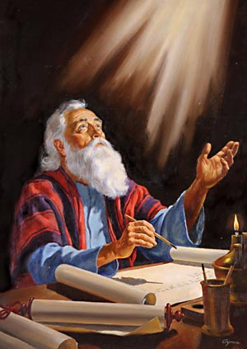
Eyewitness Testimony
The possibility of having fellowship with the apostles in knowledge of Christ:
I John 1:3-4
3. what we have seen and heard we proclaim to you also, so that you too may have fellowship with us; and indeed our fellowship is with the Father, and with His Son Jesus Christ.
4. These things we write, so that our joy may be made complete.
If one refused to accept the testimony of the apostles, would they accept any testimony?

Slide 7
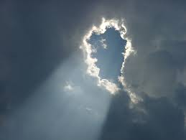
God’s Testimony
God’s voice thundered from Heaven, confirming His Son
God’s Testimony
At time of Christ’s baptism
Mt. 3:16-17: “This is My beloved Son, in whom I am well- pleased.”
On Mt. Of Transfiguration
Mt. 17:1-8: (Vs. 5) “This is My beloved Son, with whom I am well-pleased; listen to Him!”
Christ in Jerusalem
Jn. 12:28: “Father, glorify Your name.” Then a voice came out of heaven: “I have both glorified it, and will glorify it again.”
II Peter 1:17-18
17. For when He received honor and glory from God the Father, such an utterance as this was made to Him by the Majestic Glory, "This is My beloved Son with whom I am well-pleased"--
18. and we ourselves heard this utterance made from heaven when we were with Him on the holy mountain.
God’s audible voice was heard by men three times while Christ was on earth!

Slide 8
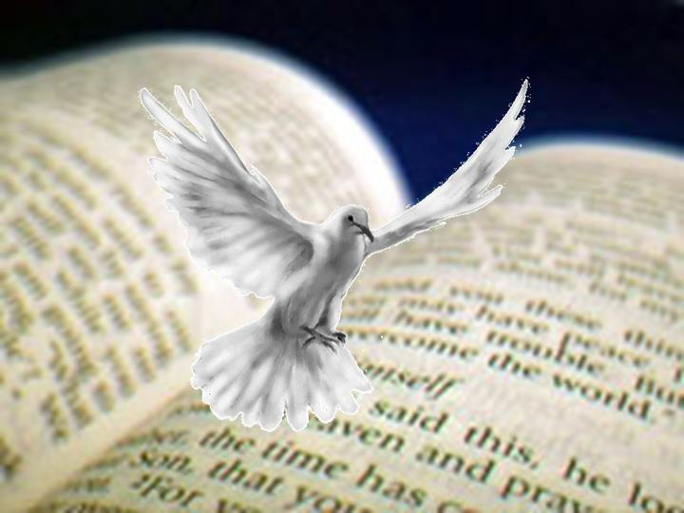
Prophecy’s Testimony
Prophecy: Proof of God’s Omnipotence & Omniscience
II Peter 1:19-21
19. So we have the prophetic word made more sure, to which you do well to pay attention as to a lamp shining in a dark place, until the day dawns and the morning star arises in your hearts.
20. But know this first of all, that no prophecy of Scripture is a matter of one's own interpretation,
21. for no prophecy was ever made by an act of human will, but men moved by the Holy Spirit spoke from God.
Emphasis on prophecy
Acts 2:16-21
Acts 2:25-31
Acts 3:18
Acts 3:22-24
Acts 10:43
I Peter 1:10-12

Slide 9
Prophecy’s Testimony
Prophecy: Proof of God’s Omnipotence & Omniscience
Lk. 24:44, 48 (Acts 3:22-24)
44. Now He said to them, "These are My words which I spoke to you while I was still with you, that all things which are written about Me in the Law of Moses and the Prophets and the Psalms must be fulfilled."
48. "You are witnesses of these things.
A False prophet has to be wrong just once!
Deut. 18:22
Harold Camping foretold end of the world – May 21, 2011 & Oct. 21, 2011
There are over 300 prophecies concerning Christ fulfilled, and many more!
The amount of prophecies fulfilled proclaims God’s power!

Slide 10
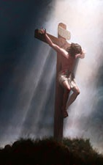
Conclusion
Jesus cited 4 testimonies as evidence in John 5
to prove that He is the Christ:
John the Baptist
(Jn. 5:33-35)
Jesus’ miracles
(Jn. 5:36; also Jn. 3:2)
God the Father
(Jn. 5:37-38)
The Scriptures
(Jn. 5:39-40, 45-47)
The force of the written message
II Peter 1:15; 3:1-2
John 12:48; Romans 2:16
Even though the (physical) writer is long dead, the word lives on and we are accountable to it!

Slide 11
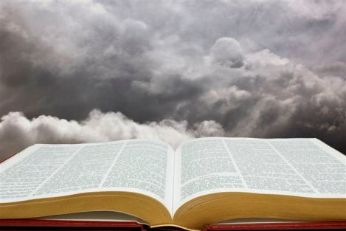
Conclusion
It is important to be “established in the truth!”
II Peter 1:12
12. Therefore, I will always be ready to remind you of these things, even though you already know them, and have been established in the truth which is present with you.
Man will always rebel against God, but let us hold fast our faith, “established in the truth!”

Slide 12
“What Must I Do To Be Saved?”
Hear The Gospel (Jn. 5:24; Rom. 10:17)
Believe In Christ (Jn. 3:16-18; Jn. 8:24)
Repent Of Sins (Lk. 13:3-5; Acts 2:38)
Confess Christ (Mt. 10:32; Rom. 10:10)
Be Baptized (Mk. 16:16; Acts 22:16)
Remain Faithful (Jn. 8:31; Rev. 2:10)
For The Erring Saint:
Repent (Acts 8:22), Confess (I Jn. 1:9),
Pray (Acts 8:22)

