Slide 1
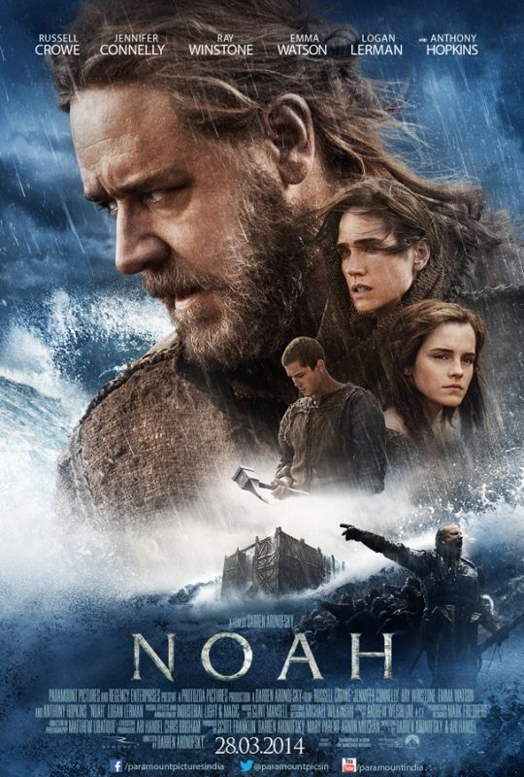
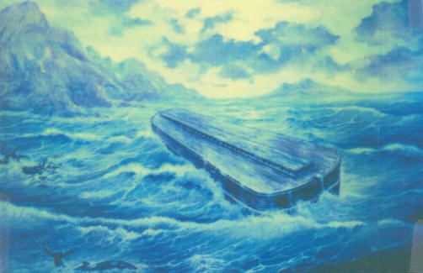
Biblical Noah vs. Hollywood Noah Text: Genesis 6:8-9; 7:1
Painting based on drawing by Alfred Lee based on “eye
witness” report of George Hagopian
Movie Poster for Paramount’s ‘Noah’
Notes:
By Nathan L Morrison
All Scripture given is from NASB unless otherwise stated
For further study, or if questions, please Call: 804-277-1983 or Visit: www.courthousechurchofchrist.com
Images:
-Painting by Alfred Lee based on “eye witness” accounts of George Hagopian
*George Hagopian claimed to have visited and even climbed up on top of the ark many times in the years of 1906-1907 as a boy, and later gave his “eye witness” descriptions of the ark in the 1970’s.
-Official Movie Poster for Darren Aronofsky’s ‘Noah,’ courtesy of Paramount Pictures

Slide 2
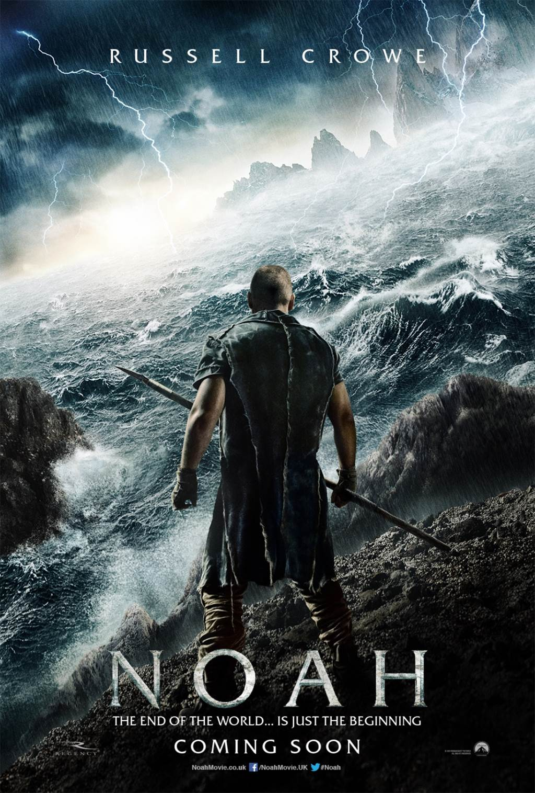
Intro
“With sweeping visuals
grounded by strong
performances in service of a
timeless tale told on a human
scale, Darren Aronofsky's
Noah brings the Bible epic
into the 21st century”
(Rottentomatoes.com)
Some “religious leaders”
endorsed it from
“organizations like the
American Bible Society,
National Catholic Register,
The King's College, Q Ideas,
Hollywood Prayer Network,
and Focus on the Family”
(Huffingtonpost.com)
“Noah is a creative
interpretation of the
Scriptural account that allows
us to imagine the deep
struggles Noah may have
wrestled with as he answered
God’s call on his life…”
(Jim Daly, Focus on the Family)
“It is an unbiblical, pagan film
from its start”
(Ken Ham, Creation Museum)
Notes:
“With sweeping visuals grounded by strong performances in service of a timeless tale told on a human scale, Darren Aronofsky's Noah brings the Bible epic into the 21st century.” (http://www.rottentomatoes.com/m/noah_2014/)
Some “religious leaders” from the Jewish and denominations even endorsed it, “including Leaders from organizations like the American Bible Society, National Catholic Register, The King's College, Q Ideas, Hollywood Prayer Network, and Focus on the Family.” (http://www.huffingtonpost.com/2014/03/22/noah-film-evangelicals_n_5009259.html)
Focus on the Family president Jim Daly said of Aronofsky’s ‘Noah,’ “Noah is a creative interpretation of the Scriptural account that allows us to imagine the deep struggles Noah may have wrestled with as he answered God’s call on his life. This cinematic vision of Noah’s story gives Christians a great opportunity to engage our culture with the biblical Noah, and to have conversations with friends and family about matters of eternal significance.” (http://time.com/35667/noah-movie-religious-leaders/)
Ken Ham, president of the Creation Museum in Kentucky, said, “It is an unbiblical, pagan film from its start.” (http://time.com/42274/ken-ham-the-unbiblical-noah-is-a-fable-of-a-film/)

Slide 3
Intro
Is it something we ought to go see then, and support with
our going?
The director, Darren Aronofsky, is a self-proclaimed atheist and publicly stated before the film’s release that ‘Noah’ was to be both an environmentalist propaganda piece, and the “least Biblical” Bible film ever made
It depicts evolutionary creation
It never mentions “God” but instead refers to a “Creator,” and Noah isn’t quite sure if the “Creator” spoke to him or not
The reason for the flood is changed: the sins of mankind are depicted as strip-mining the earth for its natural resources and eating animals
These are deliberate changes to promote an environmentalist, evolutionist point of view
Producer Scott Franklin told Entertainment Weekly, “Noah is a very short section of the Bible with a lot of gaps, so we definitely had to take some creative expression in it. But I think we stayed very true to the story and didn't really deviate from the Bible, despite the six-armed angels.”
Notes:
-The director, Darren Aronofsky, is a self-avowed atheist, and publicly stated before the film’s release that ‘Noah’ was to be both an environmentalist propaganda piece, and the “least Biblical” Bible film ever made. (http://p.washingtontimes.com/news/2014/mar/24/atheist-noah-director-brags-film-least-biblical-bi/)
-It depicts evolutionary creation, “one that is presented through an evolutionary lens, albeit a theistic one.” (http://www.theblaze.com/stories/2014/02/26/some-of-you-youre-going-to-cringe-insiders-unveil-theological-themes-in-noah-movie/)
-Producer Scott Franklin told Entertainment Weekly, “Noah is a very short section of the Bible with a lot of gaps, so we definitely had to take some creative expression in it. But I think we stayed very true to the story and didn't really deviate from the Bible, despite the six-armed angels.” (“Hollywood Finds God (Again),” Entertainment Weekly, January 25/February 1, 2013, p. 22 by Grady Smith)

Slide 4
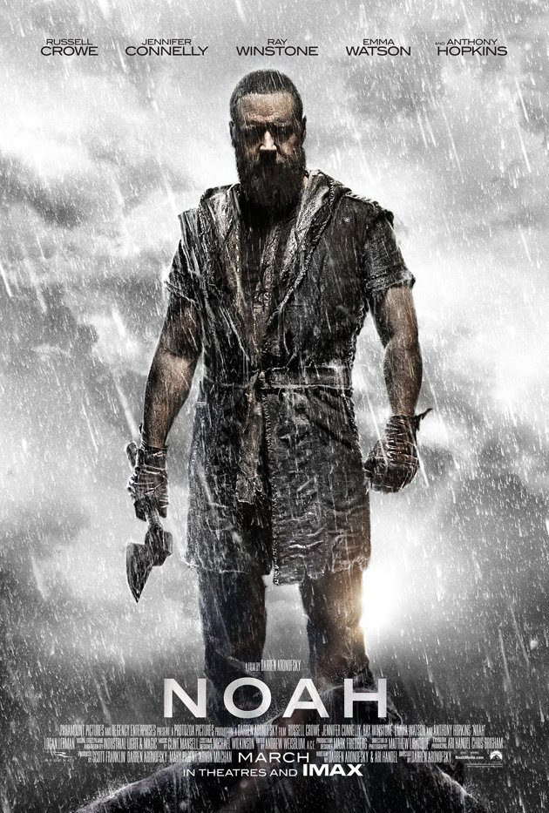
Intro
They changed the character of Noah
He is depicted as hating mankind, even so far as shown valuing a flower and animals over human life; in fact he runs an animal hospital and stops poachers
He decides the “Creator” wants all humanity wiped out for their sins against creation, even his own family, and he plots to kill his granddaughters when they are born
While Hollywood portrays Noah as the
“first environmentalist,” and a violent
sociopath who wants to end all of
humanity, the Scriptures portray Noah
very differently!

Slide 5
Noah
Genesis 6:8-9
8. But Noah found favor in the eyes of the LORD.
9. These are the records of the generations of Noah. Noah was a righteous man, blameless in his time; Noah walked with God.
Gen. 5:29: His father Lamech named him Noah saying he
will “give us rest” from work
Noah means “Rest” (H5146: “to rest, to comfort”)
Genesis 6:8-9
He found favor in the eyes of the Lord, was a just man, and walked with God! (Knew God spoke to him! – Gen. 6:13; 7:1)
Gen. 6:5-7, 11-13: He stood in contrast to the world around him!

Slide 6
Noah
We may think our day and times are evil, but it was a lot
worse in the days of Noah
Gen. 6:5: “The wickedness of man was great on the earth.” (Not to the earth or animals – Gen. 9:2-3: Prior to the flood man was vegetarian!)
6:5: “Every intent of the thoughts of his heart was only evil continually.”
6:11-12: “Was corrupt.” (Sins against God)
6:11, 13: “Filled with violence.” (Not to the earth or animals – Gen. 9:6: God condemned murder because man, not the animals, was made in the image of God)
6:6: So bad that “The Lord was sorry that He had made man on the earth, and He was grieved in His heart.”
II Peter 2:5
5. and did not spare the ancient world, but preserved Noah, a preacher of righteousness, with seven others, when He brought a flood upon the world of the ungodly;

Slide 7
Noah
Hebrews 11:7
7. By faith Noah, being warned by God about things not yet seen, in reverence prepared an ark for the salvation of his household, by which he condemned the world, and became an heir of the righteousness which is according to faith.
Hebrews 11:7
Basis of faith – things not yet seen: “Being warned by God about things not yet seen!” (Remember Heb. 11:1)
Obedient faith: “In reverence prepared an ark for the salvation of his household.” (Gen. 6:22)
Result of faith: “He condemned the world, and became an heir of the righteousness which is according to faith.”
Good examples will either convert sinners or condemn
them by their example
He didn’t “condemn the world” as in it was his judgment, but by his example he left them without excuse – God closed the door (Gen. 7:16)

Slide 8
Noah
Genesis 7:1
1. Then the LORD said to Noah, "Enter the ark, you and all your household, for you alone I have seen to be righteous before Me in this time.
Noah stands out in stark contrast to the people of his day
They were corrupt, wicked, and filled with violence.
Noah was a just man, walked with God and found favor in the eyes of the Lord.
Used later as an example of righteousness to shame Israel! (Ezek. 14:14, 20)
God was patient with men then, He is with men today, and He warns of a judgment coming
II Pet. 2:5; I Pet. 3:20; II Pet. 3:9-12
Noah’s faith was an obedient faith – caused him to do the
will of the Lord and saved his family!

Slide 9
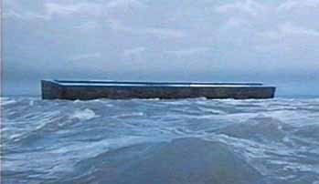
Noah’s Example of Faith
Christians are held to the same standards as Noah during
his time:
Phil. 1:27-28: One may have the tendency to lose heart and become terrified, but must remain faithful! (Remember text of Heb. 10:34-39)
Phil. 2:15-16: Christians are to be lights, to remain pure, no matter how perverse or crooked the world is around us. (Noah was such an example!)

Slide 10
Noah’s Example of Faith
I Peter 2:11-17
11. Beloved, I urge you as aliens and strangers to abstain from fleshly lusts which wage war against the soul.
12. Keep your behavior excellent among the Gentiles, so that in the thing in which they slander you as evildoers, they may because of your good deeds, as they observe them, glorify God in the day of visitation.
13. Submit yourselves for the Lord's sake to every human institution, whether to a king as the one in authority,
14. or to governors as sent by him for the punishment of evildoers and the praise of those who do right.
15. For such is the will of God that by doing right you may silence the ignorance of foolish men.
16. Act as free men, and do not use your freedom as a covering for evil, but use it as bondslaves of God.
17. Honor all people, love the brotherhood, fear God, honor the king.

Slide 11
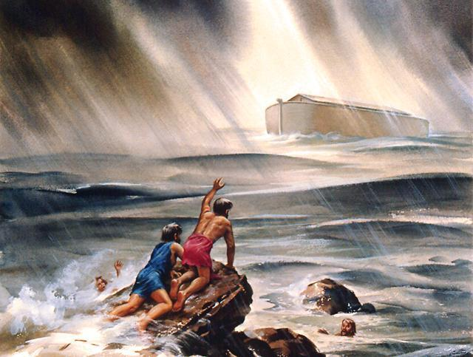
Noah’s Example of Faith
Like Noah, we live in a “crooked and perverse generation,” and like Noah, we can be found righteous, and appear as “lights in the world!”
(Phil. 2:15)

Slide 12
Conclusion
Noah’s character: Righteous!
Noah was a righteous man who walked with God – Gen. 6:8-9; 7:1
He was a “preacher of righteousness” – II Pet. 2:5
He was married to one wife – Gen. 6:18; 7:7; II Pet. 2:5: Noah, 7 others
His sons each had one wife – Gen. 6:18; 7:7, 13; I Pet. 3:20: “8 persons”
He was obedient in everything God asked him to do – Gen. 6:22; 7:5
Noah was prepared! (Gen. 7:11-13)
God teaches throughout the Scriptures that He is merciful,
loving and patient, but that there is a judgment coming
He gave the people of Noah’s day till the ark was constructed to repent.
(I Pet. 3:20)
He has given us an undetermined time and said, “Be ready.”
(Mt. 24:36-37, 42)
II Pet. 2:1-11: Judgment happened before, it will happen again!
Biblical Noah Vs. Hollywood Noah

Slide 13
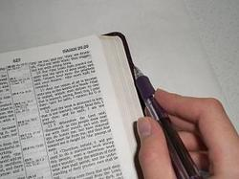
Conclusion
II Timothy 2:15
15. Be diligent to present yourself approved to God as a workman who does not need to be ashamed, accurately handling the word of truth.
Few would want to know that God destroyed the world
because of man's wickedness
That thought would make us wonder about today.
It could lead to changed life styles and righteous living.
But it's easier to change the message than to change our hearts!

Slide 14
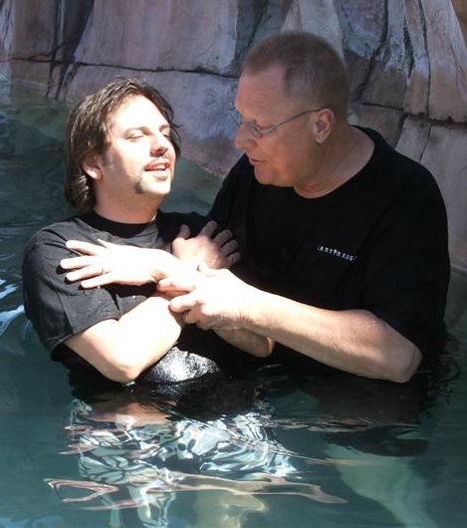
Conclusion
As Noah had to be in the ark to be saved (Gen. 7:1),
people must be “in Christ” to be saved today!
(Rom. 6:23; 8:1; Gal. 3:26-27; I Pet. 3:21)
Despite the wicked world of his day, Noah was prepared to serve God!
What about YOU?

Slide 15
“What Must I Do To Be Saved?”
Hear The Gospel (Jn. 5:24; Rom. 10:17)
Believe In Christ (Jn. 3:16-18; Jn. 8:24)
Repent Of Sins (Lk. 13:3-5; Acts 2:38)
Confess Christ (Mt. 10:32; Rom. 10:10)
Be Baptized (Mk. 16:16; Acts 22:16)
Remain Faithful (Jn. 8:31; Rev. 2:10)
For The Erring Saint:
Repent (Acts 8:22), Confess (I Jn. 1:9),
Pray (Acts 8:22)

