Slide 1
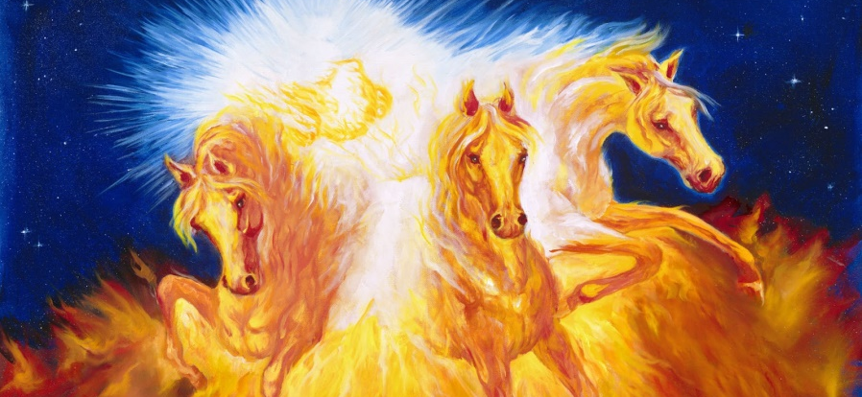
Text: I Kings 22:35; II Kings 9:33; II Kings 2:11
Three Chariots
Notes:
By Nathan L Morrison
All Scripture given is from NASB unless otherwise stated
For further study, or if questions, please Call: 804-277-1983, or visit www.courthousechurchofchrist.com
Adapted from a lesson by Mark Mayberry

Slide 2
Intro
God promises eternal life that applies to both eternal
punishment and eternal reward (life) – Mt. 25:31-46
The end of the righteous and the wicked are contrasted in the story Jesus told of the rich man and Lazarus the poor man – Lk. 16:19-26
God will reward according to our deeds – Rom. 2:4-11; 14:12; II Cor. 5:10; Rev. 20:12
Balaam to King Balak of Moab…
Numbers 23:10
"Who can count the dust of Jacob, Or number the fourth part of Israel? Let me die the death of the upright, And let my end be like his!"
For our end to be like the upright, our character must
be righteous!

Slide 3
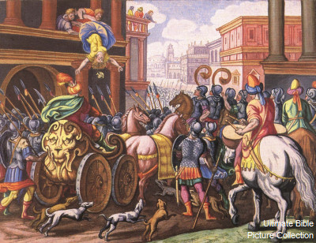
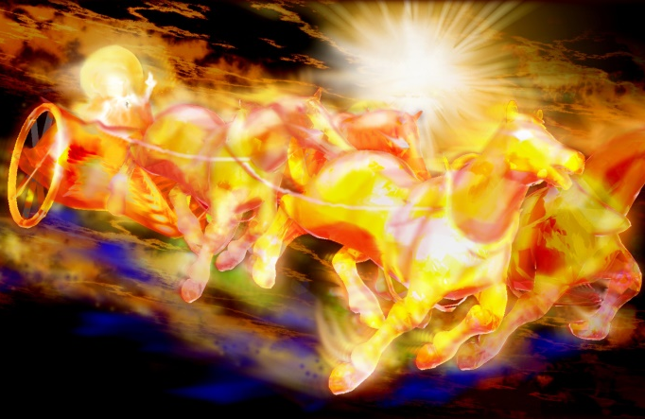
Intro
We will look at the end of three people represented by their chariots and contrast their character of life that brought them to their respective ends!

Slide 4
Ahab
Ahab’s Character
Weakness and Wickedness
I Kings 16:30-33
He “sold himself” to do evil/wickedness
I Kings 21:20, 25-26
Thought himself above the Law of God
I Kings 21:1-7, 15-16
I Kings 21:25
25. Surely there was no one like Ahab who sold himself to do evil in the sight of the LORD, because Jezebel his wife incited him.

Slide 5
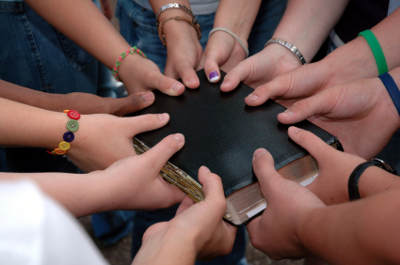
Application!
Ahab’s Character
Are we like Ahab, weak and vacillating, wicked and covetous? (Lk. 12:15; Eph. 5:5; Col. 3:5)
Have we sold (out) ourselves to do evil?
Mt. 16:26:
“For what will it profit a man if he gains the whole world and forfeits his soul? Or what will a man give in exchange for his soul?”
Three Chariots

Slide 6
Ahab
Ahab’s Chariot
Ahab’s Fixed Doom
I Kings 21:19-24, 27-29
King Ahab of Israel and King Jehoshaphat of Judah fought the Syrians
I Kings 22:1-40
Ignored God’s Warnings
I Kings 22:34-38
I Kings 22:35
The battle raged that day, and the king was propped up in his chariot in front of the Arameans, and died at evening, and the blood from the wound ran into the bottom of the chariot.

Slide 7
Application!
Ahab’s Chariot
The death of Ahab (I Kings 22:35) is a reminder that no one can escape from the presence or the judgment of God (Ps. 139:7-12; Jer. 23:23-24; Heb. 4:13)
The chariot of Ahab represents his fixed doom despite his cowardice in disguising himself (I Kings 22:30), and his hubris in thinking he could fool God (I Kings 22:34-35)!
Three Chariots

Slide 8
Jezebel
Jezebel’s Character
Wicked & Corrupt Influence
I Kings 18:19; 21:25
II Kings 9:22
Murderous
I Kings 18:4, 13; 19:1-2
I Kings 21:6-16
Sexual immorality & idolatry
Rev. 2:19-23
I Kings 18:4
for when Jezebel destroyed the prophets of the LORD, Obadiah took a hundred prophets and hid them by fifties in a cave, and provided them with bread and water.

Slide 9
Application!
Jezebel’s Character
Do we share a similarity with Jezebel, exercising a corrupt and corrosive influence? (Rev. 2:20-23)
Through our words and deeds, do we “teach” others to compromise? Do we engage in character assassination?
Do we hate our brothers and sisters (Gal. 5:13-15; I Jn. 3:15)?
I John 3:15:
Everyone who hates his brother is a murderer; and you know that no murderer has eternal life abiding in him.
Three Chariots

Slide 10
Jezebel
Jezebel’s Chariot
Jezebel’s Dreadful Death
King Jehu anointed
II Kings 9:1-13
Wrath of God upon Ahab
King Joram (II Kings 9:24)
King Ahaziah (II Kings 9:27)
Queen Jezebel (II Kings 9:30-37)
Ahab’s Sons (II Kings 10)
II Kings 9:33
He said, "Throw her down." So they threw her down, and some of her blood was sprinkled on the wall and on the horses, and he trampled her under foot.

Slide 11
Application!
Jezebel’s Chariot
The death of Jezebel (II Kings 9:30-37) is a reminder of the shame that is associated with sin (Acts 1:18-19: Judas; II Pet. 2:20-22: Fallen Christian)
The chariot of Jezebel was a dreadful death because of her shameful and wicked character!
Three Chariots

Slide 12
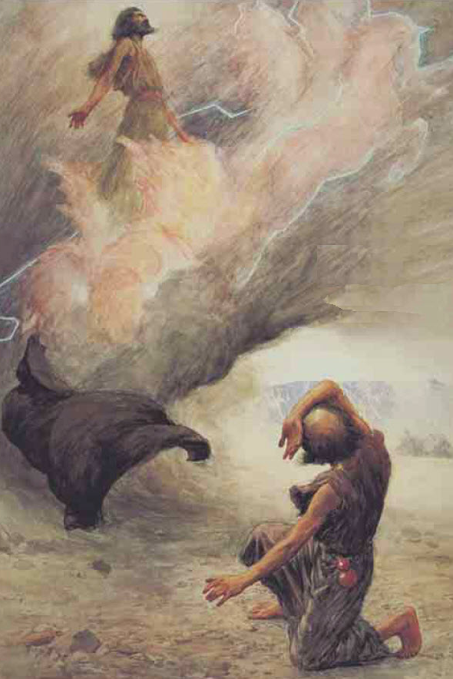
Elijah
Elijah’s Character
Conviction
I Kings 17:1; 21:20; 21:17-29
Righteous, man of prayer
James 5:16-18
James 5:16-18
Therefore, confess your sins to one another, and pray for one another so that you may be healed. The effective prayer of a righteous man can accomplish much.
Elijah was a man with a nature like ours, and he prayed earnestly that it would not rain, and it did not rain on the earth for three years and six months.
Then he prayed again, and the sky poured rain and the earth produced its fruit.

Slide 13
Application!
Elijah’s Character
Are we like Elijah, manifesting an unwavering commitment to truth (Prov. 23:23)?
Are we willing to stand and be counted, even in the face of opposition and danger (Eph. 6:10-13)?
Proverbs 23:23:
Buy truth, and do not sell it, Get wisdom and instruction and understanding.
Three Chariots

Slide 14
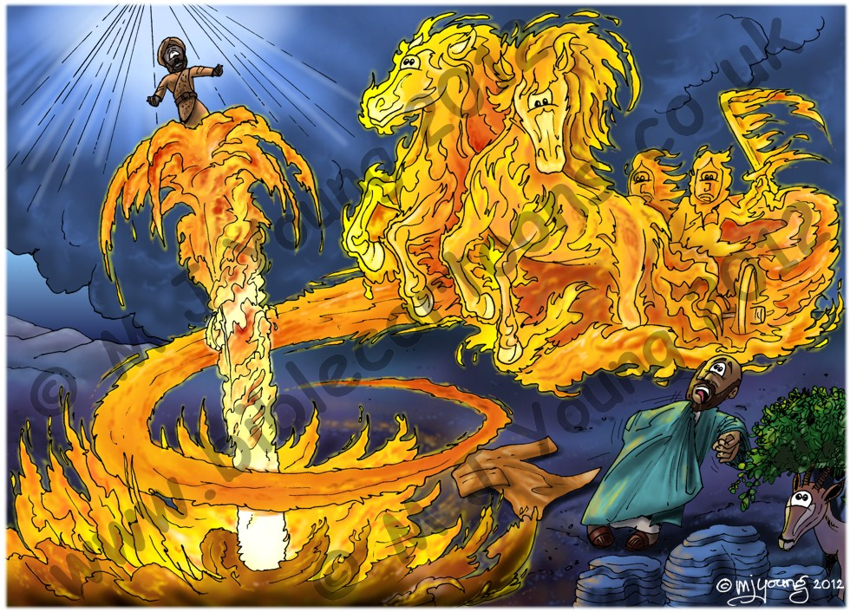
Elijah
Elijah’s Chariot
Elijah’s Glorious Deliverance
II Kings 2:1-14
Separated from Elisha by a chariot of fire drawn by horses of fire and was carried up to Heaven by a whirlwind
II Kings 2:11
As they were going along and talking, behold, there appeared a chariot of fire and horses of fire which separated the two of them. And Elijah went up by a whirlwind to heaven.

Slide 15
Application!
Elijah’s Chariot
The end of Elijah’s life (II Kings 2:11) reminds us of the blessings that God has reserved for the faithful (Rev. 2:10; 21:3-7)
Numbers 23:10: “Who can count the dust of Jacob, or number the fourth part of Israel? Let me die the death of the upright, and let my end be like his!”
The chariot of Elijah symbolized God’s glorious deliverance of Elijah as a reward for a life of faithful service and dedication to the truth!
Three Chariots

Slide 16
Conclusion
For the righteous, the day of one’s death is better than
the day of one’s birth (Eccl. 7:1-2; Rev. 14:13); yet, the
same cannot be said for the wicked (Is. 3:11; 48:22;
Rev. 20:10, 15)
Ecclesiastes 7:1-2 (Rev. 14:13)
1. A good name is better than a good ointment, And the day of one's death is better than the day of one's birth.
2. It is better to go to a house of mourning Than to go to a house of feasting, Because that is the end of every man, And the living takes it to heart.
Isaiah 3:11 (Rev. 20:15)
11. Woe to the wicked! It will go badly with him, For what he deserves will be done to him.
Isaiah 48:22 (Rev. 20:10)
22. "There is no peace for the wicked," says the LORD.

Slide 17
Conclusion
For those who remain faithful to the Lord, the end of a
matter is better than its beginning (Eccl. 7:8)
Yet, for those who fall away, the last state is worse for them than the first (II Pet. 2:20)!
Ecclesiastes 7:8
8. The end of a matter is better than its beginning; Patience of spirit is better than haughtiness of spirit.
II Peter 2:20
20. For if, after they have escaped the defilements of the world by the knowledge of the Lord and Savior Jesus Christ, they are again entangled in them and are overcome, the last state has become worse for them than the first.

Slide 18
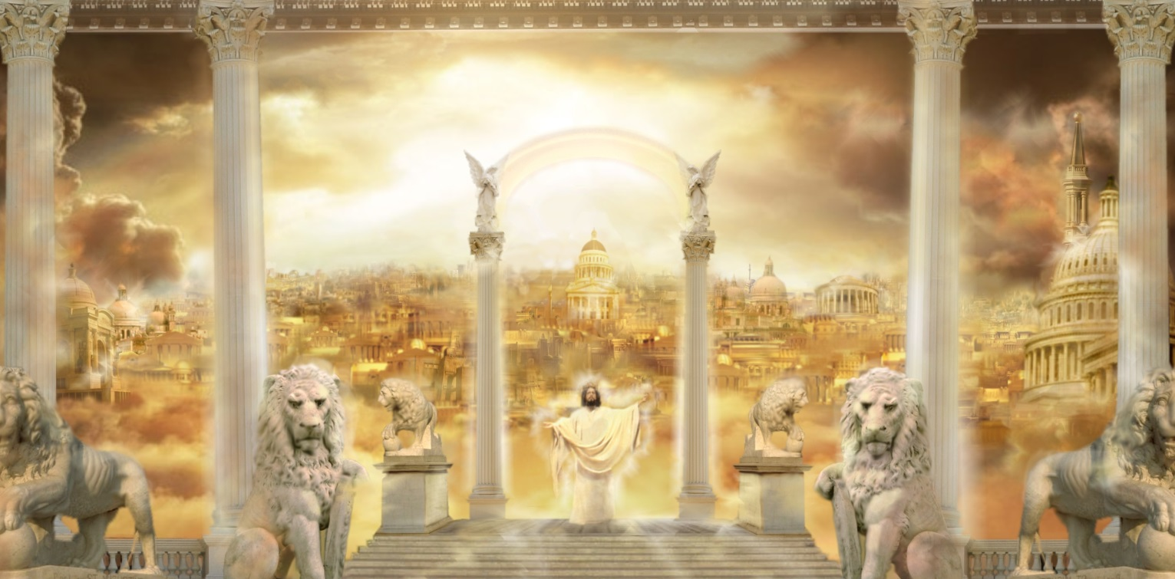
Conclusion
If we endure to the end, we will receive God’s eternal
blessings! (II Tim. 4:6-8; Js. 1:12; Rev. 2:10)
Let us share in Balaam’s conclusion:
“Let me die the death of the upright, and let my end be like his!” (Num. 23:10)

Slide 19
“What Must I Do To Be Saved?”
Hear The Gospel (Jn. 5:24; Rom. 10:17)
Believe In Christ (Jn. 3:16-18; Jn. 8:24)
Repent Of Sins (Lk. 13:3-5; Acts 2:38)
Confess Christ (Mt. 10:32; Rom. 10:10)
Be Baptized (Mk. 16:16; Acts 22:16)
Remain Faithful (Jn. 8:31; Rev. 2:10)
For The Erring Saint:
Repent (Acts 8:22), Confess (I Jn. 1:9),
Pray (Acts 8:22)

Slide 21
“What Must I Do To Be Saved?”
Hear The Gospel (Jn. 5:24; Rom. 10:17)
Believe In Christ (Jn. 3:16-18; Jn. 8:24)
Repent Of Sins (Lk. 13:3-5; Acts 2:38)
Confess Christ (Mt. 10:32; Rom. 10:10)
Be Baptized (Mk. 16:16; Acts 22:16)
Remain Faithful (Jn. 8:31; Rev. 2:10)
For The Erring Saint:
Repent (Acts 8:22), Confess (I Jn. 1:9),
Pray (Acts 8:22)

