Slide 1
Hearing & Doing Text: James 1:19-25
Notes:
By Nathan L Morrison for Sunday 05/02/2021
All Scripture given is from NASB unless otherwise stated
For further study, or if questions, please Call: 804-277-1983 or Visit: www.courthousechurchofchrist.com
Adapted from a Sermon Starter on James 1:21-22 by Mark Posey

Slide 2
INTRO
II Peter 3:10-13
10. But the day of the Lord will come like a thief, in which the heavens will pass away with a roar and the elements will be destroyed with intense heat, and the earth and its works will be burned up.
11. Since all these things are to be destroyed in this way, what sort of people ought you to be in holy conduct and godliness,
12. looking for and hastening the coming of the day of God, because of which the heavens will be destroyed by burning, and the elements will melt with intense heat!
13. But according to His promise we are looking for new heavens and a new earth, in which righteousness dwells.

Slide 3
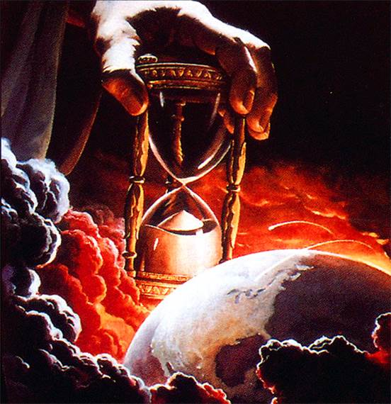
INTRO
Knowing how the world will end, Peter asks, “What sort of people ought you to be?” (II Peter 3:11)
Most of the life of a Christian is spent amidst people of the world: businesses, schools, shopping, etc. – Called to stand out!
Christians are tasked to keep perspective on the Lord’s 2nd coming and be people of holy & godly conduct (II Peter 3:11)
Saints are to be aware of the judgment day and look forward to and hasten its arrival by being prepared (II Peter 3:12-13)

Slide 4
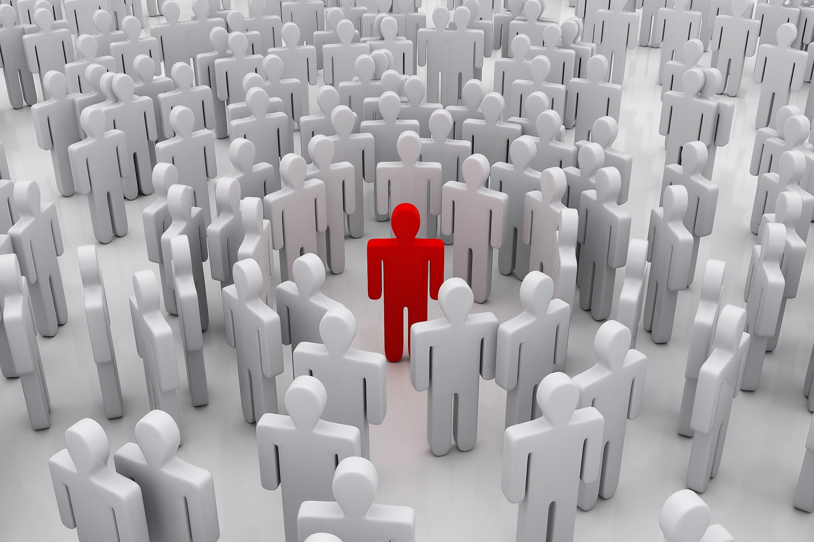
INTRO
What does that look like day-to-day, week-to-week when we aren’t assembled together on Sundays?

Slide 5
Are You A Hearer Only or a Doer?
James 1:19-25 (vss. 19-22)
19. This you know, my beloved brethren. But everyone must be quick to hear, slow to speak and slow to anger;
20. for the anger of man does not achieve the righteousness of God.
21. Therefore, putting aside all filthiness and all that remains of wickedness, in humility receive the word implanted, which is able to save your souls.
22. But prove yourselves doers of the word, and not merely hearers who delude themselves.

Slide 6
Are You A Hearer Only or a Doer?
James 1:19-25 (vss. 23-25)
23. For if anyone is a hearer of the word and not a doer, he is like a man who looks at his natural face in a mirror;
24. for once he has looked at himself and gone away, he has immediately forgotten what kind of person he was.
25. But one who looks intently at the perfect law, the law of liberty, and abides by it, not having become a forgetful hearer but an effectual doer, this man will be blessed in what he does.

Slide 7
“Therefore, putting aside all filthiness and all that remains of wickedness…” (James 1:21a)
What to do BEFORE the Sermon
Lay Aside…
Filthiness & Wickedness (James 1:21)
Every encumbrance & sin that entangles (Heb. 12:1-2)
All malice, deceit, hypocrisy, envy, & slander (I Pet. 2:1)
Notes:
Lay Aside
Strong’s: Greek apotithēmi [ap-ot-eeth'-ay-mee] (G659):
From G575 and G5087; to put away (literally or figuratively): - cast off, lay apart (aside, down), put away (off).
Thayer on apotithēmi (G659):
Verb; “to put off or aside or away”
Jas 1:21 Therefore, putting aside all filthiness and all that remains of wickedness, in humility receive the word implanted, which is able to save your souls.
Heb 12:1 Therefore, since we have so great a cloud of witnesses surrounding us, let us also lay aside every encumbrance and the sin which so easily entangles us, and let us run with endurance the race that is set before us,
Heb 12:2 fixing our eyes on Jesus, the author and perfecter of faith, who for the joy set before Him endured the cross, despising the shame, and has sat down at the right hand of the throne of God.
1Pe 2:1 Therefore, putting aside all malice and all deceit and hypocrisy and envy and all slander,

Slide 8
“Therefore, putting aside all filthiness and all that remains of wickedness…” (James 1:21a)
What to do BEFORE the Sermon
Examine…
Oneself before taking the Lord’s Supper (I Cor. 11:27-29)
Oneself to see if you are in the faith (II Cor. 13:5; I John 4:1)
Everything carefully; hold fast to that which is good (I Thess. 5:21-22)
Notes:
1Co 11:27 Therefore whoever eats the bread or drinks the cup of the Lord in an unworthy manner, shall be guilty of the body and the blood of the Lord.
1Co 11:28 But a man must examine himself, and in so doing he is to eat of the bread and drink of the cup.
1Co 11:29 For he who eats and drinks, eats and drinks judgment to himself if he does not judge the body rightly.
2Co 13:5 Test yourselves to see if you are in the faith; examine yourselves! Or do you not recognize this about yourselves, that Jesus Christ is in you—unless indeed you fail the test?
1Jn 4:1 Beloved, do not believe every spirit, but test the spirits to see whether they are from God, because many false prophets have gone out into the world.
1Th 5:21 But examine everything carefully; hold fast to that which is good;
1Th 5:22 abstain from every form of evil.

Slide 9
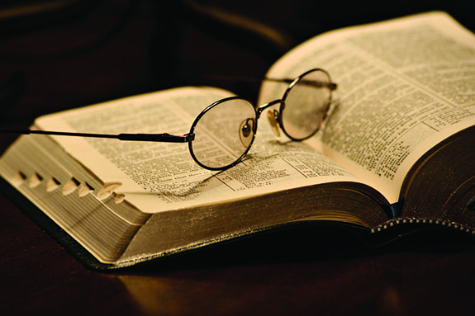
What to do BEFORE the Sermon
During the week in your day-to-day business, lay aside sin and wickedness, and examine yourself!

Slide 10
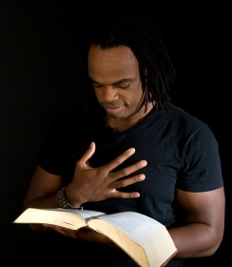
“…in humility receive the word implanted, which is able to save your souls” (James 1:21b)
What to do DURING the Sermon
Hear…
Jesus, God’s final authority (Heb. 1:1-4; John 12:48)
The unalterable word of God (Heb. 2:1-4)
The apostles and prophecy (II Pet. 1:16-21)
The reading of Scripture for exhortation & teaching (I Tim. 4:13)
Notes:
Heb 1:1 God, after He spoke long ago to the fathers in the prophets in many portions and in many ways,
Heb 1:2 in these last days has spoken to us in His Son, whom He appointed heir of all things, through whom also He made the world.
Heb 1:3 And He is the radiance of His glory and the exact representation of His nature, and upholds all things by the word of His power. When He had made purification of sins, He sat down at the right hand of the Majesty on high,
Heb 1:4 having become as much better than the angels, as He has inherited a more excellent name than they.
Joh 12:48 "He who rejects Me and does not receive My sayings, has one who judges him; the word I spoke is what will judge him at the last day.
Heb 2:1 For this reason we must pay much closer attention to what we have heard, so that we do not drift away from it.
Heb 2:2 For if the word spoken through angels proved unalterable, and every transgression and disobedience received a just penalty,
Heb 2:3 how will we escape if we neglect so great a salvation? After it was at the first spoken through the Lord, it was confirmed to us by those who heard,
Heb 2:4 God also testifying with them, both by signs and wonders and by various miracles and by gifts of the Holy Spirit according to His own will.
2Pe 1:16 For we did not follow cleverly devised tales when we made known to you the power and coming of our Lord Jesus Christ, but we were eyewitnesses of His majesty.
2Pe 1:17 For when He received honor and glory from God the Father, such an utterance as this was made to Him by the Majestic Glory, "This is My beloved Son with whom I am well-pleased"—
2Pe 1:18 and we ourselves heard this utterance made from heaven when we were with Him on the holy mountain.
2Pe 1:19 So we have the prophetic word made more sure, to which you do well to pay attention as to a lamp shining in a dark place, until the day dawns and the morning star arises in your hearts.
2Pe 1:20 But know this first of all, that no prophecy of Scripture is a matter of one's own interpretation,
2Pe 1:21 for no prophecy was ever made by an act of human will, but men moved by the Holy Spirit spoke from God.
1Ti 4:13 Until I come, give attention to the public reading of Scripture, to exhortation and teaching.

Slide 11
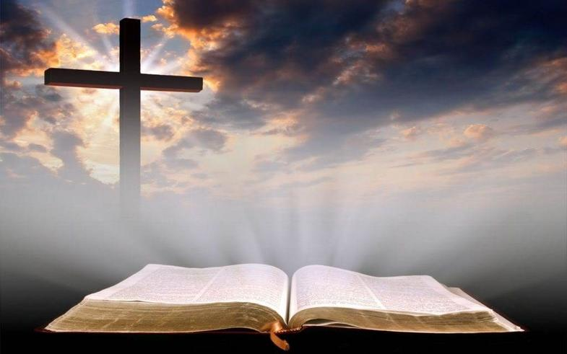
What to do DURING the Sermon
In the assembly lay aside worldly cares and immerse yourself in the exhortation and teaching from God’s word!

Slide 12
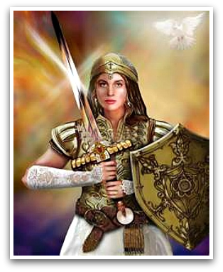
“But be doers of the word, and not hearers only, deceiving yourselves” (NKJV: James 1:22)
What to do AFTER the Sermon
Do…
Put on Compassion, Kindness, Humility, Gentleness, Patience, Forgiveness & Love (Col. 3:12-14)
Put on the whole Armor of God & pray for all saints & for all men (Eph. 6:10-18; I Tim. 2:1-2)
Look forward to Christ’s 2nd Coming by letting your light shine (II Pet. 3:10-12; Phil. 1:10; 2:14-16)
Notes:
Col 3:12 So, as those who have been chosen of God, holy and beloved, put on a heart of compassion, kindness, humility, gentleness and patience;
Col 3:13 bearing with one another, and forgiving each other, whoever has a complaint against anyone; just as the Lord forgave you, so also should you.
Col 3:14 Beyond all these things put on love, which is the perfect bond of unity.
Eph 6:10 Finally, be strong in the Lord and in the strength of His might.
Eph 6:11 Put on the full armor of God, so that you will be able to stand firm against the schemes of the devil.
Eph 6:18 With all prayer and petition pray at all times in the Spirit, and with this in view, be on the alert with all perseverance and petition for all the saints,
1Ti 2:1 First of all, then, I urge that entreaties and prayers, petitions and thanksgivings, be made on behalf of all men,
1Ti 2:2 for kings and all who are in authority, so that we may lead a tranquil and quiet life in all godliness and dignity.
2Pe 3:10 But the day of the Lord will come like a thief, in which the heavens will pass away with a roar and the elements will be destroyed with intense heat, and the earth and its works will be burned up.
2Pe 3:11 Since all these things are to be destroyed in this way, what sort of people ought you to be in holy conduct and godliness,
2Pe 3:12 looking for and hastening the coming of the day of God, because of which the heavens will be destroyed by burning, and the elements will melt with intense heat!
Php 1:10 so that you may approve the things that are excellent, in order to be sincere and blameless until the day of Christ;
Php 2:14 Do all things without grumbling or disputing;
Php 2:15 so that you will prove yourselves to be blameless and innocent, children of God above reproach in the midst of a crooked and perverse generation, among whom you appear as lights in the world,
Php 2:16 holding fast the word of life, so that in the day of Christ I will have reason to glory because I did not run in vain nor toil in vain.

Slide 13
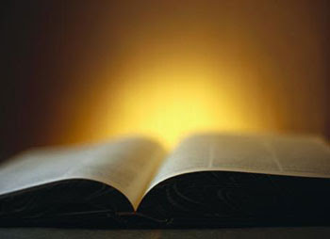
What to do After the Sermon
During the week in your day-to-day business, Put on the characteristics of Jesus Christ and be a shining light!

Slide 14
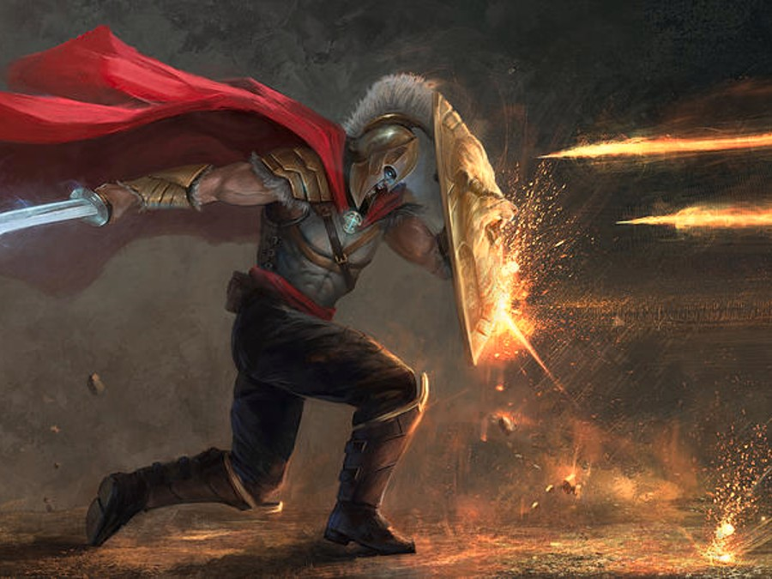
Conclusion
Saints cannot let their light shine if they hide it under a basket during the week and then let it shine Sundays (Matthew 5:14-16)
Don’t be a hearer only but a doer of God’s word! (James 1:21-22)
Let Christ live within you at all times and demonstrate that Light by applying what you have heard and learned! (Gal. 2:20; Titus 2:6-8)
By hearing & doing you can put on the Armor of God and stand firm! (Eph. 6:10-18; I Cor. 16:13)
Notes:
Gal 2:20 "I have been crucified with Christ; and it is no longer I who live, but Christ lives in me; and the life which I now live in the flesh I live by faith in the Son of God, who loved me and gave Himself up for me.
Titus 2:6 Likewise urge the young men to be sensible;
Titus 2:7 in all things show yourself to be an example of good deeds, with purity in doctrine, dignified,
Titus 2:8 sound in speech which is beyond reproach, so that the opponent will be put to shame, having nothing bad to say about us.
1Co 16:13 Be on the alert, stand firm in the faith, act like men, be strong.

Slide 15
Conclusion
After we…
We Must…
Lay aside the hindrances of sin and examine yourselves, then hear and do the word of the Lord, letting your light shine!

Slide 16
“What Must I Do To Be Saved?”
Hear The Gospel (Jn. 5:24; Rom. 10:17)
Believe In Christ (Jn. 3:16-18; Jn. 8:24)
Repent Of Sins (Lk. 13:3-5; Acts 2:38)
Confess Christ (Mt. 10:32; Rom. 10:10)
Be Baptized (Mk. 16:16; Acts 22:16)
Remain Faithful (Jn. 8:31; Rev. 2:10)
For The Erring Saint:
Repent (Acts 8:22), Confess (I Jn. 1:9),
Pray (Acts 8:22)

