Slide 1
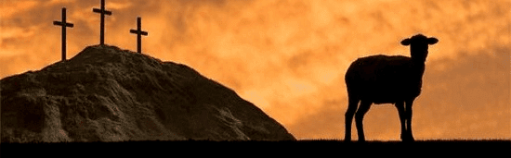
The Passover Lamb
I Corinthians 5:6-8
Notes:
By Nathan L Morrison for Sunday 04/04/2021
All Scripture given is from NASB unless otherwise stated
For further study, or if questions, please Call: 804-277-1983 or Visit: www.courthousechurchofchrist.com
Additional helps at the end of the presentation

Slide 2
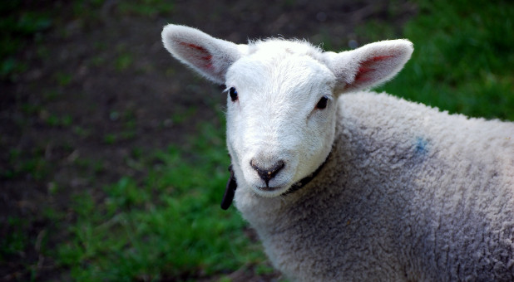
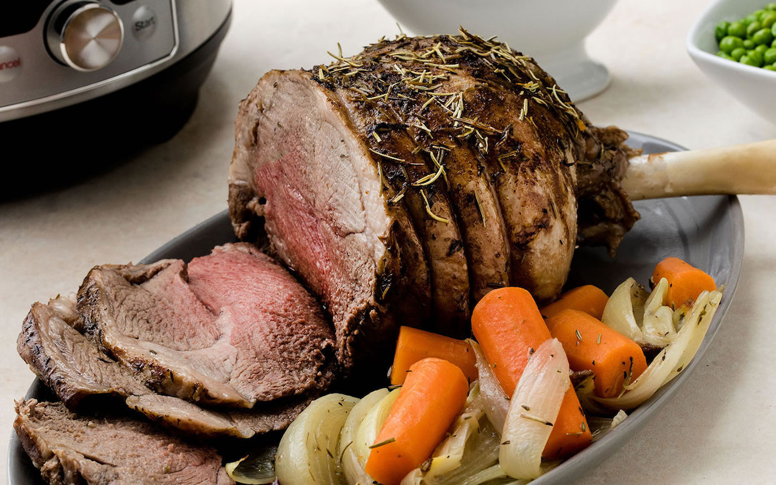
Intro
Are Easter and the Passover the same?
The words are!
The celebration is not!
Notes:
Are Easter and the Passover the same?
They are! Both words represent the annual Feast of Unleavened Bread celebrated by the Jews (Luke 22:1).
As early as the eighth century A.D., the word “Easter” was used to designate the annual Christian celebration of the resurrection of Christ (Nelson’s New Illustrated Bible Dictionary).
The only Scriptural appearance of the word “Easter” is in the King James Version Bible (KJV), produced in A.D. 1611 (17th c.), and is from a mistranslation of “pascha” [pas-khah], the Greek word for “Passover” (G3957) found in Acts 12:4. Interestingly enough, this is the only time the word “Easter” was used in the KJV for “Passover.”
While they are used interchangeably to mean the Jewish festival, they are not celebrated in the same way!
Over time the celebration known as Easter took on many differing forms from that of the Jewish Passover, and became a holiday not celebrating the exodus from Egypt, but the resurrection of Jesus, our exodus from sin and hopelessness.
Even more shocking is that it became a holiday associated with a mythical creature like Christmas, only this time a rabbit who delivered dyed eggs in baskets, often with prizes (presents) inside!
I don’t know of anyone who has the tradition of eating the Easter Bunny after the egg hunt! (There may be, I just don’t know of anyone!)

Slide 3
Intro
Jesus is called our Passover
I Corinthians 5:6-8
6. Your boasting is not good. Do you not know that a little leaven leavens the whole lump of dough?
7. Clean out the old leaven so that you may be a new lump, just as you are in fact unleavened. For Christ our Passover also has been sacrificed.
8. Therefore let us celebrate the feast, not with old leaven, nor with the leaven of malice and wickedness, but with the unleavened bread of sincerity and truth.
There are some similarities with the Passover Lamb and with Jesus Christ!
Notes:
One thing they have in common: Without being in the house for the Israelites, in Christ for saints, covered in the blood of the Lamb the people wouldn’t be saved from the wrath/judgment of God!

Slide 4
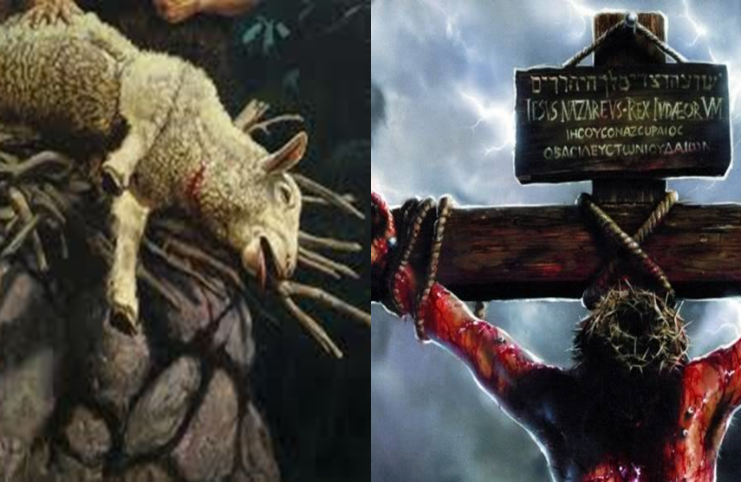
Intro
The Passover Lamb has been once for all sacrificed…Are you covered by the blood?

Slide 5
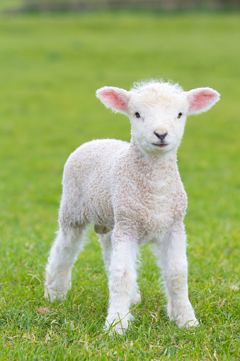
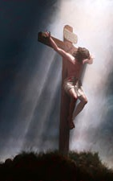
The Passover Lamb (Ex. 12:1-20; Deut. 16:1-8)
Male lamb, of the first year | Ex. 12:5
Lamb without blemish | Ex. 12:5
Taken inside house the 10th of the 1st month (Abib/Nisan) | Ex. 12:3
Examined for four days (10th-14th) | Ex. 12:3-6
Penalty of death upon the lamb being chosen | Ex. 12:4, 6
Killed publicly the 14th day of Abib/Nisan | Ex. 12:6
Killed at twilight/evening (9th hour to the 11th hour) | Ex. 12:6; Deut. 16:6
Killed at Passover | Ex. 12:6
Bones not broken | Ex. 12:46; Num. 9:12
Saved from God’s judgment by the blood on the doorposts | Ex. 12:13
Lamb must be eaten the same night | Ex. 12:8
Christ, Our Passover Lamb (John 1:29; I Cor. 5:6-8)
The Lamb of God, the Firstborn of God | John 1:29; Rom. 8:29
Without sin | II Cor. 5:21
Rode into Jerusalem the 10th of the 1st month (Nisan) | Matthew 21:1-11; Mark 11:1-11; Luke 19:28-40
Examined for four days (10th-14th) by Pharisees | Mt. 21:23-27; 22:15-46
Death penalty for sins before He was born | Is. 53:4-9; I Peter 1:17-21
Killed publicly | Mt. 27:35-44; Mark 15:29-32
Killed at twilight/evening (9th hour) | Mark 15:33-37; Luke 23:44-46
Killed during Passover | John 19:14, 31
Bones not broken | Ps. 34:20; John 19:31-36
Mankind saved from God’s judgment by the blood on the cross | Rom. 5:6-11; Col. 1:13-14; Heb. 9:22, 27-28; I Pet. 3:18
Jesus was crucified & died the same day | Mark 15:25, 33-37
Notes:
Note on Jesus being the unblemished Lamb of God
Without sin – II Cor. 5:21
Without blemish – Heb. 9:14
A lamb unblemished and spotless, the blood of Christ – I Pet. 1:19
Note on Abib & Nisan:
Abib was the name of the first month of the Hebrew Calendar until the Jewish exile.
Nisan was the name of the first month of the Hebrew Calendar after the Jewish exile and is Chaldean in origin (influences of Babylonian captivity for 70 years).
Note on when the lamb and Jesus were slain:
The Passover Lamb was killed at twilight/evening, which was the 9th to 11th hour, coinciding with 3 PM – 5 PM.
Jesus died at the 9th hour, Jewish time 3 PM.
Jewish days were from 6 PM to 6 PM.
The 14th of Nisan, the 1st day of the Passover week (7 Day Festival of Unleavened Bread) began Wednesday night at 6 PM. The lamb would have been killed around 3 PM on Thursday and Jesus ate the Passover with His disciples before 6 PM Thursday evening.
The 15th of Nisan would have begun at 6 PM Thursday night, thus would be the 2nd day of the Passover week.
Jesus was crucified at 9 AM, the 3rd hour (Mark 15:25) on Friday, the 15th of Nisan, a Preparation Day for the Sabbath, which was a “High Sabbath” because it was the Sabbath that fell during the 7-day Feast of the Unleavened Bread (John 19:14, 31).
Jesus died at the 9th hour, 3 PM, that Friday the 15th of Nisan, the 2nd day of Passover Week (Mark 15:34-37).

Slide 6
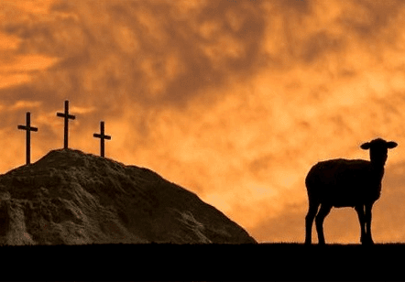
The Passover Lamb
The Passover was to annually remind the Israelites that God saved them from judgment and rescued them from the slavery and bondage of Egypt (Ex. 12:22-28; Deut. 16:1)
Christ’s crucifixion and death reminds man for all time that He saved the world from the bondage and slavery of sin!
(Mt. 1:21; Jn. 1:29; Rom. 6:22-23)
The Passover Lamb

Slide 7
The Passover Lamb
The Jews were to clean out of their house all leaven and eat the Passover with unleavened bread and bitter herbs (Ex. 12:8, 15, 19)
Since Christ, our Passover, has been sacrificed we are to clean out the leaven of malice and wickedness and celebrate with the unleavened bread of sincerity and truth!
(I Cor. 5:6-8)
The Passover Lamb
Notes:
I Corinthians 5:6-8
6. Your boasting is not good. Do you not know that a little leaven leavens the whole lump of dough?
7. Clean out the old leaven so that you may be a new lump, just as you are in fact unleavened. For Christ our Passover also has been sacrificed.
8. Therefore let us celebrate the feast, not with old leaven, nor with the leaven of malice and wickedness, but with the unleavened bread of sincerity and truth.

Slide 8
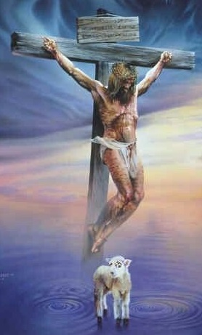
Conclusion
Jesus told His followers how He wanted to be remembered for His sacrifice for all time…
I Cor. 11:23-26
As we eat the Lord’s Supper, the unleavened bread and the fruit of vine (Luke 22:7, 14-20), we remember Him and proclaim His death until He comes again!
Notes:
1Co 11:23 For I received from the Lord that which I also delivered to you, that the Lord Jesus in the night in which He was betrayed took bread;
1Co 11:24 and when He had given thanks, He broke it and said, "This is My body, which is for you; do this in remembrance of Me."
1Co 11:25 In the same way He took the cup also after supper, saying, "This cup is the new covenant in My blood; do this, as often as you drink it, in remembrance of Me."
1Co 11:26 For as often as you eat this bread and drink the cup, you proclaim the Lord's death until He comes.
Luke 22:7: Then came the first day of Unleavened Bread on which the Passover lamb had to be sacrificed.
Luke 22:14-20: Jesus eats the Passover with His apostles and institutes the Lord’s Supper: The bread symbolizing His body that was broken for sin. The fruit of the vine symbolizing the New Covenant in His blood, “poured out for many for forgiveness of sins” (Mt. 26:28)

Slide 9
Conclusion
The Lamb of God has been sacrificed for sins for all time, won’t you obey the gospel now and be covered in His soul-saving blood?

Slide 10
“What Must I Do To Be Saved?”
Hear The Gospel (Jn. 5:24; Rom. 10:17)
Believe In Christ (Jn. 3:16-18; Jn. 8:24)
Repent Of Sins (Lk. 13:3-5; Acts 2:38)
Confess Christ (Mt. 10:32; Rom. 10:10)
Be Baptized (Mk. 16:16; Acts 22:16)
Remain Faithful (Jn. 8:31; Rev. 2:10)
For The Erring Saint:
Repent (Acts 8:22), Confess (I Jn. 1:9),
Pray (Acts 8:22)

Slide 11
Editable Table Comparing The Passover Lamb with Jesus, Our Passover Lamb

Slide 12
The Passover Lamb (Ex. 12:1-20; Deut. 16:1-8)
Male lamb, of the first year | Ex. 12:5
Lamb without blemish | Ex. 12:5
Taken inside house the 10th of the 1st month (Abib/Nisan) | Ex. 12:3
Examined for four days (10th-14th) | Ex. 12:3-6
Penalty of death upon the lamb being chosen | Ex. 12:4, 6
Killed publicly the 14th day of Abib/Nisan | Ex. 12:6
Killed at twilight/evening (9th hour to the 11th hour) | Ex. 12:6; Deut. 16:6
Killed at Passover | Ex. 12:6
Bones not broken | Ex. 12:46; Num. 9:12
Saved from God’s judgment by the blood on the doorposts | Ex. 12:13
Lamb must be eaten the same night | Ex. 12:8
Christ, Our Passover Lamb (John 1:29; I Cor. 5:6-8)
The Lamb of God, the Firstborn of God | John 1:29; Rom. 8:29
Without sin | II Cor. 5:21
Rode into Jerusalem the 10th of the 1st month (Nisan) | Matthew 21:1-11; Mark 11:1-11; Luke 19:28-40
Examined for four days (10th-14th) by Pharisees | Mt. 21:23-27; 22:15-46
Death penalty for sins before He was born | Is. 53:4-9; I Peter 1:17-21
Killed publicly | Mt. 27:35-44; Mark 15:29-32
Killed at twilight/evening (9th hour) | Mark 15:33-37; Luke 23:44-46
Killed during Passover | John 19:14, 31
Bones not broken | Ps. 34:20; John 19:31-36
Mankind saved from God’s judgment by the blood on the cross | Rom. 5:6-11; Col. 1:13-14; Heb. 9:22, 27-28; I Pet. 3:18
Jesus was crucified & died the same day | Mark 15:25, 33-37
Notes:
Note on Jesus being the unblemished Lamb of God
Without sin – II Cor. 5:21
Without blemish – Heb. 9:14
A lamb unblemished and spotless, the blood of Christ – I Pet. 1:19
Note on Abib & Nisan:
Abib was the name of the first month of the Hebrew Calendar until the Jewish exile.
Nisan was the name of the first month of the Hebrew Calendar after the Jewish exile and is Chaldean in origin (influences of Babylonian captivity for 70 years).
Note on when the lamb and Jesus were slain:
The Passover Lamb was killed at twilight/evening, which was the 9th to 11th hour, coinciding with 3 PM – 5 PM.
Jesus died at the 9th hour, Jewish time 3 PM.
Jewish days were from 6 PM to 6 PM.
The 14th of Nisan, the 1st day of the Passover week (7 Day Festival of Unleavened Bread) began Wednesday night at 6 PM. The lamb would have been killed around 3 PM on Thursday and Jesus ate the Passover with His disciples before 6 PM Thursday evening.
The 15th of Nisan would have begun at 6 PM Thursday night, thus would be the 2nd day of the Passover week.
Jesus was crucified at 9 AM, the 3rd hour (Mark 15:25) on Friday, the 15th of Nisan, a Preparation Day for the Sabbath, which was a “High Sabbath” because it was the Sabbath that fell during the 7-day Feast of the Unleavened Bread (John 19:14, 31).
Jesus died at the 9th hour, 3 PM, that Friday the 15th of Nisan, the 2nd day of Passover Week (Mark 15:34-37).

Slide 13
The Passover Lamb (Ex. 12:1-20; Deut. 16:1-8)
Male lamb, of the first year | Ex. 12:5
Lamb without blemish | Ex. 12:5
Taken inside house the 10th of the 1st month (Abib/Nisan) | Ex. 12:3
Examined for four days (10th-14th) | Ex. 12:3-6
Penalty of death upon the lamb being chosen | Ex. 12:4, 6
Killed publicly the 14th day of Abib/Nisan | Ex. 12:6
Killed at twilight/evening (9th hour to the 11th hour) | Ex. 12:6; Deut. 16:6
Killed at Passover | Ex. 12:6
Bones not broken | Ex. 12:46; Num. 9:12
Saved from God’s judgment by the blood on the doorposts | Ex. 12:13
Lamb must be eaten the same night | Ex. 12:8
Christ, Our Passover Lamb (John 1:29; I Cor. 5:6-8)
The Lamb of God, the Firstborn of God | John 1:29; Rom. 8:29
Without sin | II Cor. 5:21
Rode into Jerusalem the 10th of the 1st month (Nisan) | Matthew 21:1-11; Mark 11:1-11; Luke 19:28-40
Examined for four days (10th-14th) by Pharisees | Mt. 21:23-27; 22:15-46
Death penalty for sins before He was born | Is. 53:4-9; I Peter 1:17-21
Killed publicly | Mt. 27:35-44; Mark 15:29-32
Killed at twilight/evening (9th hour) | Mark 15:33-37; Luke 23:44-46
Killed during Passover | John 19:14, 31
Bones not broken | Ps. 34:20; John 19:31-36
Mankind saved from God’s judgment by the blood on the cross | Rom. 5:6-11; Col. 1:13-14; Heb. 9:22, 27-28; I Pet. 3:18
Jesus was crucified & died the same day | Mark 15:25, 33-37

Slide 14
Picture of Table Comparing The Passover Lamb with Jesus, Our Passover Lamb

