Slide 1
The Amen
Text:
Hebrews 12:28
Notes:
By Nathan L Morrison
All Scripture given is from NASB unless otherwise stated
For further study, or if questions, please Call: 804-277-1983 or Visit www.courthousechurchofchrist.com

Slide 2
“Amen & a-woman”
Intro
The Amen

Slide 3
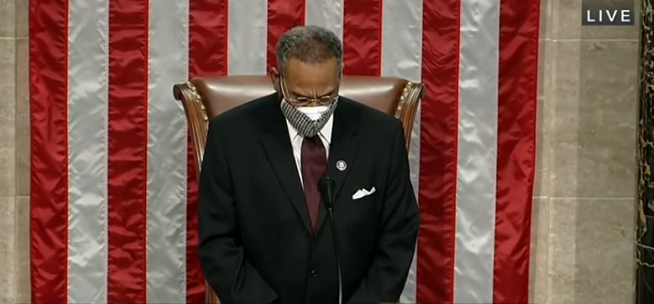
Intro
Kansas City, Missouri Congressman Emanuel Cleaver II (on Monday 01/04/2021):
Ended the prayer of the opening new session of Congress with, “Amen and a-woman.” (Some sources say, “a-women”)
Cleaver, a former Methodist pastor of 37 years, explained to the Kansas City Star that he intended the word to be “a lighthearted pun in recognition of the record number of women who will be representing the American people in Congress during this term as well as … the first female chaplain of the House of Representatives.”
Notes:
Sources:
https://thehill.com/homenews/532547-cleaver-concludes-congressional-prayer-amen-and-awoman
https://www.usatoday.com/story/opinion/2021/01/06/amen-awomen-rep-cleaver-religion-gender-column/4142111001/
https://www.kctv5.com/news/local_news/congressman-cleaver-explains-ending-prayer-with-amen-a-woman/article_cf0f6724-4eeb-11eb-9335-b776dc374c34.html

Slide 4
“Amen” is not a gendered word!
Intro
The Amen

Slide 5
Intro
“What does Amen mean?”
“Is it proper to make puns or jokes in a prayer to Almighty God?”

Slide 6
Strong’s:
H543 âmên [aw-mane']; from H539: sure; abstract, faithfulness; truly:—Amen, so be it, may it be so, truth
Amen in Hebrew (Strong’s H543)
Dictionary.com:
Amen is derived from the Hebrew âmên, which means “certainty,” “truth,” and “verily.”
In English, the word has two primary pronunciations: [ah-men] or [ey-men].
Dr. John Bergsma of the Franciscan University of Steubenville:
“The word “amen” is not a gendered word and the term “a-women” is entirely made up.”
Notes:
Sources:
(https://www.dictionary.com/e/amen/)
(https://www.catholicnewsagency.com/news/amen-is-not-gendered-and-a-woman-is-nonsense-hebrew-scholar-says-46995)

Slide 7
Strong’s:
G281 amén [am-ane']: truly
Usage: verily, truly, assuredly, amen; at the end of sentences may be paraphrased by: “So let it be.”
Amen in Greek
(Strong’s G281)

Slide 8
KJV: For verily I say unto you, Till heaven and earth pass, one jot or one tittle shall in no wise pass from the law, till all be fulfilled.
NKJ: For assuredly, I say to you, till heaven and earth pass away, one jot or one tittle will by no means pass from the law till all is fulfilled.
NAS: For truly I say to you, until heaven and earth pass away, not the smallest letter or stroke shall pass from the Law until all is accomplished.
Example of usage in NT: Matthew 5:18

Slide 9
Latin:
amen [aw-men] (adverb): (from Hebrew amen): “so be it;” true/faithful; truly/verily/; truth/faithfulness
Amen in Latin

Slide 10
“amen” (ey-men; aw-men):
transliterated “amen” from Hebrew, Greek, and Latin at the end of a prayer, during a prayer or sermon for, “May it be so!”…Or…
“Here, Here!”
“Right on!”
“I Agree!”
“Absolutely!”
“Let it be!”
“Truth!”
“Preach it!”
“You know that’s right!”
Amen in English

Slide 11
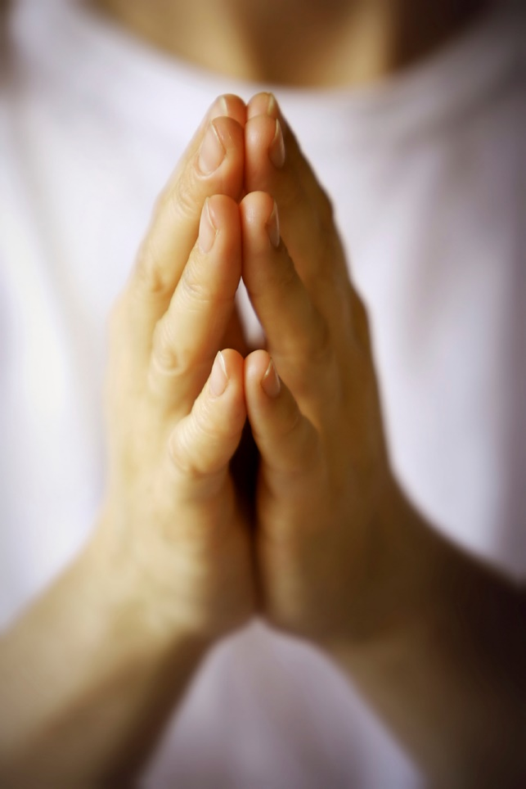
Amen is rooted in “Truth” and is a way for hearers to express their agreement or consent to what is being taught, said, or prayed!
The Meaning of Amen
The Amen

Slide 12
Old Testament:
Examples of Amen in OT & NT
(59 times!)
Deuteronomy 27:10-14 (15-26): God, through Moses, commanded the Israelites that when they enter Canaan they are to “Amen” the curses

Slide 13
“…all the people shall say, 'Amen.'”
Deuteronomy 27:15-26

Slide 14
Old Testament:
Examples of Amen in OT & NT
(59 times!)
Deuteronomy 27:15-26
I Kings 1: David, on his death bed, is told Adonijah, his oldest living son, had declared himself King and was throwing a party.
David gave instructions to anoint Solomon as King and solidify his throne (1:23-35)

Slide 15
36. Benaiah the son of Jehoiada answered the king and said, "Amen! Thus may the LORD, the God of my lord the king, say.
37. As the LORD has been with my lord the king, so may He be with Solomon, and make his throne greater than the throne of my lord King David!"
I Kings 1:36-37

Slide 16
Old Testament:
Examples of Amen in OT & NT
(59 times!)
Deuteronomy 27:15-26
I Kings 1:36
Nehemiah 8: Men and women of Israel gathered for the dedication of the wall of Jerusalem and to hear Ezra the Scribe read the Law of Moses

Slide 17
6. Then Ezra blessed the LORD the great God. And all the people answered, “Amen, Amen!” while lifting up their hands; then they bowed low and worshiped the LORD with their faces to the ground.
Nehemiah 8:6

Slide 18
Old Testament:
Examples of Amen in OT & NT
(59 times!)
Deuteronomy 27:15-26
I Kings 1:36
Nehemiah 8:6
Numerous Psalms praise God and end with an “Amen” – Psalm 89:52; 106:48

Slide 19
New Testament:
Examples of Amen in OT & NT
(59 times!)
Matthew 6:13: Jesus taught His disciples to close their prayers with “Amen” in His model prayer

Slide 20
13. And do not lead us into temptation, but deliver us from evil. For Yours is the kingdom and the power and the glory forever. Amen.
Matthew 6:13

Slide 21
New Testament:
Examples of Amen in OT & NT
(59 times!)
Matthew 6:13
Paul used it numerously throughout his epistles, but a couple notable times are:
Romans 1:25
I Timothy 1:17

Slide 22
Romans 1:25: For they exchanged the truth of God for a lie, and worshiped and served the creature rather than the Creator, who is blessed forever. Amen.
I Timothy 1:17: Now to the King eternal, immortal, invisible, the only God, be honor and glory forever and ever. Amen.
Romans 1:25; I Timothy 1:17

Slide 23
New Testament:
Examples of Amen in OT & NT
(59 times!)
Matthew 6:13
Romans 1:25; I Timothy 1:17
Peter used “Amen” in both his epistles:
I Peter 5:11
II Peter 3:18

Slide 24
I Peter 5:11: To Him be dominion forever and ever. Amen.
II Peter 3:18: but grow in the grace and knowledge of our Lord and Savior Jesus Christ. To Him be the glory, both now and to the day of eternity. Amen.
I Peter 5:11; II Peter 3:18

Slide 25
New Testament:
Examples of Amen in OT & NT
(59 times!)
Matthew 6:13
Romans 1:25; I Timothy 1:17
I Peter 5:11; II Peter 3:18
Jude closes his short letter with “Amen”
Jude 1:25

Slide 26
25. to the only God our Savior, through Jesus Christ our Lord, be glory, majesty, dominion and authority, before all time and now and forever. Amen.
Jude 25

Slide 27
New Testament:
Examples of Amen in OT & NT
(59 times!)
Matthew 6:13
Romans 1:25; I Timothy 1:17
I Peter 5:11; II Peter 3:18
Jude 1:25
John, in Revelation, uses “Amen” 8 times, but a few notable times are:
Revelation 1:7
Revelation 3:14
Revelation 19:4
Revelation 22:20

Slide 28
Revelation 1:7: BEHOLD, HE IS COMING WITH THE CLOUDS, and every eye will see Him, even those who pierced Him; and all the tribes of the earth will mourn over Him. So it is to be. Amen.
Revelation 3:14: To the angel of the church in Laodicea write: The Amen, the faithful and true Witness, the Beginning of the creation of God, says this:
Revelation 1:7; 3:14

Slide 29
Revelation 19:4: And the twenty-four elders and the four living creatures fell down and worshiped God who sits on the throne saying, “Amen. Hallelujah!”
Revelation 22:20: He who testifies to these things says, “Yes, I am coming quickly.” Amen. Come, Lord Jesus.
Revelation 19:4; 22:20

Slide 30
We can see through the OT & NT that “Amen” has been used to agree with the words of God, a speaker, a reader, to close out a praise of God, letters and prayers!
Examples of Amen in OT & NT (59 times!)
The Amen

Slide 31
Conclusion
We say “Amen” to give hearty approval to what is said in a prayer, talk, or sermon, or in what we sing in hymns!
When we come together to worship and to pray we need to remember what we are there for and Who we are addressing, and to do so with reverence and awe!

Slide 32
28. Therefore, since we receive a kingdom which cannot be shaken, let us show gratitude, by which we may offer to God an acceptable service with reverence and awe.
Hebrews 12:28

Slide 33
Conclusion
“Is it proper to make puns or jokes in a prayer to Almighty God?”
Not if we want to remain reverent!

Slide 34
When we hear the word of God or sing praises to our God, let us shout out, “Amen!” as we agree with truth!
Conclusion

Slide 35
“What Must I Do To Be Saved?”
Hear The Gospel (Jn. 5:24; Rom. 10:17)
Believe In Christ (Jn. 3:16-18; Jn. 8:24)
Repent Of Sins (Lk. 13:3-5; Acts 2:38)
Confess Christ (Mt. 10:32; Rom. 10:10)
Be Baptized (Mk. 16:16; Acts 22:16)
Remain Faithful (Jn. 8:31; Rev. 2:10)
For The Erring Saint:
Repent (Acts 8:22), Confess (I Jn. 1:9),
Pray (Acts 8:22)

