Slide 1
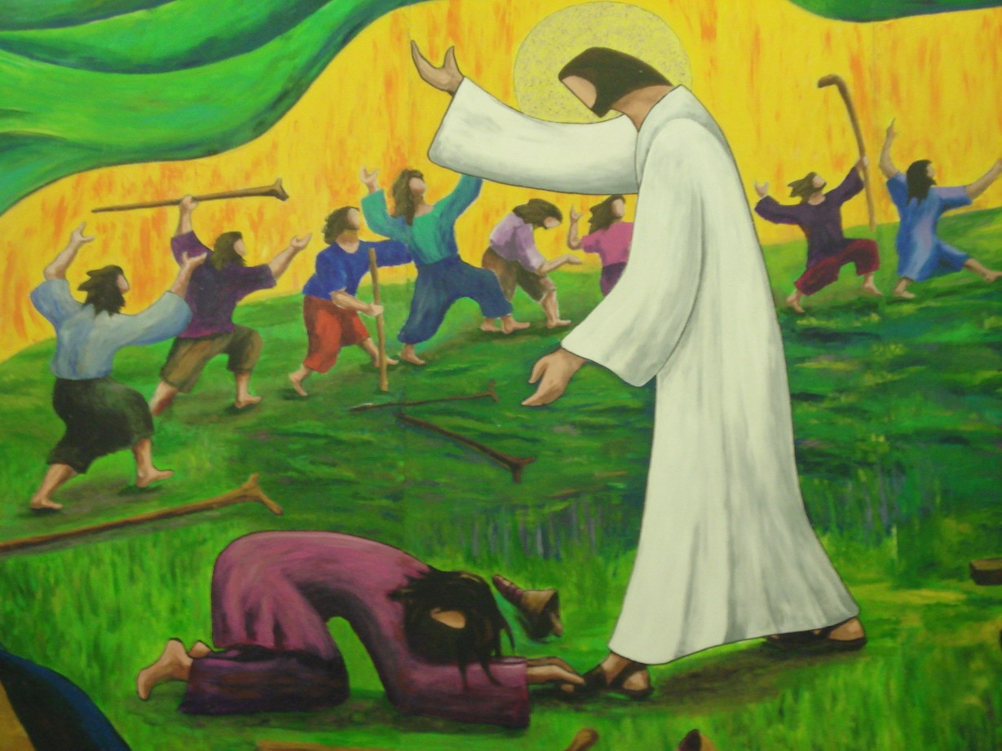
“Where Are The Nine?”
Text:
Luke 17:11-19
Notes:
By Nathan L Morrison
All Scripture given is from NASB unless otherwise stated
For further study, or if questions, please Call: 804-277-1983 or Visit www.courthousechurchofchrist.com
Some points based on lessons by Keith Sharp and Richard Thetford

Slide 2
Luke 17:11-19 (NKJV)
Intro
11. Now it happened as He went to Jerusalem that He passed through the midst of Samaria and Galilee.
12. Then as He entered a certain village, there met Him ten men who were lepers, who stood afar off.
13. And they lifted up their voices and said, "Jesus, Master, have mercy on us!"
14. So when He saw them, He said to them, "Go, show yourselves to the priests." And so it was that as they went, they were cleansed.
15. And one of them, when he saw that he was healed, returned, and with a loud voice glorified God,
16. and fell down on his face at His feet, giving Him thanks. And he was a Samaritan.
17. So Jesus answered and said, "Were there not ten cleansed? But where are the nine?
18. Were there not any found who returned to give glory to God except this foreigner?"
19. And He said to him, "Arise, go your way. Your faith has made you well."

Slide 3
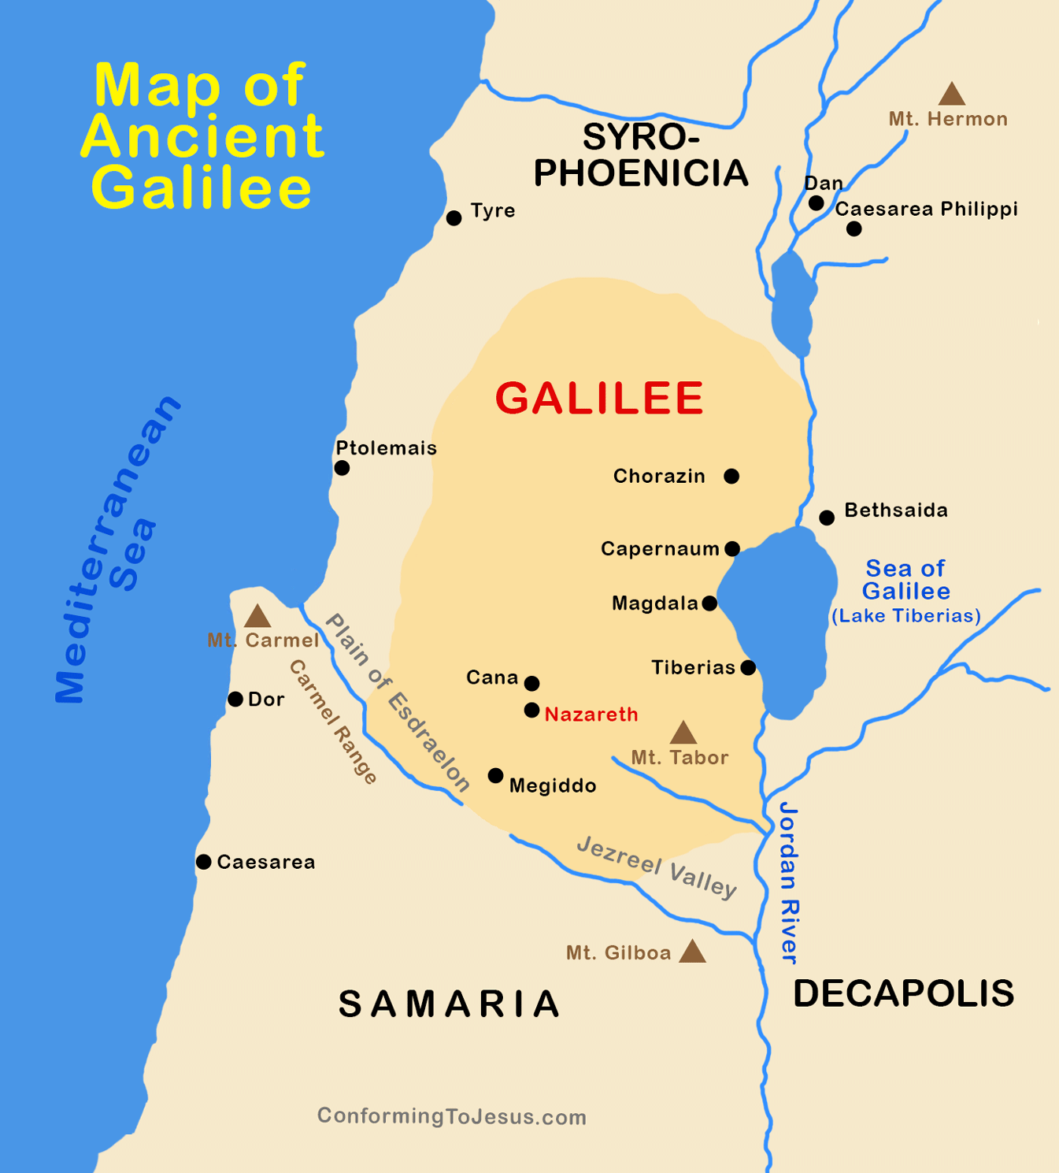
Intro
Note that they ALL:
Had the same disease – leprosy (sin)
Had the same condition – afar off (unclean)
Came to the same person – Jesus (Physician)
Cried for the same thing – mercy (helpless)
All told to do the same thing – go (obey)
All received the same blessing – healed (made clean)
Only ONE returned, the least one expected – a Samaritan (foreigner)
Ten were healed; one showed gratitude – – let us not
be like “the nine” but be like the “one!”

Slide 4
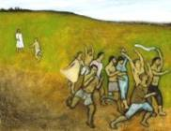
Ingratitude
Characterized by:
The wicked, or evil persons – II Tim. 3:1-5 (vs. 2)
The Gentiles as a whole – Rom. 1:21-22: Failed to thank God – Lk. 17:17
Selfishness – II Tim. 3:2; Phil. 2:3-4: Looking out only for self!
A Complaining spirit – I Cor. 10:10; Num. 16 (Korah’s Rebellion)
Ingratitude:
Being unthankful, unappreciative, ungrateful!

Slide 5
Ingratitude
Manifested towards:
Parents – Mt. 15:1-6
Others – Gen. 40:9-15, 20-23; 41:9
Brethren – I Cor. 6:8
God – Rom. 1:21
Ingratitude is a trait of the wicked – not to be in the hearts of the children of God!

Slide 6
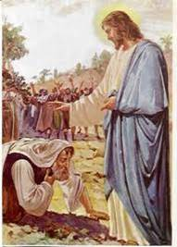
gratitude
Gratitude:
Being thankful, appreciative, grateful!
Characterized by:
Humility – Luke 17:15-16
Praising God and giving thanks – Luke 17:16

Slide 7
gratitude
Manifested towards:
Parents – Eph. 6:2-3
Others – I Tim. 2:1-2
Brethren – Phil. 1:3-6; II Thess. 1:3
God – I Thess. 5:17-18
A thankful heart will keep us from becoming “ungrateful!”

Slide 8
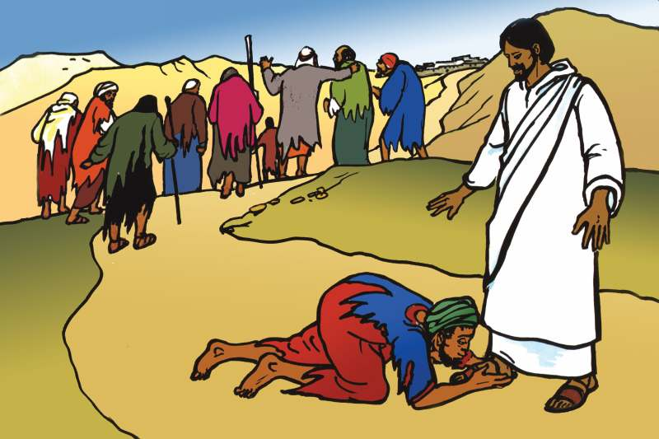
Christians Should Be Grateful To God
He is the Creator – Acts 17:28: In Him we live, move, and have our very being!
Be thankful that God sent His Son to die for us – Rom. 5:8; Heb. 2:9
Be thankful for God’s word inspired by the Holy Spirit – Jn. 16:13-15; II Tim. 3:16-17
Be thankful for all the physical things we have – Js. 1:17; Eph. 5:20
Be thankful for our Christian fellowship – II Thess. 1:3
All of our thanksgiving should go to God through Jesus Christ – Col. 3:17
Be thankful that our names are written in Heaven – Lk. 10:20; Rev. 21:27
Be thankful for salvation – that we have been cleansed from sin – Rom. 6:17-23
Let us be like the “one leper” and thank God for all He has done for us!

Slide 9
Conclusion
The account of the Ten Lepers is a reminder to us of the kind of hearts we are to have!
Which characterizes your heart?
Ingratitude is a primary characteristic of the wicked (Rom. 1:21; II Tim. 3:2)
Gratitude is commanded by and expected of us to God (Col. 3:15-17; Eph. 5:4)
Are you like the nine? (Lk. 17:17)
Let us have the heart of the one leper and give thanks all year round! (Lk. 17:18)

Slide 10
“What Must I Do To Be Saved?”
Hear The Gospel (Jn. 5:24; Rom. 10:17)
Believe In Christ (Jn. 3:16-18; Jn. 8:24)
Repent Of Sins (Lk. 13:3-5; Acts 2:38)
Confess Christ (Mt. 10:32; Rom. 10:10)
Be Baptized (Mk. 16:16; Acts 22:16)
Remain Faithful (Jn. 8:31; Rev. 2:10)
For The Erring Saint:
Repent (Acts 8:22), Confess (I Jn. 1:9),
Pray (Acts 8:22)

