Slide 1
Lessons From… NOTHING!
Text:
I Timothy 6:6-8
Notes:
By Nathan L Morrison
All Scripture given is from NASB unless otherwise stated
For further study, or if questions, please Call: 804-277-1983 or Visit www.courthousechurchofchrist.com
Based on a lesson by Richie Thetford

Slide 2
Intro
Out of nothing God created the world!
Genesis 1:1
1. In the beginning God created the heavens and the earth.
Job recognized the power of God over nothing!
Job 26:7
7. He stretches out the north over empty space And hangs the earth on nothing.
Let us see the many lessons we can learn from Nothing!

Slide 3
Lessons From NOTHING!
We Brought Nothing Into the World

Slide 4
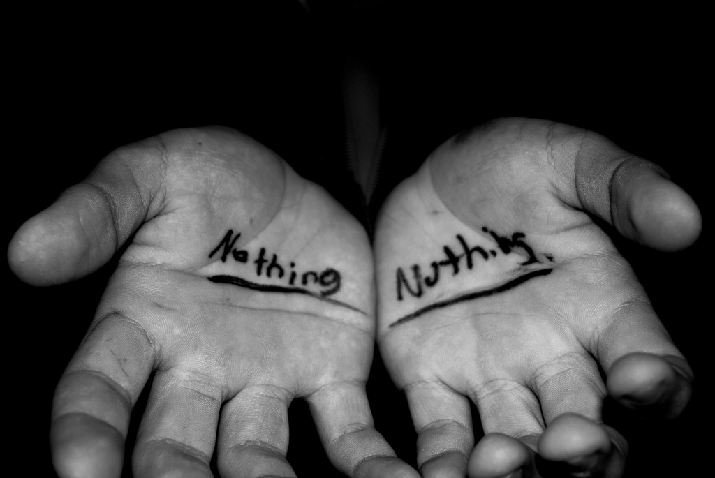
We Brought Nothing Into the World
I Timothy 6:7 (IE: Luke 12:20)
7. For we have brought nothing into the world, so we cannot take anything out of it either.
There are three times in life when we have empty hands:
At birth, at the time we come to Jesus, and at death.
This verse reminds us of the first and the last.
We brought nothing into the world, and it is certain that we can carry nothing out! (Luke 12:20: The Rich Fool)

Slide 5
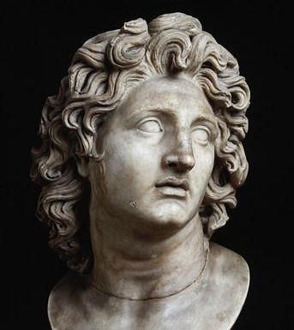
We Brought Nothing Into the World
Alexander the Great (356–323 B.C.), before his death said:
“When I am dead, carry me forth on my bier, with my hands not wrapped in cloth, but laid outside, so that all may see that they are empty.”
Notes:
Before Alexander the Great died (356 B.C.–323 B.C.), he said: “When I am dead, carry me forth on my bier, with my hands not wrapped in cloth, but laid outside, so that all may see that they are empty.” (Believer’s Bible Commentary on I Timothy 6:7)

Slide 6
We Brought Nothing Into the World
Edward Herbert Bates comments on this:
“Yes, those hands which once wielded the proudest scepter in the world; which once held the most victorious sword; which once were filled with silver and gold; which once had power to save or to sign away life, were now EMPTY.”
Notes:
Edward Herbert Bates comments on this: “Yes, those hands which once wielded the proudest scepter in the world; which once held the most victorious sword; which once were filled with silver and gold; which once had power to save or to sign away life, were now EMPTY.” (Spiritual Thoughts from the Scriptures of Truth, p. 160)

Slide 7
We Brought Nothing Into the World
Remember the warning to Israel – Amos 4:12:
“Prepare to meet your God!”
The lesson:
This life is to be spent preparing for the eternal!

Slide 8
Lessons From NOTHING!
We Brought Nothing Into the World
Morality Minus Christ = Nothing

Slide 9
Morality Minus Christ = Nothing
John 15:5
5. "I am the vine, you are the branches; he who abides in Me and I in him, he bears much fruit, for apart from Me you can do nothing.
Morality minus Christ equals Nothing!
Christ is Savior – Matthew 1:21
Christ is the Way – John 14:6
His gospel is the power to save – Romans 1:16
He will save His church – Ephesians 5:23, 27

Slide 10
Morality Minus Christ = Nothing
Not enough to be moral, must be under Christ’s authority
Mt. 7:21-23: These are people who did things they thought were “right” but were apart from Christ and so all their “good” amounted to nothing!
Col. 3:17: All that we do must be in His authority!
The lesson:
Cannot seek righteousness & leave Christ out of our lives!

Slide 11
Lessons From NOTHING!
We Brought Nothing Into the World
Morality Minus Christ = Nothing
Subtraction from God’s Word = Nothing

Slide 12
Subtraction from God’s Word = Nothing
Belief minus Baptism = Nothing
Mark 16:16
Belief (faith) + Baptism = Salvation
Mark 16:16
16. "He who has believed and has been baptized shall be saved; but he who has disbelieved shall be condemned.
Repentance minus Baptism = Nothing
Acts 2:38
Repentance + Baptism = forgiveness of sins!
Acts 22:16: Paul an example of Acts 2:38
Acts 2:38
38. Peter said to them, "Repent, and each of you be baptized in the name of Jesus Christ for the forgiveness of your sins; and you will receive the gift of the Holy Spirit.

Slide 13
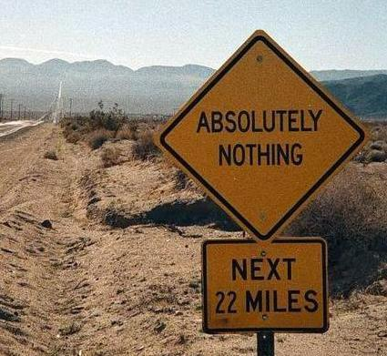
Subtraction from God’s Word = Nothing
Religious Acts minus Love = Nothing
I Cor. 13:1-3:
Faith – Love = Nothing
Benevolence – Love = Nothing
I Cor. 13:1-3
1. If I speak with the tongues of men and of angels, but do not have love, I have become a noisy gong or a clanging cymbal.
2. If I have the gift of prophecy, and know all mysteries and all knowledge; and if I have all faith, so as to remove mountains, but do not have love, I am nothing.
3. And if I give all my possessions to feed the poor, and if I surrender my body to be burned, but do not have love, it profits me nothing.

Slide 14
Subtraction from God’s Word = Nothing
Salt minus Flavor = Nothing
Mt. 5:13: Salt seasons, saves, and preserves!
A child of God that loses these qualities is “good for Nothing!”
Col. 4:6: Our speech must even be seasoned with “salt.”
Matthew 5:13 (NKJ)
13. "You are the salt of the earth; but if the salt loses its flavor, how shall it be seasoned? It is then good for nothing but to be thrown out and trampled underfoot by men.
Compromising with the world causes one’s “salt”
to become flavorless!
(Revelation 2:12-29)

Slide 15
Subtraction from God’s Word = Nothing
The seriousness of subtraction from God’s word:
Rev. 22:18-19
Subtraction from God’s word = Subtraction from eternal life!
Revelation 22:18-19
18. I testify to everyone who hears the words of the prophecy of this book: if anyone adds to them, God will add to him the plagues which are written in this book;
19. and if anyone takes away from the words of the book of this prophecy, God will take away his part from the tree of life and from the holy city, which are written in this book.
The lesson:
Subtracting from God’s word will amount to Nothing!

Slide 16
Lessons From NOTHING!
We Brought Nothing Into the World
Morality Minus Christ = Nothing
Subtraction from God’s Word = Nothing
Having Nothing, Yet Possessing All Things

Slide 17
Having Nothing, Yet Possessing All Things
II Corinthians 6:10
10. as sorrowful yet always rejoicing, as poor yet making many rich, as having nothing yet possessing all things.
Eph. 1:3: God blessed us with every (all) spiritual blessing through Christ!
Notes:
Emphasis in Scripture mine!

Slide 18
Having Nothing, Yet Possessing All Things
I Tim. 6:6-8
6. But godliness actually is a means of great gain when accompanied by contentment.
7. For we have brought nothing into the world, so we cannot take anything out of it either.
8. If we have food and covering, with these we shall be content.
I Tim. 6:6-8: Godliness + Contentment = Great Gain
Since man will carry nothing of this world out of the world, the purpose of our stay on earth is not a quest for the material; but the spiritual!
Eccl. 12:13: The purpose of man: to fear God and keep His commandments.
Mt. 6:19-20: Not profitable to lay up treasures on earth (material wealth).
Quote from the movie ‘Gladiator’ (2000): “Our deeds will echo in eternity!”
Rev. 14:13: “Blessed are the dead who die in the Lord from now on…for their deeds follow with them.”
Our priorities must be on the spiritual, for that is what
we will take out: our soul & character! (Rev. 20:12)
Notes:
Emphasis in Scripture mine!

Slide 19
Having Nothing, Yet Possessing All Things
I Tim. 6:8
8. If we have food and covering, with these we shall be content.
Contentment consists of satisfaction with the basic necessities of life
Matthew 6:25-34
The Christian should seek first the kingdom of God and His righteousness, and God will see that he does not lack the essentials of life (Mt. 6:33).
We should be content with food, clothing, and a place to live but focus on spiritual things! (Mt. 6:33; Col. 3:1-3)
The lesson:
Recognize true value of spiritual blessings
over the material!
Notes:
Emphasis in Scripture mine!

Slide 20
Conclusion
Mark 8:36-37
36. "For what does it profit a man to gain the whole world, and forfeit his soul?
37. "For what will a man give in exchange for his soul?
If we lose our souls, we have gained absolutely Nothing (wasted a preparatory life)!
To gain the whole world is also to gain absolutely Nothing!
We must ensure we are studying God’s word to know His
will, and be prepared to obey it!

Slide 21
Conclusion
For our soul to gain Nothing really is Something… (an unpleasant something!)
Rev. 20:14-15: 2nd Death = Lake of Fire!
II Thess. 1:7-9: Those who do not know God and who have not obeyed the gospel will all suffer an eternal “penalty!”
Our lives are to be spent in preparation for eternity!
Eternal life or eternal punishment?
How have you prepared?
(II Peter 3:10-12)

Slide 22
Conclusion
Learn the lessons from “Nothing”:
There is
worth losing your soul to Hell for!

Slide 23
“What Must I Do To Be Saved?”
Hear The Gospel (Jn. 5:24; Rom. 10:17)
Believe In Christ (Jn. 3:16-18; Jn. 8:24)
Repent Of Sins (Lk. 13:3-5; Acts 2:38)
Confess Christ (Mt. 10:32; Rom. 10:10)
Be Baptized (Mk. 16:16; Acts 22:16)
Remain Faithful (Jn. 8:31; Rev. 2:10)
For The Erring Saint:
Repent (Acts 8:22), Confess (I Jn. 1:9),
Pray (Acts 8:22)

