Slide 1
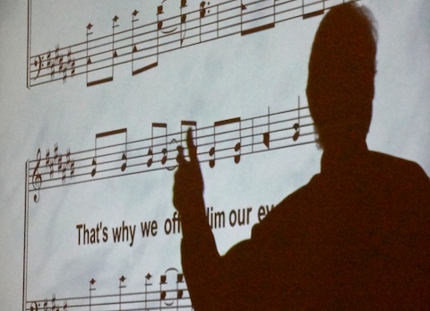
Preaching & Teaching In Hymns
Text:
Colossians
1:28; 3:16
Notes:
By Nathan L Morrison
All Scripture given is from NASB unless otherwise stated
For further study or if questions, Call: 804-277-1983, or Visit: www.courthousechurchofchrist.com
Images of Song Leaders: Brothers from the Courthouse church of Christ, Chesterfield, VA
Based on an article by Andrew Roberts, Truth Magazine, April 2015

Slide 2
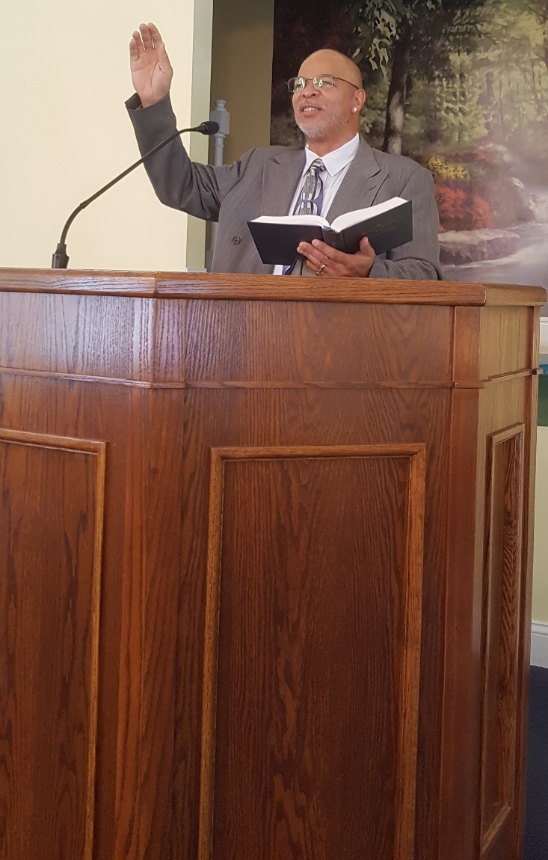
Intro
Ephesians 5:19 and Colossians 3:16 are most often used to refute the use of mechanical instruments in worship
They also represent the deeper meaning of our singing to God: teaching and preaching
There is an awesome responsibility of being a song leader!
Notes:
Image: Rich J.

Slide 3
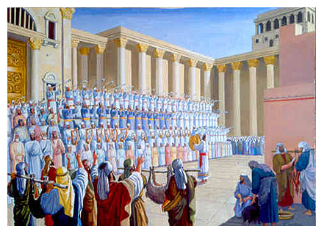
The Awesome Responsibility of a Song Leader
I Chr. 15:16-19: David
appointed Levite singers:
Heman (Ps. 88), Asaph (Ps. 50), and Ethan (Ps. 89). Also Obed-Edom (I Chr. 15:18-21)
Only Solomon surpassed them in wisdom (I Kings 4:31: They were very wise).
As Levites they were trained in the word of God and were expected to teach others (Chenaniah – I Chr. 15:22).
Singers were important to O.T.
Worship:
II Chr. 29:25-28; Neh. 12:46
Preaching & Teaching In Hymns

Slide 4
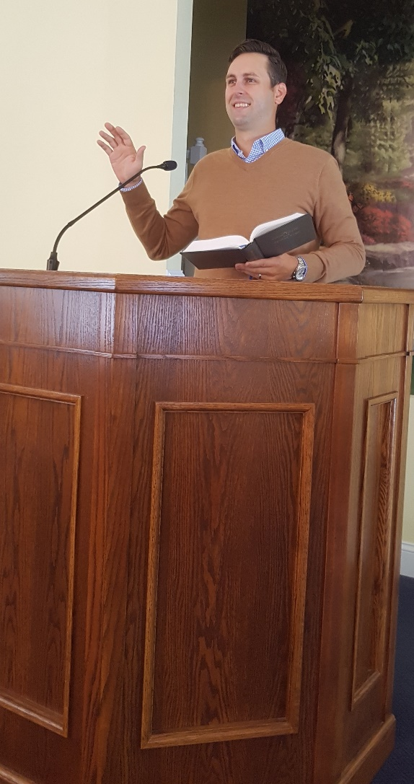
The Awesome Responsibility of a Song Leader
Notice how teaching and admonishing with the word of
Christ is done in both preaching and singing:
Colossians 1:28
We proclaim Him, admonishing every man and teaching every man with all wisdom, so that we may present every man complete in Christ.
Colossians 3:16
Let the word of Christ richly dwell within you, with all wisdom teaching and admonishing one another with psalms and hymns and spiritual songs, singing with thankfulness in your hearts to God.
Preaching & Teaching is also to be done through singing of hymns!
Preaching & Teaching In Hymns
Notes:
Image: Grant C.

Slide 5
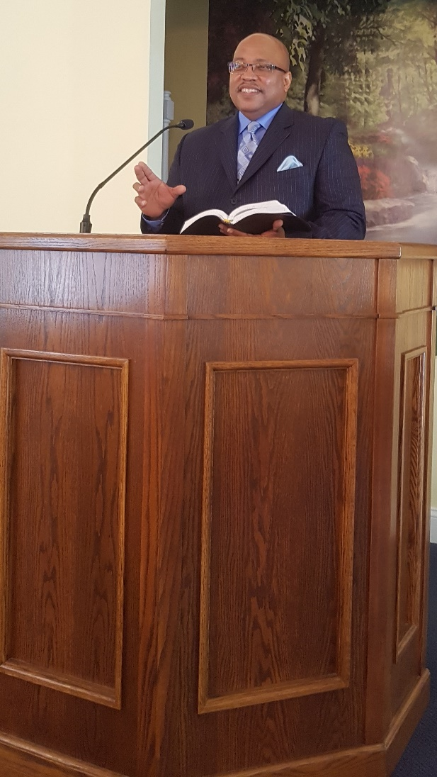
The Awesome Responsibility of a Song Leader
Who typically decides what the congregation will sing?
The Song Leader!
The preacher will study and work for many hours to accomplish one sermon, while the song leader leads the assembly in singing 4 or more sermons each time!
Every hymn has the congregation teaching, confessing, or professing something
The song leaders choose a number of sermons every Sunday: It is an awesome responsibility being a
song leader!
Preaching & Teaching In Hymns
Notes:
Image: Leon R.

Slide 6
Are Song Leaders Prepared?
“It’s Sunday. It’s 10 AM. Do you know where your song
leader is?” asks Andrew Roberts…
“Well, I guess I can lead…if no one else will”
“I mean, if nobody else will, then I’ll lead.”
When things like this happen at
any congregation, it gives off the
impression to visitors and
members alike that the service is
disorganized! (I Cor. 14:40)
Song Leaders ought to be prepared!
Preaching & Teaching In Hymns
Notes:
In an article by Andrew Roberts, he relates an oft too-familiar scenario:
He writes, “It’s Sunday. It’s 10 AM. Do you know where your song leader is?”
He goes on to say, “People are already seated and begin looking around. They wonder, ‘Why haven’t we started yet?’ One can faintly hear the words echoing around the auditorium: ‘Well, I guess I can lead…if no one else will.’”
He also relates an encounter at a congregation the first Sunday he was preaching there for a gospel meeting. To sum up: The Announcer was done making the announcements then called on the song leader to come forward. Someone shouted out that the song leader wasn’t there. The Announcer called on 3 different men to lead songs, and they all declined so he picked up a song book and was picking songs when one of the men who had refused said, “I mean, if nobody else will, then I’ll lead.” To which the Announcer said, “Oh no! I’ll do this!”

Slide 7
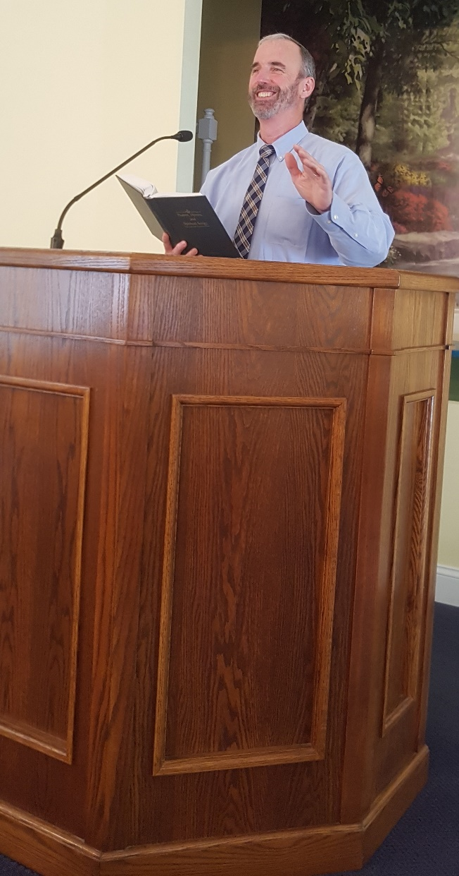
Are Song Leaders Prepared?
Congregations that have more than one good song leader
are truly blessed!
Just as the preacher and teachers
must be prepared…Are the song
leaders aware and prepared for the
awesome responsibility of leading
the congregation in preaching & teaching through singing hymns?
To do it well, it requires far more
than just musical skill!
A song leader needs wisdom, preparation, and planning!
Preaching & Teaching In Hymns
Notes:
Image: Richard F.

Slide 8
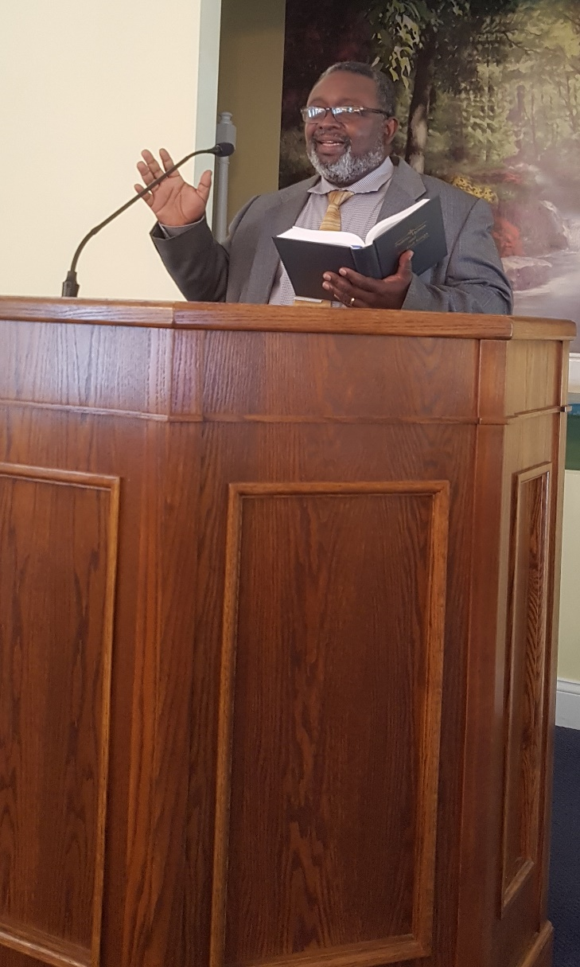
A Song Leader’s Preparation & Planning
For every hymn a song leader chooses to sing, he excludes hundreds of others!
Why does he choose the hymns he has chosen?
This may help song leaders choose hymns
The lyrics will reflect a basic theme of Christianity
The lyrics will be in harmony with Scripture
The rhythm & tune will properly express the tone & feelings of the lyrics
The language will be clear & understandable
Preaching & Teaching In Hymns
Notes:
Image: Chuck B.

Slide 9
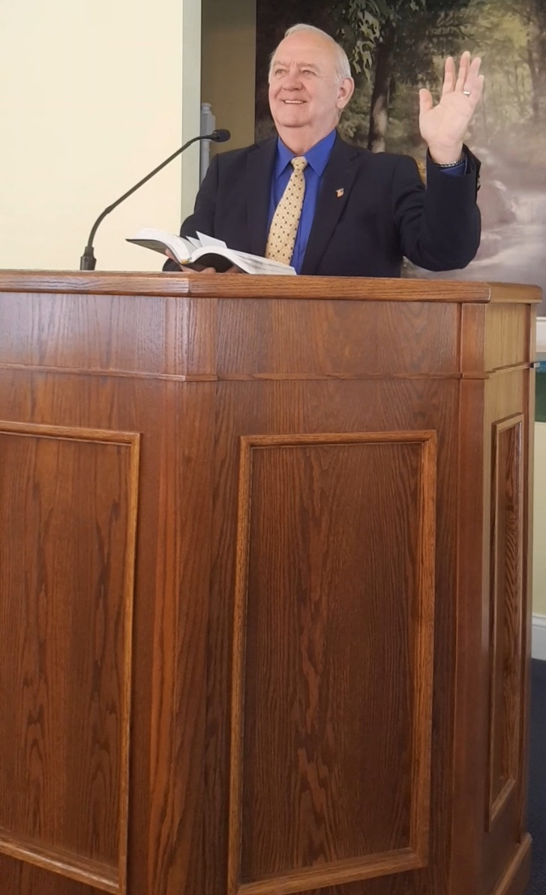
A Song Leader’s Preparation & Planning
There are many ways a song leader can prepare for the song services (This list is not exhaustive)
Song Leaders ought to purposefully choose their hymns to edify and to teach!
Preaching & Teaching In Hymns
Notes:
Image: Dick S.

Slide 10
Conclusion
Encourage song leaders to know that they stand in
the noble company of David, Asaph, Heman, Ethan, Obed-Edom and Paul as teachers of God’s word to God’s people!
Encourage song leaders to see that leading the
congregation in singing goes beyond mere musical
appreciation or vocal honing, but is a way commanded by
God to teach and admonish! (Col. 3:16)
Encourage song leaders by singing out with them so no one feels they are singing a solo!

Slide 11
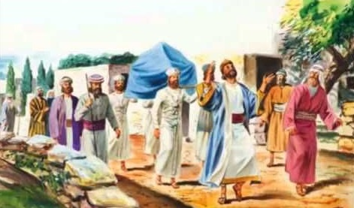
Conclusion
Song leading is an awesome responsibility and Song Leaders stand in good company!

Slide 12
“What Must I Do To Be Saved?”
Hear The Gospel (Jn. 5:24; Rom. 10:17)
Believe In Christ (Jn. 3:16-18; Jn. 8:24)
Repent Of Sins (Lk. 13:3-5; Acts 2:38)
Confess Christ (Mt. 10:32; Rom. 10:10)
Be Baptized (Mk. 16:16; Acts 22:16)
Remain Faithful (Jn. 8:31; Rev. 2:10)
For The Erring Saint:
Repent (Acts 8:22), Confess (I Jn. 1:9),
Pray (Acts 8:22)

