Slide 1
Compassion Of The Pharisees Text: Matthew 23:2-3
Notes:
By Nathan L Morrison
All Scripture given is from NASB unless otherwise stated
For further study, or if questions, please Call: 804-277-1983 or Visit www.courthousechurchofchrist.com
Adapted from a lesson by David Padfield

Slide 2
Intro
Compassion
American Heritage Dictionary: "Deep awareness of the suffering of another coupled with the wish to relieve it.”
Webster’ College Dictionary: “A suffering with another; painful sympathy; a sensation of sorrow excited by the distress or misfortunes of another; pity; commiseration. Compassion is a mixed passion, compounded of love and sorrow; at least some portion of love generally attends the pain or regret, or is excited by it. Extreme distress of an enemy even changes enmity into at least temporary affection.”
“Compassion is so congenial with us, so ingrafted into our very nature”
(Thomas, Jenner, 1751)
Notes:
Source:
Thomas Jenner once said, “Compassion is so congenial with us, so ingrafted into our very nature.” (Charity and Compassion Towards Men the Occasion of Thanksgivings to God, Aug. 23, 1751)
https://books.google.com/books/about/Charity_and_Compassion_Towards_Men_the_O.html?id=gO1bAAAAQAAJ

Slide 3
Intro
Prior to feeding the five thousand (Mt. 14:14)
Prior to feeding the four thousand (Mt. 15:32)
Compassion towards a leper (Mark 1:41)
Compassion for the widow of Nain (Luke 7:13)
Compassion shown to two blind men (Mt. 20:34)
Compassion caused Him to teach (Mk. 6:34)
Compassion caused Him to die for the sins of the world (Jn. 1:29; 3:16; Rom. 5:6-10)
He is now our compassionate High Priest (Heb. 2:17-18; 4:14-16)
Jesus was moved by compassion on many occasions

Slide 4
Intro
I Peter 2:21
For you have been called for this purpose, since Christ also suffered for you, leaving you an example for you to follow in His steps.
Jesus left for us an example to follow so that we may not go astray!
Christians are commanded to be compassionate, loving individuals – Jn. 13:34-35; Col. 3:12-14: To put on compassion and love, traits of Jesus!
We are to have compassion for one another (I Pet. 3:8).
We are to have compassion for the lost (Jude 1:22-23)

Slide 5
Intro
Matthew 23:2-3
2. saying: "The scribes and the Pharisees have seated themselves in the chair of Moses;
3. therefore all that they tell you, do and observe, but do not do according to their deeds; for they say things and do not do them.
Saints were told to “put on compassion” because there were those who did not!
Love and compassion are contrasted in Jesus and the compassion of the Pharisees!

Slide 6
The Pharisees and the Sick
Matthew 9:32-34: Jesus heals a mute, demon-possessed man
The crowds: “Nothing like this has ever been seen in Israel!”
The Pharisees: “He casts out the demons by the ruler of the demons!”
Matthew 12:22-28: Jesus heals a blind, mute demon-possessed man
The crowds: Amazed!
The Pharisees: “This man casts out demons only by Beelzebul the ruler of the demons!”
Jesus: Taught a kingdom divided cannot stand and that led into the discussion of the sin against the Holy Spirit (12:29-32)

Slide 7
The Pharisees and the Sick
Luke 6:6-11: On a Sabbath Jesus was in the synagogue teaching. A man was there with a withered right hand.
The scribes and Pharisees were watching closely to see if Jesus would heal on the Sabbath so they could accuse Him!
Jesus asked the scribes and the Pharisees if it was lawful on the Sabbath to do good or to do evil – They were silent!
Jesus healed the man, showing them an act of mercy was not breaking the Sabbath.
Pharisees: Filled with rage and plotted with the Herodians on how they might destroy Him (Mark 3:6)

Slide 8
The Pharisees and the Sick
The Pharisees: Their compassion went as far as their own selves, to their own best interests!
Jesus: Jesus’ compassion moved Him to do what was best for people.
Saints Today: Does your compassion go as far as doing what is best for others? (Phil. 2:4)

Slide 9
Challenge!
Compassion Of The Pharisees
The Pharisees and the Sick
The next time you hear of someone who is sick, make it your mission to reach out to them (Calls, Texts, Cards, Visits, etc.)!
Let them know you were thinking of them and praying for them (James 5:16)
Having the compassion of Jesus moves saints to help those who need help!

Slide 10
The Pharisees and the Adulteress
John 8:1-11: The Pharisees brought to Jesus a woman caught in adultery
The Pharisees thought they had Jesus between the Law and the law of the land.
Jewish Law: Adultery was punishable by death (Lev. 20:10: Both parties put to death).
Purely legal point of view: they were perfectly correct—but…where was the man???
They asked Jesus what He said they should do to her (Trying to trap Him)!

Slide 11
The Pharisees and the Adulteress
John 8:1-11: The Pharisees brought to Jesus a woman caught in adultery
If He said that the woman ought to be stoned to death, then: He would come into collision with Roman law, for the Jews had no power to pass or carry out the death sentence on anyone.
If He said that the woman should be pardoned then: It could be said that He was teaching men to break the Law of Moses!
Their trap backfired!
John 8:7: Jesus said, “Stone her! But let the man that is without sin be the first to cast a stone.”
There was a silence—and then slowly the accusers drifted away.
Jesus and the woman were left alone.

Slide 12
The Pharisees and the Adulteress
Pharisees: They were condemnatory. They only looked on the woman as a tool to trap Jesus, not as a person.
Jesus: Compassion & Forgiveness. He challenged her to “Go and sin no more.”
Saints Today: Do you have compassion towards your brethren when they sin? (Gal. 6:1-2)

Slide 13
Challenge!
Compassion Of The Pharisees
The Pharisees and the Adultress
The next time someone confesses a sin, either to you in private or in public, let them know you forgive them (from your heart) and that you love them (say the words), and if you are both huggers, give them a hug! (James 5:16)
Don’t allow them to be swallowed up with sorrow (II Cor. 2:1-7) by continually bringing it up or holding it over their head, but “reaffirm” your love towards them! (II Cor. 2:8)
Having the compassion of Jesus moves saints to forgive and reclaim!

Slide 14
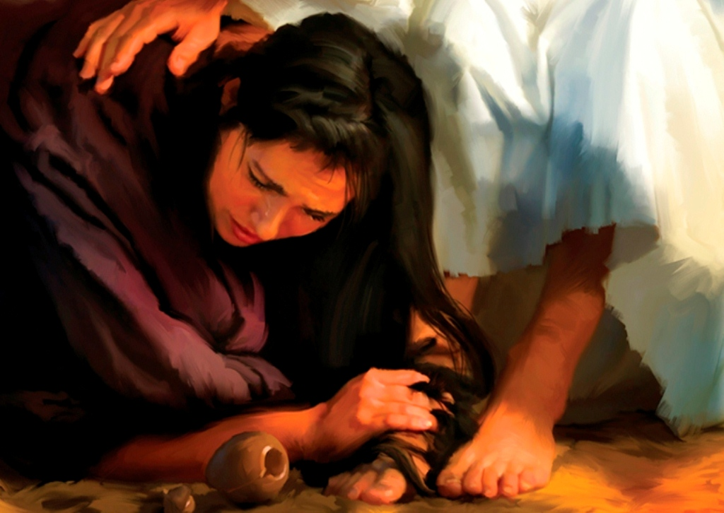
The Pharisees and the Sinful Woman
Luke 7:36-50: Jesus invited to the house of Simon the Pharisee and has His feet anointed by a sinful woman
When a guest entered such a house three things were customarily done (Lk. 7:44-46):
The host placed his hand on the guest's shoulder and gave him the kiss of peace.
Cool water was poured over the guest's feet to cleanse and comfort them.
Either a pinch of sweet-smelling incense was burned or a drop of rose oil was placed on the guest's head
None of these things were done for Jesus!
The woman was a sinful woman—a notoriously sinful woman (reputation)
“Weeping, she began to wet His feet with her tears, and kept wiping them with the hair of her head, and kissing His feet and anointing them with the perfume” (Luke 7:38)

Slide 15
The Pharisees and the Sinful Woman
Simon the Pharisee: Felt no love, and so received no forgiveness. He felt that prophets, like Pharisees, should be separate from sinners.
Jesus: Recognized her faith and forgave her sins, though they were many.
Saints Today: Do you have compassion to teach the lost? (Jude 22-23)

Slide 16
Challenge!
Compassion Of The Pharisees
The Pharisees and the Sinful Woman
The next time you encounter someone (brother or unbeliever) you believe to be a lost cause due to their reputation, don’t write them off but give them a chance! (II Tim. 2:24-26)
Our goal in teaching the gospel is not to judge a book by its cover but to snatch souls from the snare of the devil! (Ananias with Saul of Tarsus! – Acts 9:10-16)
Having the compassion of Jesus moves saints to teach and redeem sinners!

Slide 17
Conclusion
Matthew 23:2-3: "They do not practice what they preach, “Do as they say; not what they do.”
John 13:34-35: Jesus was an example in all that He said and did.
We are to be Christ-like and not like the Pharisees!
Christ-like compassion will move us to help people in need, even when we see someone in sin
To offer them the physical help as we are able – James 2:13-17; I John 3:17-18
To offer spiritual help when needed: to seek to correct and forgive, not to humiliate and condemn – Col. 3:12-14; II Tim. 2:24-26

Slide 18
Conclusion
It’s easy to treat one another (and other people) like the Pharisees, but more of a challenge to treat one another like Jesus treated people!
Do you show the compassion of the Pharisees or do you show the compassion of Jesus?

Slide 19
“What Must I Do To Be Saved?”
Hear The Gospel (Jn. 5:24; Rom. 10:17)
Believe In Christ (Jn. 3:16-18; Jn. 8:24)
Repent Of Sins (Lk. 13:3-5; Acts 2:38)
Confess Christ (Mt. 10:32; Rom. 10:10)
Be Baptized (Mk. 16:16; Acts 22:16)
Remain Faithful (Jn. 8:31; Rev. 2:10)
For The Erring Saint:
Repent (Acts 8:22), Confess (I Jn. 1:9),
Pray (Acts 8:22)

Slide 22
“What Must I Do To Be Saved?”
Hear The Gospel (Jn. 5:24; Rom. 10:17)
Believe In Christ (Jn. 3:16-18; Jn. 8:24)
Repent Of Sins (Lk. 13:3-5; Acts 2:38)
Confess Christ (Mt. 10:32; Rom. 10:10)
Be Baptized (Mk. 16:16; Acts 22:16)
Remain Faithful (Jn. 8:31; Rev. 2:10)
For The Erring Saint:
Repent (Acts 8:22), Confess (I Jn. 1:9),
Pray (Acts 8:22)

