Slide 1
What Are You Wearing?
Text:
Galatians 3:27
Notes:
By Nathan L Morrison for Sunday August 30, 2020
All Scripture given is from NASB unless otherwise stated
For further study or if questions, Call: 804-277-1983, or Visit: www.courthousechurchofchrist.com
Based on an article by Larry R. Ping II, Back To Basics Volume 6 Number 11, Nov. 2008

Slide 2
Intro
We know how to adorn ourselves physically…
Do we know how to adorn our hearts (Our Inner Self)?
Pure character springs from fear of God – Eccl. 12:13-14
Manner of life “adorns” (“to put on” or “to wear”) the “doctrine of God” – Tit. 2:10
Manner of life “worthy of the gospel of Christ” – Phil. 1:27
The idea of “putting on” appears throughout the Scriptures, and there are things we are told to “put on”
The phrase “to put on” has the meaning of adorning the heart of man.
The Scriptures tell us there are things to put on …
What are you wearing?

Slide 3
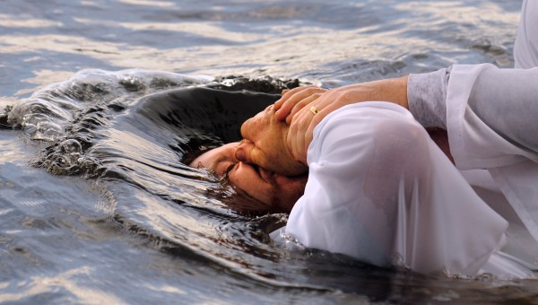
Christ
Those who were baptized have “clothed” themselves with Christ
NKJV: Those who “were baptized into Christ have put on Christ.”
Putting “on Christ” means to be “in Christ.”
Benefits of being “in Christ”:
Eph. 1:3: All “spiritual blessings” are found “in Christ”
II Cor. 5:17: One is a “new creature” “in Christ”
Redemption (Rom. 3:24), sanctification (I Cor. 1:2), nearness to God (Eph. 2:13), reconciliation (Eph. 2:16), and eternal life (I Jn. 5:11) belong to those “in Christ”
Galatians 3:27
For all of you who were baptized into Christ have clothed yourselves with Christ.
Have you put on Christ?

Slide 4
New Self
Saints are to “lay aside” (“put off”) the old self (old way of life) and “put on the new self” (new way of life “in Christ”)
Ephesians 4:22-24
II Corinthians 5:17
Baptism “into Christ” is also baptism into His death”
Romans 6:3-4: put away the old self and put on the new creature
Putting “on the new self” requires repentance
The old way of life is the “former” manner of life (Eph. 2:1-3) – must repent and “walk in a manner worthy” of the gospel (Eph. 4:1; Col. 1:10)
Ephesians 4:24
and put on the new self, which in the likeness of God has been created in righteousness and holiness of the truth.
Have you put on the New Self?

Slide 5
Full Armor of God
Clothing one’s self “in Christ” includes putting “on the full armor of God”
This armor does not protect against “flesh and blood” but against “the rulers, against the powers, against the world forces of this darkness, against the spiritual forces of wickedness in the heavenly places” (Eph. 6:12).
The spiritual armor and weapons (Eph. 6:14-18) are meant for both protection and offense against “the schemes of the devil” (Eph. 6:11).
Putting on the whole armor of God is for the saint “to stand firm” (Eph. 6:13)
Ephesians 6:11
Put on the full armor of God, so that you will be able to stand firm against the schemes of the devil.
Have you put on the Full Armor of God?

Slide 6
Love
Love is “put on” when one puts on Christ
Jn. 13:35: By our love for one another the world will know we are His.
I Pet. 2:17: saints ought to “love the brotherhood.”
Love seeks after the best interest of another (I Jn. 3:16-18; Js. 2:15-17).
Love is not selfish or jealous – I Cor. 13:4-7
I Jn. 5:2-3: We show our love for the brethren by loving God, and we show we love God by obeying (keeping) His commandments.
We are not to love the world or the things in the world – I John 2:15-17
Colossians 3:14
Beyond all these things put on love, which is the perfect bond of unity.
Have you put on Love?

Slide 7
Immortality
Saints ought to seek after that day we put aside our mortality and put on immortality
Rom. 2:5-10: Those who seek for immortality will be honored with eternal life, but those who do not obey the truth will suffer for eternity.
I Jn. 5:11: “Eternal life” is promised by God (I Jn. 2:25) and is “in His Son.”
Those “in Christ” will be those to “put on immortality”
I Corinthians 15:54
But when this perishable will have put on the imperishable, and this mortal will have put on immortality, then will come about the saying that is written, "DEATH IS SWALLOWED UP in victory.
Will you put on Immortality?

Slide 8
Conclusion
Baptism begins the process of “putting on” these certain
things “in Christ!” (Galatians 3:27)
Through baptism one calls on the name of the Lord and:
Puts on Christ (Sins are washed away – Acts 22:16)
Puts on the new self (former way of life is put to death)
Puts on the full armor of God (needed to stand firm)
Puts on love (for each other and for God)
Puts on immortality (acquiring the promise of eternal life!)
We should all long for the day when the promise shall be fulfilled that says, “He will wipe away every tear from their eyes; and there will no longer be any death; there will no longer be any mourning, or crying, or pain; the first things have passed away" (Rev. 21:4)

Slide 9
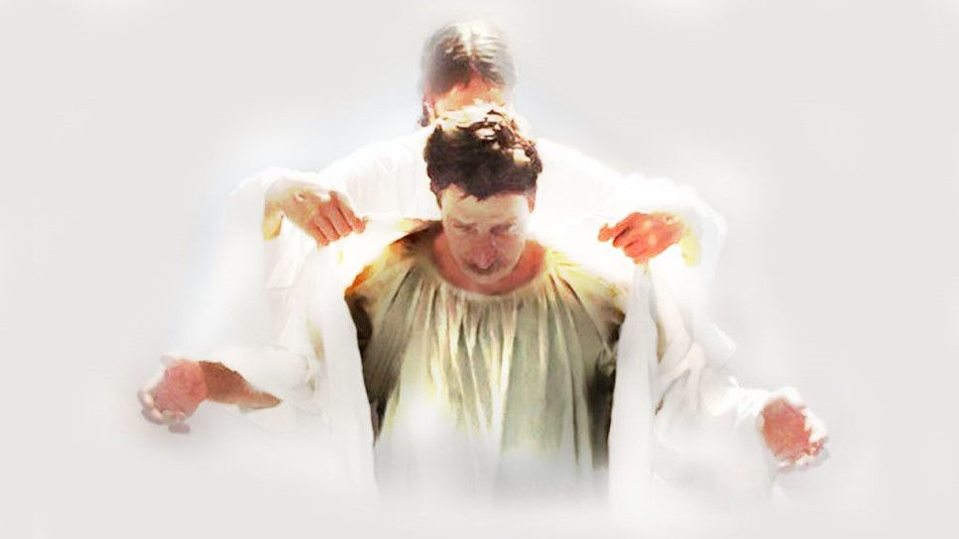
Conclusion
Everyday we are to adorn our hearts with the character of Christ to prepare for eternity!
What are you wearing?

Slide 10
“What Must I Do To Be Saved?”
Hear The Gospel (Jn. 5:24; Rom. 10:17)
Believe In Christ (Jn. 3:16-18; Jn. 8:24)
Repent Of Sins (Lk. 13:3-5; Acts 2:38)
Confess Christ (Mt. 10:32; Rom. 10:10)
Be Baptized (Mk. 16:16; Acts 22:16)
Remain Faithful (Jn. 8:31; Rev. 2:10)
For The Erring Saint:
Repent (Acts 8:22), Confess (I Jn. 1:9),
Pray (Acts 8:22)

