Slide 1
The Days Of Noah Part 3 Be Prepared Text: Luke 17:26-27, 30
Notes:
By Nathan L Morrison
All Scripture given is from NASB unless otherwise stated
For further study, or if questions, please Call: 804-277-1983 or Visit www.courthousechurchofchrist.com

Slide 2
Intro
Luke 17:26-27, 30
26. "And just as it happened in the days of Noah, so it will be also in the days of the Son of Man:
27. they were eating, they were drinking, they were marrying, they were being given in marriage, until the day that Noah entered the ark, and the flood came and destroyed them all.
30. "It will be just the same on the day that the Son of Man is revealed.
Jesus compared the days of Noah to the last days & His return:
The people’s behavior before the flood – Unprepared
The return of Christ will come upon mankind as suddenly and unexpectedly as did the flood in the days of Noah – Matthew 24:36-39
The people were warned – Noah was “a preacher of righteousness” (II Pet. 2:5)

Slide 3
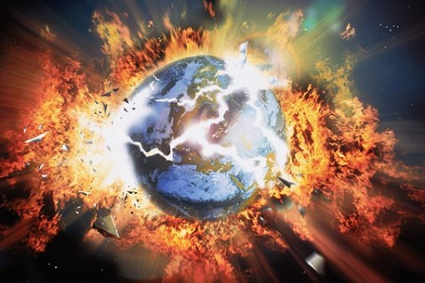
Intro
II Peter 3:7
7. But by His word the present heavens and earth are being reserved for fire, kept for the day of judgment and destruction of ungodly men.
Today people are told to prepare for destruction that will come by way of intense heat that will burn up the earth and the elements – II Peter 3:10-12
No matter what people in the world around us are doing, we must be prepared for that day!
Despite what the people in the world around him were doing, Noah and his family were prepared!

Slide 4
What Can The Righteous Do? Be Prepared!
The righteous must continue to keep their faith in God
II Timothy 4:7
7. I have fought the good fight, I have finished the course, I have kept the faith;

Slide 5
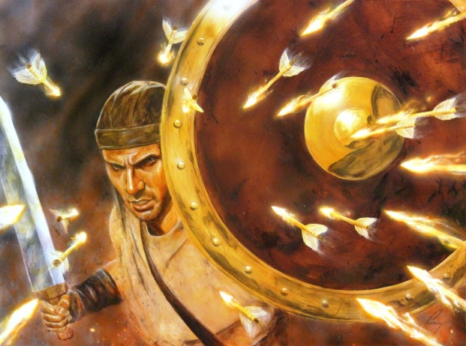
The righteous must continue to keep their faith in God (II Tim. 4:7)
God rules over heaven and earth (Mt. 28:18; Col. 1:16-17)
When evil rises up the righteous look up and rely on God (Ps. 121:1-2)
Faith can overcome temptation (Eph. 6:16) and overcome the world (I Jn. 5:4)
“The will of the Lord be done!” (Acts 21:10-14; James 4:15)
We know that “God causes all things to work together for good to those who love God” (Rom. 8:28; Phil. 4:22)
Saints must continue to teach the gospel for in it is the power of God to change the hearts & lives of sinners (Rom. 1:16; I Cor. 6:9-11)

Slide 6
What Can The Righteous Do? Be Prepared!
The righteous must continue to keep their faith in God
The righteous must continue to pray
I Thessalonians 5:17
17. pray without ceasing;

Slide 7
The righteous must continue to pray (I Thess. 5:17)
Saints are to pray for our leaders (I Tim. 2:1-4)
When the apostles of Christ faced threats from their people's religious leaders they earnestly prayed, not to escape personal pain and injury, but for the boldness to continue to speak God's word (Acts 4:23-31)
We can pray for the courage of faith to be true to the Lord in the face of those who oppose righteousness and champion sin (I Pet. 3:14-16)
Paul asked for prayers that he may proclaim the gospel boldly! (Eph. 6:19-20)

Slide 8
What Can The Righteous Do? Be Prepared!
The righteous must continue to keep their faith in God
The righteous must continue to pray
The righteous must remain above reproach
Philippians 2:14-16
14. Do all things without grumbling or disputing;
15. so that you will prove yourselves to be blameless and innocent, children of God above reproach in the midst of a crooked and perverse generation, among whom you appear as lights in the world,
16. holding fast the word of life, so that in the day of Christ I will have reason to glory because I did not run in vain nor toil in vain.

Slide 9
The righteous must remain above reproach! (Phil. 2:14-16)
This means being careful in how we answer and respond to the wickedness around us.
We are to be gentle when correcting error (II Tim. 2:24-26)
“Speaking the truth in love” – Eph. 4:15

Slide 10
What Can The Righteous Do? Be Prepared!
The righteous must continue to keep their faith in God
The righteous must continue to pray
The righteous must remain above reproach
The righteous must be careful not to be consumed by anger
Ephesians 4:26
26. BE ANGRY, AND yet DO NOT SIN; do not let the sun go down on your anger,

Slide 11
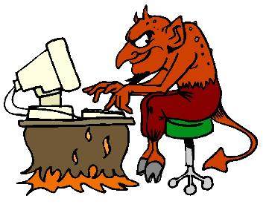
The righteous must be careful not to be consumed by anger! (Eph. 4:26)
Ps. 37:1: “Do not fret because of evildoers, nor be envious of the workers of iniquity”
We must not allow the sins of evil people to turn us into raving fools! (Eccl. 7:9; James 1:19-20)
The righteous are disgusted by the sins of the wicked as well as by those who condone and comfort sinners (Amos 5:15; Rom. 1:32; 12:9)
The righteous give place to the wrath of God; they are not drawn into sin by the sins of others (Rom. 12:17-19)

Slide 12
What Can The Righteous Do? Be Prepared!
The righteous must continue to keep their faith in God
The righteous must continue to pray
The righteous must remain above reproach
The righteous must be careful not to be consumed by anger
The righteous must overcome evil with good
Romans 12:21
21. Do not be overcome by evil, but overcome evil with good.

Slide 13
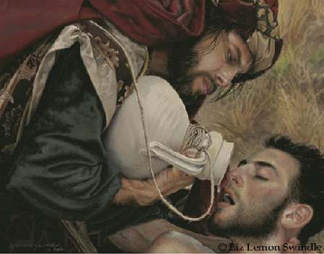
The righteous must overcome evil with good (Rom. 12:21)
Patiently enduring unjust suffering “finds favor with God!” (I Pet. 2:20)
God's “favor” is given to those who follow the example of Jesus when He suffered for us (I Pet. 2:21-22)
Jesus’ parable of The Good Samaritan (Luke 10:25-37) teaches us to overcome unjust treatment, bias & prejudice by being a neighbor & loving our neighbors like ourselves (Mark 12:30-31)

Slide 14
What Can The Righteous Do? Be Prepared!
The righteous must continue to keep their faith in God
The righteous must continue to pray
The righteous must remain above reproach
The righteous must be careful not to be consumed by anger
The righteous must overcome evil with good
The righteous must remember they are living for heaven
Philippians 3:20
20. For our citizenship is in heaven, from which also we eagerly wait for a Savior, the Lord Jesus Christ;

Slide 15
The righteous must remember they are living for heaven (Phil. 3:20)
This world is not our home; our citizenship is in heaven (I Pet. 1:4; Phil. 3:20)
Remain virtuous in mind and conduct; “Keep your behavior excellent among the Gentiles...” (I Pet. 2:12)
Innocent before man and God (Acts 24:16)
Christians give up their moral credibility when they think and act like the world while trying to defend what is right! (I Pet. 3:16-17; 4:15-16; Phil. 2:14-16)

Slide 16
What Can The Righteous Do? Be Prepared!
The righteous must continue to keep their faith in God
The righteous must continue to pray
The righteous must remain above reproach
The righteous must be careful not to be consumed by anger
The righteous must overcome evil with good
The righteous must remember they are living for heaven
The righteous will exercise their rights & freedoms as citizens
I Peter 2:17
17. Honor all people, love the brotherhood, fear God, honor the king.

Slide 17
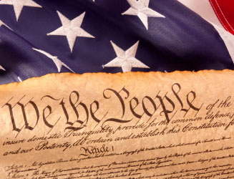
The righteous will exercise their rights & freedoms as citizens (I Peter 2:13-17)
It is right to do so (Acts 22:25-29; 25:11: Paul exercised his rights as a Roman)
But while doing so, Christians remember to “honor the king” even while disagreeing with the ruling authorities (I Pet. 2:13-17)
Were Caesars worthy of honor from saints?
No, but in that they were appointed by God, as are “the governing authorities” (Rom. 13:1), they are because saints are to be innocent from wrong-doing (I Pet. 4:15-16)
As U.S. citizens we exercise our right to vote and remove the ungodly from office

Slide 18
What Can The Righteous Do? Be Prepared!
The righteous must continue to keep their faith in God
The righteous must continue to pray
The righteous must remain above reproach
The righteous must be careful not to be consumed by anger
The righteous must overcome evil with good
The righteous must remember they are living for heaven
The righteous will exercise their rights & freedoms as citizens
The righteous will obey God rather than men
Acts 5:29
29. But Peter and the apostles answered, "We must obey God rather than men.

Slide 19
The righteous will obey God rather than men (Acts 5:29)
I Pet. 2:13: “submit…for the Lord's sake to every human institution”
But…“we ought to obey God rather than men” (Acts 5:29)
Just because the law of men legalizes a practice, saints do not have to accept it or teach it!
King Nebuchadnezzar of Babylon legalized idolatry (Daniel 3)
There are many things our government legalizes that saints cannot condone…
Divorce and Remarriage for any reason (Matthew 5:31-32; 19:3-9; Mark 10:6-12)
Drinking socially or to get drunk (Galatians 5:19-21; I Peter 4:3-5)
Same-sex marriage (Matthew 19:4-6; Mark 10:6-9; I Corinthians 6:9-10)

Slide 20
What Can The Righteous Do? Be Prepared!
The righteous must continue to keep their faith in God
The righteous must continue to pray
The righteous must remain above reproach
The righteous must be careful not to be consumed by anger
The righteous must overcome evil with good
The righteous must remember they are living for heaven
The righteous will exercise their rights & freedoms as citizens
The righteous will obey God rather than men
What can the righteous do in the face of evil?
Remain above reproach in the midst of a wicked and perverse generation, putting our faith and trust in God!

Slide 21
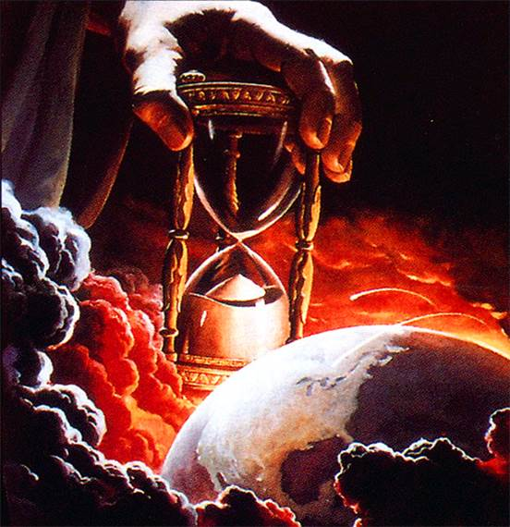
Conclusion
Noah showed that it can be done! That one can be righteous and walk with God even when the rest of the world is corrupt! (Genesis 6:8-9)
“What can the righteous do?” Be above reproach, trust in God, and teach the gospel and the consequences for sin
The statistics will resemble those of Noah’s day:
100% deliverance for those prepared to meet God, and 0% escape for the unprepared!
Are you ready for Christ’s return?

Slide 22
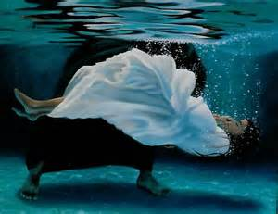
Conclusion
How does one get in Christ?
As Noah had to be in the ark to be saved (Gen. 7:1), people must be “in Christ” to be saved today! (Rom. 6:23; 8:1)
Let us not be so distracted with the cares of this world that we be like those “in the days of Noah” who were caught by destruction unaware!
One is immersed in water in Jesus’ name for the forgiveness of sin! (Gal. 3:26-27; Acts 2:38; 22:16) – One is baptized into Christ and into His church (I Cor. 12:13)
Just as water punished the wicked, it also saved Noah from the corrupting influence of wicked men (I Peter 3:20-21) – Water played a role in salvation then and still does today!

Slide 23
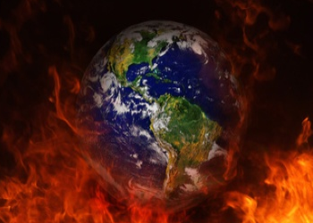
Conclusion
Are you prepared for Christ’s Return?

Slide 24
“What Must I Do To Be Saved?”
Hear The Gospel (Jn. 5:24; Rom. 10:17)
Believe In Christ (Jn. 3:16-18; Jn. 8:24)
Repent Of Sins (Lk. 13:3-5; Acts 2:38)
Confess Christ (Mt. 10:32; Rom. 10:10)
Be Baptized (Mk. 16:16; Acts 22:16)
Remain Faithful (Jn. 8:31; Rev. 2:10)
For The Erring Saint:
Repent (Acts 8:22), Confess (I Jn. 1:9),
Pray (Acts 8:22)

