Slide 1
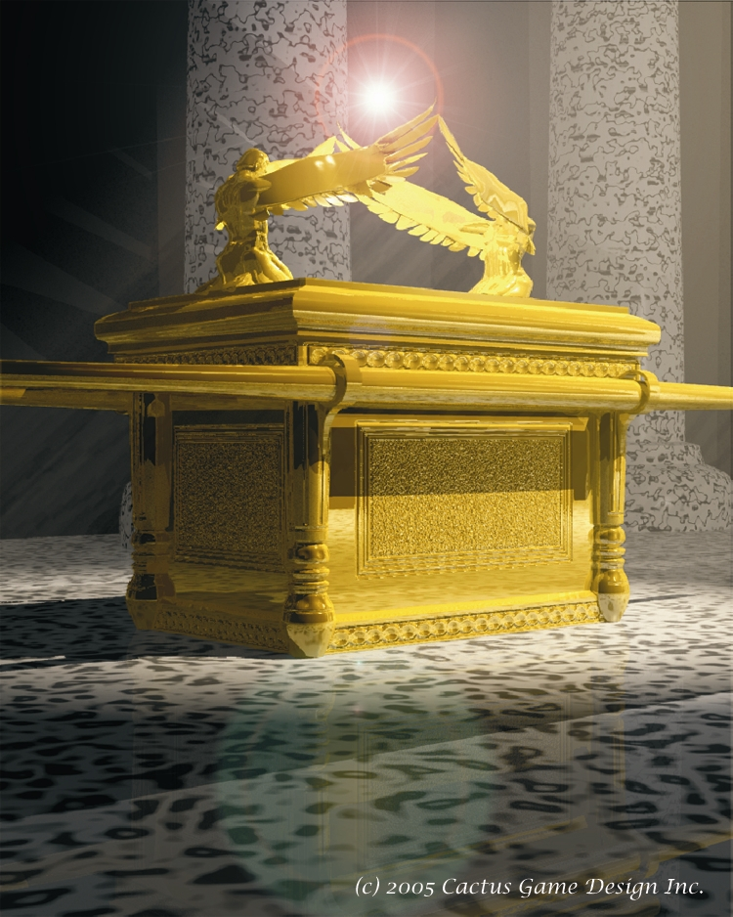
Obed-Edom: Legacy Of Service To God
Text:
II Samuel 6;
I Chronicles 13:13-14; 26:4-8
Notes:
By Nathan L Morrison
All Scripture given is from NASB unless otherwise stated
For further study, or if questions, please Call: 804-277-1983 or Visit www.courthousechurchofchrist.com
Adapted from a lesson by Timothy Ruffin

Slide 2
intro
The Ark of the Covenant was coming to Jerusalem!
What a day of rejoicing!
Ark taken by Philistines
Celebration & rejoicing turned to sadness & fear
(II Sam. 6:5-7)
Ark at the house of Abinadab
(I Sam. 5-7)
David came to take the ark to Jerusalem
(II Sam. 6:1-4; II Chr. 13:1-4)
David was angry because the Lord struck Uzzah
(II Sam. 6:8)
David wondered how he could bring the ark into the city (II Sam. 6:9)
David took it to the house of Obed-Edom the Gittite
(II Sam. 6:10)

Slide 3
And David was unwilling to move the ark of the LORD into the city of David with him; but David took it aside to the house of Obed-edom the Gittite.
Thus the ark of the LORD remained in the house of Obed-edom the Gittite three months, and the LORD blessed Obed-edom and all his household.
II Samuel 6:10-11

Slide 4
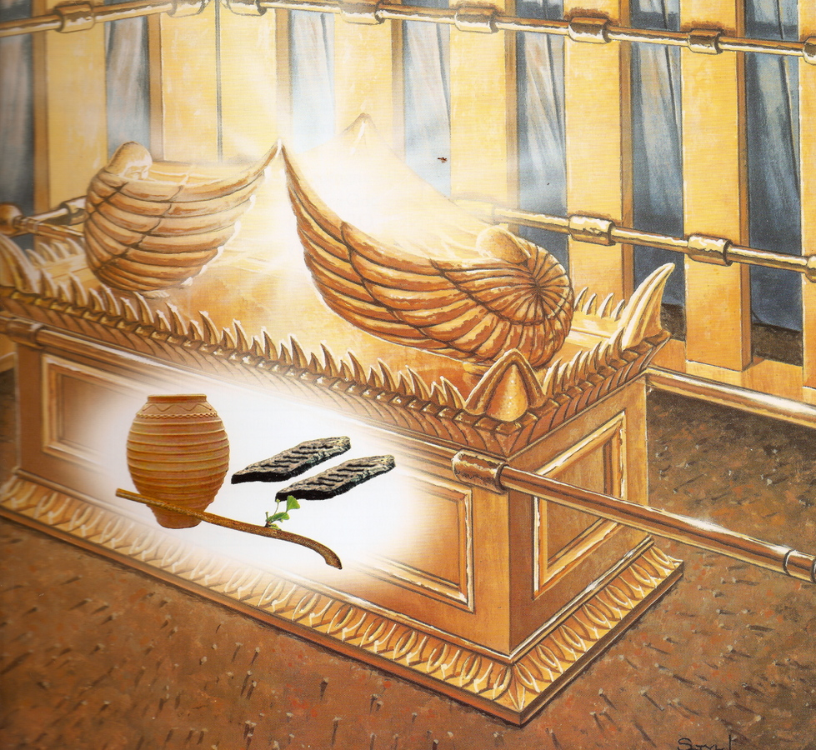
intro
Lev. 16:2; Num. 7:89
Heb. 9:4-5; Ex. 25:21-22
Obed-Edom held the ark in his home for 3 months and God blessed them! (II Sam. 6:11)

Slide 5
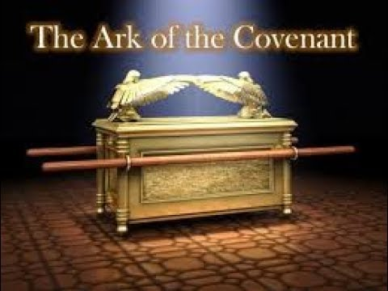
Fathers are to train their children in God’s word:
Obed-Edom Welcomed God Into His House
They walked with, they talked with, ate with, and communed with God for 3 months!
Old Covenant
Deut. 4:10; 6:7; 11:19
New Covenant
Eph. 6:4
Obed-Edom set the right example for his family in welcoming God in his house!
Obed-Edom: Legacy Of Service To God

Slide 6
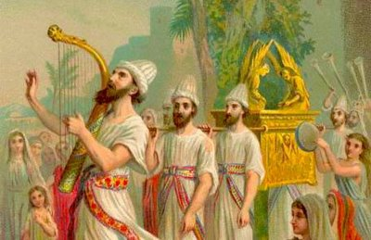
David decided to do it right (I Chr. 15:1-15): Levites carry it!
Obed-Edom Willingly Rejoiced in the Lord
David determined to bring the ark up to Jerusalem
(II Sam. 6:12-15)
David appointed Levite singers to go before the ark
Obed-Edom was a singer (I Chr. 15:16-18)
The appointed singers also played instruments
Obed-Edom played the lyre (I Chr. 15:19-21)
The ark was brought up to Jerusalem with shouting and rejoicing (I Chr. 15:25, 28)
Obed-Edom chosen of Levites to celebrate, thank and praise God
(I Chr. 16:4-5)
Obed-Edom was a man who readily rejoiced in the Lord!
Obed-Edom: Legacy Of Service To God

Slide 7
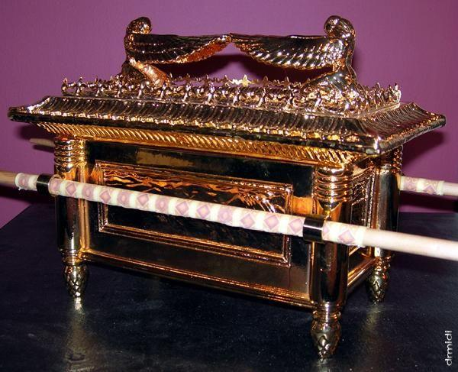
He was a blessed man (II Sam. 6:11) – Not just physically but spiritually!
Obed-Edom Guarded the Things of God
He was a gatekeeper of the ark of the covenant (I Chr. 15:24; 16:37-38)
God blessed him with 8 sons and 62 grandchildren (I Chr. 26:8) – Physical blessings!
His sons and their sons were mighty men of valor (I Chr. 26:6) and valiant men (I Chr. 26:7)
His sons and their descendants were able men to serve God with strength! (I Chr. 26:8) – Spiritual blessings!
Obed-Edom’s legacy was a family who loved the Lord & were qualified for His service!
Obed-Edom: Legacy Of Service To God

Slide 8
Fathers Like Obed-Edom Are Needed Today
Our country and the world we live in makes it hard to find good fathers
U.S.: there are more than 20 million homes without fathers
U.S.: 40-50% of marriages in the U.S. end in divorce! (Divorce numbers in recent years have declined – but so have marriages!)
U.S.: Less marriages are taking place and more than 40% of births in the U.S. are born out of wedlock! (“Non-marital childbearing”)
Notes:
Sources:
1.In our country there are more than 20 million homes without fathers! (There are probably more than that where the father may be present but is emotionally absent!) – About 1 in 4 children live in a home without a dad!
a. http://fathers.com/statistics-and-research/the-extent-of-fatherlessness/
b. https://www.fatherhood.org/fatherhood-data-statistics#:~:text=There%20is%20a%20father%20absence,a%20father%20in%20the%20home.
2.40-50% of marriages in the U.S. end in divorce! (Divorce numbers in recent years have declined – but so have marriages!)
a. https://www.census.gov/library/visualizations/interactive/marriage-divorce-rates-by-state.html
b. https://www.cdc.gov/nchs/fastats/marriage-divorce.htm#:~:text=Number%20of%20divorces%3A%20782%2C038%20(45,45%20reporting%20States%20and%20D.C.)
c. https://www.apa.org/topics/divorce/
3.Less marriages are taking place and more than 40% of births in the U.S. are born out of wedlock! (“Non-marital childbearing”)
a. https://www.census.gov/library/visualizations/interactive/marriage-divorce-rates-by-state.html
b. https://www.pbs.org/wgbh/third-rail/episodes/episode-7-is-marriage-dead/why-are-fewer-people-getting-married/#:~:text=Now%20only%20about%20two%20million,from%2070%20percent%20in%201967.
c. https://www.childtrends.org/publications/dramatic-increase-in-percentage-of-births-outside-marriage-among-whites-hispanics-and-women-with-higher-education-levels#:~:text=Among%20the%20most%20notable%20changes,(Child%20Trends%2C%202016)

Slide 9
Fathers Like Obed-Edom Are Needed Today
There is a need for fathers like Obed-Edom to train up their children to be “able for the service” of God!
(I Chr. 26:8)
It is getting harder and harder to find men willing to serve: preachers, teachers, elders and deacons!
We need men who are “able to serve”
We need fathers to teach their sons to want to welcome God in their homes, to rejoice in God, and guard the things of God!
We need fathers to train up their sons (and daughters) to want to serve God!

Slide 10
Fathers Like Obed-Edom Are Needed Today
We need men who become able fathers to rise up and raise able & godly children!
HOW?

Slide 11
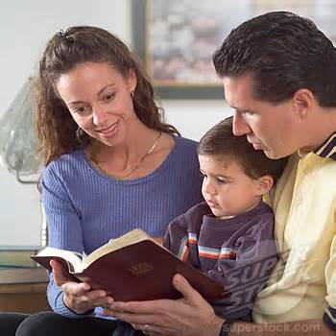
Fathers, be like Obed-Edom!
Fathers Like Obed-Edom Are Needed Today
Welcome God into your home
Prov. 1:7; 24:3-4; Mark 12:30-31
Rejoice in the Lord
Rom. 5:6-10; John 14:1-6
Guard the things of God
Psalms 127:3-5; I Cor. 15:33; I Tim. 6:20-21; Jude 3
Godly fathers must recognize the value in raising their children to love God, and know that they can’t raise their children the way the world raises its children!
Obed-Edom: Legacy Of Service To God

Slide 12
Conclusion
Fathers, welcome God in your homes, rejoice in the Lord, and guard the things of God!
With God in your home, you will raise up your children differently from the world, and they may rise up to be able (qualified) to serve God!
Let your family see your excitement to serve God and they too may rejoice in Him!

Slide 13
“What Must I Do To Be Saved?”
Hear The Gospel (Jn. 5:24; Rom. 10:17)
Believe In Christ (Jn. 3:16-18; Jn. 8:24)
Repent Of Sins (Lk. 13:3-5; Acts 2:38)
Confess Christ (Mt. 10:32; Rom. 10:10)
Be Baptized (Mk. 16:16; Acts 22:16)
Remain Faithful (Jn. 8:31; Rev. 2:10)
For The Erring Saint:
Repent (Acts 8:22), Confess (I Jn. 1:9),
Pray (Acts 8:22)

