Slide 1
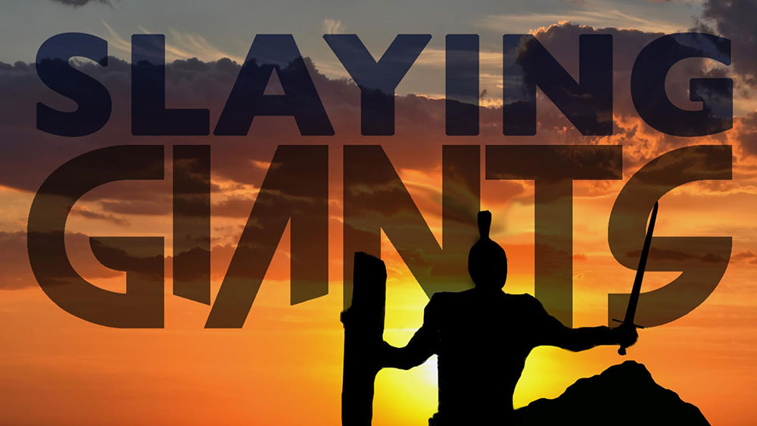
Climbing Mountains, Slaying Giants!
Text: Joshua 14:12
Notes:
By Nathan L Morrison
All Scripture given is from NASB unless otherwise stated
For further study, or if questions, please Call: 804-277-1983 or Visit www.courthousechurchofchrist.com

Slide 2
Intro
Saints are to be different, to stand out from the crowd, to be lights! (Mt. 5:14-16; Rom. 12:2; II Cor. 6:17;I Pet. 1:14-16: “Be holy as God is holy!”)
Matthew 5:16
16. "Let your light shine before men in such a way that they may see your good works, and glorify your Father who is in heaven.
Romans 8:29-30
29. For those whom He foreknew, He also predestined to become conformed to the image of His Son, so that He would be the firstborn among many brethren;
30. and these whom He predestined, He also called; and these whom He called, He also justified; and these whom He justified, He also glorified.

Slide 3
Intro
Shammua
Shaphat
Igal
Palti
Gaddiel
Gaddi
Ammiel
Sethur
Nahbi
Geuel
Do you remember these names?

Slide 4
Intro
Shammua
Shaphat
Igal
Palti
Gaddiel
Gaddi
Ammiel
Sethur
Nahbi
Geuel
What about now?
JOSHUA
Ten spies: gave a bad report
Two spies: gave a good report
CALEB

Slide 5
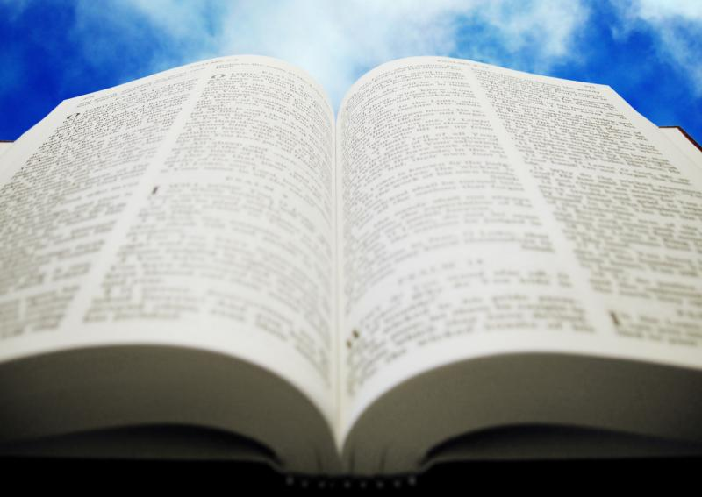
intro
Caleb
Only he and Joshua survived the wilderness (Num.
14:30, 38)
Spy from Tribe of Judah (Num. 13:6)
Brought back a faithful report – Num. 13:30: “We will overcome!”
He asks for the hardest task: The mountain with the giants!
Dare to be like Caleb!
Took action in the conquest at 85 years old!
Joshua 14:12 (NKJV)
12. Now therefore, give me this mountain of which the LORD spoke in that day; for you heard in that day how the Anakim were there, and that the cities were great and fortified. It may be that the LORD will be with me, and I shall be able to drive them out as the LORD said."

Slide 6
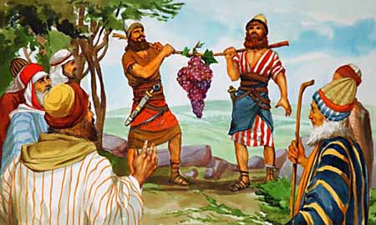
Caleb Had a “Different Spirit”
Numbers 14:24
24. "But My servant Caleb, because he has had a different spirit and has followed Me fully, I will bring into the land which he entered, and his descendants shall take possession of it.”
Dare to be like Caleb and trust in God, having a
“Can Do” attitude!
Note the contrast of spirits:
Caleb: Positive and was willing to act on his faith (Num. 13:27-30)
The Ten: Negative and acted on fear and unbelief (Num. 13:32-33)
Caleb: Saw all that they saw and said, “We are able” (Num. 13:30)
The Ten: Gripped by doubt and fear, “We are not able” (Num. 13:31)
Caleb: Willing to work to gain the victory (Num. 14:6-9)
The Ten: Wanted the reward without the labor (Num. 14:2-40)

Slide 7
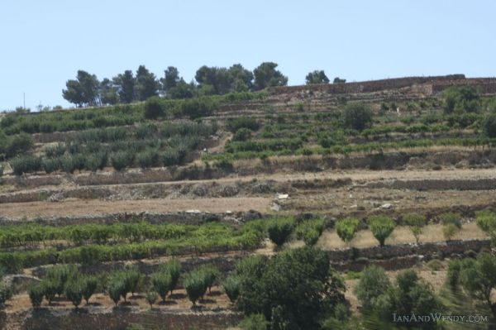
Taking On the Giants
Joshua 14:12
12. "Now then, give me this hill country about which the LORD spoke on that day, for you heard on that day that Anakim were there, with great fortified cities; perhaps the LORD will be with me, and I will drive them out as the LORD has spoken."
David slew a few giants! – II Sam. 17; 21:16-22: Goliath by David, and Goliath’s 4 sons felled by David and his men!
Caleb asked for the “hill country” (NKJ: “mountain”) where the giants dwelt:
Hebron was 3,040 ft above sea level (highest town in Palestine)
Formerly Kiriath-arba, (Arba, greatest of the Anakim) – Josh. 14:15
Hebron named after Arba’s son Anak (giants) – Josh. 15:13
Notes:
Image: Hebron today

Slide 8
Taking On the Giants
Caleb took on the fortified cities of the giants:
Notes:
Image: Hebron today

Slide 9
Joshua 14:6-11
6. Then the sons of Judah drew near to Joshua in Gilgal, and Caleb the son of Jephunneh the Kenizzite said to him, "You know the word which the LORD spoke to Moses the man of God concerning you and me in Kadesh-barnea.
7. "I was forty years old when Moses the servant of the LORD sent me from Kadesh-barnea to spy out the land, and I brought word back to him as it was in my heart.
8. "Nevertheless my brethren who went up with me made the heart of the people melt with fear; but I followed the LORD my God fully.
9. "So Moses swore on that day, saying, 'Surely the land on which your foot has trodden will be an inheritance to you and to your children forever, because you have followed the LORD my God fully.'
10. "Now behold, the LORD has let me live, just as He spoke, these forty- five years, from the time that the LORD spoke this word to Moses, when Israel walked in the wilderness; and now behold, I am eighty-five years old today.
11. "I am still as strong today as I was in the day Moses sent me; as my strength was then, so my strength is now, for war and for going out and coming in.

Slide 10
Taking On the Giants
Joshua 14:12
12. "Now then, give me this hill country about which the LORD spoke on that day, for you heard on that day that Anakim were there, with great fortified cities; perhaps the LORD will be with me, and I will drive them out as the LORD has spoken."
Caleb took on the fortified cities of the giants:
Had waited 45 years to go mountain climbing to take on the giants (Joshua 14:10) that made others feel like “grasshoppers” (Num. 13:33).
They were on his land, and he would drive them out by the strength of God! (Joshua 14:12)
Notes:
Image: Hebron today

Slide 11
Taking On the Giants
Caleb took on the fortified cities of the giants:
He still saw things through the eyes of faith and not as they appeared outwardly – lesson for us! (II Cor. 5:7: “We walk by faith, not by sight”)
He was eighty-five years old and he could have said, “I am ready to retire – give me an easy place.”
But Caleb chose the difficult task – He climbed a mountain and killed giants (Joshua 15:13-14), the very thing that was the stumbling block of the ten that drove the multitude to sin against God! (Numbers 13-14)
Dare to be like Caleb and have faith and trust in God to take on your giants and defeat them!
Notes:
Image: Hebron today

Slide 12
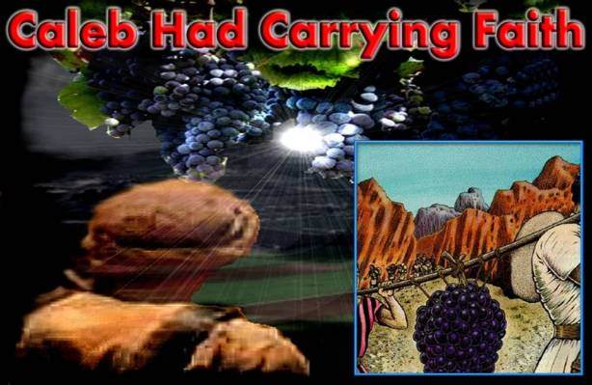
Caleb’s Reward: The Mountain Promised By God
Reward not apparent at first:
Stood with the minority (He and Joshua stood against majority) – Num. 13-14
The multitude was ready to stone him and Joshua – Num. 14:10
He had to wander in the wilderness with the guilty (Num. 14:28-35
He saw the land and had carried back evidences of God’s goodness, and waited to enter the land and possess it
Notes:
Image: Hebron today

Slide 13
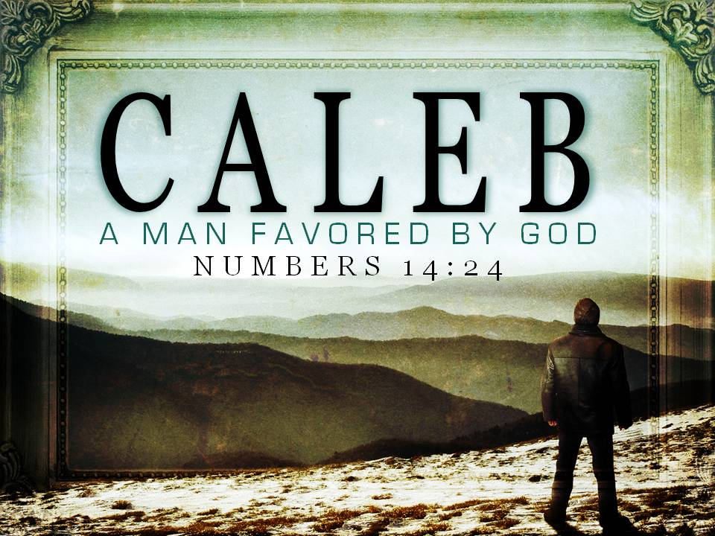
Caleb’s Reward: The Mountain Promised By God
Numbers 14:24
14. "But My servant Caleb, because he has had a different spirit and has followed Me fully, I will bring into the land which he entered, and his descendants shall take possession of it.”
Joshua 14:14
14. Therefore, Hebron became the inheritance of Caleb the son of Jephunneh the Kenizzite until this day, because he followed the LORD God of Israel fully.
Had approval of God and his own conscience:
Num. 14:24; Josh. 14:12-14: “My servant Caleb;” “he wholly followed the LORD God of Israel.”
Notes:
Image: Hebron today

Slide 14
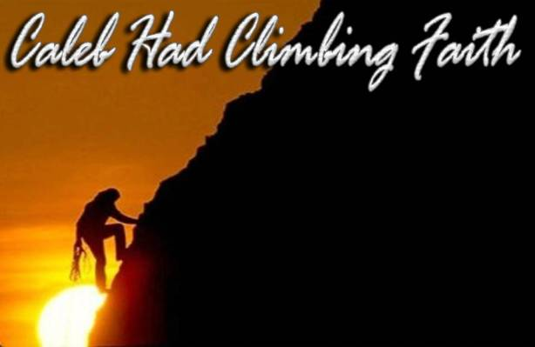
Caleb’s Reward: The Mountain Promised By God
The difference in him and the others during the forty years:
The People: wandered waiting to die
Today: II Thess. 1:7-9: Those disobedient to God wander life to their “deaths.”
Caleb: wandered to enter the Promised Land and live
Today: Rom. 8:18: We wander with the guilty awaiting life! (I Pet. 1:3-4)
Caleb: His faithfulness was never forgotten –recorded for all time and eternity
Today: God remembers & records the names of the faithful into the Lamb’s Book of Life (Rev. 20:11-15; 21:25-27)

Slide 15
Caleb’s Reward: The Mountain Promised By God
Joshua 14:14
14. Therefore, Hebron became the inheritance of Caleb the son of Jephunneh the Kenizzite until this day, because he followed the LORD God of Israel fully.
He gained the victory! – Caleb had Conquering Faith!
Josh. 14:12, 15; 15:14: Drives out the sons of Anak.
Josh. 14:14; 15:13: Takes Hebron and its lands (“The hill country, mountain”)
Notes:
Image: Hebron today

Slide 16
Joshua 21:11-12 (8-10: Levites)
11. Thus they gave them Kiriath-arba, Arba being the father of Anak (that is, Hebron), in the hill country of Judah, with its surrounding pasture lands.
12. But the fields of the city and its villages they gave to Caleb the son of Jephunneh as his possession.

Slide 17
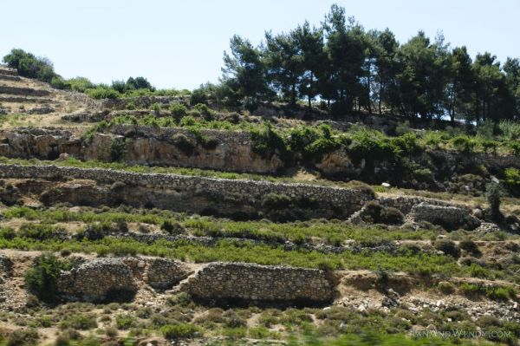
Caleb’s Reward: The Mountain Promised By God
Joshua 14:14
14. Therefore, Hebron became the inheritance of Caleb the son of Jephunneh the Kenizzite until this day, because he followed the LORD God of Israel fully.
He gained the victory! – Caleb had Conquering Faith!
Josh. 14:12, 15; 15:14: Drives out the sons of Anak.
Josh. 14:14; 15:13: Takes Hebron and its lands (“The hill country, mountain”)
Josh. 21:11-12: Settles down to his reward, sharing with the Levites (21:8-10)
Dare to be like Caleb in overcoming adversity, be faithful to the end, and be rewarded!
Notes:
Image: Hebron today

Slide 18
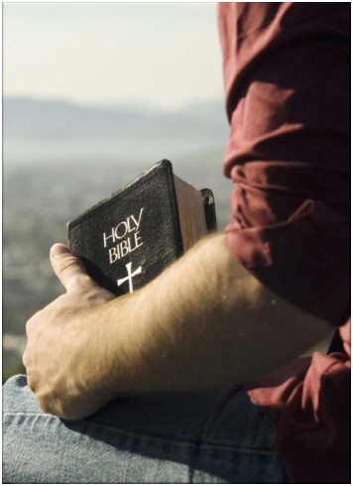
Conclusion
We see in Caleb the spirit we are to possess:
Overcome the trials of life! (Js. 1:2-4; Rev. 21:7)
The reward may not be apparent – Caleb had to suffer with the wicked for 40 years! (Num. 14:28-35)
Be faithful to the end! (II Tim. 4:6-8; Rev. 2:10) – Don’t give up!
Caleb never gave up and never lost faith in God! (Josh. 14:12-14)
Receive the reward from God! (Js. 1:12; Rev. 2:10; cf. Mt. 25:34, 46)
Caleb overcame and enjoyed the rewards of his God! (Josh. 14:14; 15:13)

Slide 19
Conclusion
Dare to be like Caleb in realizing God is bigger than any “giants” we face:
We live in a world that is oft scary at times, opposed to God, and is alluring with all manner of temptations, all to draw away our faith from God!
Fears, worry, anxiety, and panic are traits of the world – Give yours to God – I Peter 5:7
We all have giants in our lives —fear, self-doubt, loneliness, temptation, jealousy…God can handle them all and give us peace
We need the faith of Caleb to not let anything take us away from the reward God has promised!

Slide 20
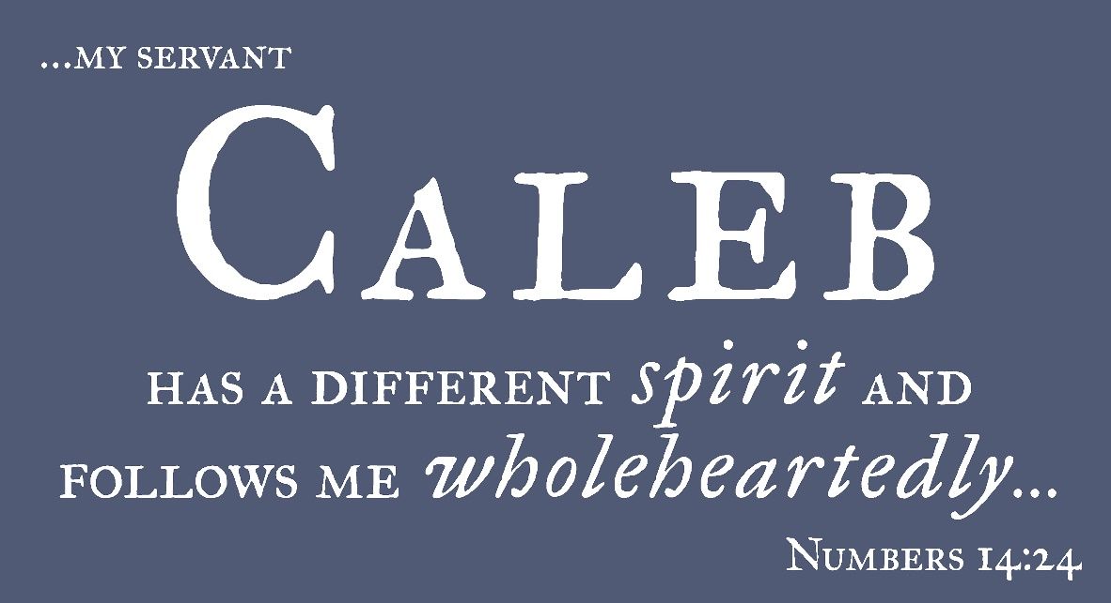
Conclusion
What spirit do you possess?
(Caleb possessed a “different spirit”)
You must possess another spirit than the world!
(Rom. 12:1-2; I Pet. 1:14-16)
Dare to be like Caleb and stand out from the crowd! (Will you overcome & be faithful till death?)

Slide 21
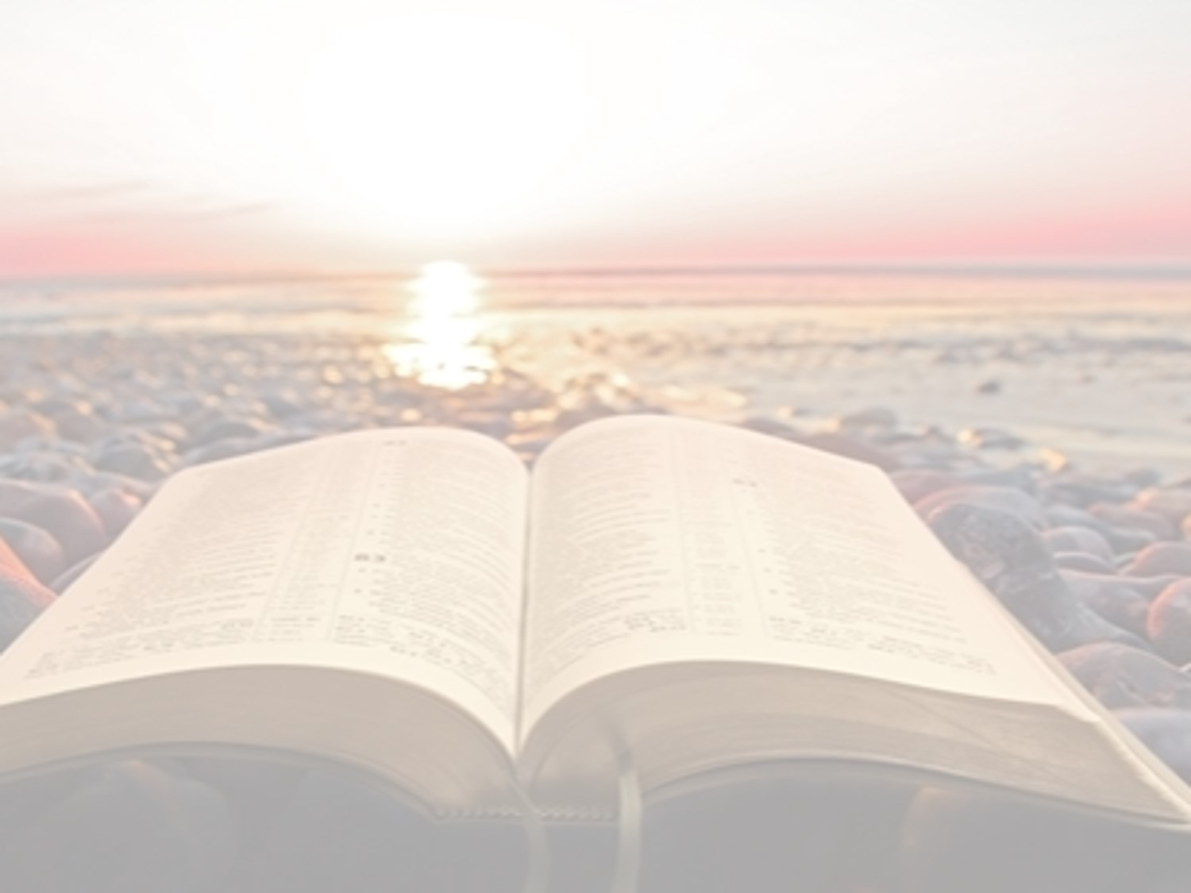
“What Must I Do To Be Saved?”
Hear The Gospel (Jn. 5:24; Rom. 10:17)
Believe In Christ (Jn. 3:16-18; Jn. 8:24)
Repent Of Sins (Lk. 13:3-5; Acts 2:38)
Confess Christ (Mt. 10:32; Rom. 10:10)
Be Baptized (Mk. 16:16; Acts 22:16)
Remain Faithful (Jn. 8:31; Rev. 2:10)
For The Erring Saint:
Repent (Acts 8:22), Confess (I Jn. 1:9),
Pray (Acts 8:22)

