Slide 1
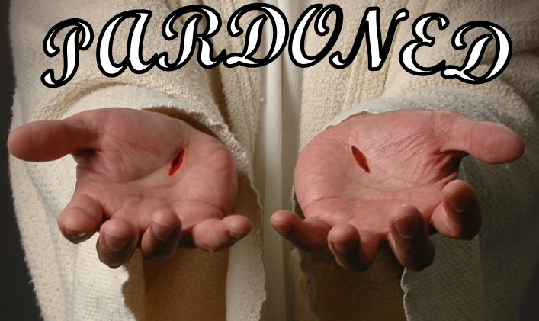
Amazing Grace!
Text: Ephesians 2:1-12
Notes:
By Nathan L Morrison
All Scripture given is from NASB unless otherwise stated
For further study, or if questions, please Call: 804-277-1983 or Visit www.courthousechurchofchrist.com
“Amazing Grace” by John Newton

Slide 2
Intro
Ephesians. 2:1-12 (vss. 1-7)
And you were dead in your trespasses and sins,
in which you formerly walked according to the course of this world, according to the prince of the power of the air, of the spirit that is now working in the sons of disobedience.
Among them we too all formerly lived in the lusts of our flesh, indulging the desires of the flesh and of the mind, and were by nature children of wrath, even as the rest.
But God, being rich in mercy, because of His great love with which He loved us,
even when we were dead in our transgressions, made us alive together with Christ (by grace you have been saved),
and raised us up with Him, and seated us with Him in the heavenly places in Christ Jesus,
so that in the ages to come He might show the surpassing riches of His grace in kindness toward us in Christ Jesus.

Slide 3
Intro
Ephesians. 2:1-13 (vss. 8-13)
For by grace you have been saved through faith; and that not of yourselves, it is the gift of God;
not as a result of works, so that no one may boast.
For we are His workmanship, created in Christ Jesus for good works, which God prepared beforehand so that we would walk in them.
Therefore remember that formerly you, the Gentiles in the flesh, who are called "Uncircumcision" by the so-called "Circumcision," which is performed in the flesh by human hands—
remember that you were at that time separate from Christ, excluded from the commonwealth of Israel, and strangers to the covenants of promise, having no hope and without God in the world.
But now in Christ Jesus you who formerly were far off have been brought near by the blood of Christ.

Slide 4
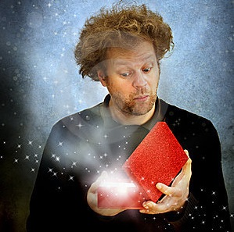
Intro
“Saved by grace” (Ephesians 2:4-5, 8)
“Grace” = charis [khar'-ece ] (G5485): unmerited favor; grace (ious), benefit, gift, joy of liberality, pleasure, thank(-s, -worthy).
Favor (Luke 1:30); Credit (Luke 6:32-34); Concession (Acts 25:3: NKJ: Favor); Thanks (Romans 6:17); Blessing (II Corinthians 1:15: NKJ: Benefit); Gracious (II Cor. 8:6-7)
It means it is favor granted to someone who does not deserve it.
God’s favor to man is shown in the death of Christ and His word
Heb. 2:9: Christ, by God’s grace (G5485), died for all.
God didn’t have to!
Acts 20:32: The word of God is the “word of His grace (G5485).”
God didn’t have to!

Slide 5
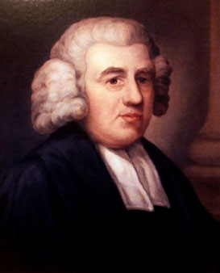
Intro
John Newton (1725-1807):
“Amazing Grace” (1779)
A British sailor and slave trader, and later a gospel preacher.
He became a slave trader, and was even enslaved for a period of time himself.
On 03/10/1748 (a date he never forgot) his ship was nearly wrecked, and he cried out to God for help. When the storm quieted, he found a Bible and when landed, he converted.
He gave up profanity, gambling, and drinking.
Though converted he remained a slave trader till his retirement in 1754.
He authored “Amazing Grace” in 1779 as his spiritual autobiography.
In 1788, 34 years after retiring he aided the abolition of the slave trade in the U.K. He said later that he didn’t feel truly converted till he did so!
“Amazing Grace” was given an American “Plantation” tune in 1835.
Grace was necessary for salvation because man
is separated from God by sin!
Notes:
Image: John Newton
Sources:
http://homeschoolblogger.com/hymnstudies/497836/
http://en.wikipedia.org/wiki/John_Newton
Then Sings My Soul Book I, p. 79 by Robert J. Morgan

Slide 6
Reason for Grace
Sinners are
“Dead” People
In order for there to be salvation, there must be something to be saved from!
Eph. 2:1-12; 4:18
Eph. 2:2-3: Sinners are “in the world.”
Eph. 2:3: Sinners are “children of wrath.”
Eph. 2:11-12: Sinners are “without God and without hope in the world.”
Rom. 5:8-9
8. But God demonstrates His own love toward us, in that while we were yet sinners, Christ died for us.
9. Much more then, having now been justified by His blood, we shall be saved from the wrath of God through Him.
Rom. 5:8-9: Christ died so man may be saved from the wrath of God!
Eph. 2:8-9: By God’s grace we are saved through faith.
Acts 15:11: Salvation is by God’s grace
Man needed a Savior because sin separated man from God, & man was lost!

Slide 7
Method of Grace
Grace in Christ
Man could not be saved by the Law of Moses!
Jesus’ Sacrifice
Eph. 2:5: That means His death (sacrifice) accomplished grace.
Heb. 2:9: A price had to be paid for sin. He tasted death for everyone.
Rom. 5:6-10: Man was incapable of saving himself. Man was “helpless.”
Galatians 2:20-21
"I have been crucified with Christ; and it is no longer I who live, but Christ lives in me; and the life which I now live in the flesh I live by faith in the Son of God, who loved me and gave Himself up for me.
"I do not nullify the grace of God, for if righteousness comes through the Law, then Christ died needlessly."
Heb. 10:1-4: The Law of Moses involved the blood of animals.
Heb. 10:10-14: The new covenant involves the blood of the Son of God (Vs. 29). One sacrifice for all time (Heb. 9:28; 10:12)
While man was helpless God’s grace provided a means for salvation!

Slide 8
“Saved by Grace”
Saved by Grace
Speaking of the Gentiles’ conversion – Acts 15:7
Acts 15:11: Speaker?
Peter – Acts 15:7
Mt. 10:2: A man personally associated with Jesus.
Mt. 16:16-17: One to whom the identity of Jesus had been revealed.
Mt. 16:19: The one promised the “keys of the kingdom.”
Acts 2:1-4: One of the ones baptized in the Holy Spirit.
Acts 3:9: One who could heal the sick and raise the dead.
Acts 15:11
11. "But we believe that we are saved through the grace of the Lord Jesus, in the same way as they also are."
Acts 15:11: The proof of Peter’s salvation was his faith!
“But we believe”

Slide 9
“Saved by Grace”
Saved by Grace
Grace is the gift of God that brings about salvation for mankind
Eph. 2:8-9; Heb. 2:9
I John 2:25: God has promised eternal life.
II Peter 1:5-11: God has made salvation possible.
II Peter 1:10-11: “The entrance into the eternal kingdom of our Lord and Savior Jesus Christ” (I Pet. 1:4-5:Heaven)
Romans 5:15
15. But the free gift is not like the transgression. For if by the transgression of the one the many died, much more did the grace of God and the gift by the grace of the one Man, Jesus Christ, abound to the many.
Rom. 3:24; 5:15; Eph. 4:7: God sent His Son to die for the sins of the world as a free gift unto salvation!
Not a license to continue in sin (Rom. 6:1-2)
Heaven is to be revealed as the ultimate expression of God’s grace:
An eternal rest!

Slide 10
Conclusion
Is salvation by grace conditional or unconditional?
Grace: NOT Unconditional
Col. 1:21-23: “If indeed you continue in the faith…”
Titus 2:11-12: Grace instructs us to deny ungodliness and worldliness…
Titus 2:11-12
11. For the grace of God has appeared, bringing salvation to all men,
12. instructing us to deny ungodliness and worldly desires and to live sensibly, righteously and godly in the present age,
I Cor. 10:12: If unconditional, why Paul’s admonition to the Corinthians? “Take heed” that one does not fall.
James 2:14-26: If unconditional, why is “faith without works dead?”

Slide 11
Conclusion
Is salvation by grace conditional or unconditional?
Grace: Conditional
Heb. 5:9: Jesus is the “source of eternal salvation” to those who obey Him! (Titus 2:12: …live sensibly, righteously, and godly!)
Heb. 5:9
9. And having been made perfect, He became to all those who obey Him the source of eternal salvation,
Like Naaman’s cure for leprosy (II Kings 5; Luke 4:27) mankind is given the cure for sin, but we must accept the terms! (Heb. 5:9: We must obey Him)
Acts 2:38; 22:16: The cure for sin is given in Christ but we must choose to accept it as did the Jews on Pentecost and Saul of Tarsus!
He asks that we trust Him enough to obey the gospel as He has said (Matthew 28:18-20; Mark 16:16; Acts 2:38; 22:16) – to repent of sins and be baptized for the forgiveness of sins in the name of the Father, Son, and Holy Spirit.
He asks that we give our lives to the One who gave His for us (Titus 2:14).

Slide 12
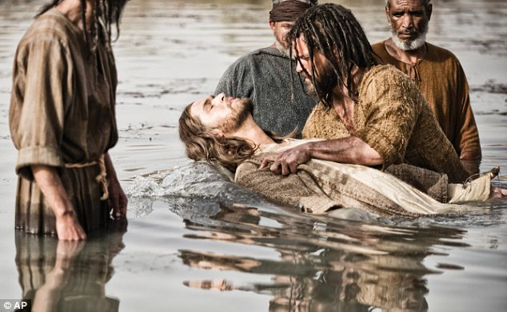
Conclusion
Grace, the gift of God, is reached by those who are obedient! (Heb. 5:9)
Mark 16:16: Must obey the words of Jesus to be saved! (Acts 20:32: “Word of His grace;” Gal. 1:6: “Called you by the grace of Christ.”)
God, by His grace, gave to man the means to be saved! (Rom. 6:3-4: Through obedience to the gospel in baptism we share in the death, burial, and resurrection of Jesus!)
OBEDIENCE
GRACE

Slide 13
Conclusion
Those obedient to God’s word truly receive “Amazing Grace!” (“How sweet the sound!”) – Pardon (forgiveness) from their sins in the blood of Jesus! (Ephesians 1:7)

Slide 14
“What Must I Do To Be Saved?”
Hear The Gospel (Jn. 5:24; Rom. 10:17)
Believe In Christ (Jn. 3:16-18; Jn. 8:24)
Repent Of Sins (Lk. 13:3-5; Acts 2:38)
Confess Christ (Mt. 10:32; Rom. 10:10)
Be Baptized (Mk. 16:16; Acts 22:16)
Remain Faithful (Jn. 8:31; Rev. 2:10)
For The Erring Saint:
Repent (Acts 8:22), Confess (I Jn. 1:9),
Pray (Acts 8:22)

