Slide 1
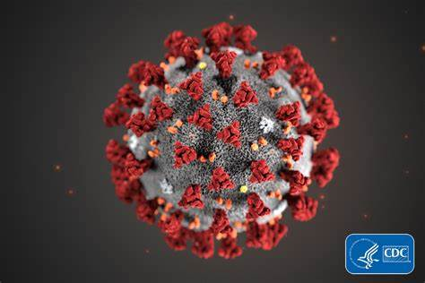
The Present Distress
Text: I Corinthians 7:26
Notes:
By Nathan L Morrison
All Scripture given is from NASB unless otherwise stated
For further study, or if questions, please Call: 804-277-1983 or Visit www.courthousechurchofchrist.com

Slide 2
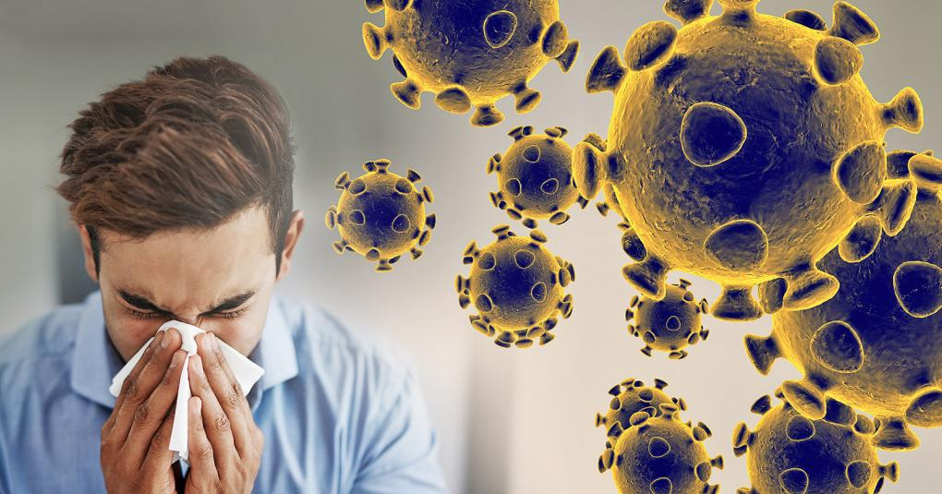
Intro
We live in unsettling times, in pandemic times due to health concerns over COVID-19
The news is affecting people around us, in our communities, neighborhoods, state, country and the countries around the world
Recommended: No groups over 10 people!

Slide 3
Intro
Perhaps, none of us have had to deal with a pandemic like this in our lifetimes
Think of the worst you have seen!
We have lived through other flu seasons, but nothing like this in recent memory, an aggressive respiratory infection that does kill!

Slide 4
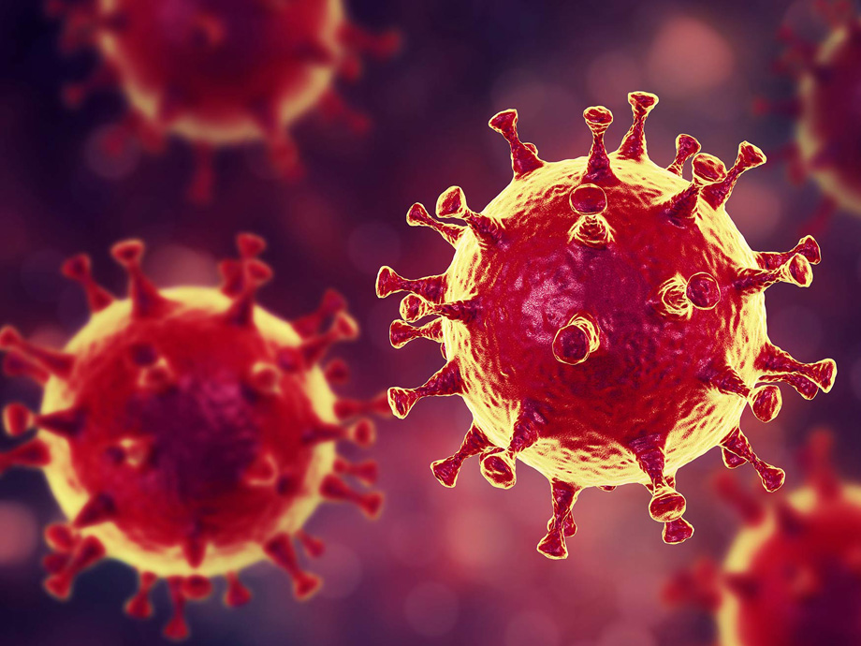
Intro
I Peter 5:8-9
8 Be of sober spirit, be on the alert. Your adversary, the devil, prowls around like a roaring lion, seeking someone to devour.
9 But resist him, firm in your faith, knowing that the same experiences of suffering are being accomplished by your brethren who are in the world.

Slide 5
Intro
It may be comforting to look back and see that Christians in times past have faced similar trials!

Slide 6
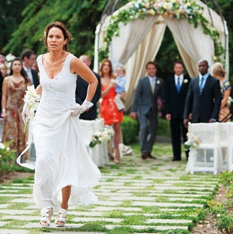
The Present Distress of I Corinthians 7
I Corinthians 7:26
A “Present Distress”
Whatever it was, Paul advised them to alter their normal habits and not to marry! (7:27)
A present distress requires that judgments be made based upon that particular crisis!
Paul was not against marriage – I Corinthians 7:1-4, 9
Paul was not teaching God forbids marriage – I Timothy 4:1-5
We need to adjust to our “present distress” and change some habits!
Notes:
Some following points by Doy Moyer
I. The Present Distress of I Corinthians 7
A. The Christians in the 1st c. were facing a “present distress.” (Some following points by Doy Moyer)
1. I Corinthians 7:26:
a. “I think then that this is good in view of the present distress, that it is good for a man to remain as he is.”
B. We don’t know exactly what this crisis was. It could have been some kind of tribulation, persecution, or perhaps a famine or something else. Whatever it was, Paul advised that it would be better under those circumstances not to marry (Alter their normal habits!).
1. There certainly can be distresses in time that can cause us temporarily to alter our normal habits. (We are in such a time now!)
2. I Corinthians 7:27: “Are you bound to a wife? Do not seek to be released. Are you released from a wife? Do not seek a wife.”
3. Paul advised against marriage because of a present distress (v. 26), but said it was his judgment and there was no sin involved if someone married anyway.
4. Paul was not against marriage – I Corinthians 7:1-4, 9: He taught men and women ought to be married if they can’t have self-control.
5. Paul was not teaching God forbids marriage – I Timothy 4:1-5: Men who forbid marriage are a sign of false teaching.
6. Imagine some in Corinth accusing Paul of false teaching on marriage!
7. Imagine Paul being charged with trying to change God’s will or calling into question his faith over this!
C. A present distress requires that judgments be made based upon that particular crisis.
1. Here, Paul was advising that under the “present distress” normal activities be put on hold!
D. Application:
1. For us, judgments are being made about how much and how often our contact should be.
2. Godly people are trying to navigate their way through a storm for which they have little to no precedent.
3. This is temporary. It will pass.
4. Even if you personally don’t think this is a bid deal, others do, and we need to help alleviate fear and stress by showing compassion!
5. People are canceling their weddings, even now under this “present distress!”
E. We need to adjust to our “present distress” and the new normal that causes us to change some habits!

Slide 7
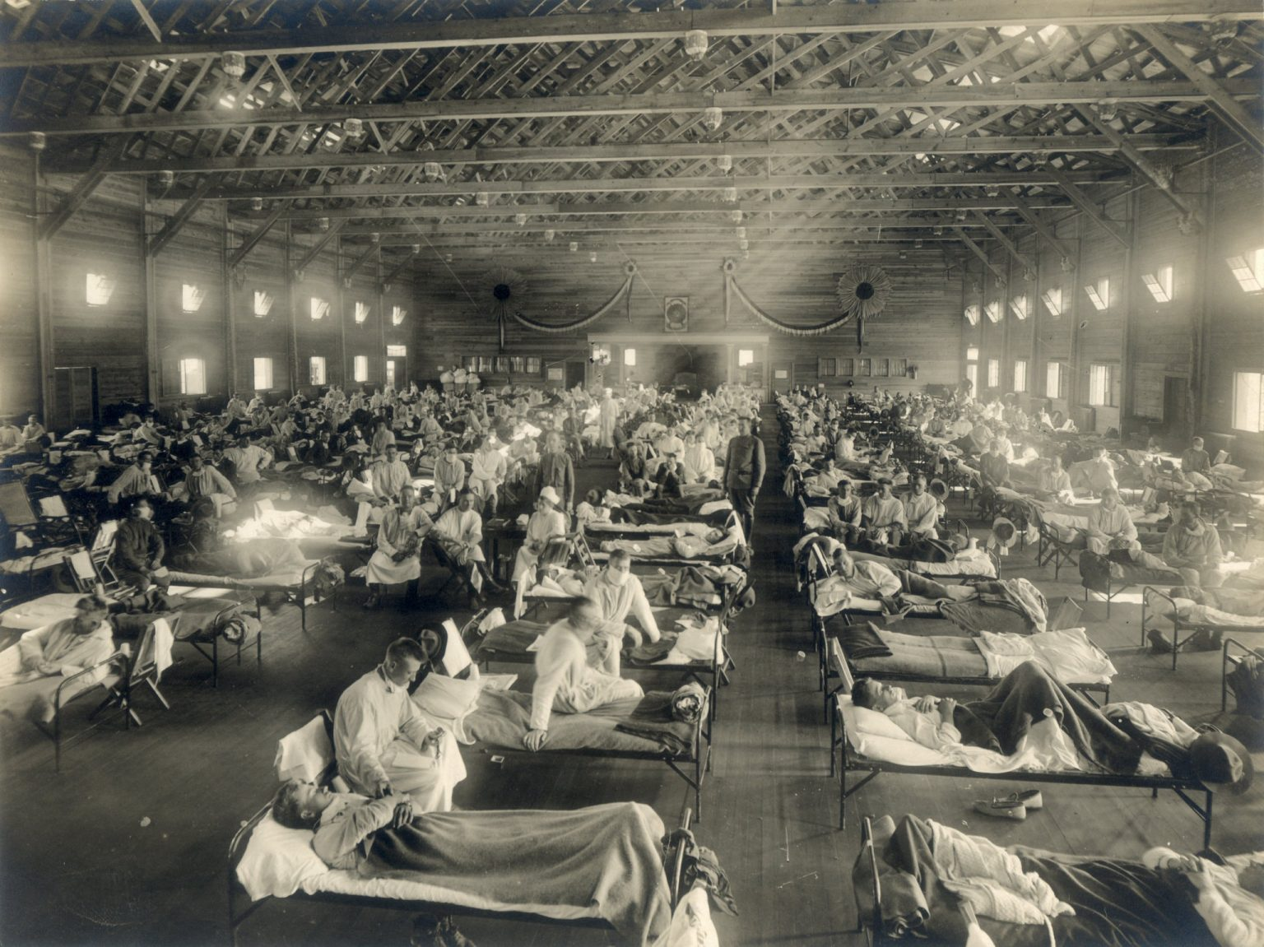
The Spanish Flu of 1918
Spanish Flu, 1918
A “Present Distress”
As the influenza spread, the government recommended the cancellation of Sunday assemblies
These restrictions and reactions sound as if they were being made today in our “present distress!”
Some Christians experienced this as government interference – Acts 5:29
Other Christians felt they could obey both God and the government – I Timothy 2:1-2
Christians in times past had to also make hard decisions, to alter normal habits!
Notes:
From an article by John Mark Hicks
https://christianchronicle.org/how-churches-of-christ-responded-when-the-1918-spanish-flu-killed-millions/?fbclid=IwAR1RjI02p9LxRxUKTIKS9XgaHZBhDWFceVEJ-X1AaBm1PbTEu1WHUOCCatw
Image: Camp Funston at Fort Riley, Kan., in 1918 | Photo via Wikimedia Commons
II. The Spanish Flu of 1918
A. As Christians we don’t want to shut our doors but to continue meeting as we feel is right.
B. One of the last times a pandemic hit like this and affected churches meeting together was during the Spanish Flu Pandemic of 1918, over 100 years ago!
C. How did Christians react to their “present distress” then?
1. From an article by John Mark Hicks: https://christianchronicle.org/how-churches-of-christ-responded-when-the-1918-spanish-flu-killed- millions/?fbclid=IwAR1RjI02p9LxRxUKTIKS9XgaHZBhDWFceVEJ-X1AaBm1PbTEu1WHUOCCatw
2. Many congregations canceled services, and some Christians focused on feeding and nursing the poor, with many church buildings turned into hospitals!
3. However, even then there were those who called into question the faith of those who chose to stay home.
4. We can learn a lot from the “present distress” of the past and how others handled it!
D. The Spanish Flu of 1918
1. The influenza would kill almost 700,000 in the United States and 50 million globally. It was the worst pandemic in modern history.
2. As the flu spread across the U.S. in the late fall and early winter of 1918, theaters, schools, businesses and churches closed their doors for weeks.
3. The Tennessee Health Department advised churches to suspend their Sunday meetings for Oct. 20 and 27. No one protested, and 92 churches complied.
4. As the influenza spread, the government recommended the cancellation of Sunday assemblies. Churches were urged, “to observe strictly all the regulations urged by our State Boards of Health and cooperate in every way.”
5. Some died caring for others: The Gospel Advocate reported that J. D. Northcut, an evangelist from Tracy City, Tennessee, fell ill with “influenza followed by pneumonia” and died at the age of 43. He had given “almost continual attention to sufferers near him.”
6. M.C. Kurfees, the minister of the Campbell Street Church of Christ in Louisville, Ky., sent a letter to his members announcing the congregation’s compliance with the Kentucky State Board of Health. “It behooves us,” he wrote, “to cheerfully submit to this order and to exert all our energies in an earnest and sympathetic effort to cooperate with the benevolent purpose of our government to check the deplorable disease.”
7. Some Christians experienced this as government interference. They resented the government’s orders to shut their doors on Sunday mornings. “We must obey God rather than man” (Acts 5:29), a few argued.
8. Other Christians felt they could accept the quarantines and restrictions without complaint because they recognized one could obey both God and the government.
a. E. C. Fuqua of Fort Collins, CO said, “Carefully observing [government] restrictions, we feel free to meet a few brethren in a private home and worship according to the New Testament teaching.” In this way, “the assembly thus formed is not unlawful, and the worship rendered is lawful to God,” which demonstrates “loyalty to both.”
b. Others saw it as merciful and loving, and J.C. McQuiddy, editor of the Gospel Advocate said it is also merciful to forego meeting with the saints if it “would jeopardize the lives of members of not only their families, but the families also of many other people.”
c. He also said Christians, while meeting with a few in homes, should observe the restrictions “cheerfully, seeking to lead quiet, holy, and unblameable lives.” (I Timothy 2:1-2)
E. Application:
1. These restrictions and reactions sound as if they were being made today in our “present distress!”
F. Christians in times past had to also make hard decisions, knowing it will pass. It is temporary, but necessary to alter normal habits!

Slide 8
The Coronavirus (COVID-19), Our “Present Distress”
COVID-19, 2020
A “Present Distress”
Romans 13:1-7 (v.4): The government is to look out for our good
As the virus spread, the government recommended groups of no more than 10!
Many of these decisions are going to center around how we treat one another!
Christians are going to want to be together – Need to alter our habits out of love!
Elders and churches have difficult decisions ahead of them
While these decisions and adjustments are being made, we need to avoid vilifying one another – I Corinthians 13:4
Pray for each other – Build up one another (Philippians 2:3-4: Put others first!)
Notes:
III. The Coronavirus (COVID-19), Our “Present Distress”
A. Let us not look at the government’s recommendations and mandates as “persecutions.”
1. Romans 13:1-7 (v.4): The government is to look out for our good.
2. In times past, the government persecuted Christians (1st century by the Jews and Romans), and some still do today!
3. But the restrictions suggested now are for our good.
4. The government is not saying we can’t worship God, just be smart and cautious in how big the group we gather in does (no more than groups of ten!).
B. Elders and churches have difficult decisions ahead of them. While these decisions and adjustments are being made, we need to avoid vilifying one another.
1. I Corinthians 13:4: Love is patient and kind.
C. Many of these matters in our present distress are going to center around how we treat one another.
1. How will we treat our elderly? If they are “shut in,” we do not expect them to meet like normal.
2. How will we show love to one another when we ourselves may get sick? We don’t tell the sick that they need to come to services and, if they don’t, they aren’t trusting God enough
3. How will we serve the needs of those who are ill? We tell people that if they are sick, they should stay home – If they are in the hospital, no one thinks they are sinning if they cannot meet!
4. How can we build up one another during a time when we cannot be together the way we normally are? These are personal distresses, and people need to use their judgment about what to do.
5. How will we show mercy and compassion if we will feel “just fine” but might put others at risk if we are not careful?
6. How will we respect the way others feel, regardless of how we might feel?
7. This is not like altering services because we have “better” things to do!
D. While this virus is not peculiar to Christians, it does affect Christians because our practices involve close personal and social interaction (We like to hug one another!)
E. Christians are going to want to be together – Need to alter our habits out of love!
F. If ever there is a time to show love, respect, and mercy, now is the time!
G. Pray for each other – Build up one another (Philippians 2:3-4: Put others first!)

Slide 9
Conclusion
Each congregation has its own challenges
This is uncharted territory for all of us!
Putting others first requires that we consider others' needs over our own
Show compassion
Be understanding
Build up one another
Trust God
Pray for one another!

Slide 10
Conclusion
“When I am afraid, I put my trust in you” (Psalm 56:3)
Don’t be afraid, don’t panic!
Panic and preparation are very different…
Panic is irrational.
Preparation is rational.
Panic is based on fear.
Preparation is based on trust.
Panic loses sight of the needs of others.
Preparation cares for the needs of others.
Panic forgets God is in control.
Preparation submits to God’s control.

Slide 11
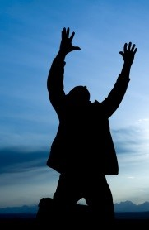
Conclusion
Prepare. Don’t panic. Trust God. Pray! (Philippians 4:6)
“Be anxious for nothing, but in everything by prayer and supplication with thanksgiving let your requests be made known to God!”
Let’s be in a state of prayer for all those affected by this illness!
Whatever our “Present Distress,” let’s not panic, but exercise wisdom and caution, leaning on our Mighty God!

Slide 12
“What Must I Do To Be Saved?”
Hear The Gospel (Jn. 5:24; Rom. 10:17)
Believe In Christ (Jn. 3:16-18; Jn. 8:24)
Repent Of Sins (Lk. 13:3-5; Acts 2:38)
Confess Christ (Mt. 10:32; Rom. 10:10)
Be Baptized (Mk. 16:16; Acts 22:16)
Remain Faithful (Jn. 8:31; Rev. 2:10)
For The Erring Saint:
Repent (Acts 8:22), Confess (I Jn. 1:9),
Pray (Acts 8:22)

