Slide 1
How To Apply: Forgiveness Like Jesus Text: Matthew 18:21-35
Notes:
By Nathan L Morrison
All Scripture given is from NASB unless otherwise stated
For further study, or if questions, please Call: 804-277-1983 or Visit www.courthousechurchofchrist.com

Slide 2
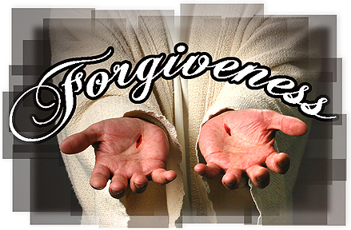
Intro
All men have sinned (Romans 3:23)
All men are subject to eternal punishment from God (Romans 6:23)
All men have received grace (mercy, compassion) from God through the sacrifice of Jesus (Romans 5:15; Hebrews 2:9; I Peter 3:18) – the “just for the unjust”
Those who obey the gospel are made fellow heirs with Jesus and are part of the family of God (Romans 8:14-17; Acts 2:47; I Timothy 3:15)

Slide 3
Intro
even after obeying the gospel, saints will make mistakes and sin (Romans 3:23; Galatians 6:1-2)
What does the saint do now?

Slide 4
Intro
They have already been covered in the blood of Jesus and their sins washed away in baptism (Ephesians 1:7; Acts 22:16)
The saint is to confess their sins and ask God for forgiveness (James 5:16; I John 1:9)
But what happens when others sin against us and ask for forgiveness?

Slide 5
How Often Do I Forgive?
Matthew 18:21-22
21 Then Peter came and said to Him, "Lord, how often shall my brother sin against me and I forgive him? Up to seven times?“
22 Jesus said to him, "I do not say to you, up to seven times, but up to seventy times seven.
Matthew 18:15-20: Jesus laid out what to do when a brother sins against another.
Peter asked how often one should forgive!
(Matthew 18:21-22)

Slide 6
How Often Do I Forgive?
Peter raised the question of how often he should forgive a brother who sinned against him.
He may have thought he was showing unusual grace by suggesting seven as an outside limit.
Jesus answered “not ... seven times but up to seventy times seven.”
Matthew 18:21-22 (Luke 17:3-4)
Notes:
Jesus did not intend us to understand a literal 490 times; this was a figurative way of saying “Indefinitely.”
Someone might then ask, “Why bother to go through the steps outlined above? (Matthew 18:15-20) Why go to an offender alone, then with one or two others, then take him to church? Why not just forgive, and let that be the end of it?”
The answer is that there are stages in the administration of forgiveness, as follows:
When a brother wrongs me or sins against me, I should forgive him immediately in my heart (Eph. 4:32). That frees me from a bitter, unforgiving spirit, and leaves the matter on his shoulders.
While I have forgiven him in my heart, I do not yet tell him that he is forgiven. It would not be righteous to administer forgiveness publicly until he has repented. So I am obligated to go to him and rebuke him in love, hoping to lead him to confession (Luke 17:3).
As soon as he apologizes and confesses his sin, I tell him that he is forgiven (Luke 17:4).

Slide 7
The Unforgiving Servant
Matthew 18:23-24
23 "For this reason the kingdom of heaven may be compared to a king who wished to settle accounts with his slaves.
24 "When he had begun to settle them, one who owed him ten thousand talents was brought to him.
Jesus then gives a parable of the kingdom of heaven to warn against the consequences of an unforgiving spirit by subjects who have been freely forgiven.

Slide 8
The Unforgiving Servant
Matthew 18:25-26
25 "But since he did not have the means to repay, his lord commanded him to be sold, along with his wife and children and all that he had, and repayment to be made.
26 "So the slave fell to the ground and prostrated himself before him, saying, 'Have patience with me and I will repay you everything.’
Jesus told a STORY OF A certain king who wanted to clear the bad debts off his books.

Slide 9
The Unforgiving Servant
When the kING saw the contrite attitude of his servant, he forgave him the entire 10,000 talents!
Matthew 18:27
27 "And the lord of that slave felt compassion and released him and forgave him the debt.
Notes:
Perhaps he recognized the slave could never pay it back!

Slide 10
The Unforgiving Servant
One servant, who owed the king ten thousand talents, was broke, so his lord ordered that he and his family be sold into slavery in payment of the debt.
The distraught servant begged for time, promising to pay him all if given the chance.
Matthew 18:23-27

Slide 11
The Unforgiving Servant
Like many debtors, he was incredibly optimistic about what he could do if only he had time (vs. 26).
Galilee's total revenue only amounted to 300 talents and this man owed 10,000!
Matthew 18:23-27
Notes:
From the Believer’s Bible Commentary (BBC)

Slide 12
The Unforgiving Servant
The detail about the vast amount is intentional.
An amount that would take a lifetime to pay!
It is to shock the listeners and capture their attention, and also to emphasize an immense debt to God.
Matthew 18:23-27
Notes:
Martin Luther used to say, “We are all beggars before Him. We cannot hope to pay.”
(Daily Notes of the Scripture Union)
The immense debt to God is one no man can pay back!

Slide 13
The Unforgiving Servant
When the king saw the contrite attitude of his servant, he forgave him the entire 10,000 talents!
It was an epic display of grace, not justice.
Matthew 18:23-27

Slide 14
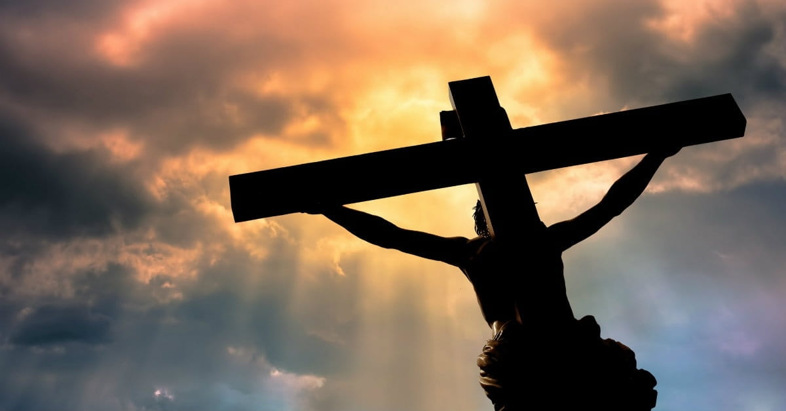
The Unforgiving Servant
The parable itself is a beautiful picture of the grace of God on all men
We sin and are justly due the punishment
We beg for forgiveness
The King (God) hears us and has compassion and forgives us
This is all seen in the death and sacrifice of Jesus Christ for the ungodly (I Peter 3:18)

Slide 15
The Unforgiving Servant
Matthew 18:28-30
28 "But that slave went out and found one of his fellow slaves who owed him a hundred denarii; and he seized him and began to choke him, saying, 'Pay back what you owe.’
29 "So his fellow slave fell to the ground and began to plead with him, saying, 'Have patience with me and I will repay you.’
30 "But he was unwilling and went and threw him in prison until he should pay back what was owed.
But then the forgiven servant goes out and doesn’t show mercy and compassion on a fellow servant

Slide 16
The Unforgiving Servant
Matthew 18:31-33
31 "So when his fellow slaves saw what had happened, they were deeply grieved and came and reported to their lord all that had happened.
32 "Then summoning him, his lord said to him, 'You wicked slave, I forgave you all that debt because you pleaded with me.
33 'Should you not also have had mercy on your fellow slave, in the same way that I had mercy on you?'
But then the forgiven servant goes out and doesn’t show mercy and compassion on a fellow servant

Slide 17
The Unforgiving Servant
Matthew 18:34-35
34 "And his lord, moved with anger, handed him over to the torturers until he should repay all that was owed him.
35 "My heavenly Father will also do the same to you, if each of you does not forgive his brother from your heart."
But then the forgiven servant goes out and doesn’t show mercy and compassion on a fellow servant

Slide 18
The Unforgiving Servant
The forgiven servant had a fellow servant who owed him one hundred denarii (a denarius was a day’s wage!).
Rather than forgive him, he grabbed him by the throat and demanded payment in full.
Matthew 18:28-35

Slide 19
The Unforgiving Servant
The hapless debtor pled for an extension, but it was no use.
He was thrown into prison till he paid the debt—a bad situation made worse, since his chance of earning money was gone as long as he was imprisoned!
Matthew 18:28-35
Notes:
Pleading for more time should have triggered the memory in the forgiven servant that he had been on his knees begging for more time!

Slide 20
The Unforgiving Servant
The other servants, outraged by this inconsistent behavior, told the king.
He was furious with the unforgiving servant.
Having been forgiven a big debt, he was unwilling to forgive a pittance.
So he was returned to the jailers' custody till his debt was paid!
Matthew 18:28-35

Slide 21
The Application
God is the King.
All His servants had contracted a great debt of sin which they were unable to pay.
In wonderful grace and compassion, the Lord paid the debt and granted full and free forgiveness.
Matthew 18:35

Slide 22
The Application
What about when a Christian wrongs another?
When rebuked, he apologizes and asks forgiveness.
But the offended believer refuses.
It’s like a man who has been forgiven millions of dollars, but won't forgive a few hundred.
Matthew 18:35

Slide 23
The Application
Will the King allow such behavior to go unpunished?
Certainly not!
The unforgiving servant will suffer loss at the Judgment Seat of Christ!
Jesus says this is done to the one who does not forgive from the heart
Matthew 18:35

Slide 24
The Application
Ephesians 4:32
32 Be kind to one another, tender-hearted, forgiving each other, just as God in Christ also has forgiven you.
Saints are to forgive as Christ forgave…
selflessly, sacrificially

Slide 25
The Application
Colossians 3:13
13 bearing with one another, and forgiving each other, whoever has a complaint against anyone; just as the Lord forgave you, so also should you.
Saints are to forgive as Christ forgave…
selflessly, sacrificially

Slide 26
The Application
Willful child
Rebellious teen
Troublesome employee
Hurtful friend
Upset Spouse
Saints are to forgive as Christ forgave (Eph. 4:32; Col. 3:13)
What does that look like?

Slide 27
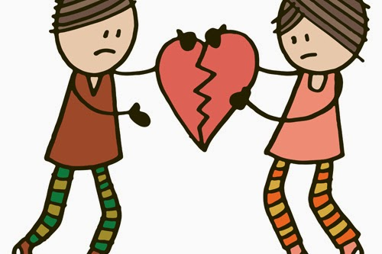
Conclusion
If we love others as Christ loved us (John 13:34-35) we will have a heart of compassion and be ready and willing to forgive (Col. 3:12-13) others when they repent and ask for forgiveness.

Slide 28
Conclusion
When we sin and stand before God on our knees, we don’t want justice (what we are truly owed), we want grace and mercy!
We have been forgiven a debt we can never pay and are all fellow debtors.

Slide 29
Conclusion
We are to have the heart that grants grace and mercy (not justice) to others!

Slide 30
Let us be a forgiving servant who forgives as Jesus forgave us!

Slide 31
“What Must I Do To Be Saved?”
Hear The Gospel (Jn. 5:24; Rom. 10:17)
Believe In Christ (Jn. 3:16-18; Jn. 8:24)
Repent Of Sins (Lk. 13:3-5; Acts 2:38)
Confess Christ (Mt. 10:32; Rom. 10:10)
Be Baptized (Mk. 16:16; Acts 22:16)
Remain Faithful (Jn. 8:31; Rev. 2:10)
For The Erring Saint:
Repent (Acts 8:22), Confess (I Jn. 1:9),
Pray (Acts 8:22)

