Slide 1
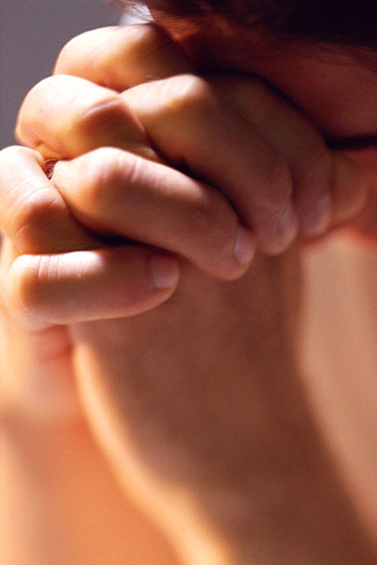
Prayers Never Prayed
Text:
Eph. 2:8-9; Heb. 11:6; John 14:15
Notes:
By Nathan L Morrison
All Scripture given is from NASB unless otherwise stated
For further study, or if questions, please Call: 804-277-1983 or Visit www.courthousechurchofchrist.com
Adapted from a lesson by Steve Higginbotham

Slide 2
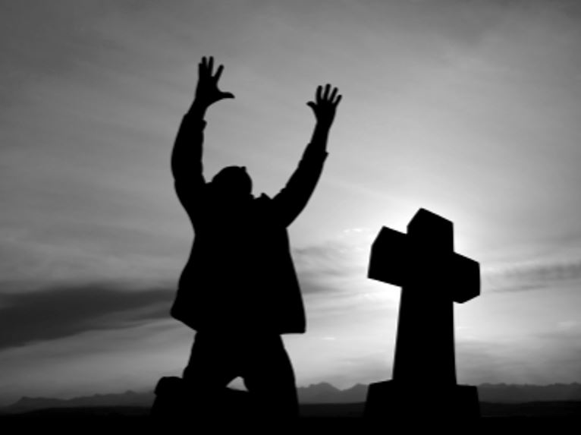
Intro
There exists a tension between grace, faith, & works…
Ephesians 2:8-9
8. For by grace you have been saved through faith; and that not of yourselves, it is the gift of God;
9. not as a result of works, so that no one may boast.
Hebrews 11:6
6. And without faith it is impossible to please Him, for he who comes to God must believe that He is and that He is a rewarder of those who seek Him.
John 14:15
15. "If you love Me, you will keep My commandments.

Slide 3
Intro
This tension has resulted in error involving opposite extremes
There are those who teach grace alone saves, and others who teach faith alone saves
The Scriptures teach all of them in concert: the grace of God appeared to all men bringing salvation (Titus 2:11), and our faith in God is manifested in our obedience, which is our works (Titus 2:12-14; James 2:17, 24, 26)!
James 2:24
24. You see that a man is justified by works and not by faith alone.

Slide 4
Intro
Grace, Faith, Works
This can be demonstrated in six prayers never prayed in the Scriptures!

Slide 5
6 Prayers Never Prayed
The Shipbuilder’s Prayer
Genesis 6
Noah found grace, yet he was commanded to build an ark.
What if Noah had prayed the “shipbuilder’s prayer” & refused to build the ark?
Genesis 6:22: Noah did all that God commanded him to do!

Slide 6
6 Prayers Never Prayed
The Shipbuilder’s Prayer
The Firstborn Prayer
Exodus 12
The Israelites were the objects of God’s grace, yet he commanded them to kill a lamb and put it’s blood on the doorpost.
What if Moses had told the people to simply pray the “firstborn prayer” and refuse to kill a lamb and apply the blood to the doorpost?
Exodus 12:28: The sons of Israel did all that God commanded them to do!

Slide 7
6 Prayers Never Prayed
The Shipbuilder’s Prayer
The Firstborn Prayer
The Red Sea Prayer
Exodus 14
God was showing his favor upon Israel as they exited Egyptian bondage.
Once trapped, God commanded them to move forward.
What if Moses had refused to lead the people through the Red Sea, and instead pray the “Red Sea Prayer?”
Exodus 14:28-31: The Israelites did as God commanded and were saved, and the Egyptian army all drowned!

Slide 8
6 Prayers Never Prayed
The Shipbuilder’s Prayer
The Firstborn Prayer
The Red Sea Prayer
The Harlot’s Prayer
Joshua 2:12-21
Rahab had shown kindness to the spies, and thus was promised mercy.
The condition was that she stay in the house and put a scarlet cord in the window.
What if Rahab, instead of putting a cord in the window prayed the “Harlot’s Prayer?”
Joshua 2:21; 6:22-25: Rahab tied the scarlet cord in the window and was saved with her family! (James 2:25-26)

Slide 9
6 Prayers Never Prayed
The Shipbuilder’s Prayer
The Firstborn Prayer
The Red Sea Prayer
The Harlot’s Prayer
The Leper’s Prayer
II Kings 5
Naaman was shown grace and was told to dip seven times in the Jordan river.
What if Naaman had, instead of dipping in the Jordan, prayed the “Leper’s Prayer?”
II Kings 5:14: Naaman obeyed God and was made whole again!

Slide 10
6 Prayers Never Prayed
The Shipbuilder’s Prayer
The Firstborn Prayer
The Red Sea Prayer
The Harlot’s Prayer
The Leper’s Prayer
The Sinner’s Prayer
Acts 2:38
God showed grace to sinners and commanded them to repent and be baptized.
What if men, instead of repenting and being baptized, decided to simply pray the “Sinner’s Prayer?”
Acts 2:41: The Jews on Pentecost heard the word of God, obeyed it by being baptized and were added to the church!

Slide 11
Conclusion
In every above scenario someone was a recipient of God’s grace and had conditions for it:
Build an Ark
Sprinkle Blood
Cross the Red Sea
Tie a Scarlet Cord
Dip 7 Times in the Jordan River
Repent & Be Baptized

Slide 12
Conclusion
Prayer is not a substitute for obedience!
Prayer will not save us: Obedience to God’s word will!
Nowhere in the Scriptures, when one asked what they needed to do to be saved, was the answer given to pray for salvation!
Grace, Faith, & Works all have an essential role in our salvation!
God has grace “covered”
What remains is whether we will exhibit a faith that obeys! (James 2:14-26)!

Slide 13
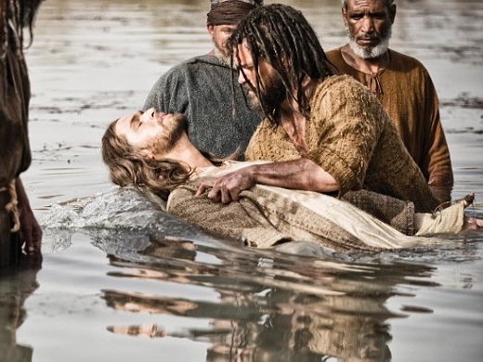
Conclusion
We are all saved the same way: Obedience to the gospel – Mark 16:16: Believe and be baptized to be saved!

Slide 14
“What Must I Do To Be Saved?”
Hear The Gospel (Jn. 5:24; Rom. 10:17)
Believe In Christ (Jn. 3:16-18; Jn. 8:24)
Repent Of Sins (Lk. 13:3-5; Acts 2:38)
Confess Christ (Mt. 10:32; Rom. 10:10)
Be Baptized (Mk. 16:16; Acts 22:16)
Remain Faithful (Jn. 8:31; Rev. 2:10)
For The Erring Saint:
Repent (Acts 8:22), Confess (I Jn. 1:9),
Pray (Acts 8:22)

