Slide 1
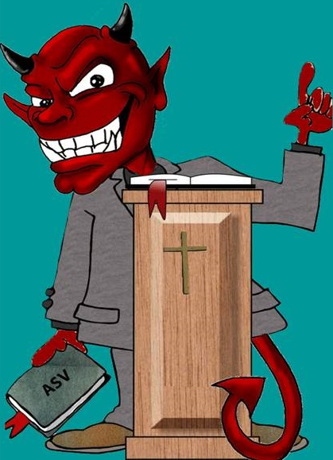
Satan Knows…
Text:
I Peter 5:8-9
Notes:
By Nathan L Morrison
All Scripture given is from NASB unless otherwise stated
For further study, or if questions, please Call: 804-277-1983 or Visit www.courthousechurchofchrist.com
Adapted from a lesson by Richard Thetford

Slide 2
Intro
I Peter 5:8-9
8. Be of sober spirit, be on the alert. Your adversary, the devil, prowls around like a roaring lion, seeking someone to devour.
9. But resist him, firm in your faith, knowing that the same experiences of suffering are being accomplished by your brethren who are in the world.
Luke 8:12
“Those beside the road are those who have heard; then the devil comes and takes away the word from their heart, so that they will not believe and be saved.”

Slide 3
Intro
Some may think of the devil as an imaginary being; that he doesn’t really exist
Some use him as an excuse for sin – Flip Wilson’s “The devil made me do it”
Jesus declared Satan as an ACTIVE being!
We know God is all-powerful and knows everything about us (Heb. 4:13)
There are a great many things Satan knows too, and we should be aware!

Slide 4
The Devil Knows…
Jesus Christ is the Son of God
Satan tempted Christ in the wilderness
Matthew 4:1-11
Satan is the ruler of the demons & the demons know who Jesus is!
Luke 11:15
Mt. 8:28-29; Mk. 3:11; 5:3-7; Lk. 4:41; 8:27-28
Satan & his demons know Jesus is the Son of God & tremble! (James 2:19)

Slide 5
The Devil Knows…
Who Every Accountable Child Belongs To
Child of God
John 1:12
Philippians 2:15-16
Child of Satan
Acts 13:8-10
I John 3:10
Satan knows who is his and who is not, and those that are not become targets!

Slide 6
The Devil Knows…
Most People Have Already Been Secured
The Unrighteous
I John 3:10
Romans 1:18-32
The Disobedient
II Thessalonians 1:7-9
Matthew 7:13-14;25:41
Misery loves company and Satan wants all to dwell with him for eternity!

Slide 7
The Devil Knows…
Most People Don’t Realize He is…
Powerful – Eph. 2:1-2; 6:12
deceives men – Gen. 3:1-6; II Cor. 11:3
The father of lies – Jn. 8:44
Deceitful – II Cor. 11:14-15
Evil – I Jn. 2:13
Not the master of Hell, but an inmate with the wicked – Mt. 25:41 (Rev. 20:10)
One of his greatest tricks is to deceive the world into thinking he doesn’t exist!

Slide 8
The Devil Knows…
He Has Lost Those That…
Study – II Tim. 2:15; Heb. 11:6
Practice righteousness – Rom. 6:17-18; Titus 2:11-12
Watch for him – Acts 20:28-31; I Pet. 5:8
Resist him – Js. 4:7; I Pet. 5:9
Fight against him – Eph. 6:10-16
Overcome – I Jn. 2:13
Though he knows he has lost them, he doesn’t just give up!

Slide 9
Conclusion
Satan has sought from the beginning to discredit God (Genesis 3:1-6)
He lost his war with God to nullify His promise of the Seed of woman (Gen. 3:15) that would destroy him.
He lost the war against Christ when he came to tempt Him (Mt. 4:1-11).
So he went after His friends: Judas, Peter, all of the disciples (Mt. 26:56: All fled).

Slide 10
Conclusion
Now he continues to deceive the world, and will do all he can to try to keep you and me from being faithful
After losing one of his to God, he doesn’t give up
Luke 8:12-14: He uses temptation and the enticements of the world to try them and test their faith that he might pull them back (The Rocky & Thorny Soil saints).
Don’t let him draw you away once you have escaped! (Luke 8:15; Col. 1:13)

Slide 11
Conclusion
I Peter 5:9
But resist him, firm in your faith, knowing that the same experiences of suffering are being accomplished by your brethren who are in the world.
James 4:7
Submit therefore to God. Resist the devil and he will flee from you.
Stand firm in your faith and resist Satan!

Slide 12
“What Must I Do To Be Saved?”
Hear The Gospel (Jn. 5:24; Rom. 10:17)
Believe In Christ (Jn. 3:16-18; Jn. 8:24)
Repent Of Sins (Lk. 13:3-5; Acts 2:38)
Confess Christ (Mt. 10:32; Rom. 10:10)
Be Baptized (Mk. 16:16; Acts 22:16)
Remain Faithful (Jn. 8:31; Rev. 2:10)
For The Erring Saint:
Repent (Acts 8:22), Confess (I Jn. 1:9),
Pray (Acts 8:22)

