Slide 1
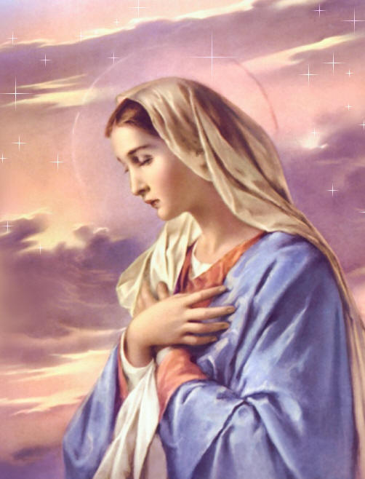
Mary: “Blessed Among Women”
Godly Women Series Part 9
Text:
Luke 1:26-38, 42, 48
Notes:
By Nathan L Morrison
All Scripture given is from NASB unless otherwise stated
For further study, or if questions, please Call: 804-277-1983 or Visit www.courthousechurchofchrist.com
Some points taken from an article by Edwin Crozier

Slide 2
Intro
Men and women alike can provide us with sources of
strength and inspiration
Eve: “Mother of all living” (Gen. 3:20), moved past sin!
Sarah: Mother of nations (Gen. 17:16), Mother of saints (Gal. 4:26,31), Mother of godly wives (I Pet. 3:6)!
Ruth: An example of faith and virtue (Ruth 1:16-18; 3:11)
Abigail: An example of faith, respect, wisdom, and concern! (I Sam. 25)
Proverbs 31 Woman: Her relationships, behavior, and character were virtuous and faithful! (Prov. 31:10-31)
The Shunammite Woman: She served God with the abilities she had! She was hospitable, content, & had faith in God! (II Kings 4:8-37)
Queen Esther: Brave queen who trusted God (Est. 4:14-5:4)
Peter’s Wife: Faithful companion (Mk. 1:29-31; I Cor. 9:5)
Godly role models are greatly needed in our society!

Slide 3
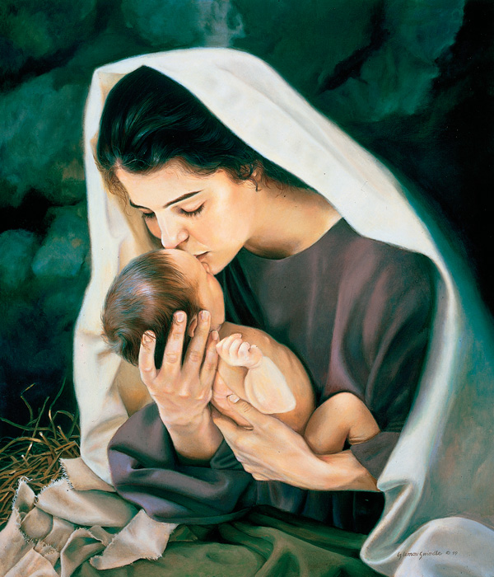
Intro
In talking about godly women, we can’t leave out Mary, the mother of Jesus!
She was chosen from among all the women of her day to bear the physical form of the Son of God (Lk. 1:26-38) and to raise Him!
The story of Mary is about Jesus!
Notes:
Image: Mary Kissing Baby Jesus by Liz Lemon Swindle

Slide 4
Luke 1:26-33
26. Now in the sixth month the angel Gabriel was sent from God to a city in Galilee called Nazareth,
27. to a virgin engaged to a man whose name was Joseph, of the descendants of David; and the virgin's name was Mary.
28. [NKJV] And having come in, the angel said to her, "Rejoice, highly favored one, the Lord is with you; blessed are you among women!"
29. But she was very perplexed at this statement, and kept pondering what kind of salutation this was.
30. The angel said to her, "Do not be afraid, Mary; for you have found favor with God.
31. "And behold, you will conceive in your womb and bear a son, and you shall name Him Jesus.
32. "He will be great and will be called the Son of the Most High; and the Lord God will give Him the throne of His father David;
33. and He will reign over the house of Jacob forever, and His kingdom will have no end."

Slide 5
Luke 1:34-38
34. Mary said to the angel, "How can this be, since I am a virgin?"
35. The angel answered and said to her, "The Holy Spirit will come upon you, and the power of the Most High will overshadow you; and for that reason the holy Child shall be called the Son of God.
36. "And behold, even your relative Elizabeth has also conceived a son in her old age; and she who was called barren is now in her sixth month.
37. "For nothing will be impossible with God."
38. And Mary said, "Behold, the bondslave of the Lord; may it be done to me according to your word." And the angel departed from her.
Mary was favored by God (Lk. 1:28, 30) and “blessed among women” (Lk. 1:[NKJ: 28], 42, 48)!

Slide 6
Her Purity & Virtue
Virgin – Luke 1:26-27, 34
See also Rev. 14:4
Engaged – Luke 1:27 (NASB), Espoused (KJV), Betrothed (NKJ)
Heb. 13:4
Luke 1:38; Matthew 1:19-25
Abstained till after the birth of Jesus, then Became wife of Joseph
Matthew 1:24-25
Matthew 13:55-56

Slide 7
Her Purity & Virtue Application:
God will keep His word!
The Lord commands purity & virtue of all who would follow Him (Phil. 4:8-9; I Jn. 3:1-3)!
Let Mary be your example: virginity, engaged, married!
I John 3:3
3. And everyone who has this hope fixed on Him purifies himself, just as He is pure.
You don’t have to wait until you are grown up and old to be an example of faith!

Slide 8
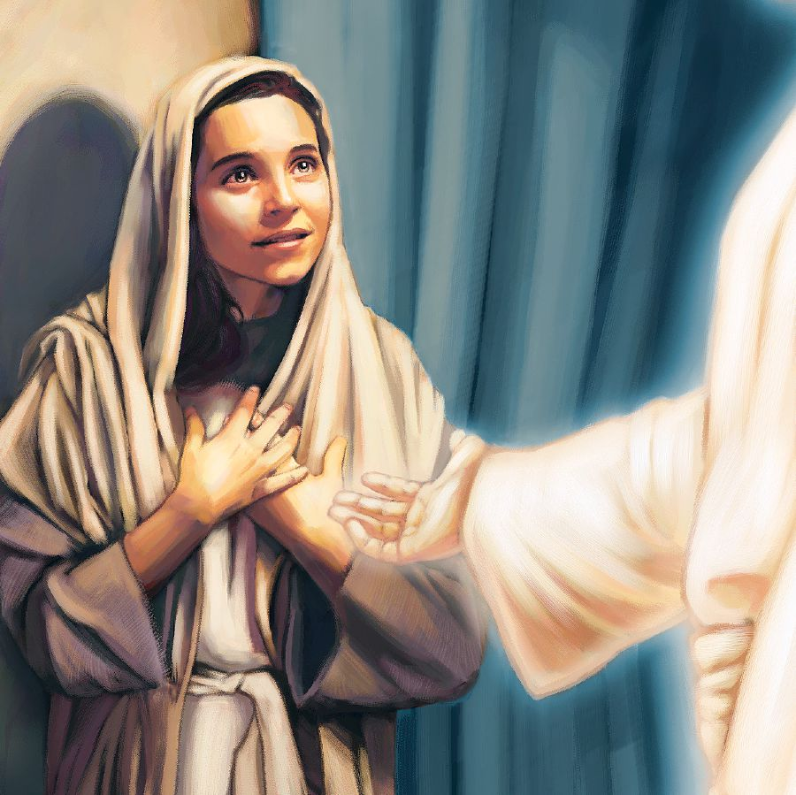
Her Purity & Virtue
Virgin
Engaged
Wife
She was a chaste, moral (virtuous), obedient servant of the Lord!

Slide 9
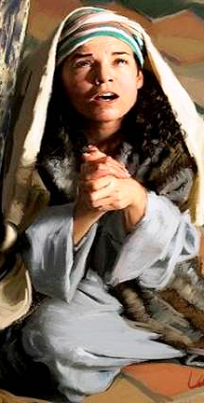
Her Humility & Submission
Humbly accepted the word of God, “Behold, the bondslave of the Lord; may it be done to me according to your word” – Luke 1:31-33, 35, 38
She accepted the word of God from Gabriel! She trusted in God to work out the details!
Submitted
To God – Luke 1:38
To her husband – Mt. 2:13-22; col. 3:18
To Her Son – John 2:1-12; Mark 3:31-35

Slide 10
Her Humility & Submission Application:
Followers of Jesus must exhibit the humility and trust of Mary!
Eph. 4:1-3
I Peter 5:5
5. You younger men, likewise, be subject to your elders; and all of you, clothe yourselves with humility toward one another, for GOD IS OPPOSED TO THE PROUD, BUT GIVES GRACE TO THE HUMBLE.
James 1:21
Col. 3:12

Slide 11
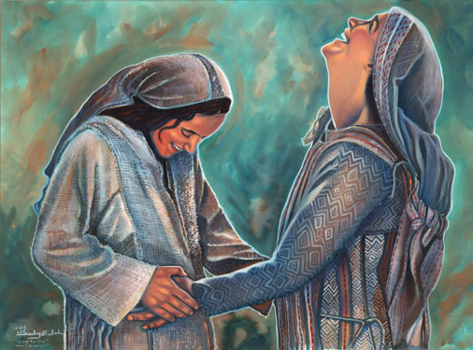
Her Humility & Submission
Humble
Submitted
She was humble and in subjection to the will and word of God!

Slide 12
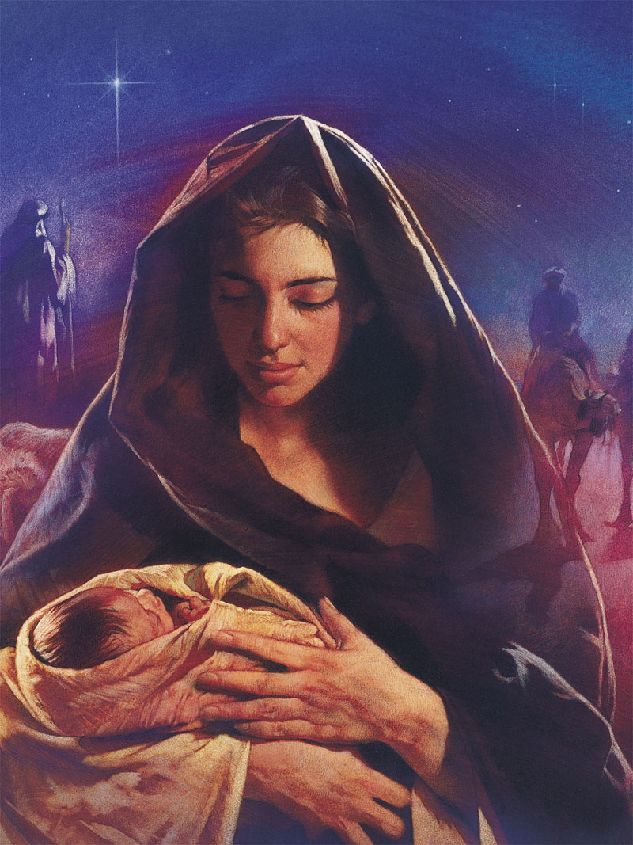
Her Heart Was Filled With Heavenly Things
Shepherds – Luke 2:8-18
Mary treasured all these things in heart and pondered on them (Luke 2:19)
The wise men from the east bowed & worshiped Jesus, and gave expensive gifts! (Matthew 2:1-11)
At the Temple – Luke 2:21-32
They were amazed at Simeon’s words (Luke 2:21-33)
At the Temple for Passover – Luke 2:41-50
Mary treasured all these things in her heart (Luke 2:51)

Slide 13
Her Heart Was Filled With Heavenly Things Application:
All saints ought to treasure heavenly things and ponder on things of God!
Col. 3:1-3
Phil. 4:8
8. Finally, brethren, whatever is true, whatever is honorable, whatever is right, whatever is pure, whatever is lovely, whatever is of good repute, if there is any excellence and if anything worthy of praise, dwell on these things.
Make room for Jesus in your hearts and follow Him today!
Jesus is the good news of great joy!
(John 14:7; Acts 4:12)

Slide 14
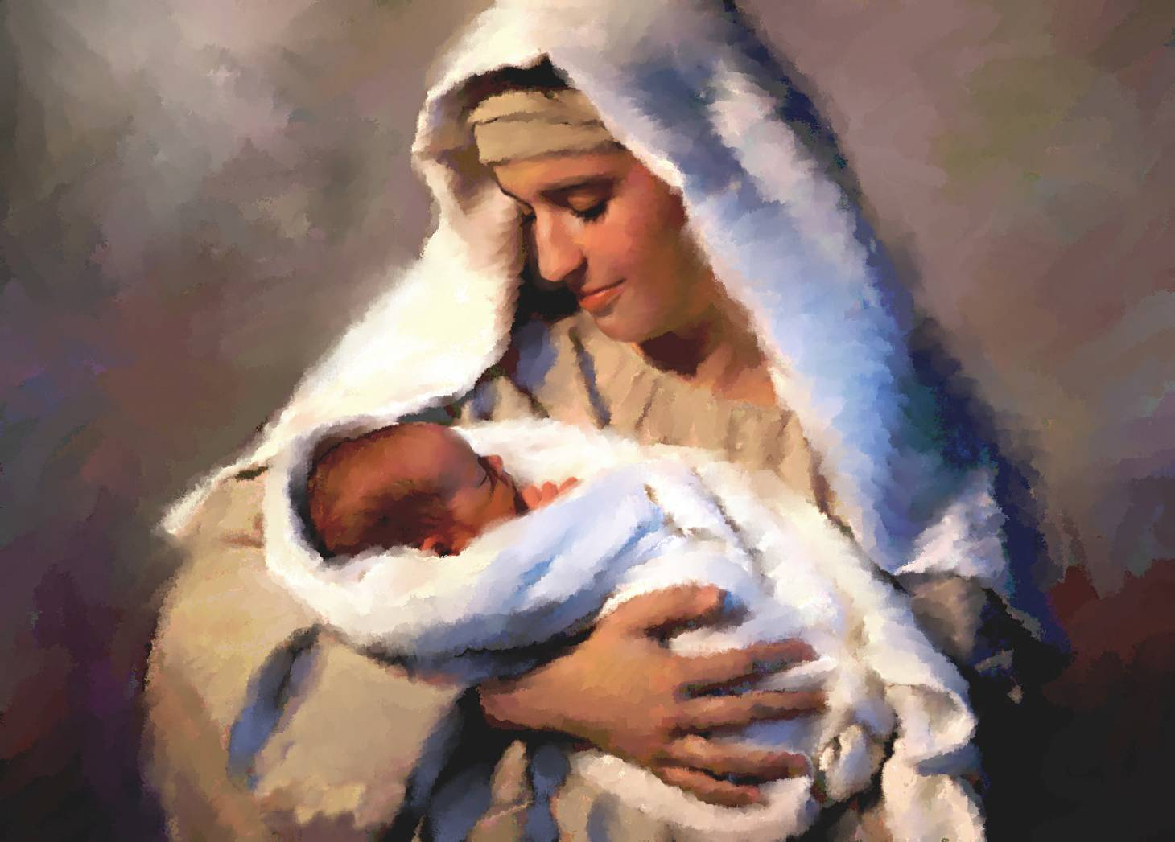
Her Heart Was Filled With Heavenly Things
Shepherds
Temple when Jesus was 8 days old
Temple for Passover
Mary filled her heart with heavenly things and pondered on things of God!

Slide 15
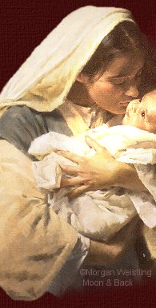
Her Faith
Elizabeth said Mary, “Believed” – Luke 1:45
Elizabeth was Mary’s relative (Luke 1:36)
Knew God’s word – Luke 1:46-56
She quotes from Ps. 103:17 in Vs. 50, and from Ps. 107:9 in Vs. 53.
She also praises God for His promise to Abraham
She and Joseph kept the Law
Jesus at Temple – Luke 2:21 (Lev. 12:3)
offered sacrifices – Luke 2:22-24 (Lev. 12:6-8)
The Passover – Luke 2:41-42 (Deut. 16:16)
In the “Upper Room” – Acts 1:14
Her last mention in Scripture is of her and her children listed among believers
Notes:
Image: Mary Kissing Baby Jesus by Morgan Weistling

Slide 16
Her Faith Application:
Mary & Joseph kept God’s word
We need to have faith in God and in His plans (Heb. 11:1, 6)
We need to have faith, even if it requires our lives!
(II Tim. 4:6-8; Rev. 2:10)
II Tim. 4:7
7. I have fought the good fight, I have finished the course, I have kept the faith;
May we be willing to do that for our children, to teach them to put God 1st!

Slide 17
Her Faith
Believed
Knew God’s word
She & Joseph kept the Law
In “Upper Room” with believers
Mary was faithful to God from beginning to end of her record in the Scriptures!
Notes:
Image: Mary Kissing Baby Jesus by Liz Lemon Swindle

Slide 18
Conclusion
Mary played a role in God’s Plan: she was chosen for a special part, to be the mother of the Lord
(Luke 1:42-43)
It was a favor that God bestowed upon her
(Luke 1:28-30)
Gen. 6:8: “Noah found favor in the eyes of the Lord.” God saved him & his family.
Mary found favor with God and would bear His Son into this world, “who takes away the sin of the world” (John 1:29)
She was “blessed among women” (Luke 1:[NKJ: 28], 42, 48)
One of a woman's greatest earthly blessings is in her children
(Prov. 31:28)
Her Firstborn was not only a blessing to her but to all who will hear, believe and come to Him (Luke 11:27-28)

Slide 19
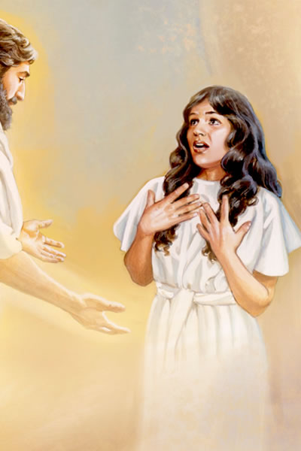
Conclusion
Mary was a woman “favored by God” (Luke 1:28, 30) and “blessed among women!” (Luke 1:42)
There are many examples of godly women in Scripture and this series didn’t get them all, for time would fail us if we discussed Rahab, Deborah, Hannah, of Mary Magdalene, Lydia and Dorcas!
Conclusion
Mary was a woman “favored by God” (Luke 1:28, 30) and “blessed among women!” (Luke 1:42)
There are many examples of godly women in Scripture and this series didn’t get them all, for time would fail us if we discussed Rahab, Deborah, Hannah, of Mary Magdalene, Lydia and Dorcas!

Slide 20
Conclusion
As we consider the life of Mary let all Christians strive to be godly and remain faithful!
Will you remain faithful to the end? (Rev. 2:10)

Slide 21
“What Must I Do To Be Saved?”
Hear The Gospel (Jn. 5:24; Rom. 10:17)
Believe In Christ (Jn. 3:16-18; Jn. 8:24)
Repent Of Sins (Lk. 13:3-5; Acts 2:38)
Confess Christ (Mt. 10:32; Rom. 10:10)
Be Baptized (Mk. 16:16; Acts 22:16)
Remain Faithful (Jn. 8:31; Rev. 2:10)
For The Erring Saint:
Repent (Acts 8:22), Confess (I Jn. 1:9),
Pray (Acts 8:22)

Slide 22
Luke 1:28-30 (NKJV)
28. And having come in, the angel said to her, "Rejoice, highly favored one, the Lord is with you; blessed are you among women!"
29. But when she saw him, she was troubled at his saying, and considered what manner of greeting this was.
30. Then the angel said to her, "Do not be afraid, Mary, for you have found favor with God.”

