Slide 1
Godly Fathers Text: Eph. 6:4
Notes:
By Nathan L Morrison
All Scripture given is from NASB unless otherwise stated
For further study, or if questions, please Call: 804-277-1983 or Visit www.courthousechurchofchrist.com
Many points from several sources, including lessons from Joe Price and Richard Thetford

Slide 2
Intro
The beginning of Father’s Day:
The first Father's Day was observed in the State of Washington on June 19, 1910 at the urging of Sonora Smart Dodd from Spokane, WA to honor fathers as hers raised her when her mother died.
In 1924, President Calvin Coolidge recognized Father's Day as the third Sunday in June of that year and encouraged states to do the same. Congress officially recognized Father's Day in 1956 with the passage of a joint resolution.
Ten years later, in 1966, President Lyndon Johnson issued a proclamation calling for the third Sunday in June to be recognized as Father's Day. In 1972, President Richard Nixon permanently established the observance of the third Sunday in June as Father's Day in the United States.
Sonora Smart Dodd lived to see her idea come to fruition. She died in 1978 at the ripe old age of 96. (A Brief History of Father's Day by Andrew Hollandbeck)
Though this is a special one-time event each year,
we all should honor our fathers on a daily basis –
especially those who are pleasing to God!
Notes:
(A Brief History of Father's Day by Andrew Hollandbeck)

Slide 3
Intro
Psalm 128 A Song of Ascents.
1. How blessed is everyone who fears the LORD, Who walks in His ways.
2. When you shall eat of the fruit of your hands, You will be happy and it will be well with you.
3. Your wife shall be like a fruitful vine Within your house, Your children like olive plants Around your table.
4. Behold, for thus shall the man be blessed Who fears the LORD.
5. The LORD bless you from Zion, And may you see the prosperity of Jerusalem all the days of your life.
6. Indeed, may you see your children's children. Peace be upon Israel!

Slide 4
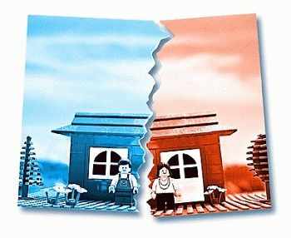
Intro
The United States is rapidly becoming a fatherless society:
2011: Children living in female-headed homes with no spouse present had a poverty rate of 47.6%. This is over four times the rate for children living in married-couple families.
2014: 23.6% of US children (17.4 million) lived in father-absent homes! (2013: 15m)
55% (55.2) of WIC recipients are raised by single-mothers, 48.2% of all Head Start recipients are from father-absent homes, and 37% of public assistance and Section 8 housing are female-headed households.
40 percent of our children do not live in the same home as their biological father!
Notes:
(http://fatherhoodfactor.com/us-fatherless-statistics/)

Slide 5
Intro
The need for godly fathers has always been great!
TV and movies for the last 30 years have portrayed the father as an imbecile or a bungler, the fool in contrast to the smart and wise mother, who truly holds the family together.
Godly = God-like, or like-God (Titus 2:12: “Godly” is from G2153 that means “pious”)

Slide 6
Intro
The world needs godly fathers: Fathers who love God
& His word; fathers of faith, fathers with character
& courage to meet the challenges of fatherhood!
Eph. 6:4
4. Fathers, do not provoke your children to anger, but bring them up in the discipline and instruction of the Lord.
God is our supreme example of Fatherhood
(II Cor. 6:17-18) and what fathers ought to be like!

Slide 7
Fathers Are Progenitors (to bring forth; an ancestor in the direct line; a forefather)
God is our supreme example of fatherhood
(II Cor. 6:17-18)
Progenitor (Father of life–Creator; New birth/adoption): Js. 1:18; Gal. 4:5-7.
Fathers give life to their children – Gen. 5:3 (Adam)
Most men can sire offspring; takes men of character to be fathers!
Grave responsibility to bring a soul into the world; taken far too lightly!

Slide 8
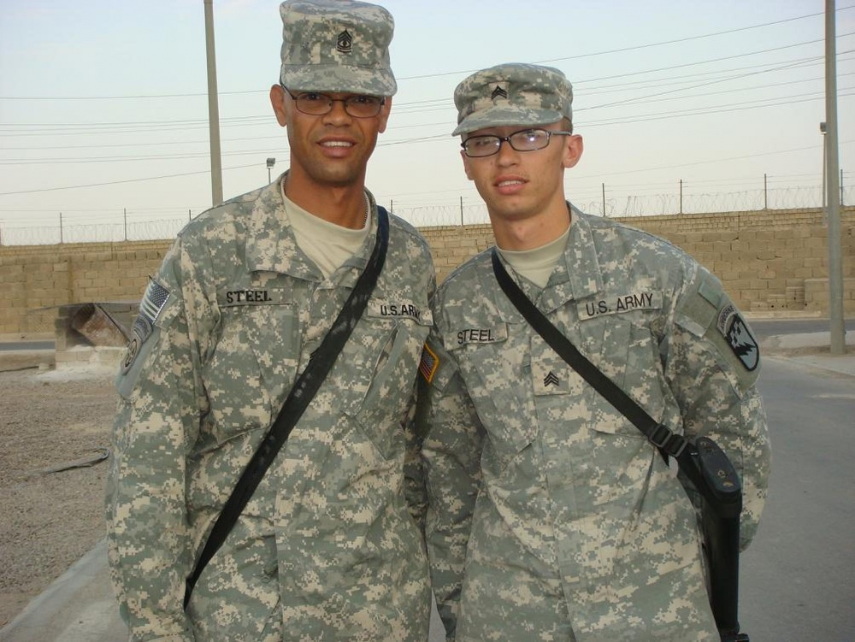
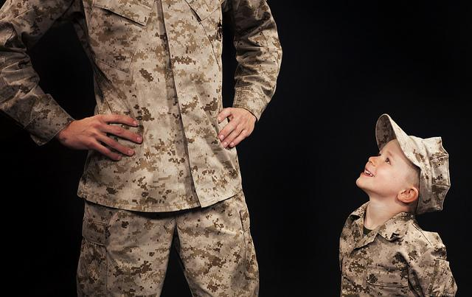
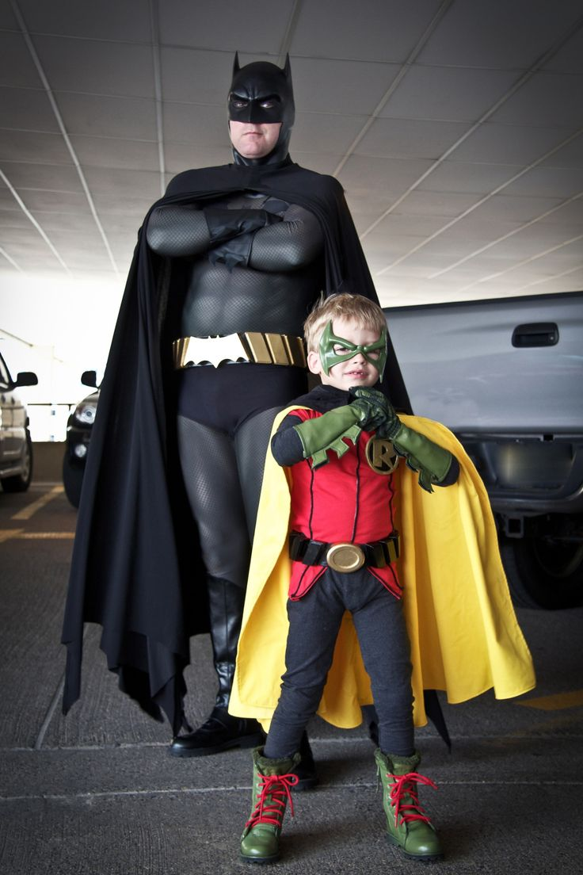
Fathers Are Progenitors
(to bring forth)
I Pet. 4:9; Heb. 13:2: Saints are to Practice hospitality!
Children will be similar to their fathers – Gen. 5:3
Not just physically, but moral character & spiritual interests (Saints to imitate God – Eph. 5:1)
Like produces like – The Jews: Jn. 8:39, 44; The carpenter’s son was a carpenter: Mt. 13:55; Mk. 6:3 (Children’s lives are shaped by their parents!)
Like God, fathers are to be there for their children to guide and give them life and more!

Slide 9
Fathers Are Providers
God is our supreme example of fatherhood
(II Cor. 6:17-18)
Provider (Father of lights – Constancy): Js. 1:17
Fathers Provide Many Things for their Families
Physical provisions – I Tim. 5:8 (Lk. 11:11-13; II Cor. 12:14-15)
I Tim. 5:8
8. But if anyone does not provide for his own, and especially for those of his household, he has denied the faith and is worse than an unbeliever.

Slide 10
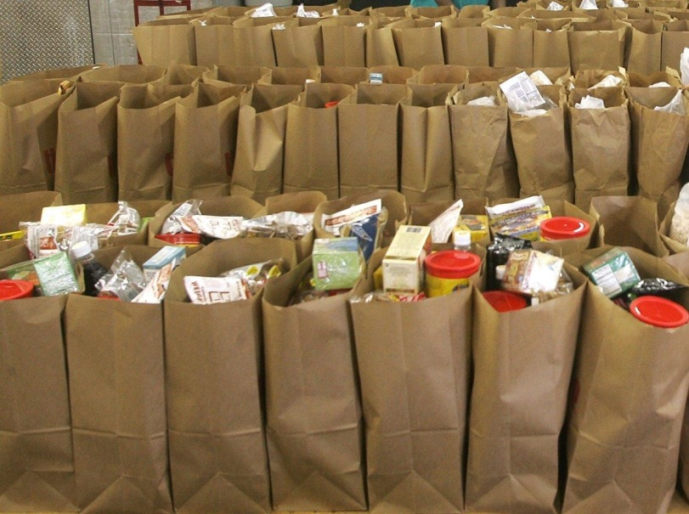
Fathers Are Providers: Physical Provisions
Fathers Provide Many Things for their Families
Physical provisions – I Tim. 5:8 (Lk. 11:11-13; II Cor. 12:14-15)
Requires faith in God – Mt. 6:25-33; Eccl. 2:24-25; 5:18-19
Demands sacrifice, dedication…RESPONSIBILITY! (Col. 3:23-24)
Eccl. 5:18-19
18. Here is what I have seen to be good and fitting: to eat, to drink and enjoy oneself in all one's labor in which he toils under the sun during the few years of his life which God has given him; for this is his reward.
19. Furthermore, as for every man to whom God has given riches and wealth, He has also empowered him to eat from them and to receive his reward and rejoice in his labor; this is the gift of God.

Slide 11
Fathers Are Providers
Fathers Provide Many Things for their Families
Physical provisions – I Tim. 5:8 (Lk. 11:11-13; II Cor. 12:14-15).
Spiritual provisions – Eph. 6:4 (teaching & correction)
Eph. 6:4
4. Fathers, do not provoke your children to anger, but bring them up in the discipline and instruction of the Lord.

Slide 12
Fathers Are Providers: Spiritual Provisions
Fathers Provide Many Things for their Families
Spiritual provisions – Eph. 6:4 (teaching & correction)
Instruction in God’s word – Is. 38:19; Ps. 44:1; 78:5-8
Faith, hope, thanksgiving & obedience – I Chr. 28:9; Ps. 78:7
Humble & faithful – Ps. 78:8
Honor your parents – Eph. 6:1-3 (Ex. 20:12); Col. 3:20
Listen to your father and mother – Prov. 3:1-2; 6:20-23; 23:22
Psalm 78:5-8
5. For He established a testimony in Jacob And appointed a law in Israel, Which He commanded our fathers That they should teach them to their children,
6. That the generation to come might know, even the children yet to be born, That they may arise and tell them to their children,
7. That they should put their confidence in God And not forget the works of God, But keep His commandments,
8. And not be like their fathers, A stubborn and rebellious generation, A generation that did not prepare its heart And whose spirit was not faithful to God.

Slide 13
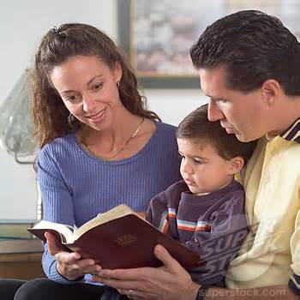
Fathers Are Providers: Spiritual Provisions
Fathers Provide Many Things for their Families
Spiritual provisions – Eph. 6:4 (teaching & correction)
Instruction in God’s word – Is. 38:19; Ps. 44:1; 78:5-8
Correction – Prov. 3:11-12; 6:23 (Heb. 12:5-11); II Tim. 3:16-17
Prov. 3:11-12
11. My son, do not reject the discipline of the LORD Or loathe His reproof,
12. For whom the LORD loves He reproves, Even as a father corrects the son in whom he delights.

Slide 14
Fathers Are Providers: Emotional Provisions
Fathers Provide Many Things for their Families
Physical provisions – I Tim. 5:8 (Lk. 11:11-13; II Cor. 12:14-15).
Spiritual provisions – Eph. 6:4 (teaching & correction)
Emotional provisions – Col. 3:21 (God is a comforter – II Cor. 1:3)
Col. 3:21
21. Fathers, do not exasperate your children, so that they will not lose heart.
II Cor. 1:3-4
3. Blessed be the God and Father of our Lord Jesus Christ, the Father of mercies and God of all comfort,
4. who comforts us in all our affliction so that we will be able to comfort those who are in any affliction with the comfort with which we ourselves are comforted by God.

Slide 15
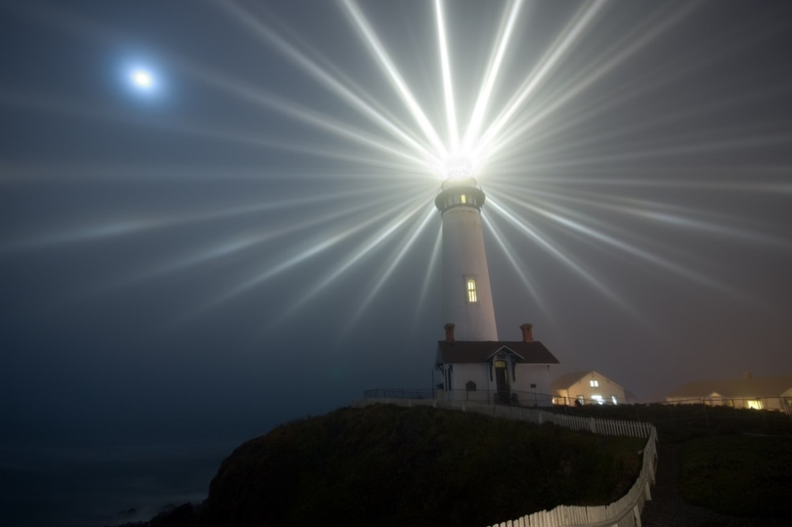
Fathers Are Providers
Fathers Provide Many Things for their Families
Physical provisions – I Tim. 5:8 (Lk. 11:11-13; II Cor. 12:14-15).
Spiritual provisions – Eph. 6:4 (teaching & correction)
Emotional provisions – Col. 3:21 (God is a comforter – II Cor. 1:3)
Example & influence – Mt. 5:16 (Phil. 3:17)
Mt. 5:16
16. "Let your light shine before men in such a way that they may see your good works, and glorify your Father who is in heaven.

Slide 16
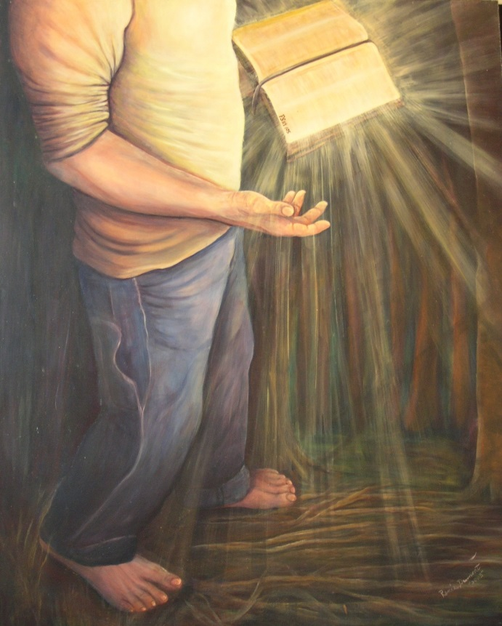
Fathers Are Providers: Example & Influence
Fathers Provide Many Things for their Families
Example & influence – Mt. 5:16 (Phil. 3:17)
Children learn what they see and live.
Be salt and light for your children (Mt. 5:13-16).
Be an example of faithfulness, obedience, worship, prayer, Bible study, honesty, responsibility, courtesy, kindness, etc…
Phil. 3:17 (can be applied to father and children!)
17. Brethren, join in following my example, and observe those who walk according to the pattern you have in us.

Slide 17
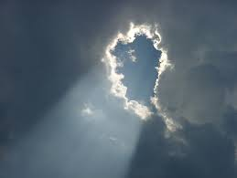
Fathers Are Providers
Fathers Provide Many Things for their Families
Physical provisions – I Tim. 5:8 (Lk. 11:11-13; II Cor. 12:14-15).
Spiritual provisions – Eph. 6:4 (teaching & correction)
Emotional provisions – Col. 3:21 (God is a comforter – II Cor. 1:3)
Example & influence – Mt. 5:16 (Phil. 3:17)
Like God, fathers are to provide many things to their
families and see to their needs!

Slide 18
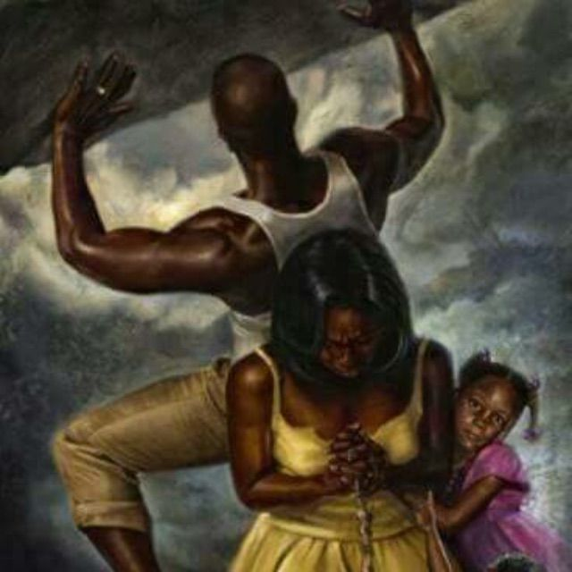
Fathers Are Protectors
God is our supreme example of fatherhood
(II Cor. 6:17-18)
Protector (Rock, Fortress, Deliverer, Shield, Stronghold): Ps. 18:2; 31:2-3
Fathers protect their families
Protect from Physical Harm: Gen. 45:7-8 (Job 29:16); Mt. 7:9-10 (Eccl. 9:2, 11: All will die, despite best efforts – Heb. 9:27)
Job 29:16-17
16. "I was a father to the needy, And I investigated the case which I did not know.
17. "I broke the jaws of the wicked And snatched the prey from his teeth.

Slide 19
Fathers Are Protectors: Physical Harm
Fathers protect their families
Protect from Physical Harm: Gen. 45:7-8 (Job 29:16-17); Mt. 7:9-10
Protecting from cold, hunger, and harm (I Tim. 5:8)
A father is willing to live and die for those under his protection!
That is what Jesus did (Jn. 15:13)
God designed for the man to be the leader, the head of the family, as Christ is the head of the church and gave His life for her (Eph. 5:25)
Jn. 15:13
13. "Greater love has no one than this, that one lay down his life for his friends.
Eph. 5:25
25. Husbands, love your wives, just as Christ also loved the church and gave Himself up for her,

Slide 20
Fathers Are Protectors
Fathers protect their families
Protect from Physical Harm: Gen. 45:7-8 (Job 29:16); Mt. 7:9-10 (Eccl. 9:2, 11: All will die, despite best efforts – Heb. 9:27)
Protect from Spiritual Danger: I Thess. 2:11-12
I Thess. 2:11-12
11. just as you know how we were exhorting and encouraging and imploring each one of you as a father would his own children,
12. so that you would walk in a manner worthy of the God who calls you into His own kingdom and glory.

Slide 21
Fathers Are Protectors: Spiritual Harm
Fathers protect their families
Protect from Spiritual Danger: I Thess. 2:11-12
Harm of evil influences, worldly companions, false teaching & sinful practices (Prov. 7:2, 4-5, 24-26; 13:14; I Cor. 15:33).
Fathers, set the standard! (Josh. 24:15)
Prov. 7:2, 4-5
2. Keep my commandments and live, And my teaching as the apple of your eye.
4. Say to wisdom, "You are my sister," And call understanding your intimate friend;
5. That they may keep you from an adulteress, From the foreigner who flatters with her words.
Josh. 24:15 (Abbrev.)
15. “…choose for yourselves today whom you will serve… but as for me and my house, we will serve the LORD."

Slide 22
Fathers Are Protectors
Fathers protect their families
Protect from Physical Harm: Gen. 45:7-8 (Job 29:16); Mt. 7:9-10 (Eccl. 9:2, 11: All will die, despite best efforts – Heb. 9:27)
Protect from Spiritual Danger: I Thess. 2:11-12
Like God, fathers are to protect their families from
physical and spiritual dangers!

Slide 23
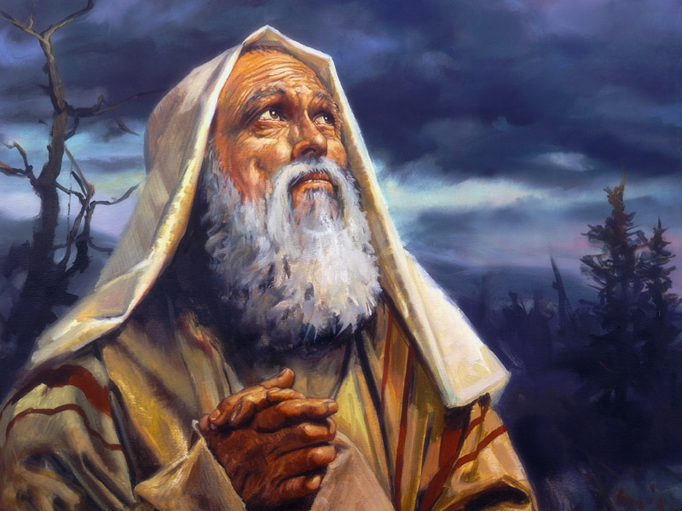
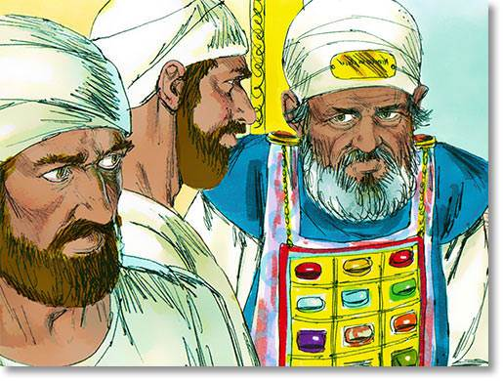
Conclusion
A Contrast of Two Fathers:
Abraham: A Father God Could Trust – Gen. 18:19
Fathers: Can God trust you to walk with Him, to lead your family in His ways, to provide & protect the souls under your care?
As God expected him to teach his children, you are to teach yours!
Eli: A Father Who Preferred His Sons over God – I Sam. 2:22-25, 27-29 (3:13).
We must not honor our children before (instead of) God (Mt. 10:37).
Improper priorities leads to the demise of families & souls!

Slide 24
Conclusion
Children: Love your father, as there are many that do not
have one! (Make your father’s heart rejoice by walking in God’s truth – III Jn. 4; Prov. 23:15-16)
Fathers: Love your children, because what they become will depend on your example & teaching!
(Walk A Little Plainer, Daddy)
Notes:
Poem, Walk A Little Plainer, Daddy by Forrest Flowers, 1969

Slide 25
“What Must I Do To Be Saved?”
Hear The Gospel (Jn. 5:24; Rom. 10:17)
Believe In Christ (Jn. 3:16-18; Jn. 8:24)
Repent Of Sins (Lk. 13:3-5; Acts 2:38)
Confess Christ (Mt. 10:32; Rom. 10:10)
Be Baptized (Mk. 16:16; Acts 22:16)
Remain Faithful (Jn. 8:31; Rev. 2:10)
For The Erring Child of God:
Repent (Acts 8:22), Confess (I Jn. 1:9),
Pray (Acts 8:22)

