Slide 1
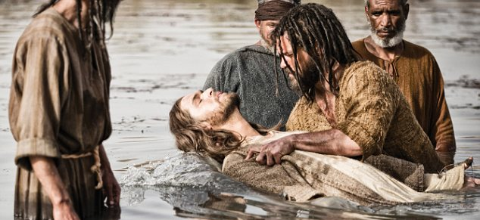
Baptism Part 1: What It Does and Does Not Do Text: Galatians 3:26-27
Notes:
By Nathan L Morrison
All Scripture given is from NASB unless otherwise stated
For further study, or if questions, please Call: 804-277-1983 or Visit www.courthousechurchofchrist.com
Based on a lesson by Richard Thetford and some charts from Richard Thetford

Slide 2
Intro
God’s offer of salvation and eternal life: Repent and be
baptized! (Mk. 16:15-16)
Baptism is one subject that has been much abused:
Called “an outward appearance of an inward grace”
Called “a work” thus non-essential to salvation of one’s soul
Called by some “optional” while others claim it is “mandatory” as it is a command of the Lord, but it is only necessary after one is saved by prayer
It is a direct command from Jesus Himself, and His
apostles and N.T. writers wrote about it often enough that
there are plenty of examples recorded for us!
We need to know the purpose and limitations of baptism:
What it does and does not do!

Slide 3
Baptism: What It Does
Baptism Does:
Put us into Christ (I Cor. 12:13; Gal 3:26-27)
Wash away our sins (Eph. 1:7; Acts 2:38; 22:16)
Save us (Mk. 16:16; I Pet 3:21)
Put us into the kingdom (Jn. 3:5; Col. 1:13-14)
Gal. 3:26-27
26. For you are all sons of God through faith in Christ Jesus.
27. For all of you who were baptized into Christ have clothed yourselves with Christ.
Baptism (obedience) changes our relationship to God
and washes away our sins!

Slide 4
Baptism: What It Does Not Do
Make a Minor an Adult (Change immaturity into maturity)

Slide 5
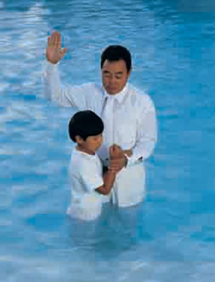
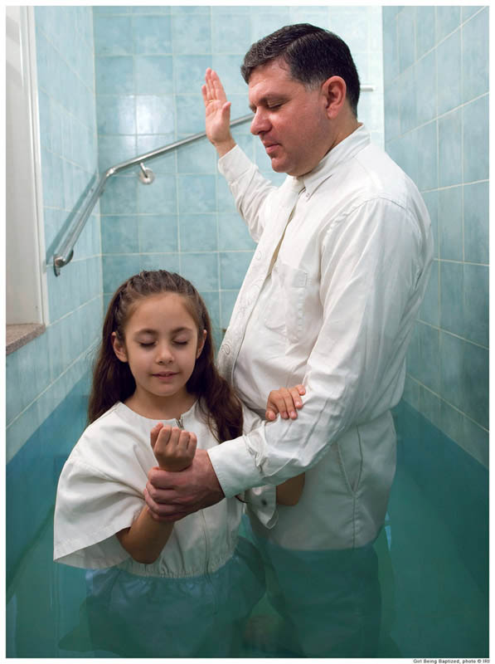
Baptism: What It Does Not Do
Make a minor an adult:
Baptism doesn’t make a boy a man or a girl a woman!
The “man” of I Tim. 2:11-12 was an adult male, not a boy (G3816)!
Man: Gr. aner (G435): a man (properly as an individual male): fellow, husband, man, sir.
Woman: Gr. gune (G1135): a woman; specifically a wife: wife, woman.
Child: Gr. pais (G3816): infant, child, boy or girl; Jesus in Luke 2:42-43
I Tim. 2:11-12
11. A woman must quietly receive instruction with entire submissiveness.
12. But I do not allow a woman to teach or exercise authority over a man, but to remain quiet.
Baptism does not change the
maturity of anyone!

Slide 6
Baptism: What It Does Not Do
Make a Minor an Adult
Affirm Feelings
Does not change genders
Is not a welcome ceremony

Slide 7
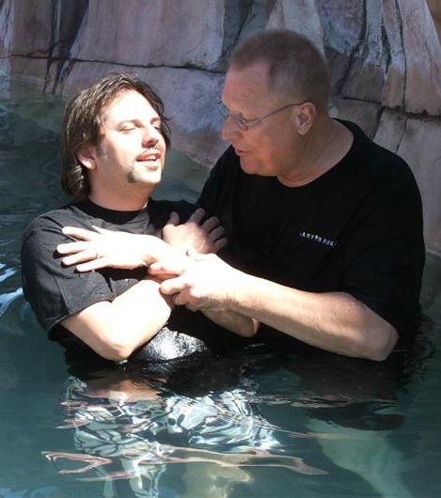
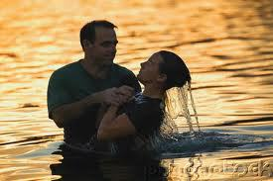
Baptism: What It Does Not Do
Does not change genders:
In December 2018 the Church of England issued pastoral guidance that “advises clergy to refer to transgender people by their new name” in a newly-announced baptism-style ceremony for transgender people to be welcomed into the Anglican faith.
Men & women, alike, were being baptized – Acts 8:12 (their gender did not change at baptism!)
Acts 8:12
12. But when they believed Philip preaching the good news about the kingdom of God and the name of Jesus Christ, they were being baptized, men and women alike.
Notes:
Source:
“Church of England to offer baptism-style services to transgender people to celebrate their new identity for first time,” Helena Horton, The Telegraph, Dec, 11, 2018; https://www.telegraph.co.uk/news/2018/12/11/church-england-offer-baptism-style-services-transgender-people/

Slide 8
Baptism: What It Does Not Do
Is not a welcome ceremony:
This new, celebratory service is called the “Affirmation of Baptismal Faith,” at which the person may be “presented with gifts such as a Bible inscribed in their chosen name, or a certificate” (Ibid). “The guidance notes: “For a trans person to be addressed liturgically by the minister for the first time by their chosen name may be a powerful moment in the service.”
It is a new birth – John 3:3-7; Rom. 6:4
Romans 6:4
4. Therefore we have been buried with Him through baptism into death, so that as Christ was raised from the dead through the glory of the Father, so we too might walk in newness of life.
Baptism doesn’t affirm feelings, change genders, or ceremonially affirm faith!
Notes:
Source:
“Church of England to offer baptism-style services to transgender people to celebrate their new identity for first time,” Helena Horton, The Telegraph, Dec, 11, 2018; https://www.telegraph.co.uk/news/2018/12/11/church-england-offer-baptism-style-services-transgender-people/

Slide 9
Baptism: What It Does Not Do
Make a Minor an Adult
Affirm Feelings
Does not change genders
Is not a welcome ceremony
Remove Temptation

Slide 10
Baptism: What It Does Not Do
II Tim. 3:12
12. Indeed, all who desire to live godly in Christ Jesus will be persecuted.
Remove Temptation:
Jesus was tempted immediately after His baptism – Mt. 3-4
II Tim. 3:12: Those that will live godly will be persecuted
Js. 1:12
12. Blessed is a man who perseveres under trial; for once he has been approved, he will receive the crown of life which the Lord has promised to those who love Him.
We won’t be tempted beyond what we are able to endure
(I Cor. 10:13; Js. 1:12)
We must endure temptation to be approved by God!

Slide 11
Baptism: What It Does Not Do
Make a Minor an Adult
Affirm Feelings
Does not change genders
Is not a welcome ceremony
Remove Temptation
Make One Sinless

Slide 12
Baptism: What It Does Not Do
Guarantee sinless perfection:
I Jn. 1:9-10: We will all still sin and slip up. We need to repent when we fall.
I Jn. 3:9-10: As a child of God we will “not practice” sin or unrighteousness.
I Jn. 1:9-10
9. If we confess our sins, He is faithful and righteous to forgive us our sins and to cleanse us from all unrighteousness.
10. If we say that we have not sinned, we make Him a liar and His word is not in us.
Simon (baptized) still sinned & needed to repent (Acts 8:13-24)
Peter committed public sin of hypocrisy and needed to repent – Gal. 2:11-12
The Corinthians, Galatians, and the churches in Asia sinned & needed to repent!
Baptism washes away our sins but does not make us
sinless forever!

Slide 13
Baptism: What It Does Not Do
Make a Minor an Adult
Affirm Feelings
Does not change genders
Is not a welcome ceremony
Remove Temptation
Make One Sinless
Guarantee Eternal Salvation

Slide 14
Baptism: What It Does Not Do
Heb. 5:9
9. And having been made perfect, He became to all those who obey Him the source of eternal salvation,
Guarantee eternal salvation:
Eternal salvation is given to those who obey Him – Heb. 5:9
Baptism is not the end of obedience
Continual Obedience – Phil. 1:27; 2:12
One must be steadfast in worship and service to God – Acts 2:42; Jn. 8:31; I Cor. 15:58
Phil. 1:27
27. Only conduct yourselves in a manner worthy of the gospel of Christ, so that whether I come and see you or remain absent, I will hear of you that you are standing firm in one spirit, with one mind striving together for the faith of the gospel;
Baptism is the beginning of our walk with God!
(Rom. 6:4) – Col. 3:1-2; Mt. 6:33

Slide 15
Baptism: What It Does Not Do
Make a Minor an Adult
Affirm Feelings
Does not change genders
Is not a welcome ceremony
Remove Temptation
Make One Sinless
Guarantee Eternal Salvation
Baptism results in eternal life IF one is faithful till death
(Rev. 2:10), not through baptism only!

Slide 16
Conclusion
Baptism puts one into Christ but in and of itself, does NOT
guarantee eternal salvation!
Jesus said people with no firm root of faith can fall away –
Mt. 13:18-23
Hebrews 2:1
For this reason we must pay much closer attention to what we have heard, so that we do not drift away from it.

Slide 17
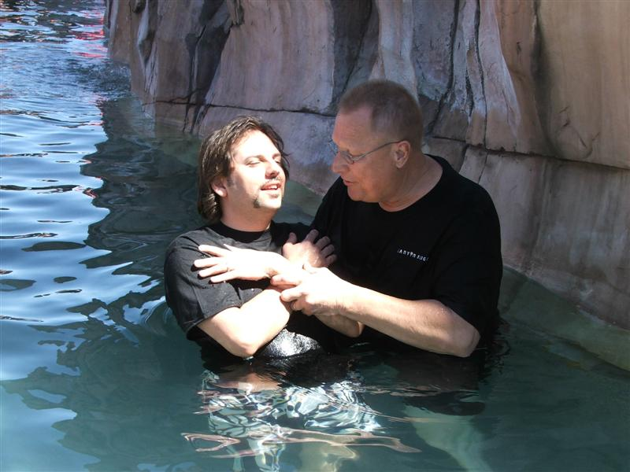
Conclusion
There are things baptism does and does not do:
We need to be baptized and understand it is only the
beginning of our walk with God in the right relationship!

Slide 18
“What Must I Do To Be Saved?”
Hear The Gospel (Jn. 5:24; Rom. 10:17)
Believe In Christ (Jn. 3:16-18; Jn. 8:24)
Repent Of Sins (Lk. 13:3-5; Acts 2:38)
Confess Christ (Mt. 10:32; Rom. 10:10)
Be Baptized (Mk. 16:16; Acts 22:16)
Remain Faithful (Jn. 8:31; Rev. 2:10)
For The Erring Child:
Repent (Acts 8:22), Confess (I Jn. 1:9),
Pray (Acts 8:22)

