Slide 1
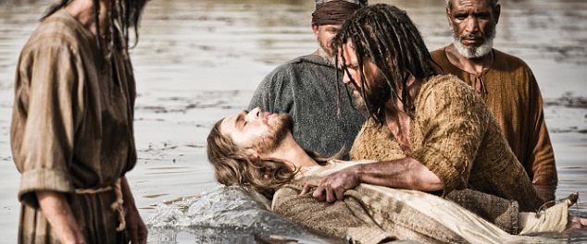
Dying With Jesus
Text: Romans 6:3-11
Notes:
Prepared by Nathan L Morrison
All Scripture given is from NASB unless otherwise stated
For further study, or if questions, please Call: 804-277-1983 or Visit www.courthousechurchofcrist.com

Slide 2
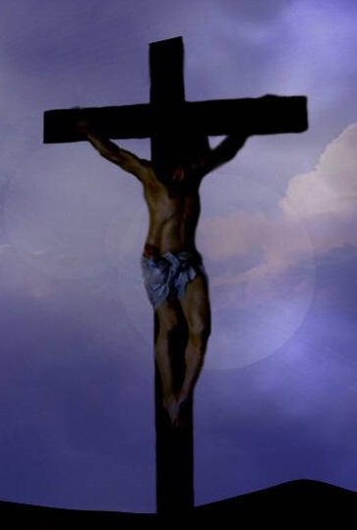
Intro
The gospel teaches Jesus Christ crucified – I Cor. 2:2
To teach Jesus crucified we must also teach sinners to die with Him to be saved! (Rom. 6:8)
If one is in Christ, one is a “new creature, the old things passed away! (II Cor. 5:17)
How does one get “into Christ” to become a “new creature?”

Slide 3
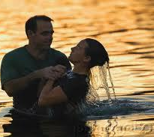
Intro
Baptism puts a person “in Christ” – Gal. 3:27
Rom. 6:3-11: In baptism the sinner crucifies the “old self” with Christ and is baptized into His death (dies with Him)
Gal. 3:27
For all of you who were baptized into Christ have clothed yourselves with Christ.
It is important to know what baptism does and what the state of one is without baptism!

Slide 4
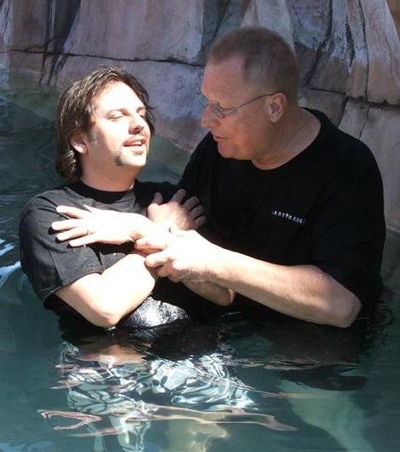
What Baptism Does
Put On Christ
Gal. 3:27
If at
BAPTISM
you have…
Washed Away Sins
Acts 22:16
Forgiveness Of Sins
Acts 2:38
Freedom From Sin
Rom. 6:7, 16-18
Shared in Christ’s Death & Resurrection
Rom. 6:3-4, 5-8, 11
Entered The Body
Of Christ
I Cor. 12:13

Slide 5
State Without Baptism
Sin Leads To Death
Rom. 6:23
Then
What is Your Condition
WITHOUT Baptism?
Judged
John 12:48
Condemned
Mark 16:16
In Wickedness
James 1:21-22
Prayers Go Unheard
I Pet. 3:12
Wrath Of God
II Thess. 1:7-9

Slide 6
Conclusion
The apostle Paul said we get “into Christ” through faith in baptism (Gal. 3:26-27)
Through baptism we die with Jesus and are made alive in His resurrection!
If we don’t die with Jesus:
We won’t be forgiven of our sins!
We won’t be in His body, the church!
We won’t be made alive with Him!

Slide 7
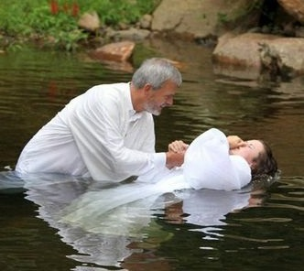
Conclusion
Blessed eternally is the one who dies with Jesus!
Have you died with Jesus through baptism?

Slide 8
“What Must I Do To Be Saved?”
Hear The Gospel (Jn. 5:24; Rom. 10:17)
Believe In Christ (Jn. 3:16-18; Jn. 8:24)
Repent Of Sins (Lk. 13:35; Acts 2:38)
Confess Christ (Mt. 10:32; Rom. 10:10)
Be Baptized (Mk. 16:16; Acts 22:16)
Remain Faithful (Jn. 8:31; Rev. 2:10)
For The Erring Saint:
Repent (Acts 8:22), Confess (I Jn. 1:9),
Pray (Acts 8:22)

